Slide 1
Functions

Slide 2
C Functions
In c, we can divide a large program into the basic building blocks known as function. The function contains the set of programming statements enclosed by {}. A function can be called multiple times to provide reusability and modularity to the C program. In other words, we can say that the collection of functions creates a program. The function is also known as procedure or subroutine in other programming languages.

Slide 3
Advantage of functions in C
There are the following advantages of C functions.
By using functions, we can avoid rewriting same logic/code again and again in a program.
We can call C functions any number of times in a program and from any place in a program.
We can track a large C program easily when it is divided into multiple functions.
Reusability is the main achievement of C functions.
However, Function calling is always a overhead in a C program.

Slide 4
Function Aspects
There are three aspects of a C function.
Function declaration A function must be declared globally in a c program to tell the compiler about the function name, function parameters, and return type.
Function call Function can be called from anywhere in the program. The parameter list must not differ in function calling and function declaration. We must pass the same number of functions as it is declared in the function declaration.
Function definition It contains the actual statements which are to be executed. It is the most important aspect to which the control comes when the function is called. Here, we must notice that only one value can be returned from the function.

Slide 5
SN | C function aspects | Syntax
1 | Function declaration | return_type function_name (argument list);
2 | Function call | function_name (argument_list)
3 | Function definition | return_type function_name (argument list) {function body;}
The syntax of creating function in c language is given below:
return_type function_name(data_type parameter...)
{
//code to be executed
}

Slide 6
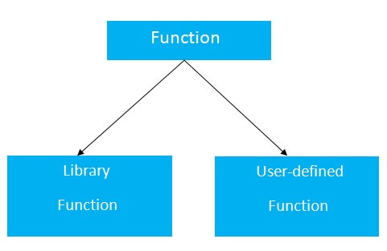
Types of Functions
There are two types of functions in C programming:
Library Functions: are the functions which are declared in the C header files such as scanf(), printf(), gets(), puts(), ceil(), floor() etc.
User-defined functions: are the functions which are created by the C programmer, so that he/she can use it many times. It reduces the complexity of a big program and optimizes the code.

Slide 7
Return value
A C function may or may not return a value from the function. If you don't have to return any value from the function, use void for the return type.
Let's see a simple example of C function that doesn't return any value from the function.
Example without return value:
void hello()
{
printf("hello c");
}

Slide 8
If you want to return any value from the function, you need to use any data type such as int, long, char, etc. The return type depends on the value to be returned from the function.
Let's see a simple example of C function that returns int value from the function.
Example with return value:
int get()
{
return 10;
}
In the above example, we have to return 10 as a value, so the return type is int. If you want to return floating-point value (e.g., 10.2, 3.1, 54.5, etc), you need to use float as the return type of the method.
float get()
{
return 10.01;
}

Slide 9
Different aspects of function calling
A function may or may not accept any argument. It may or may not return any value. Based on these facts, There are four different aspects of function calls.
function without arguments and without return value
function without arguments and with return value
function with arguments and without return value
function with arguments and with return value

Slide 10
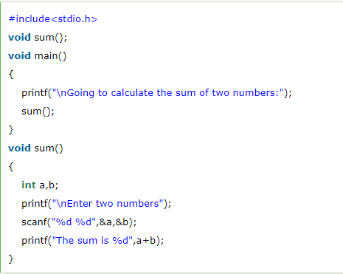
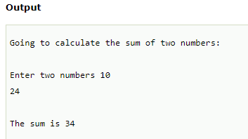
Example for Function without argument and without return value

Slide 11
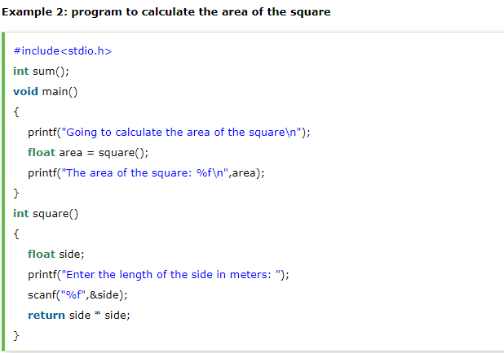
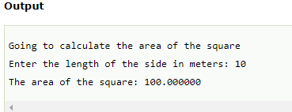
Example for Function without argument and with return value

Slide 12
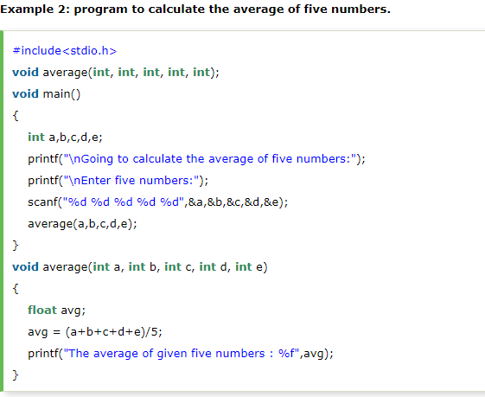
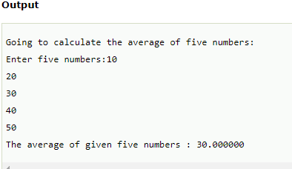
Example for Function with argument and without return value

Slide 13
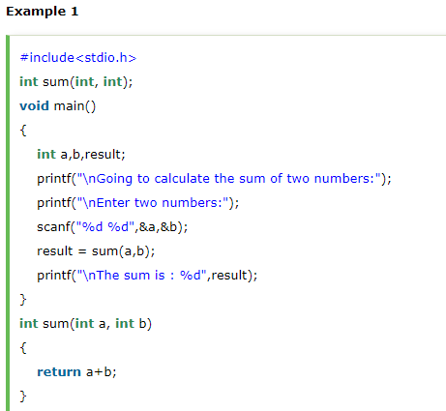
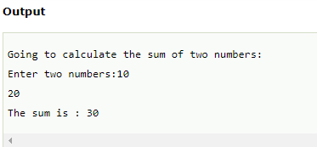
Example for Function with argument and with return value

Slide 14
C Library Functions
Library functions are the inbuilt function in C that are grouped and placed at a common place called the library. Such functions are used to perform some specific operations. For example, printf is a library function used to print on the console. The library functions are created by the designers of compilers. All C standard library functions are defined inside the different header files saved with the extension .h. We need to include these header files in our program to make use of the library functions defined in such header files. For example, To use the library functions such as printf/scanf we need to include stdio.h in our program which is a header file that contains all the library functions regarding standard input/output.

Slide 15
SN | Header file | Description
1 | stdio.h | This is a standard input/output header file. It contains all the library functions regarding standard input/output.
2 | conio.h | This is a console input/output header file.
3 | string.h | It contains all string related library functions like gets(), puts(),etc.
4 | stdlib.h | This header file contains all the general library functions like malloc(), calloc(), exit(), etc.
5 | math.h | This header file contains all the math operations related functions like sqrt(), pow(), etc.
6 | time.h | This header file contains all the time-related functions.
7 | ctype.h | This header file contains all character handling functions.
8 | stdarg.h | Variable argument functions are defined in this header file.
9 | signal.h | All the signal handling functions are defined in this header file.
10 | setjmp.h | This file contains all the jump functions.
11 | locale.h | This file contains locale functions.
12 | errno.h | This file contains error handling functions.
13 | assert.h | This file contains diagnostics functions.

Slide 16
Call by value and Call by reference in C

Slide 17
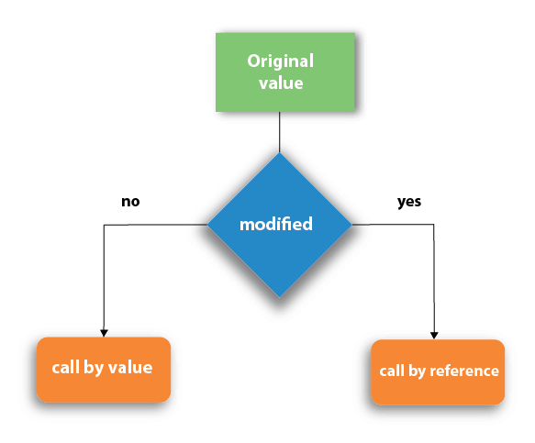
There are two methods to pass the data into the function in C language, i.e., call by value and call by reference.

Slide 18
Call by value in C
In call by value method, the value of the actual parameters is copied into the formal parameters. In other words, we can say that the value of the variable is used in the function call in the call by value method.
In call by value method, we can not modify the value of the actual parameter by the formal parameter.
In call by value, different memory is allocated for actual and formal parameters since the value of the actual parameter is copied into the formal parameter.
The actual parameter is the argument which is used in the function call whereas formal parameter is the argument which is used in the function definition.

Slide 19
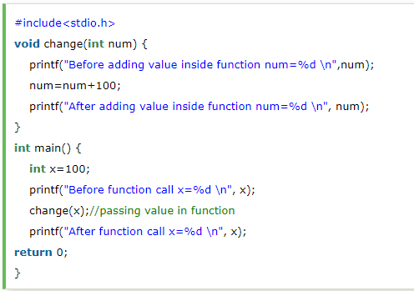
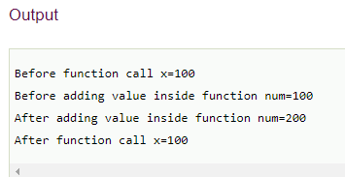
Call by value example

Slide 20
Call by reference in C
In call by reference, the address of the variable is passed into the function call as the actual parameter.
The value of the actual parameters can be modified by changing the formal parameters since the address of the actual parameters is passed.
In call by reference, the memory allocation is similar for both formal parameters and actual parameters. All the operations in the function are performed on the value stored at the address of the actual parameters, and the modified value gets stored at the same address.

Slide 21
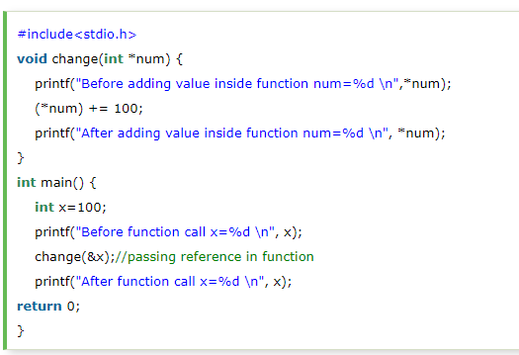
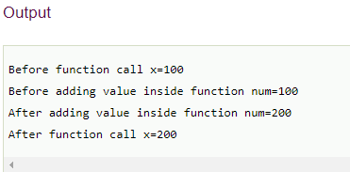
Call by reference example

Slide 22
Difference between call by value and call by reference in c
No. | Call by value | Call by reference
1 | A copy of the value is passed into the function | An address of value is passed into the function
2 | Changes made inside the function is limited to the function only. The values of the actual parameters do not change by changing the formal parameters. | Changes made inside the function validate outside of the function also. The values of the actual parameters do change by changing the formal parameters.
3 | Actual and formal arguments are created at the different memory location | Actual and formal arguments are created at the same memory location

