Slide 1


MINOR PROJECT
(JTD792)
Bharti School of Telecommunication Technology & Management
Indian Institute of Technology, Delhi
“Wearable System for predicting Freezing of Gait in people affected by Parkinson’s disease”
Supervisor: Prof. S.D Joshi (Dept. of Electrical Engineering, IIT Delhi)
&
Prof. Deepak Joshi (Centre for Biomedical Engineering, IIT Delhi)
Presented By:
Ayush Gupta (2019JTM2673)
09th September 2020

Slide 2

Outline:
Motivation
Parkinsons’s Disease & its Causes
Freezing of Gait (FoG)
Treatment for FoG
Wearable devices to monitor gait
Detection of FoG
Methodology to solve the problem
Gait Monitoring and Feature Extraction
Implementation of k-NN Model
Result & Future Work

Slide 3
Motivation:
We have to provide wearable systems that can predict the occurrence of Freezing of Gait (FoG) in people affected by Parkinson's Disease. The FoG is an episodic gait disturbance that affects locomotion in Parkinson's Disease. This system will also generate external force to the patient so that patient can start their motion.
This wearable system uses three tri-axial accelerometer sensors that have worn on the patient's back, hip, and ankle. The gait featured is extracted from the accelerometer's signal, through data windowing and dimensional reduction.
We have to find the accuracy and confusion matrix of machine learning-based model to predict freezing. We have to find the best model to predict events on the online data.
This system has future applications that it can implement in mobile devices and wearable fitness bands that can give rhythmic stimuli to the patient before FoG. Hence any accident to the patient can be avoided.

Slide 4
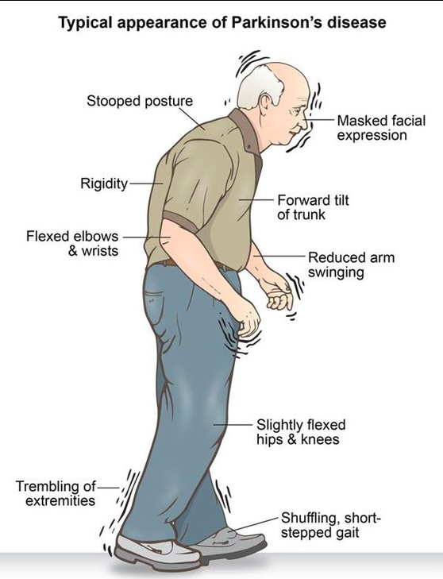
Parkinson’s Disease:
Parkinson’s Disease is a neurodegenerative disorder that affects locomotion activity in the body. There are symptoms in Parkinson’s disease, such as termor, shaking, and difficulty in walking.
This disease was first described in the essay on shaking palsy by James Parkinson in 1817.
This disease mainly arises with the age of the person. It is seen that this disease primarly occurs in men more as compared to women.
The main problem with this Disease is that there are no medical tests to detect it in many cases, so it is difficult to diagnose it accurately.

Slide 5
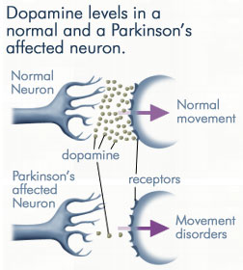
Causes of Parkinson’s Disease:
It is caused by dying of nerve cells, which mainly responsible for movement in the body. These cells found in substantia nigra part of the brain.
Due to these neurons’s decaying, there is a lack of dopamine chemical that affects the whole movement in the body.
Dopamine acts as a messenger between the parts of the brain and nervous system that help control and co-ordinate body movements.
It is believed that genetic changes and environmental factors may be responsible for the loss of dopamine.
Increasing the level of dopamine can be done by levodopa to improve some movement process, but it is not an effective solution.

Slide 6
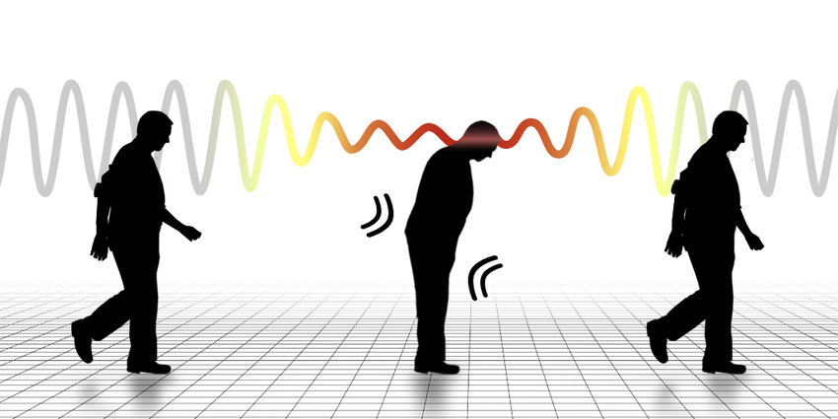
Freezing of Gait (FoG):
The Freezing of Gait only contributes most of the fall in PD patients. FoG is an episodic gait disturbance that affects is shown up to 30 sec.
When the patient suffered FoG, his feet glued to the ground, FoG typically manifests as a sudden and transient inability to move. FoG also depends on environmental conditions.
At the time of FoG, the brain is incapable of co-ordinating motion activity, which results in PD patients not moving their feet despite their intention to move.
The freezing mainly occurs in gait initiation, turning, passing through narrow space significantly increases the risk of falling during walking.
FoG often happens suddenly, asymmetrically, and with a short duration make the clinical detection, tracking, and evaluation of the onset of FoG a challenging task.

Slide 7
Treatment for FoG:
There is currently no cure for FoG, but there are treatments are available to help relieve the symptoms and maintain your quality of life. These treatments can include medication, supportive therapies, surgery.
In medication treatment, patients responds to levodopa, monoamine oxidase inhibitors, deep brain stimulation. In this treatment, levodopa is used to manage motor symptoms in Parkinson’s disease patients.
These treatments mainly depend on the clinical and descriptions’ ability of the patients and the medical treatment have also some side-effects.
Therefore, an accurate and automatic FoG detection approach is desired to detect or even objectively predict FoG’s occurrence in advance. It’s important to address FoG before it becomes challenging for a person with PD, since it is easier to manage if targeted earlier.
It may be difficult for a person to admit to problems with gait, but the earlier the issues are accepted and addressed, the better chance patient have to manage it with less difficulty.
Wearable devices are the right solution for the assessment and treatment of freezing gait in Parkinson’s disease.

Slide 8
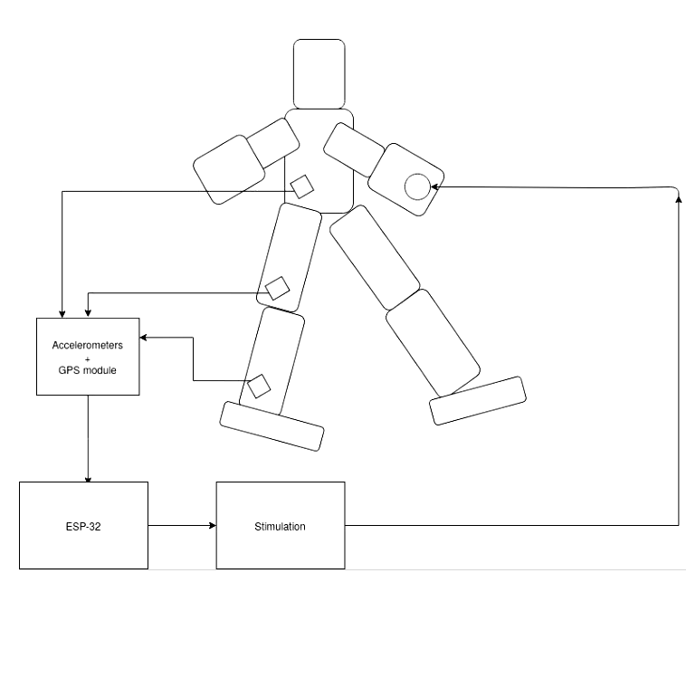
Wearable Assistant for FoG Detection:
With wearable technologies, it is easy to obtain insightful information on gait characteristics of the patient. These devices can easily detect the FoG.
Wearable devices are more suitable for long-term monitoring of PD in living conditions because of its light-weight, and comfort.
These wearable devices mainly dealt with recognizing of FOG events based on offline datasets gathered from wearable devices through different sensors such as accelerometers, gyroscopes, EEG sensors.
These devices can also provide rhythmic visual, sensory, or auditory stimuli to the patient upon FoG detection to reduce its duration.
In this wearable device, three accelerometer sensors were used to extract the gait features of the patient which placed on the back, hip, and ankle of the patient. The raw signals of these accelerometers can be used for recognizing and predicting of freezing of gait.

Slide 9
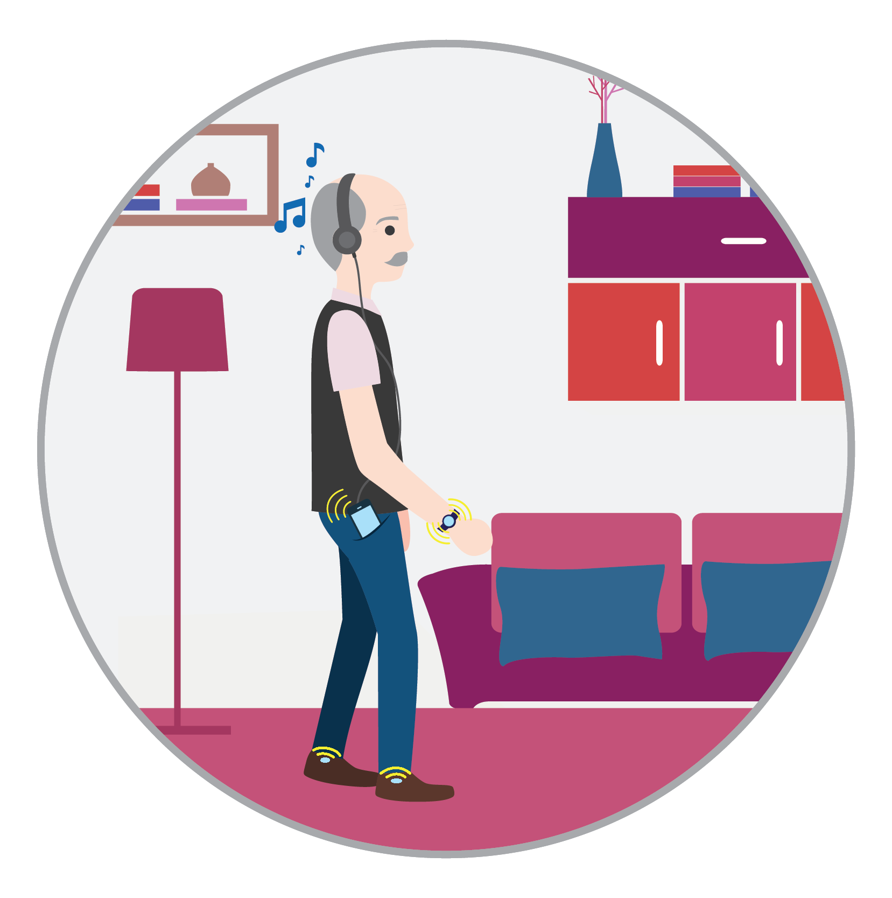
Rhythmic auditory stimulation (RAS):
When the wearable system detect the freezing symptoms in patient by analysis of gait then stimulation can be pass to patient to come out from freezing.
This method is often called biofeedback and uses different sensory modalities such as audio, vibrotactile and visual cues. These are the physiological effects that improve movement control in the patient.
Rhythmic auditory stimulation (RAS) is one of the neurological therapy methods that can free the patient from freezing. In this cues can be a rythmic pattern usually very simple such as a repetitive frequency due to the low cost technology used.
Through this stimulation, patients get guidance to hit the ground with their feet, and it also provides an external cue so that patient can start their movement.
Rhythm is an essential element of motor movement, including motor control and output, because rhythmic auditory cueing facilitates movement by providing a mechanism for planning movements.

Slide 10
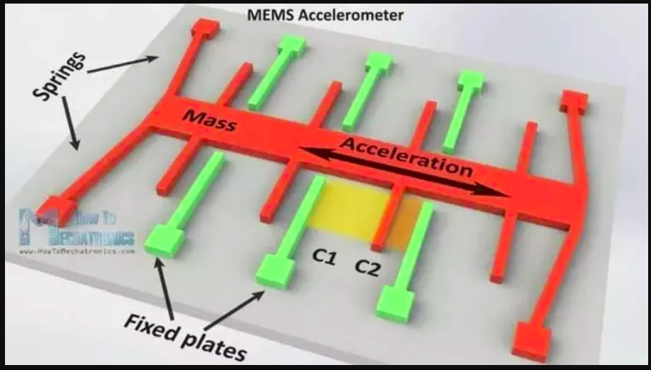
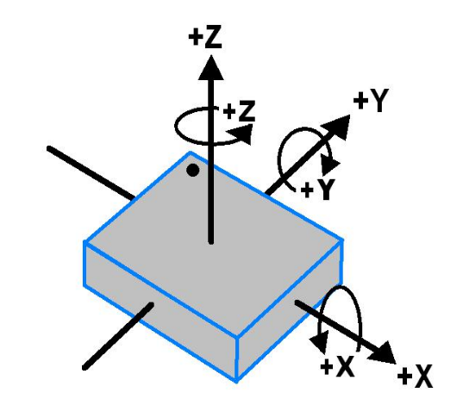
Accelerometer Sensor:
The accelerometer is a microelectronic mechanical device that measures the force of acceleration due to gravity in the ‘g’ unit.
Acceleration sensors can be used in applications requiring tilt sensing. Accelerometers are Micro Electronic Mechanical System (MEMS) that can sense either static or dynamic acceleration forces.
The accelerometer’s working principle is a simple mass-spring system in which the object’s acceleration depends on the spring’s displacement.
The piezoelectric effect is applied to this spring-mass system, which converts mechanical motion into the electrical signal. In this effect, one capacitor plate is attached to the object in the mass-spring system, and the other capacitor plate is fixed. When the mass moved, then the capacitance between plates would also change.
The accelerometer can measure position in all 3-dimension with respect to ground.

Slide 11
Detection & Predecting of Freezing:
There are different statistical methods to detect FoG, which uses statistical features of raw signals from wearable devices’ sensors. Freezing can be easily detected through the power spectra of the raw signal of the accelerometer.
Freezing Index defined as the ratio of power spectral densities in freeze band (3-8 Hz) and locomotion band (0.5-3 Hz) to characterize FOG using frequency domain information.
A wearable system can be designed based on FI’s value so that it can automatically detect FoG and apply a rhythmic auditory intervention to help patients resume walking while FoG is happening.
The freezing index can improve the classification accuracy. Based on the freezing index, different machine learning methods can be applied to predict freezing in advance.
We will use k-NN machine learning model to predict FoG event based on the DAPHANET dataset. We will use it to classify data into FoG and no FoG category.

Slide 12
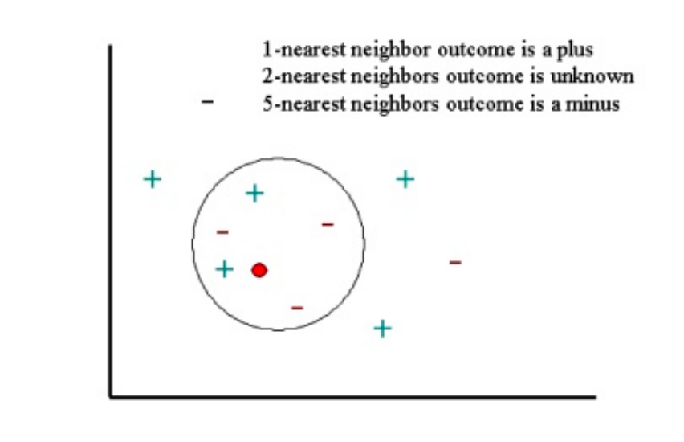

k-Nearest Neighbor (k-NN) Algorithm:
k-NN is used for classification and regression which can easily implement to train the model.
The training datasets are used to train the model; then, this model can predict the test data class. k-NN has been used in statistical estimation and pattern recognition.
There are different measures for distance calculation like Euclidean, Manhattan distance, and Chebyshev. The Euclidean distance (d) between two points x &y of M-dimensions is given by:
In k-NN, the k is the number of neighbours which is assigned to unknown data by measuring its Euclidean distance.

Slide 13
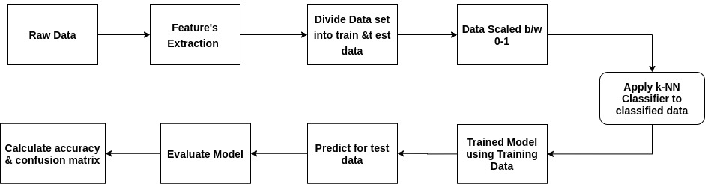
Methodology To Solve Problem:
To predict the FoG in advance, we would apply the method to reach to our result. There are the following steps that would be followed to predict the Freezing of Gait in wearable devices. The whole workflow can be understood from the below figure, which we will use in wearable device.

Slide 14
Gait Monitoring:
The patient’s gait is monitored by three tri-axial accelerometer sensors worn on the back, hip, and ankle of the patient.
The features for classification are extracted from the raw data of the accelerometer through the dimensionality reduction technique.
We are using data from the Daphnet Freezing of Gait Dataset in users with Parkinson’s disease. This dataset consists of data from different ten users in which users 4 and 10 did not show any freeze.
This data is in the form of the matrix with one line per sample and one column per channel. The data of a patient at different instant is shown below:
Time (ms) | ax (mg) | ay (mg) | az (mg) | hx (mg) | hy (mg) | hz (mg) | bx (mg) | by (mg) | bz (mg) | State
2781 | 60 | 49 | -970 | 118 | 64 | -979 | 116 | 514 | -834 | 0
755687 | 161 | 980 | 356 | -227 | 944 | 262 | 97 | 1009 | -87 | 1
818171 | 228 | 970 | 396 | -263 | 972 | 191 | 58 | 1028 | -106 | 2

Slide 15
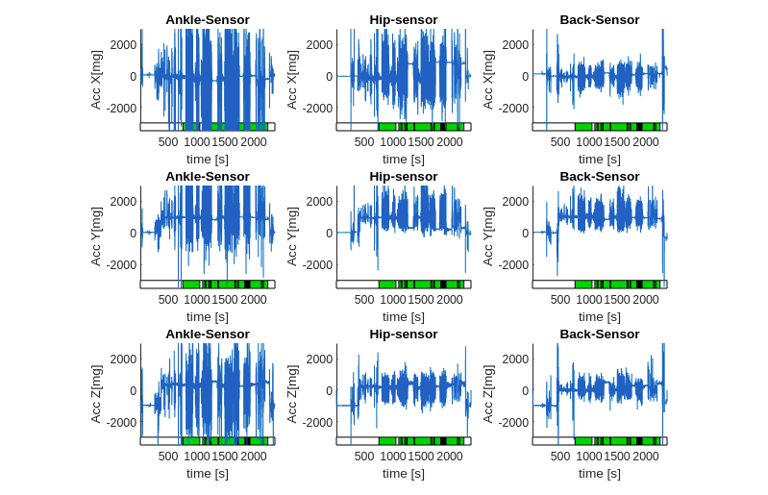
Accelerometer’s Reading:
The given figure shows that variations of 3-sensor’s reading with respect to time for a single patient.

Slide 16
Feature Extraction:
In most classification, firstly, raw data should be projected into different feature spaces so that classification can be made easier. This pre-processing stage is known as feature extraction. In this stage, the dataset’s dimension is reduced so that model learns quickly, and hence by this processing speed increases.
We are applying PCA, LDA dimension reduction techniques, to reduce dimension of dataset. These techniques removed redundant features from the data.
Principal Component Analysis (PCA) technique figures out co-relations and patterns among the datasets after finding out co-relations, it transformed the original feature space into a new space with most data variation. With the help of PCA our model takes aproximates 5sec to predict require events
In Linear Discriminant Analysis (LDA) is based on Fisher’s linear discriminant, a method to find out the linear combination of features that separate samples of different classes. LDA is more effective than PCA when it comes to a multi-class problem, but it requires toknow in advance the label of each training data.
LDA creates a new axis on whichit projects the information from the different features to minimize the variance and maximize the distance between means of the two classes. With LDA our model takes around 3sec to predict the output.

Slide 17
Classification & Prediction:
Classification is depended strongly on the feature extraction. It is usually based on the training phase, where a classification algorithm builds a classifier by analyzing a set of D-dimensional data known as the training set.
The dataset is in the form of a matrix that contains different 9- features and one target state. In target, it is indicating by 0,1 and 2, which means the experiment is not started, indicating no freeze and freeze, respectively.
Training data do the learning of classifiers, so we will divide our dataset into a training dataset and testing dataset. We have different 9 features which should be scaled between 0 to 1 so that classifier can work accurately.
We are classifying our data into classes no FoG, FoG with the help of a k-NN classifier. We are predicting testing data from our k-NN model; if the predicted value is 1, it means freezing will not come in the patient.
If the predicted value is 2, that means the patient will get FoG. This classifier is also evaluating different dimension reduction techniques and comparing its accuracy and computing time.

Slide 18
Result and Future Work:
We are getting accuracy to predict FoG with the k-NN classifier is about 90% and computing time around 4 sec with different dimensionality reduction techniques.
It is found that the k-NN algorithm is less complicated, and it can easily be implemented with extensive data.
To find Freezing Index so that classification between classes can be accurate.
We had applied our algorithm on the offline dataset, but there is a requirement that it should also be used with online (real-time) data so that this application can be placed in the smartphone of the user.
For better prediction Neural network model can be apply to predict freezing event.
Wearable devices should be implemented so that better model can apply on real-time data.

Slide 19
Refrences:
M. Bachlin et al., "Wearable Assistant for Parkinson’s Disease Patients With the Freezing of Gait Symptom," in IEEE Transactions on Information Technology in Biomedicine, vol. 14, no. 2, pp. 436-446, March 2010, doi: 10.1109/TITB.2009.2036165.
F. Demrozi, R. Bacchin, S. Tamburin, M. Cristani, and G. Pravadelli. Towards a wearable system for predicting the freezing of gait in people affected by parkinson’s disease. IEEE Journal of Biomedical and Health Informatics, pages 1–1, 2019.
Y. Guo, L. Wang, Y. Li, L. Guo and F. Meng, "The Detection of Freezing of Gait in Parkinson’s Disease Using Asymmetric Basis Function TV-ARMA Time–Frequency Spectral Estimation Method," in IEEE Transactions on Neural Systems and Rehabilitation Engineering, vol. 27, no. 10, pp. 2077-2086, Oct. 2019, doi: 10.1109/TNSRE.2019.2938301.
s. GÜNEY and B. BÖLÜK, "Daphnet Freezing Recognition with Gait Data by Using Machine Learning Algorithms," 2020 43rd International Conference on Telecommunications and Signal Processing (TSP), Milan, Italy, 2020, pp. 252-255, doi: 10.1109/TSP49548.2020.9163510.
https://archive.ics.uci.edu/ml/datasets/Daphnet+Freezing+of+Gait
https://www.analyticsvidhya.com/blog/2018/03/introduction-k-neighbours-algorithm-clustering/
https://www.youtube.com/watch?v=eqZgxR6eRjo
https://www.ncbi.nlm.nih.gov/pmc/articles/PMC5764963/

Slide 20
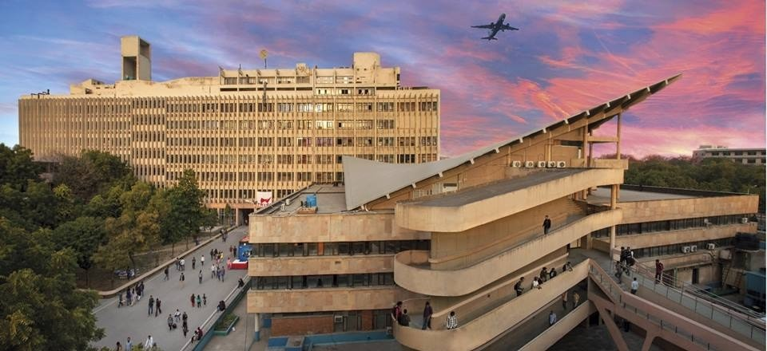
Thank You!

