Slide 1

Project :
“An analytical overview of Indian Economy (using R and Python)”
________________________________________
Under the guidance of
Dr. Priya Ranjan Sinha Mahapatra
Associate Professor & HOD
Dept. of Computer Science & Engineering
University of Kalyani _________________________________________________________
Presented by :-
Jeet Das ( Roll no - 90/MCA/160019 )

Slide 2
Features provided by this project :
(1) Basics of “ Python ” and “ R ” programming
(2) “ Data visualization “ using R and Python
(3) Basics of Economy ( Spl. reference to Indian Economy )
(4) Prediction model using “ Linear regression “
(5) Employment in different sectors in India
(6) Introduction to some mega projects in India
and so on ……

Slide 3
Project Structure :
Section - A : Sector Growth
Section – B : Employment Growth
Section – C : Megaprojects in India
Section – D : References

Slide 4
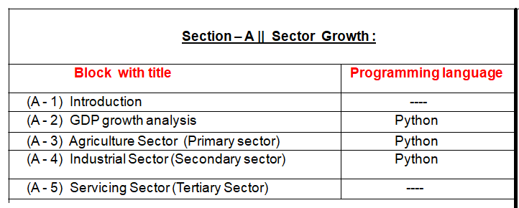

Slide 5
(A – 1) Introduction :
Need of Economics :
Economics is the study of how societies use scarce resources to produce
valuable commodities and distribute them among different people.
There are two key ideas in economics –
(i) that goods are scarce, and
(ii) that society must use its resources efficiently.
NB. Scarce resource = It is only available in small quantities

Slide 6
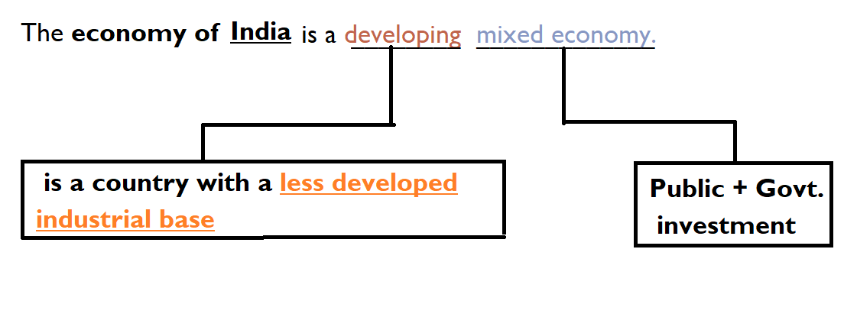
(A – 1) Introduction ( continued ) :
Indian Economy :
Type of sectors in Indian Economy :
(1) Primary Sector
(2) Secondary (or) Manufacturing (or) Industrial Sector
(3) Tertiary Sector (or) Services Sector

Slide 7
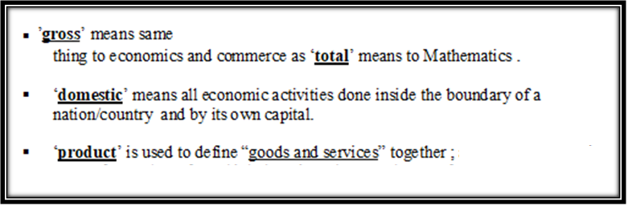
(A - 2) GDP growth analysis :
(1) GDP = Gross Domestic Product
(2) Need of GDP :
(2.1) It is a “quantitative” concept and its volume/size indicates the ‘internal’ strength of the economy.
(2.2) But it does not say anything about the ‘qualitative’ aspects of the produced goods and services.
(2.3)It is used by the IMF/WB in the comparative analyses of its member nations.

Slide 8
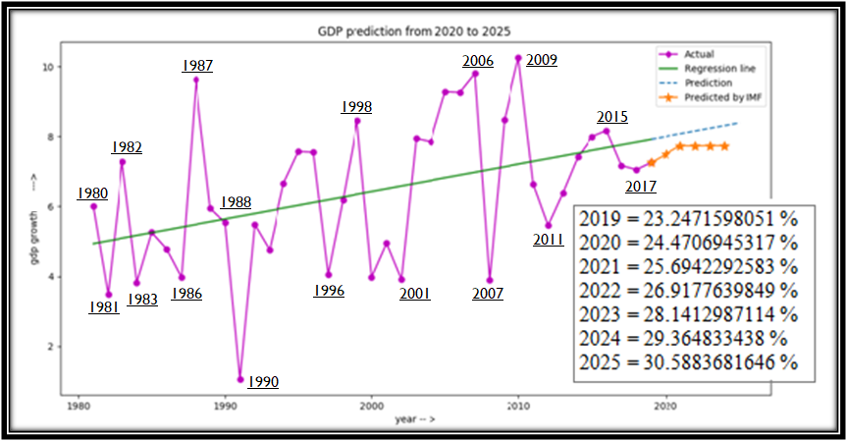
(A - 2) GDP growth analysis ( continued ) :
Indian GDP growth analysis (available data from IMF
[International Monetary Fund]) as shown below with prediction model :
___________________________________________________________________

Slide 9
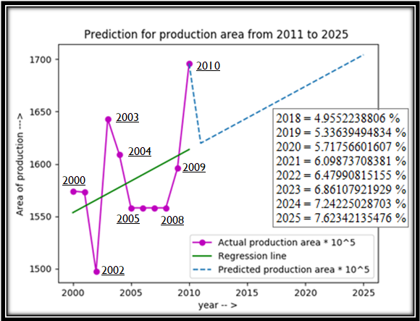
(A - 3) Agriculture Sector (Primary sector) :
There are two types of prediction model are as follows :
(A-3/1) Prediction for production area :

Slide 10
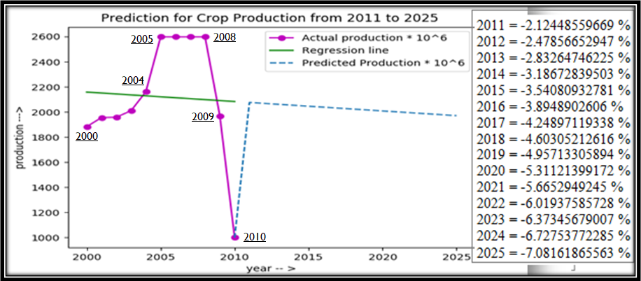
(A - 3) Agriculture Sector (Primary sector) (continued……. ):
(A-3/2) prediction for crop production :

Slide 11
( A- 4) Industrial Sector ( Secondary Sector ) analysis :
data analysis of eight core industry:
It contains index, production and growth of Eight
Core Industries. Eight Core Industries are –
_________________________________
(1) Electricity ,
(2) Steel,
(3) Refinery products,
(4) Crude oil,
(5) Coal,
(6) Cement,
(7) Natural gas and
(8) Fertilizers.

Slide 12
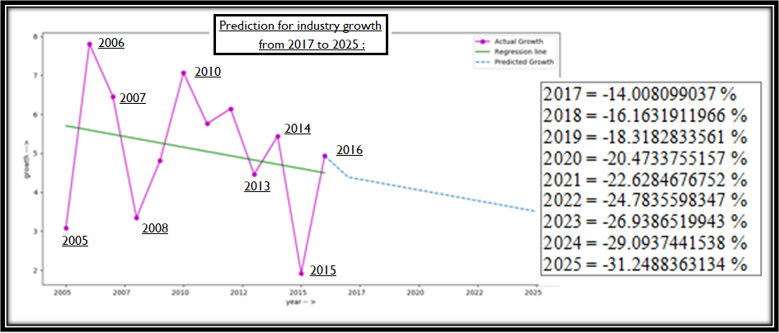
( A- 4) Industrial Sector ( Secondary Sector ) analysis :
continued ……

Slide 13
(A-5) Servicing Sector analysis (Tertiary Sector) :
The services sector has the largest share of India's GDP, accounting for 57% in 2012,
up from 15% in 1950.It is the seventh-largest services sector by nominal GDP, and
third largest when purchasing power is taken into account.
There are different types of services sector are as follows :-
(1) Aviation :
(1.1) Nationalization :
(1.2) De-regulation :
(2) Banking and financial services
(2.1) Organized sector,
(2.2) Scheduled banks :
(2.3) Unorganized sector
(3) Financial technology :
(4) Information technology :
(5) Insurance :
(6) Retail :
(7)Tourism :
(8) Media and Entertainment industry :
(9) Healthcare :
(10) Logistics :
(11) Printing :
(12) Telecommunications :

Slide 14
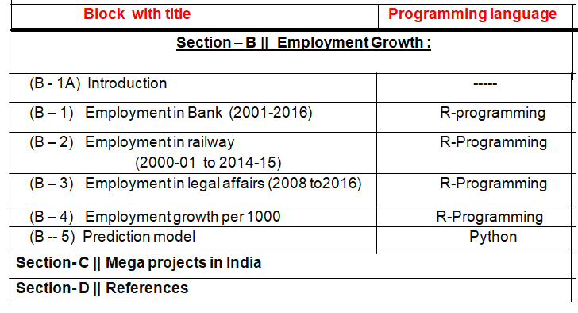
Project structure :

Slide 15
Section – B || Employment Growth:
(B - 1A) Introduction :
___________________________________________________________
(1) How does employment affect the economy?
Employment and unemployment are the driving forces behind
economic growth and stagnation.
As a small business owner, you can affect your local economy
by hiring additional workers as long as your hiring is in response
to consumer reaction to your company's products and services.
(2) Why employment is important to the economy?
The Importance of Employment & Workplace in the Society.
The stability of the economy rests on the ability to maintain a low
unemployment rate and provide a safe, secure workplace.
When a solid relationship exists between the individual and her working environment, society benefits overall as well.

Slide 16
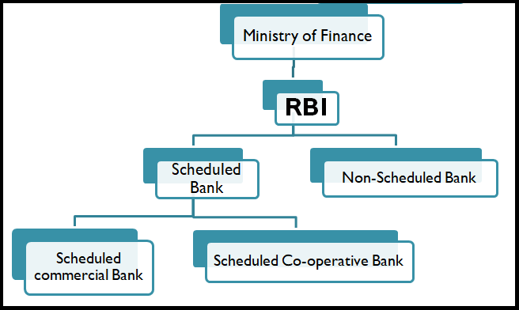
(B – 1) Employment in Bank (2001-2016) :
Fig : Different types of banks in India
Scheduled Banks :Scheduled Banks in India refer to those
banks which have been included in the Second Schedule
of Reserve Bank of India Act, 1934.
Non-Scheduled Banks : Banks not under this Schedule are
called Non-Scheduled Banks.

Slide 17
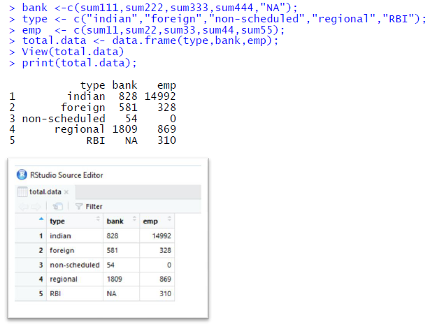
Bank employment details(2001-2016) :

Slide 18
(B – 2) Employment in railways from 2000-01 to 2014-15 :
The data indicates about Employment in Railway Zones/Units/Board and Other Offices :-
(1) Central,
(2) Eastern,
(3) East Central,
(4) East Cost,
(5) Metro Railway Kolkata,
(6) Northern,
(7) North Central,
(8) North Eastern,
(9) Northeast Frontier ,
(10) North Western,
(11) Southern,
(12) South Central,
(13) South Eastern,
(14)Southeast Central,
(15)South Western,
(16)Western,
(17)West Central,
(18)Production Units,
(19)Railway Board& Other Railway Offices of railways.

Slide 19
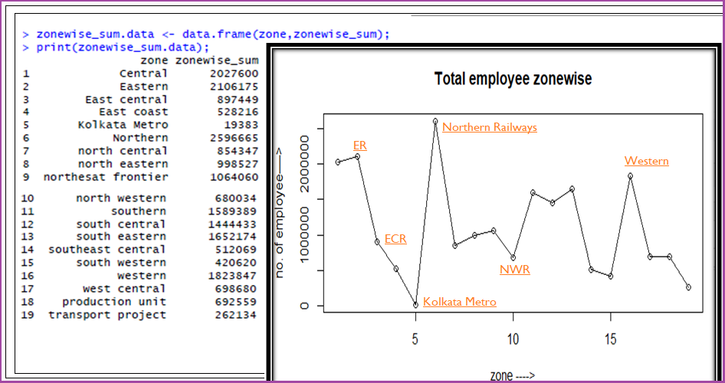
Plot the total employment details zone wise :

Slide 20
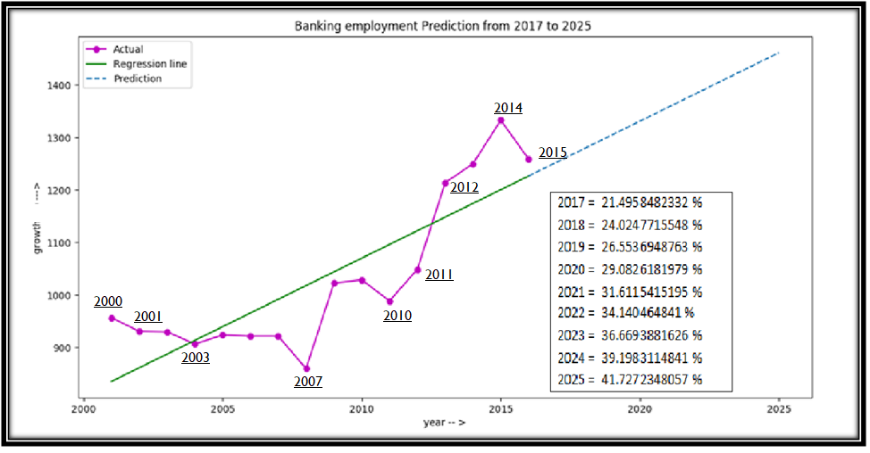
(B - 5) Prediction model used in banking , railway and
legal affairs sector & compare them :
(B-5/a) Banking employment prediction from 2017 to 2025

Slide 21
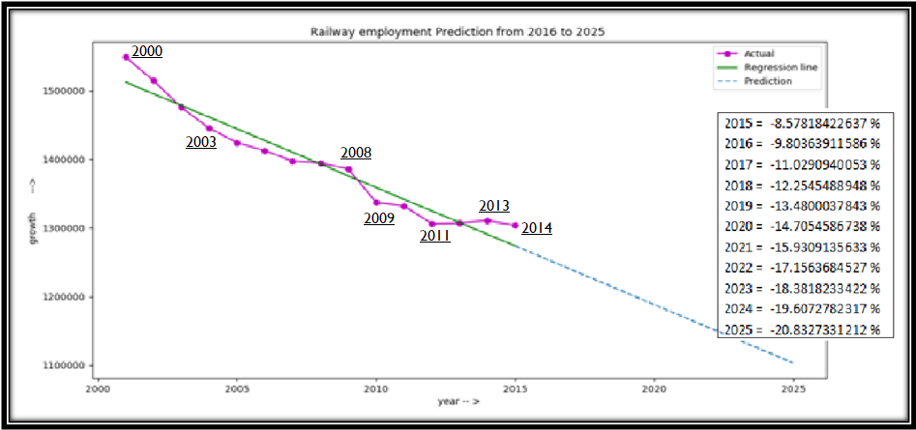
Employment & prediction of Indian railways up to 2025 :

Slide 22
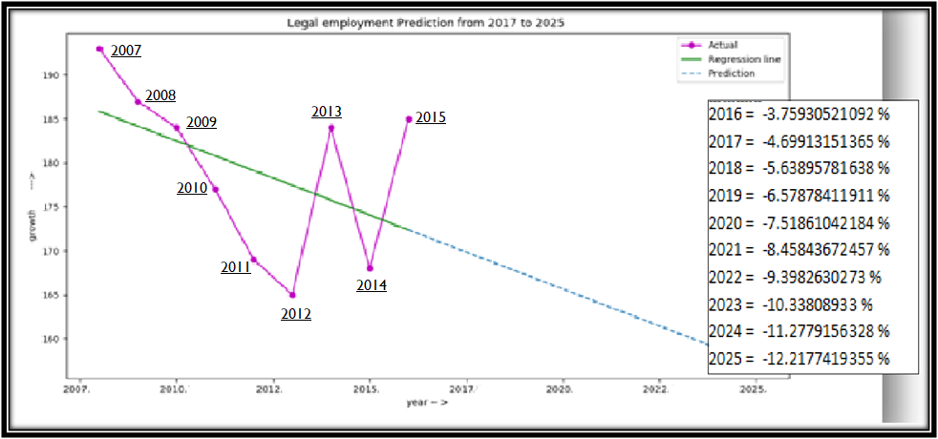
Employment in Legal sector up to 2025 :

Slide 23
Section- C || Mega projects in India
"Megaprojects” are temporary projects characterized by:
(1) large investment commitment,
(2) vast complexity (especially in organizational terms), and
(3) long-lasting impact on the economy,
the environment, and society".

Slide 24
The list of mega projects in India are as follows :
Projects | Investor | Amount
(1) Bharatmala | Govt. of India | ₹ 5.35 lakh crore (US$77 billion)
(2) Delhi–Mumbai Industrial Corridor (DMIC) Project | The project has received a major boost from India and Japan. | initial size of ₹1,000 crore (US$144.7 million)
(3) Gujarat International Finance Tec-City ( GIFT ) | Govt. Of Gujrat | Rs 10,500 crore
Continued….

Slide 25
The list of mega projects in India are as follows :
( continued….)
[04] Vrindavan Chandrodaya Mandir | Investment : ₹ 300 crore (US$43 million)
[05] World One | Investment : ₹ 150 million (US$2.2 million)
[06] Kalpasar Project | Investment : ₹ 90,000 crore (as of 2017)
[07] Viraat Ramayan Mandir | Investment : ₹ 500 crore (US$72 million)
[08] Namaste Tower | Investment : Not known
[09] Mumbai Trans Harbour Link | Investment : ₹ 14,262 crore (US$2.1 billion)
[10] Setu Bharatam | Investment : ₹ 102 billion (US$1.5 billion)
[11] SmartCity, Kochi | Investment : Not known
[12] Banihal Qazigund Road Tunnel | Investment : Not known
[13] Kacchi Dargah–Bidupur Bridge | Investment : Rs 3,600 crore
[14] Three Sixty West | Investment : Not known
[15] Chennai Bangalore Industrial Corridor | Investment : Not known
[16] Inland waterways of India | Investment : Not known

Slide 26
Section- D || References :
[1] Indian-Economy-For-Civil-Services-Examinations - Dr.Ramesh Singh,
7th Edition,McGRAW Hill Education WE series
[2] R Cookbook, Paul Teetor, O’Reilly Media
[3] Getting Started with RStudio,John Verzani, O’Reilly Media
[4]Python Cookbook,3rd Edition, David Beazley and Brian K. Jones, O’Reilly Media
[5] Python for Data Analysis,Wes McKinney, O’Reilly Media
[6] https://en.wikipedia.org/wiki/Economy_of_India
[7] https://en.wikipedia.org/wiki/List_of_megaprojects_in_India

Slide 27
Thank you…….

