Slide 1
POWER CONSUMPTION MONITORING USING HOME AUTOMATION
GROUP MEMBERS :
ANISH SALGIA
BHAVANA GUPTA
DAISY MANIAR
SIDDHESH DALVI
PROJECT GUIDE :
Prof . P.P.Adivarekar

Slide 2
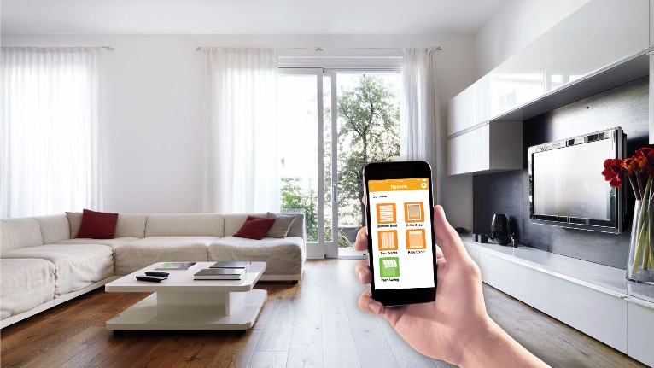
INTRODUCTION
The objective of this project is to develop a device that allows the user to remotely control and monitor multiple home appliances using a cellular phone. This system will be a powerful and flexible tool that will offer this service at any time and from anywhere with the constraints of the technologies being applied.
We will be using this concept to design a system that acts as a platform to receive messages which in fact are commands sent to control different appliances and devices connected.

Slide 3
ABSTRACT
The project describes the design and development of a system for household appliance control using cell phone through global system for mobile communication (GSM) technology. The cellular communications is a potential solution for such remote controlling activities.
SMS (short message service) technology can be used to control household appliances from distance. Remotely, the system allows the home owner to monitor and control the home appliances via mobile phone set by sending commands in the form of SMS messages and receiving the appliances status as well.
The proposed system makes use of wireless control hence can be effectively used in systems were unwired connections are desired. The system uses the user’s mobile handset for control and therefore the system is more adaptable and cost-effective and also providing ubiquitous access for appliance control.

Slide 4
PROPOSED SYSTEM
The proposed system will be able to control all the appliances in a controlled environment.
Controlling the appliances(turning on and off respectively)can be done by the user itself.
Firstly the mobile Application will send the commands instructed by the user to the Arduino Uno module.
From there it will be forwarded to a set of relays and finally the relays will send the sensed signal to the respected appliance.
The relays will be connected to a feedback kit,which will revert the status of the relays to the Arduino.
In addition to this, the system will also notify the user about the status of the appliances through notification.
The data about the appliances(ie time of switching on and off,power consumed by a particular appliance)will also get generated and the user can access this data at any point of time.

Slide 5
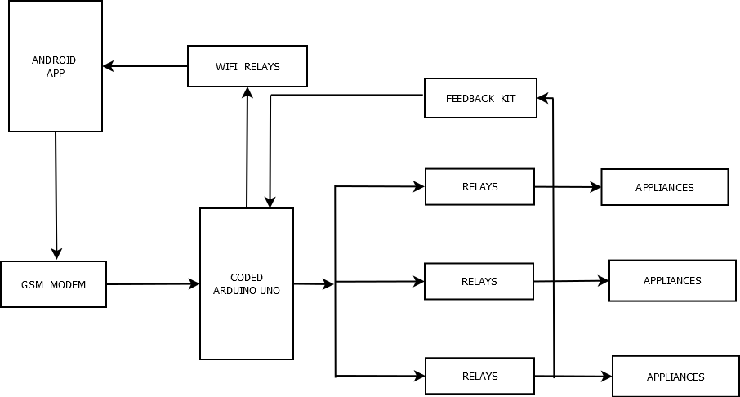
DESIGN

Slide 6
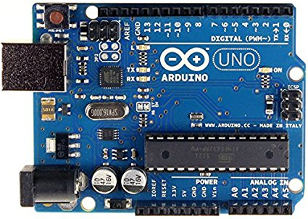
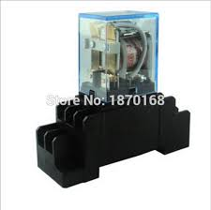
TECHNOLOGY STACK
Android Studio .
Andruino Uno Model
Relays
Sensors

Slide 7
DEPENDENCIES
Android Mobile .
Internet .

Slide 8
PLAN & DEVELOPMENT
SCRUM
Pre-Game : Requirement Analysis and Planning .
Game : Coding and Implementation .
Post-Game : Testing and Feedback .

Slide 9
FUTURE SCOPE
It can be used to control industrial appliances.
Analysis recorded by the android App (database) can be used to monitor the number of hours of power consumed by the appliances.
We can calculate the life span of the appliance by the help of information stored.

