Slide 1
Lab5: InfoGAN
Department of Computer Science, NCTU
TA: Alan(李懿倫)、Julia(呂佳倪)

Slide 2
Important Date
Experiment Report Submission Deadline: 11/11 11:59 a.m
Demo date: 11/11
Zip all files in one file
Report(.pdf)
Source code
Name it like 「DLP_LAB5_yourID_name.zip」
ex: DLP_LAB5_409551015_李懿倫.zip
Email it to julialu67.cs08g@nctu.edu.tw with subject MTK_DLP_LAB5_yourID_name

Slide 3

Lab Objective
In this lab, you need to implement an InfoGAN for number generation.
Number generation
Noise + fixed latent code -> generate images which are the same number but different appearance.
Noise + fixed latent code ->

Slide 4
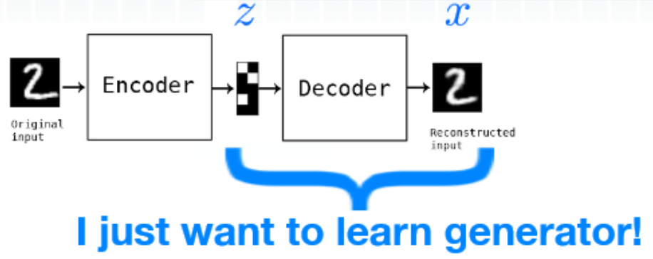

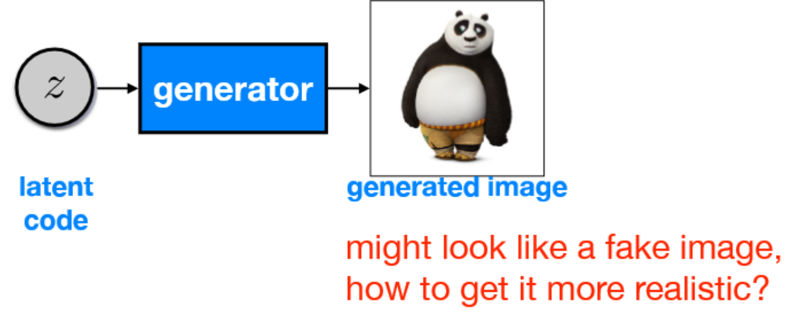
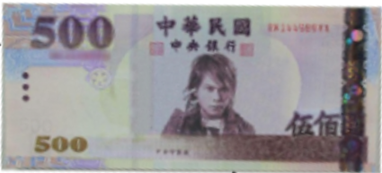
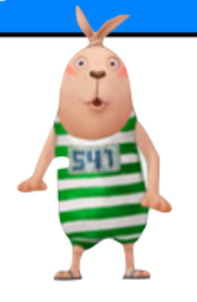
GAN (Generative Adversarial Networks)

Slide 5
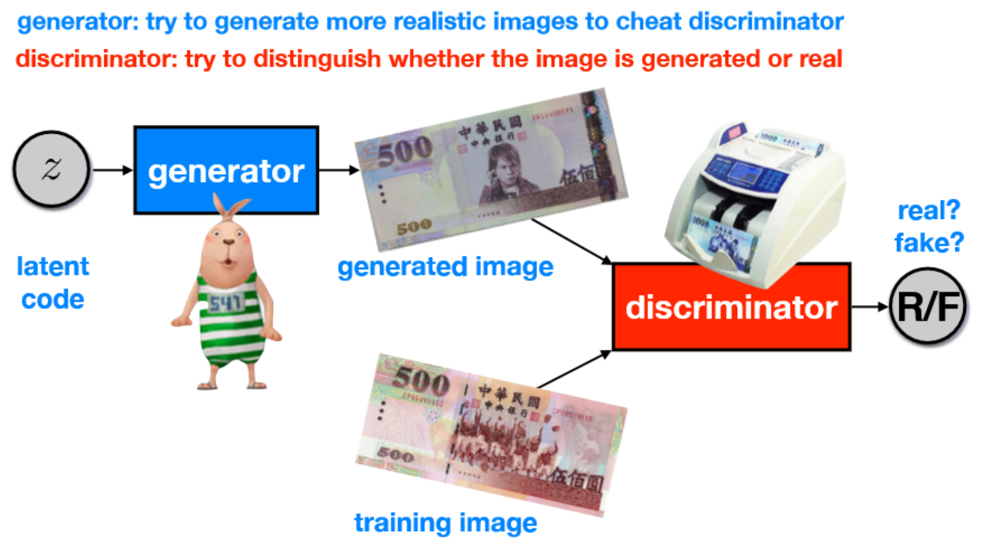
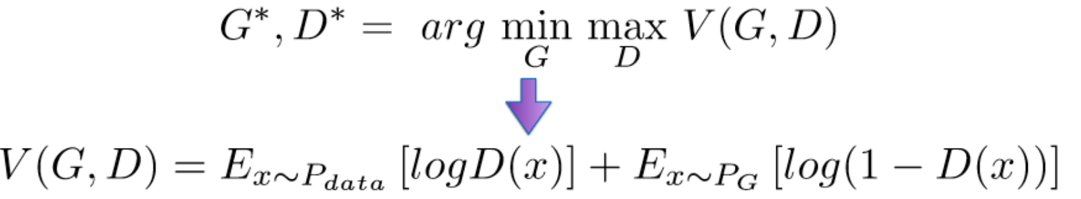
GAN (Generative Adversarial Networks)

Slide 6
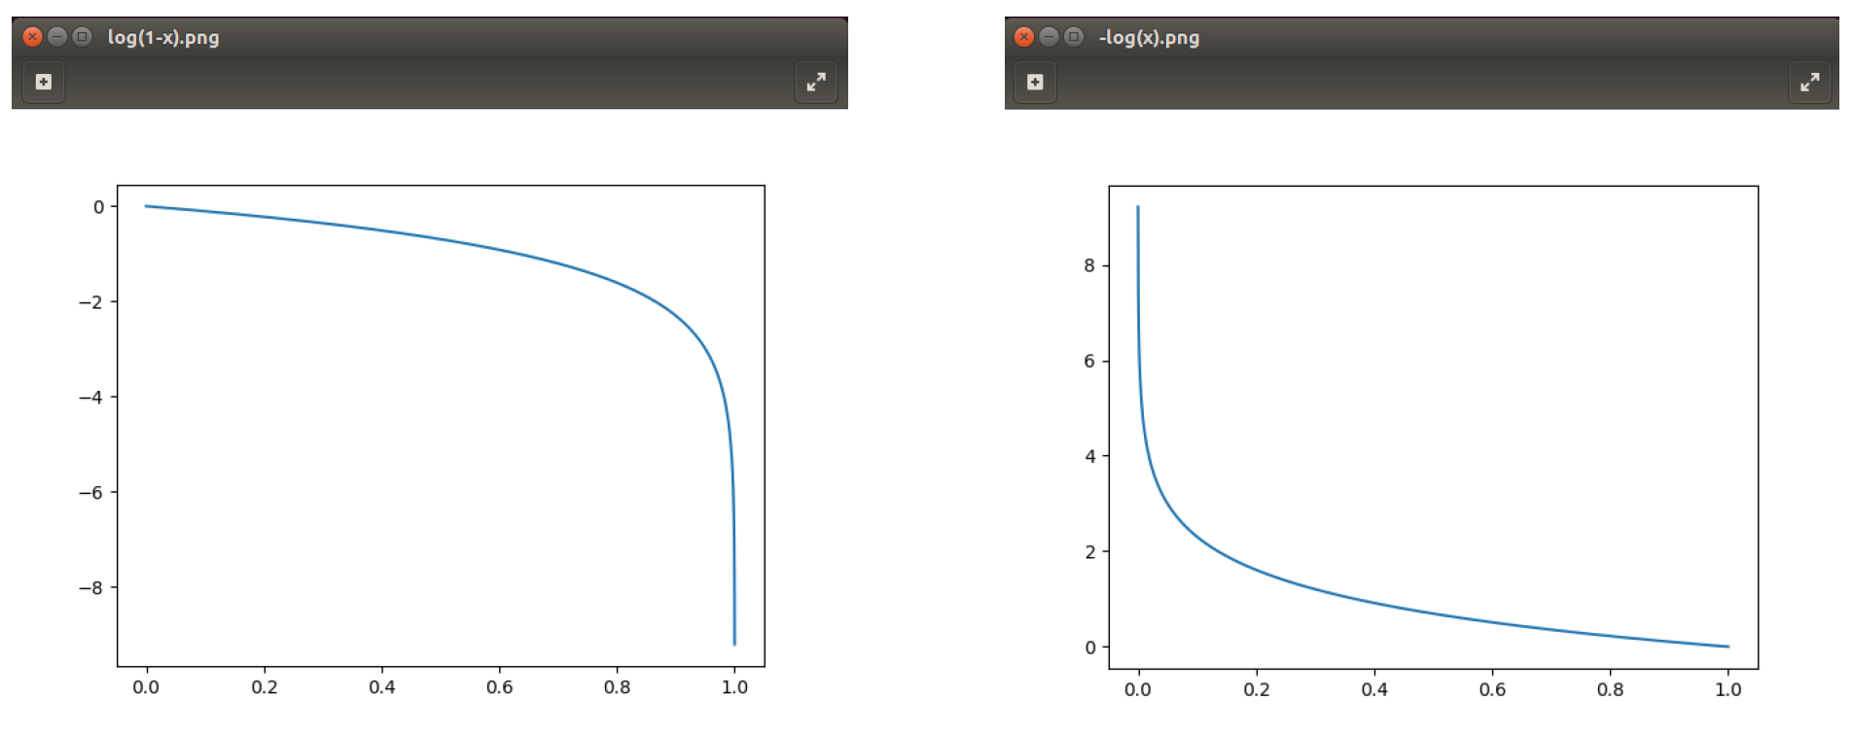

GAN-Loss
Adversarial Loss
$L_{D}=−log\left(D\left(x\right)\right)−log⁡(1−D(G\left(z\right))$
$$\left\{\begin{aligned}L_{G}=log⁡(1−D\left(G\left(z\right)\right) \\ { L}_{G }=−log⁡(D\left(G\left(z\right)\right) \end{aligned}\right.$$

Slide 7
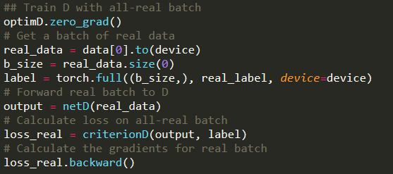

GAN-Train the Discriminator
Minimize $L_{D}=−log\left(D\left(x\right)\right)−log⁡(1−D(G\left(z\right))$
Passing a batch of real data through $D$and calculate $log\left(D\left(x\right)\right)$
nn.BCELoss($D\left(x\right),1$)

Slide 8
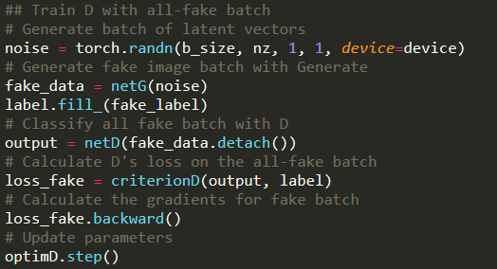

GAN-Train the Discriminator
Minimize $L_{D}=−\log\left(D\left(x\right)\right)−log⁡(1−D(G\left(z\right))$
Sample a noise $z$ and construct a fake data $G(z)$
Passing a batch of fake data through $D$and calculate $log\left(1−D\left(G(z)\right)\right)$
nn.BCELoss($D\left(G(z)\right),0$)

Slide 9
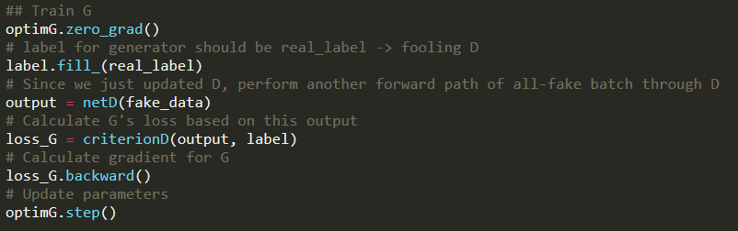

GAN-Train the Generator
Minimize $L_{G}=−log⁡(D(G\left(z\right))$
Passing the fake data through $D$and calculate $log\left(D\left(G(z)\right)\right)$
nn.BCELoss($D\left(G(z)\right),1$)

Slide 10

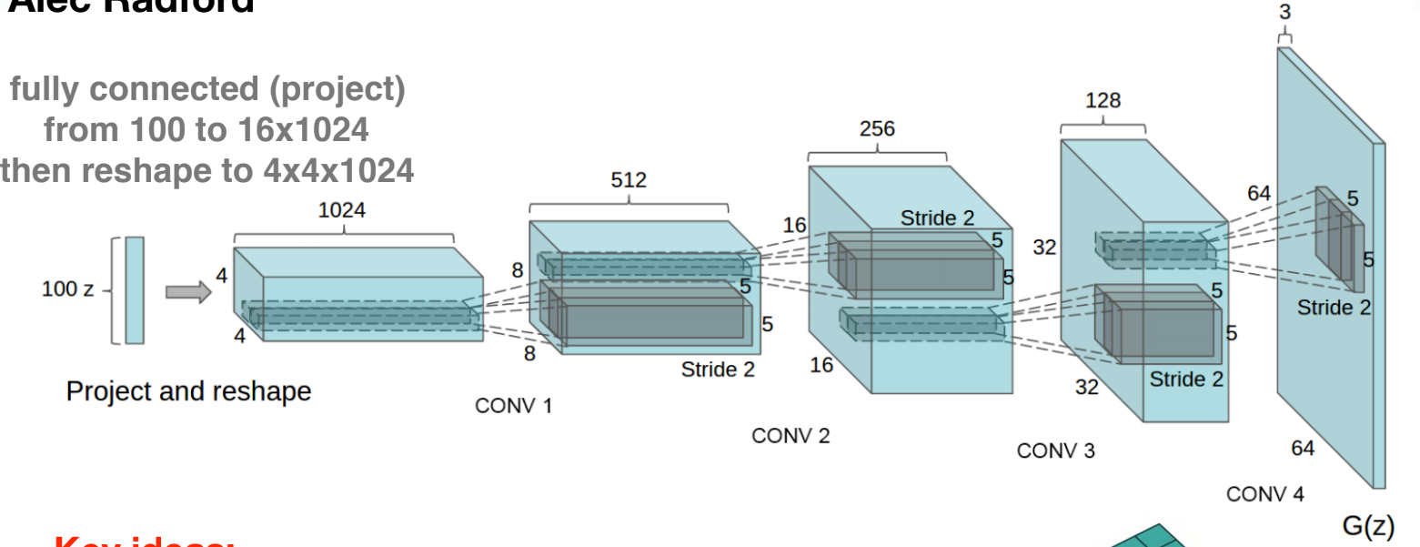
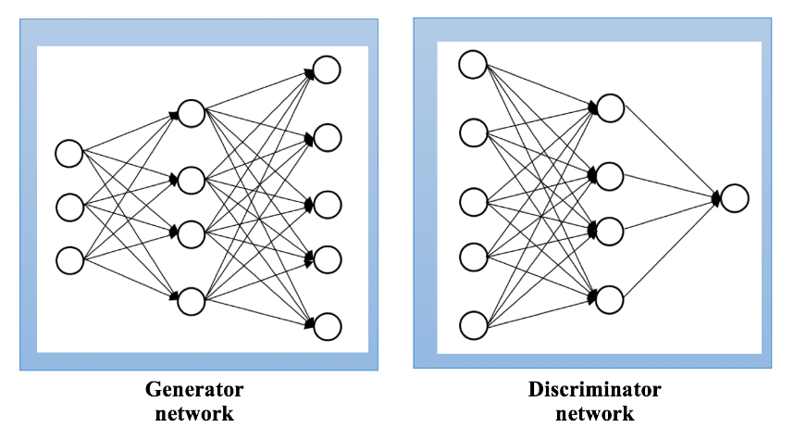
From GAN to DCGAN
Replace fully connected layers with convolutions
Use batch normalization after each layer
Convolution
Transposed Convolution
GAN
DCGAN

Slide 11
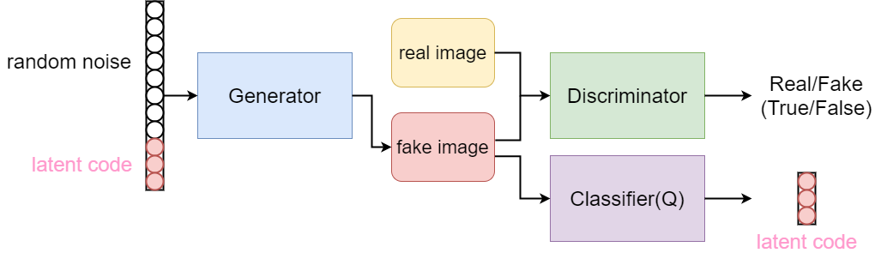
InfoGAN
InfoGAN: Interpretable Representation Learning by Information Maximizing Generative Adversarial Nets

Slide 12
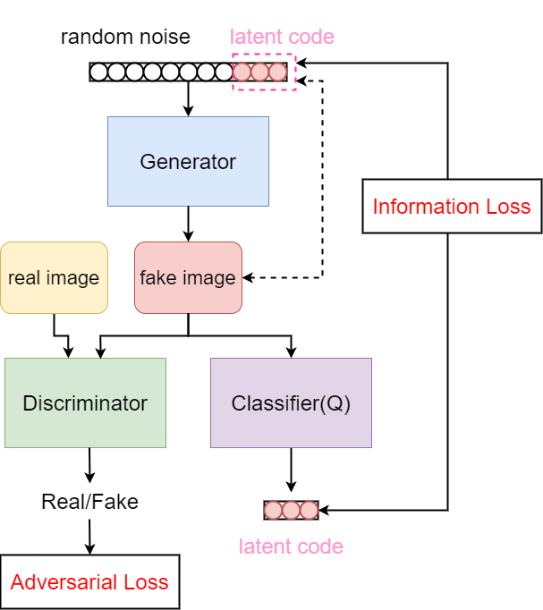
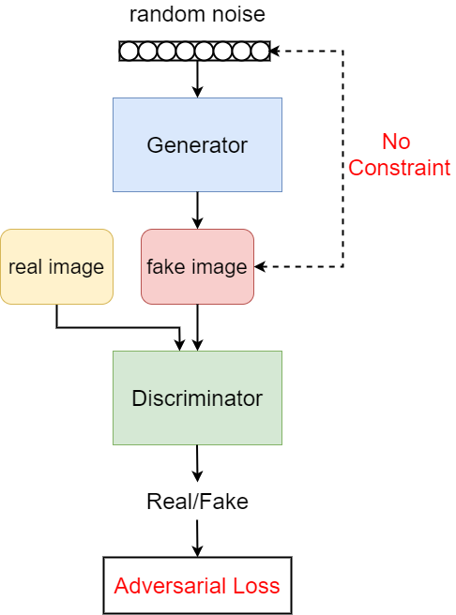
Difference
GAN
InfoGAN

Slide 13
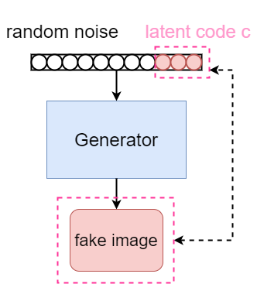

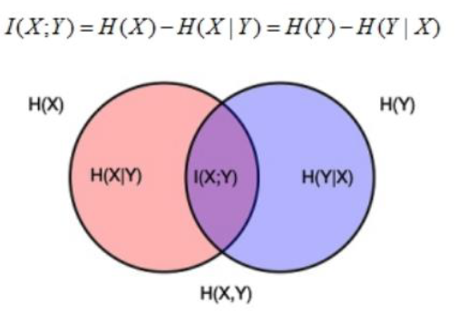


InfoGAN
Mutual Information:
$I\left(X;Y\right)=H\left(X\right)−H\left(X | Y\right)=H(Y−H(Y|X)$
$$I(c;G\left(z,c\right))$$

Slide 14
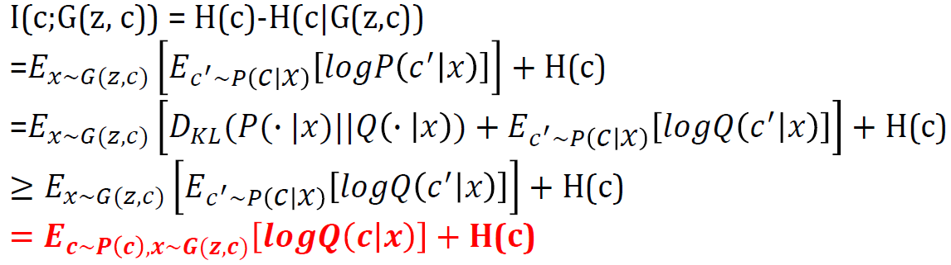

InfoGAN-prof
fixed value
$$L_{I}\left(G,Q\right)=c∙logQ\left(G\left(z,c\right)\right)+H(c)$$
$$maximize I\left(c;G\left(z,c\right)\right)=maximize L_{I}\left(G,Q\right)=maximize c∙\log{Q\left(G\left(z,c\right)\right)}=minimize−c∙\log{Q\left(G\left(z,c\right)\right)}$$
Cross Entropy Loss

Slide 15
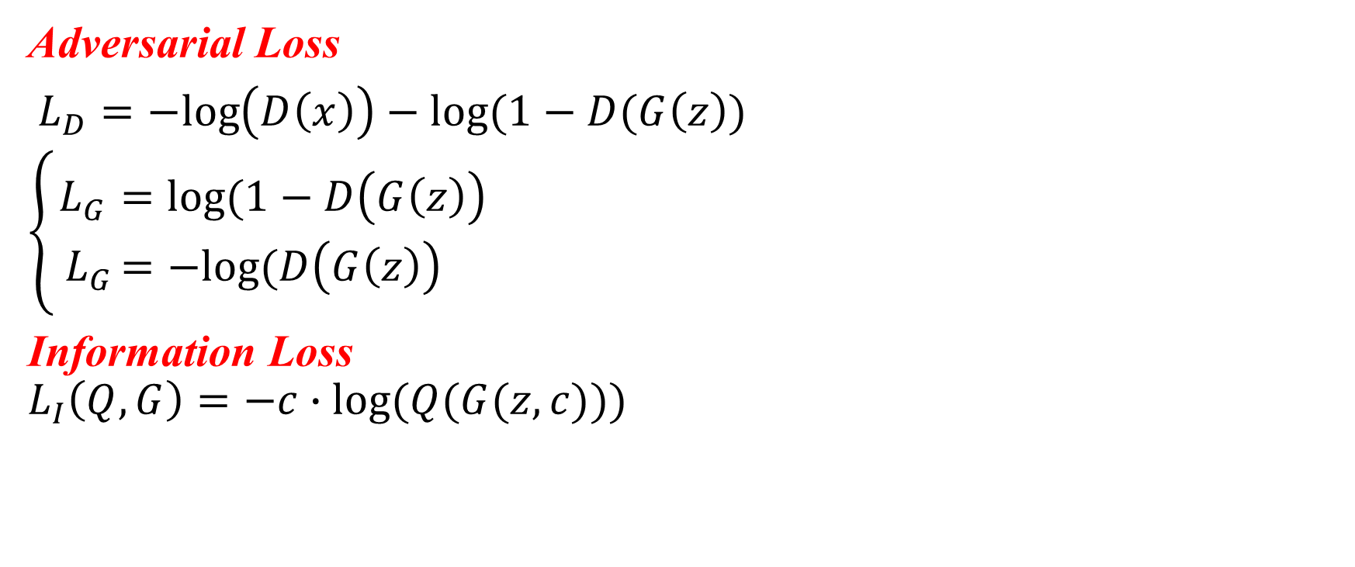
InfoGAN-Loss
Adversarial Loss
$L_{D}=−log\left(D\left(x\right)\right)−log⁡(1−D(G\left(z\right))$
$\left\{\begin{aligned}L_{G}=log⁡(1−D\left(G\left(z\right)\right) \\ { L}_{G }=−log⁡(D\left(G\left(z\right)\right) \end{aligned}\right.$
Information Loss
$$L_{I}\left(Q,G\right)=−c∙log⁡(Q(G(z,c)))$$

Slide 16
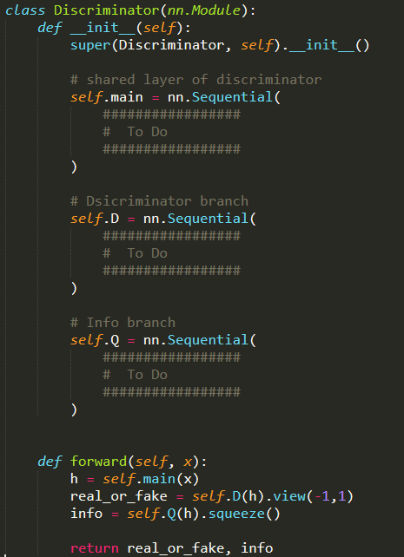
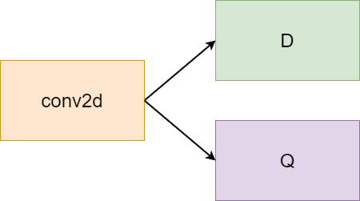
InfoGAN (share-layer)
In practice, D and Q will share conv layers to share the information.

Slide 17
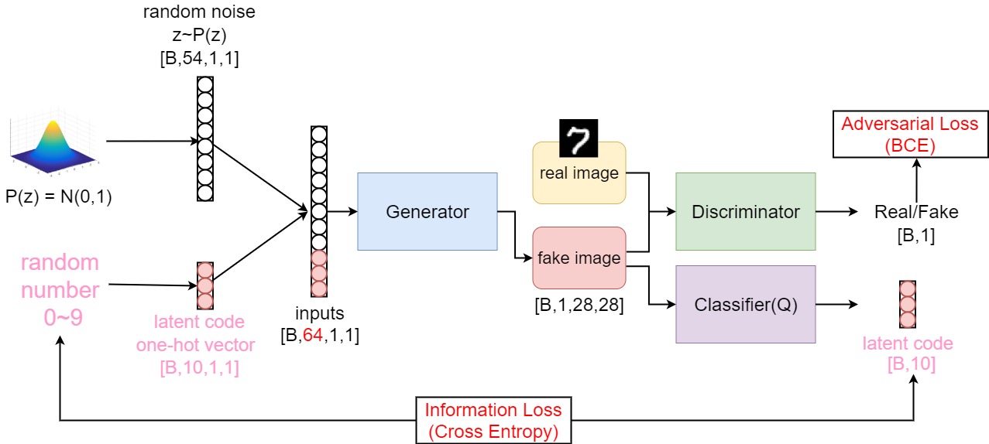
InfoGAN-MNIST number generation
style, stroke,
position, size,
etc.

Slide 18
Lab Requirement
Modify the DCGAN architecture to InfoGAN.
Implement the model architecture in model.py
Implement training procedure
Implement the training procedure in train.py
Adopt traditional generator and discriminator loss.
Maximize the mutual information between generated images and discrete one-hot vector.
Show the generated images of numbers.
Plot the generator loss, discriminator loss and information loss during training.
Implement the evaluation procedure.

Slide 19
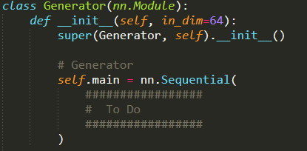
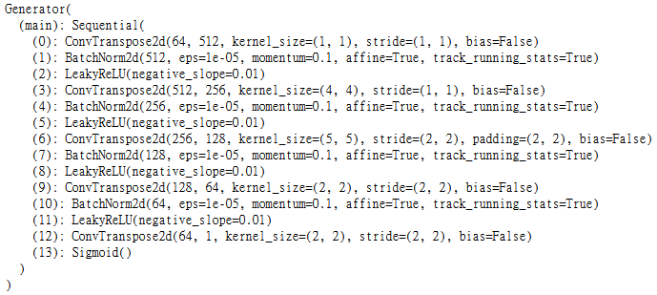
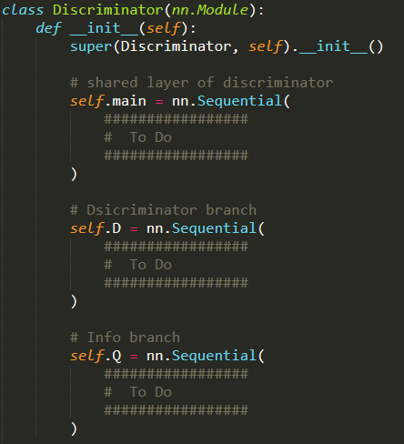
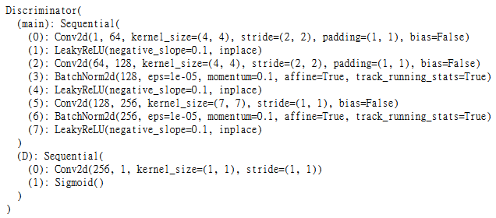
Modify model.py
Hint: Don’t use fully connected layer in Q, use convolution.

Slide 20
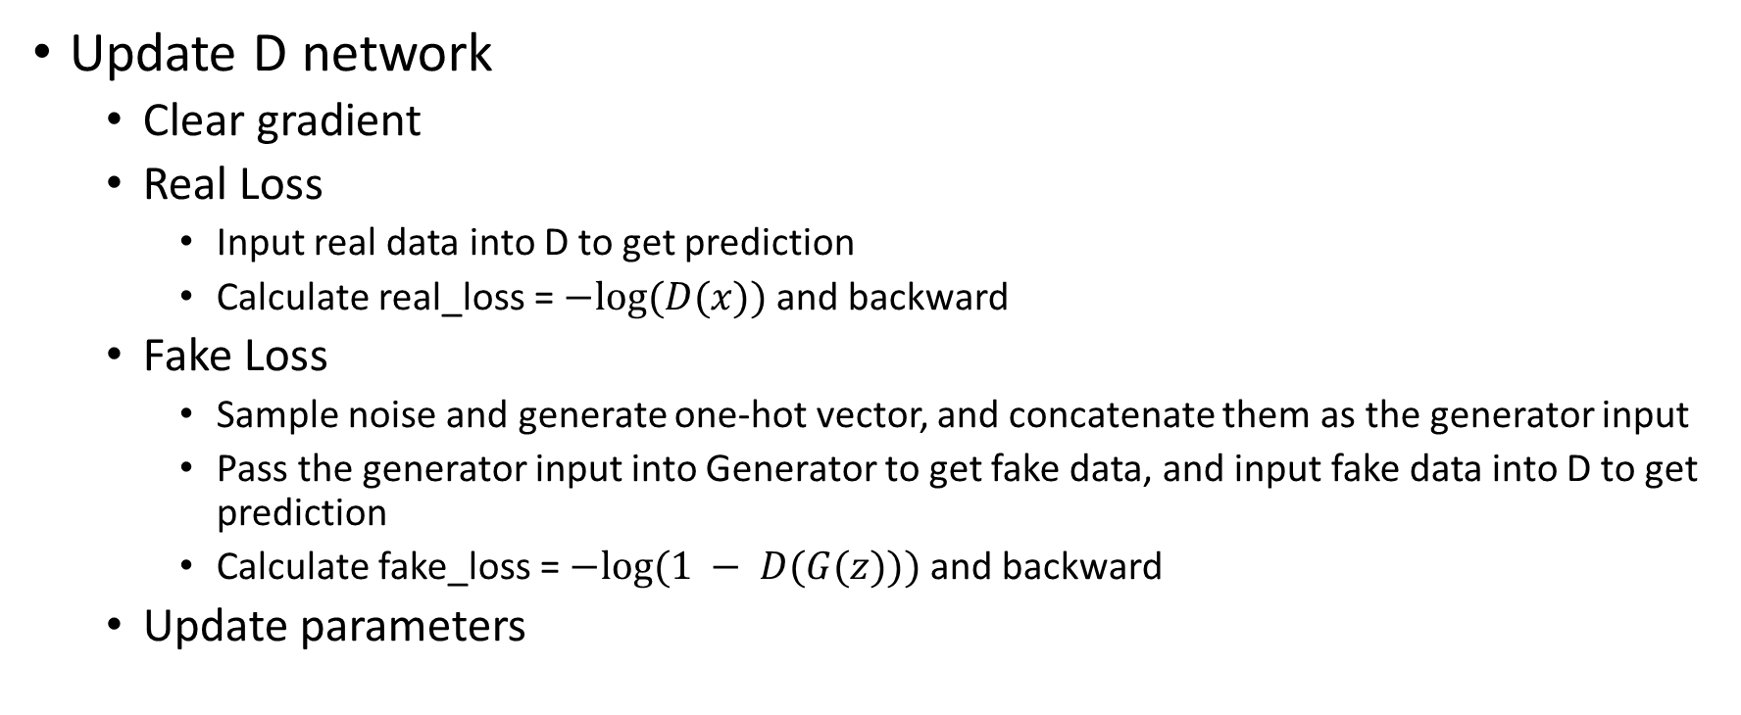
Training procedure
Update D network
Clear gradient
Real Loss
Input real data into D to get prediction
Calculate real_loss = $−log⁡(D(x))$and backward
Fake Loss
Sample noise and generate one-hot vector, and concatenate them as the generator input
Pass the generator input into Generator to get fake data, and input fake data into D to get prediction
Calculate fake_loss = $−log⁡(1 − D(G(z)))$and backward
Update parameters

Slide 21
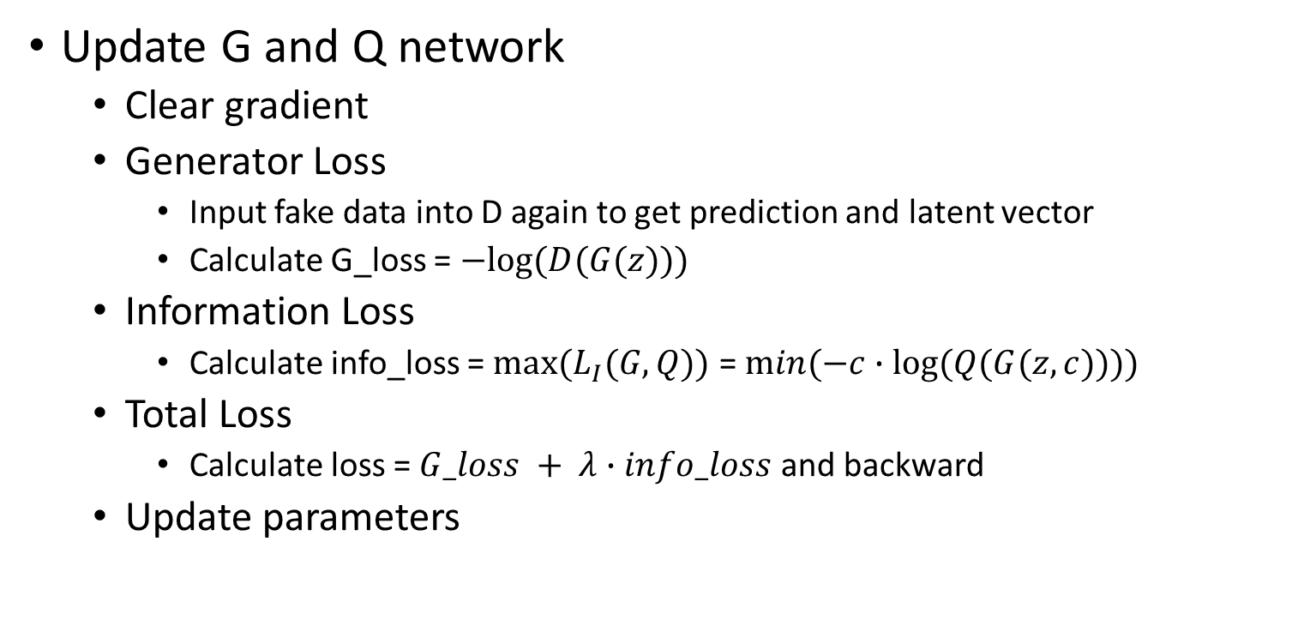
Training procedure
Update G and Q network
Clear gradient
Generator Loss
Input fake data into D again to get prediction and latent vector
Calculate G_loss = $−log⁡(D(G(z)))$
Information Loss
Calculate info_loss = $max⁡(L_{I}(G,Q))$ = $min⁡(−c∙log⁡(Q(G(z,c))))$
Total Loss
Calculate loss = $G_loss + λ∙info_loss$ and backward
Update parameters

Slide 22
Hyper-parameters
noise size = 54
latent code size = 10
total epochs = 50
optimizer : Adam
learning rate for G and Q: 1e⁻³
learning rate for D: 2e⁻⁴
Info loss weight: 0.25
You can adjust the hyper-parameters according to your own ideas.

Slide 23
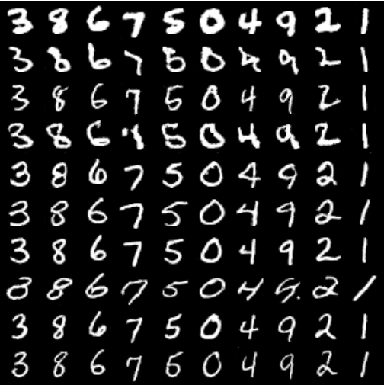
Expected output
10 numbers (latent vectors) with 10 different styles (noises).
10 styles
10 numbers

Slide 24

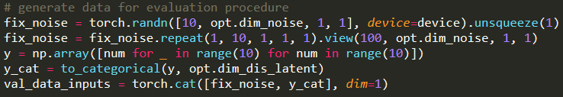
Demo
Please implement the evaluation procedure
Load pretrained model weights
Generate output with 10 numbers x 10 styles
While demo, you should run the evaluation and show your result to TA

Slide 25
Scoring Criteria
Report (50%)
A. Introduction (10%)
B. Experiment Setups (20%)
How did you implement Info GAN
Adversarial loss
Maximizing mutual information
Which loss function of generator did you use? What’s the difference?
C. Results and discussion (20%)
Results of your samples
Training loss curves

Slide 26
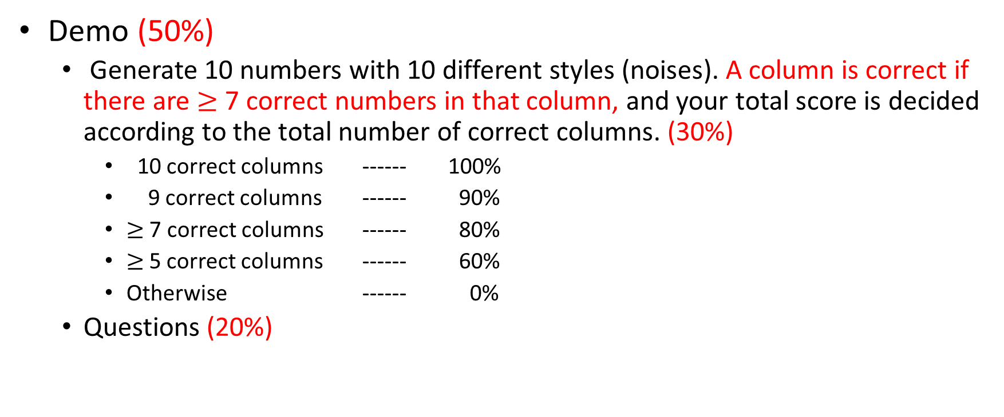
Scoring Criteria
Demo (50%)
Generate 10 numbers with 10 different styles (noises). A column is correct if there are $≥$ 7 correct numbers in that column, and your total score is decided according to the total number of correct columns. (30%)
10 correct columns ------ 100%
9 correct columns ------ 90%
$≥$ 7 correct columns ------ 80%
$≥$5 correct columns ------ 60%
Otherwise ------ 0%
Questions (20%)

