Slide 1

Overview of Agents in Various Disciplines
Exploring agents' roles and ethical implications
Notes:
AI-generated content may be incorrect. --- Agents play a crucial role across multiple disciplines, from computer science to philosophy. This presentation will explore the definition of agents, their roles in various fields, and delve into ethical considerations surrounding AI agents. Image source: Microsoft 365 content library

Slide 2
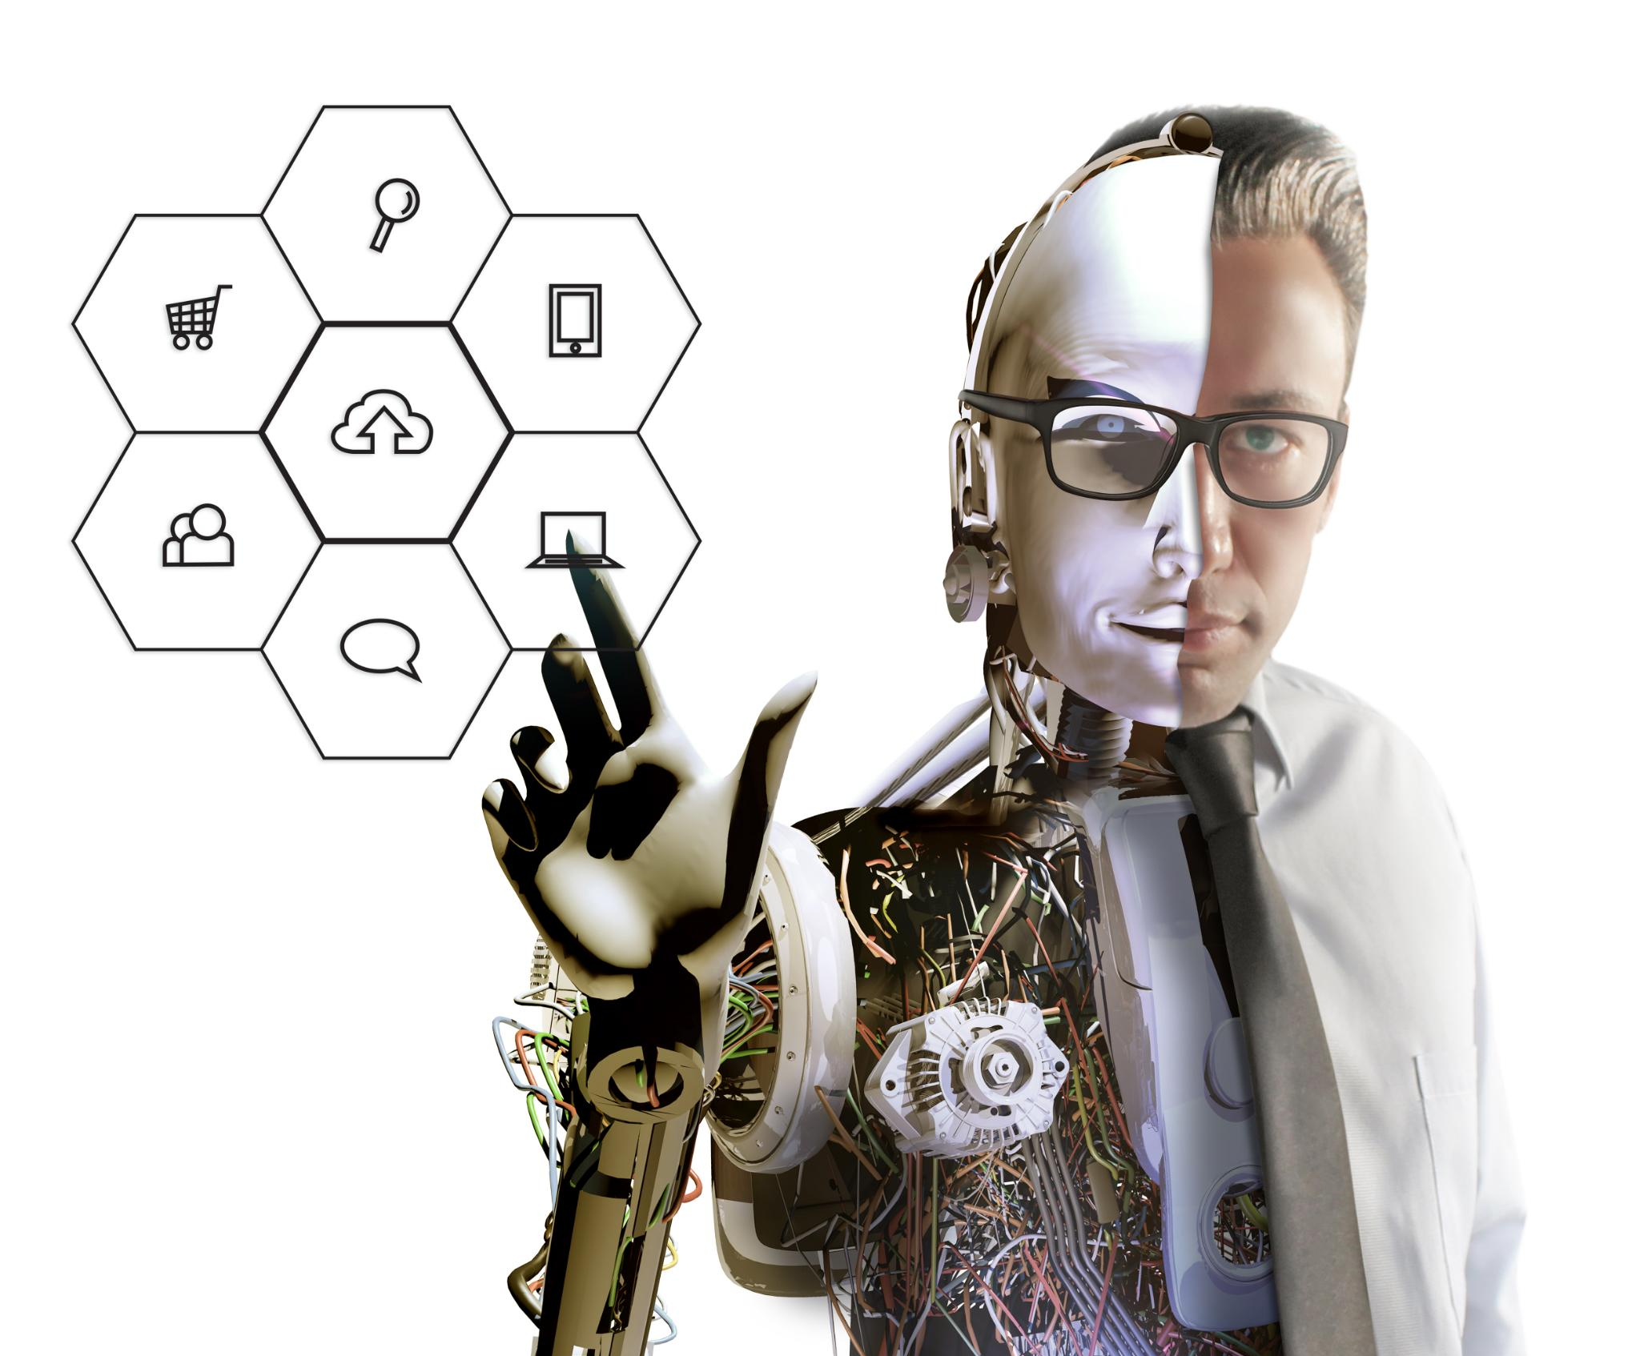
Fundamental Concept of Agents
Definition of an Agent
An agent is an entity that perceives its environment using sensors and takes action to achieve goals.
Types of Agents
Agents can be biological, like humans and animals, or artificial, such as robots and software programs.
Applications of Agents
Agents are used in various fields, including AI, robotics, economics, and philosophy, to model complex behaviors.
Notes:
--- This slide references information from the following file: https://microsoftapc-my.sharepoint.com/personal/v-chimingni_microsoft_com/_layouts/15/Doc.aspx?sourcedoc=%7BB854003A-308B-432B-8935-6569194324F6%7D&file=template1.docx&action=default&mobileredirect=true&DefaultItemOpen=1 An agent is a broad concept that spans multiple disciplines, including artificial intelligence, computer science, robotics, economics, and philosophy. In its most fundamental sense, an agent is an entity that perceives its environment through sensors, processes information, and takes actions to achieve specific objectives. Agents can be biological, such as humans and animals, or artificial, such as software programs, robots, and autonomous systems. Image source: Microsoft 365 content library

Slide 3

AI Agents and Their Classifications
Definition of AI Agents
AI agents are autonomous systems making decisions based on their perceptions and experiences in a specific environment.
Classification of AI Agents
AI agents can be classified by their intelligence and autonomy levels, such as reactive, deliberative, learning, and multi-agent systems.
Reactive vs. Deliberative Agents
Reactive agents respond to stimuli in a simple manner, while deliberative agents plan actions based on internal models of the world.
Learning Agents
Learning agents enhance their performance over time through experience, often utilizing reinforcement learning methods.
Notes:
--- This slide references information from the following file: https://microsoftapc-my.sharepoint.com/personal/v-chimingni_microsoft_com/_layouts/15/Doc.aspx?sourcedoc=%7BB854003A-308B-432B-8935-6569194324F6%7D&file=template1.docx&action=default&mobileredirect=true&DefaultItemOpen=1 In the field of artificial intelligence (AI), an agenty is typically defined as an autonomous system that makes decisions based on its perceptions and experiences. AI agents operate within an environment, gathering data through sensors (such as cameras, microphones, or data streams), analyzing that data using reasoning mechanisms or machine learning models, and executing actions to accomplish predefined goals. AI agents can be classified based on their level of intelligence and autonomy. Reactive agents are the simplest, responding to stimuli in a rule-based manner without maintaining an internal state. Deliberative agents build internal models of the world and plan actions based on predictions about future states. Learning agents improve their performance over time through experience, utilizing reinforcement learning or other adaptive methods. Multi-agent systems consist of multiple agents that interact, collaborate, or compete within a shared environment, often leading to emergent behaviors. Image source: Microsoft 365 content library

Slide 4
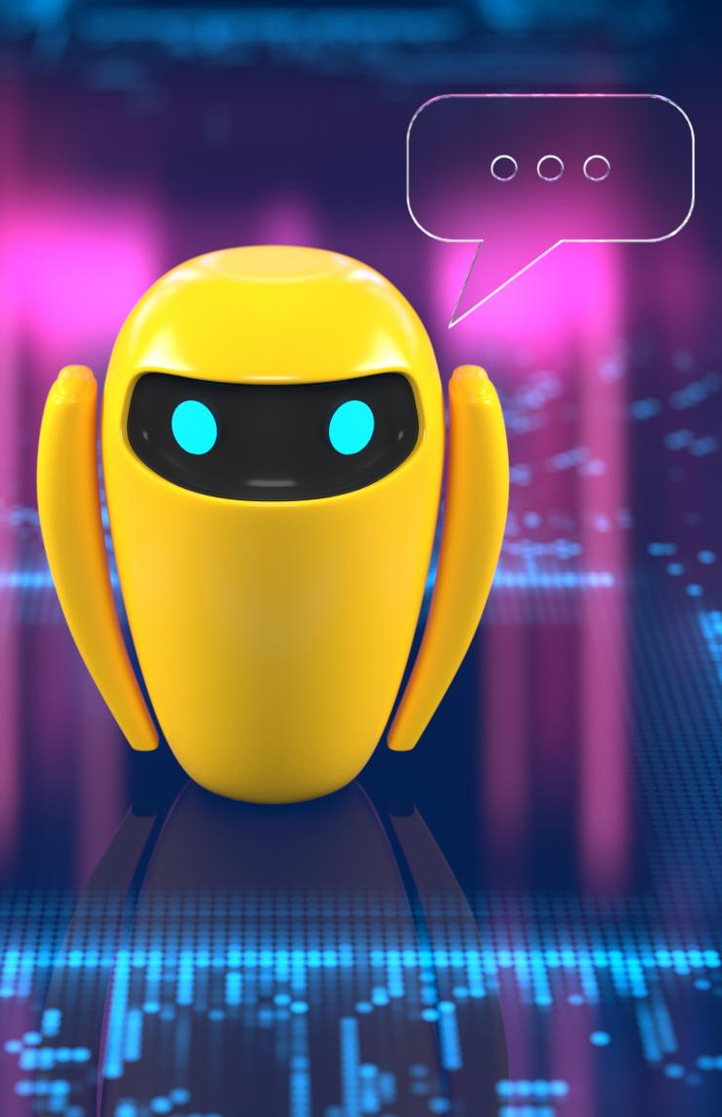
Software Agents and Their Applications
Role of Software Agents
Software agents automate processes and enhance decision-making, making them crucial in various applications.
Intelligent Personal Assistants
Software agents like intelligent personal assistants help users manage daily tasks, providing personalized recommendations.
Cybersecurity Applications
In cybersecurity, autonomous agents monitor networks, detect anomalies, and execute preventive measures against threats.
Conversational Agents
Conversational agents, such as chatbots, process natural language to provide human-like responses in customer service.
Notes:
--- This slide references information from the following file: https://microsoftapc-my.sharepoint.com/personal/v-chimingni_microsoft_com/_layouts/15/Doc.aspx?sourcedoc=%7BB854003A-308B-432B-8935-6569194324F6%7D&file=template1.docx&action=default&mobileredirect=true&DefaultItemOpen=1 In computer science, software agents play a critical role in automating processes, managing distributed systems, and enhancing decision-making. Agents can be designed to operate in various domains, such as intelligent personal assistants, recommendation systems, and automated trading systems. A software agent is a program that autonomously performs tasks on behalf of users or other programs. These agents may use rule-based systems, machine learning models, or advanced AI techniques to adapt to changing conditions. Autonomous agents in cybersecurity monitor networks for threats, detect anomalies, and take preventive actions. Conversational agents, such as chatbots and virtual assistants, process natural language inputs and generate human-like responses, making them integral to customer service and user interaction platforms. Image source: Microsoft 365 content library

Slide 5
Robotic Agents and Their Capabilities
Autonomous Systems
Robotic agents are autonomous systems capable of interacting with their environment using various sensors and AI algorithms.
Data Processing and Action
Robotic agents sense their environment, process data with AI, and execute actions via actuators to navigate effectively.
Industrial Robotics
In industrial settings, robots enhance efficiency and precision, performing repetitive tasks with high accuracy through specialized designs.
Notes:
--- This slide references information from the following file: https://microsoftapc-my.sharepoint.com/personal/v-chimingni_microsoft_com/_layouts/15/Doc.aspx?sourcedoc=%7BB854003A-308B-432B-8935-6569194324F6%7D&file=template1.docx&action=default&mobileredirect=true&DefaultItemOpen=1 In robotics, an agent often refers to an autonomous system capable of interacting with the physical world. Robotic agents can sense their environment through sensors like LiDAR, cameras, and IMUs, process this data using AI algorithms, and take physical actions via actuators. Advanced robotic agents, such as autonomous drones and self-driving cars, incorporate deep learning, reinforcement learning, and computer vision to navigate and interact with their surroundings safely and efficiently. Robots operating in industrial settings, such as robotic arms in manufacturing plants, function as specialized agents that optimize efficiency, reduce errors, and perform repetitive tasks with high precision. Image source: Microsoft brand library

Slide 6
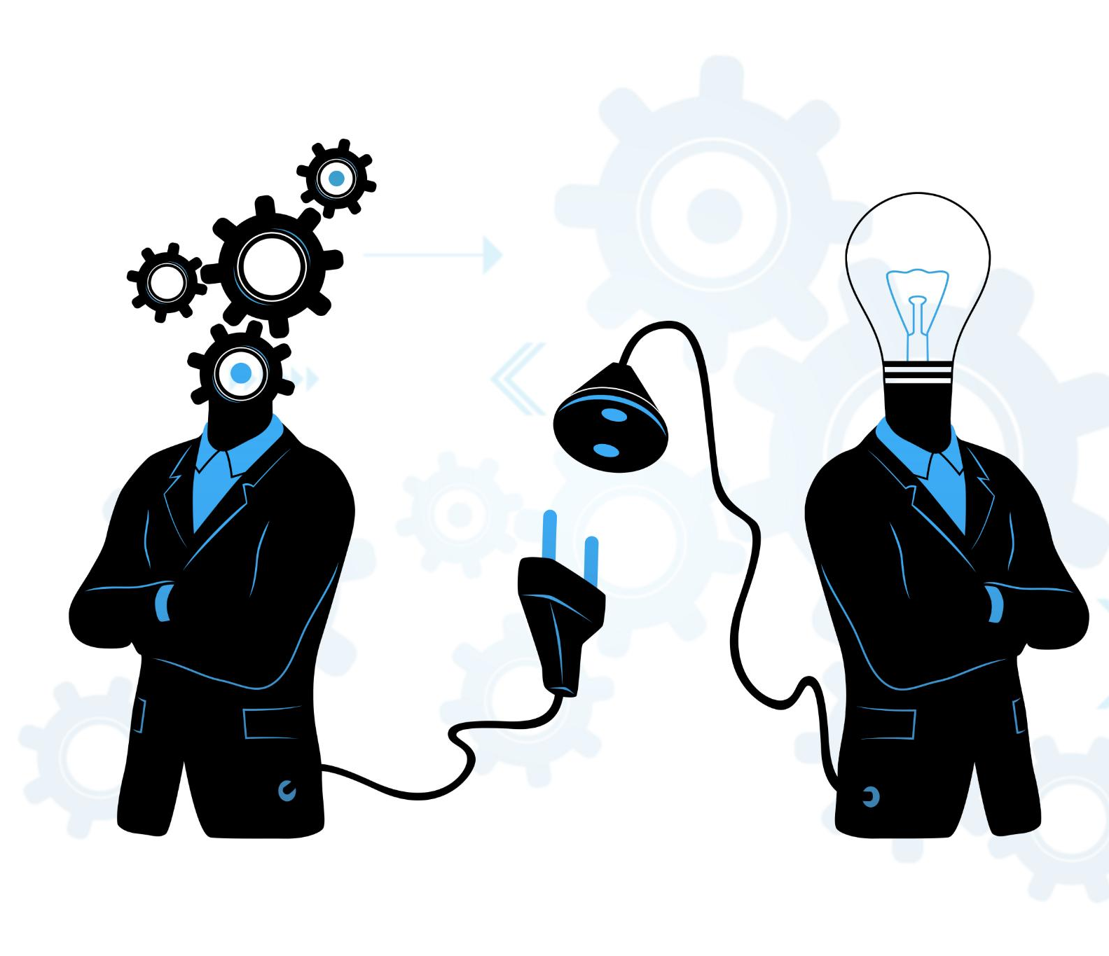
Agency, Autonomy, and Intentionality
Philosophical Agency
Agency is fundamentally connected to autonomy, intentionality, and the exercise of free will in decision-making processes.
Moral Responsibility
The study of philosophical agents raises questions about consciousness and moral responsibility in decision-making.
Artificial Intentionality
The debate centers on whether artificial agents can possess genuine intentionality or simply simulate human-like behaviors.
Emergent Behaviors
Some argue that advanced AI systems reflect emergent behaviors that resemble agency, raising ethical questions.
Notes:
--- This slide references information from the following file: https://microsoftapc-my.sharepoint.com/personal/v-chimingni_microsoft_com/_layouts/15/Doc.aspx?sourcedoc=%7BB854003A-308B-432B-8935-6569194324F6%7D&file=template1.docx&action=default&mobileredirect=true&DefaultItemOpen=1 From a philosophical perspective, agency is closely tied to autonomy, intentionality, and free will. The study of philosophical agents involves questions about consciousness, moral responsibility, and the nature of decision-making. The debate over whether artificial agents can possess genuine intentionality or whether they merely simulate human-like behaviors remains a central issue in AI ethics and cognitive science. Some argue that advanced AI systems, particularly those utilizing deep reinforcement learning and neural networks, exhibit emergent behaviors that resemble agency, while others maintain that these systems lack true understanding and intentionality. Image source: Microsoft 365 content library

Slide 7
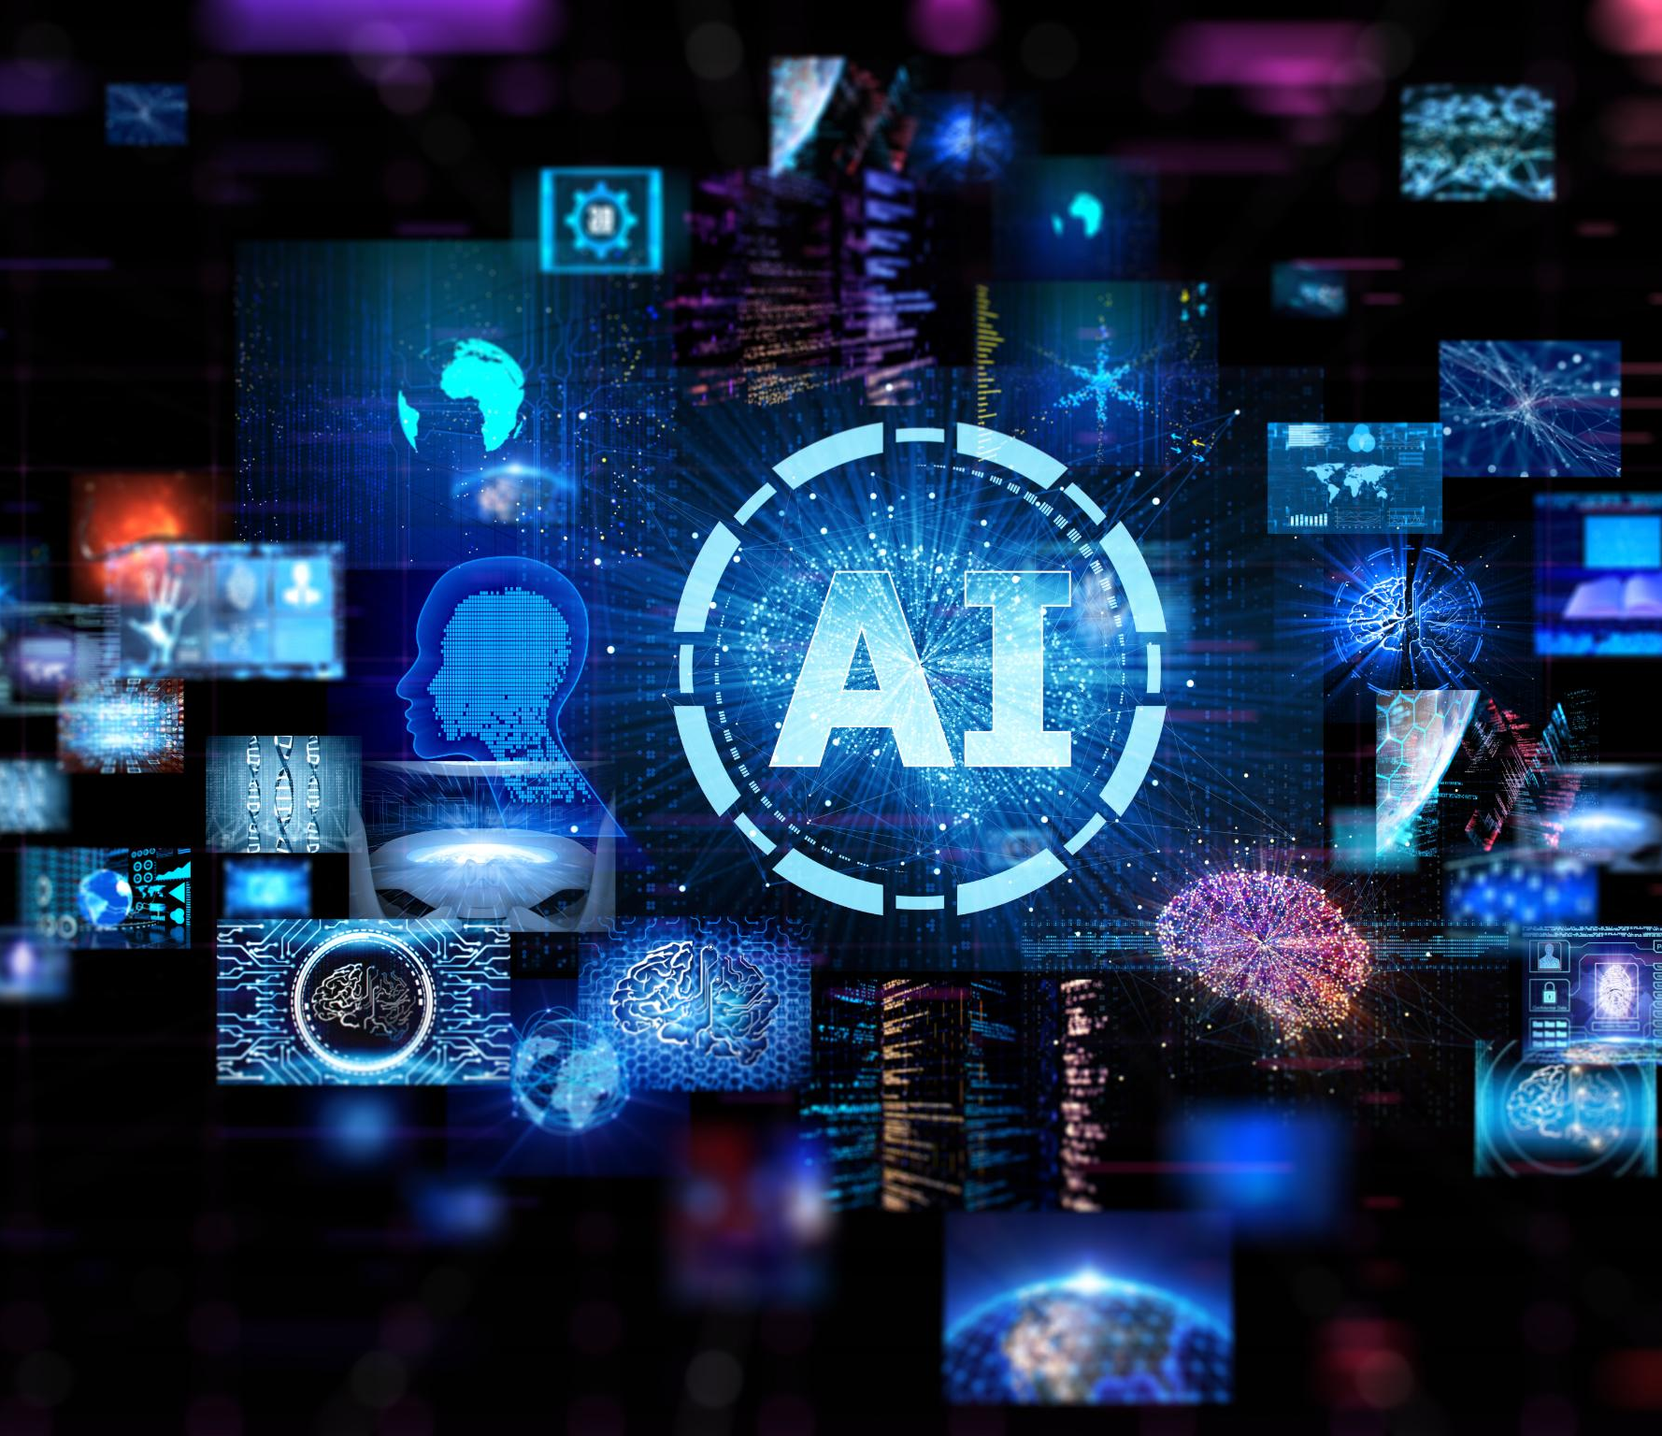
Generalist AI Agents and Ethical Challenges
Advancements in AI Agents
The development of generalist AI agents represents a significant frontier, allowing agents to perform tasks across multiple domains without specific training.
Ethical Considerations
As AI agents take on more decision-making roles, ethical issues like accountability, bias, and fairness become critical.
Governance Challenges
Ensuring AI agents align with human values and operate transparently is essential for effective AI governance.
Regulatory Frameworks
Regulatory frameworks and guidelines are being developed to mitigate risks in areas like law enforcement and finance.
Notes:
--- This slide references information from the following file: https://microsoftapc-my.sharepoint.com/personal/v-chimingni_microsoft_com/_layouts/15/Doc.aspx?sourcedoc=%7BB854003A-308B-432B-8935-6569194324F6%7D&file=template1.docx&action=default&mobileredirect=true&DefaultItemOpen=1 As AI continues to evolve, the role of agents is expanding into increasingly complex domains. The development of generalist AI agents, capable of performing diverse tasks across multiple domains without task-specific training, represents a major frontier in AI research. Projects like OpenAI's GPT-4 and DeepMind’s AlphaZero exemplify how reinforcement learning, self-supervised learning, and transformer architectures contribute to the creation of more generalized, adaptable agents. Ethical considerations surrounding AI agents are also a growing area of concern. As autonomous agents assume greater roles in decision-making, questions about accountability, bias, and fairness arise. Ensuring that AI agents operate transparently and align with human values is a key challenge in AI governance. Regulatory frameworks and ethical guidelines are being developed to mitigate risks associated with AI-driven decision-making in critical areas such as law enforcement, financial markets, and autonomous warfare. Image source: Microsoft 365 content library

Slide 8
Conclusion
Diverse Functions of Agents
Agents play crucial roles across various fields, enhancing technology and provoking philosophical discussions.
Implications for AI and Robotics
Understanding the implications of agents is vital for navigating the complexities of AI and robotics responsibly.
Future of Technology
Navigating the future responsibly requires awareness of the roles and responsibilities of agents in society.
Notes:
In conclusion, agents serve diverse functions across disciplines, from enhancing technology to raising philosophical questions. Understanding their implications is essential for navigating the future of AI and robotics responsibly.

