Slide 1
English Phonetics
ENGL-238
2021 Fall

Slide 2
English consonants & vowels

Slide 3
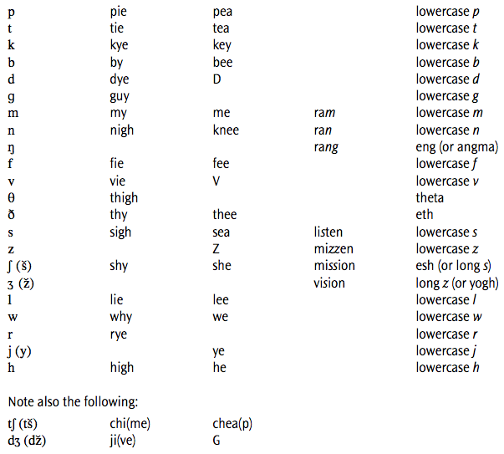
English consonants

Slide 4
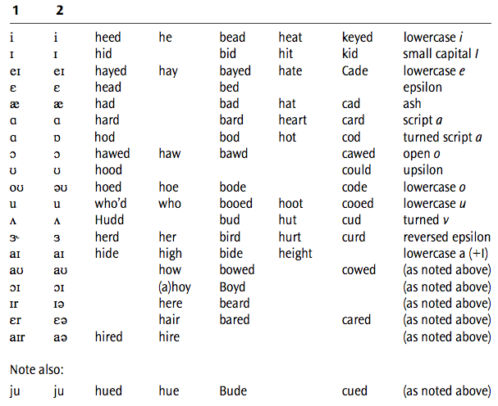
English vowels
monophthongs
diphthongs

Slide 5
Phonetics
A study on speech
How speech is described
Articulatory phonetics (from mouth) ← the most primitive
How to produce speech
Acoustic phonetics (through air)
How to transmit speech
Auditory phonetics (to ear)
How to hear speech

Slide 6
Praat

Slide 7
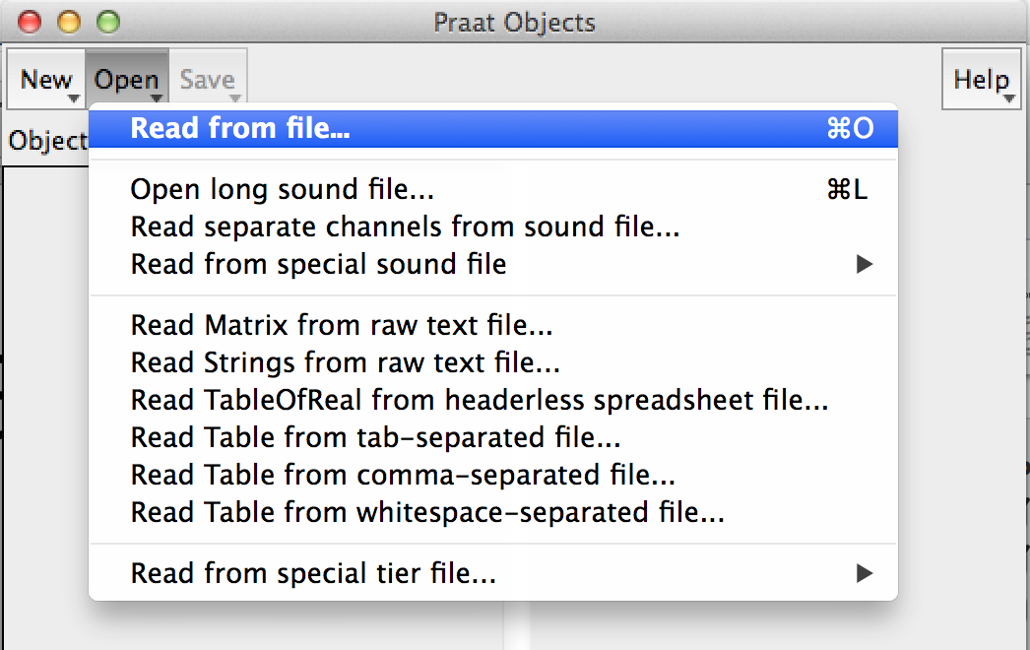
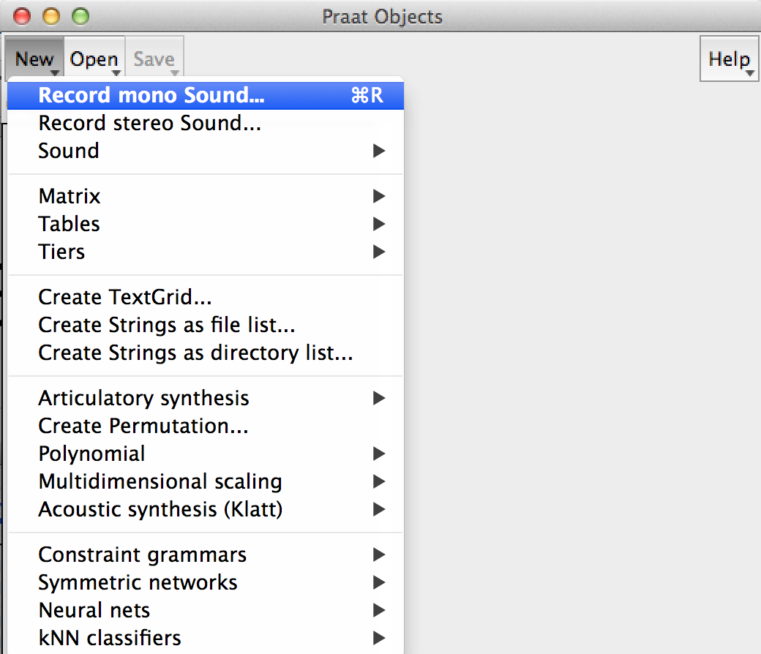
Praat
open sound file
record sound

Slide 8
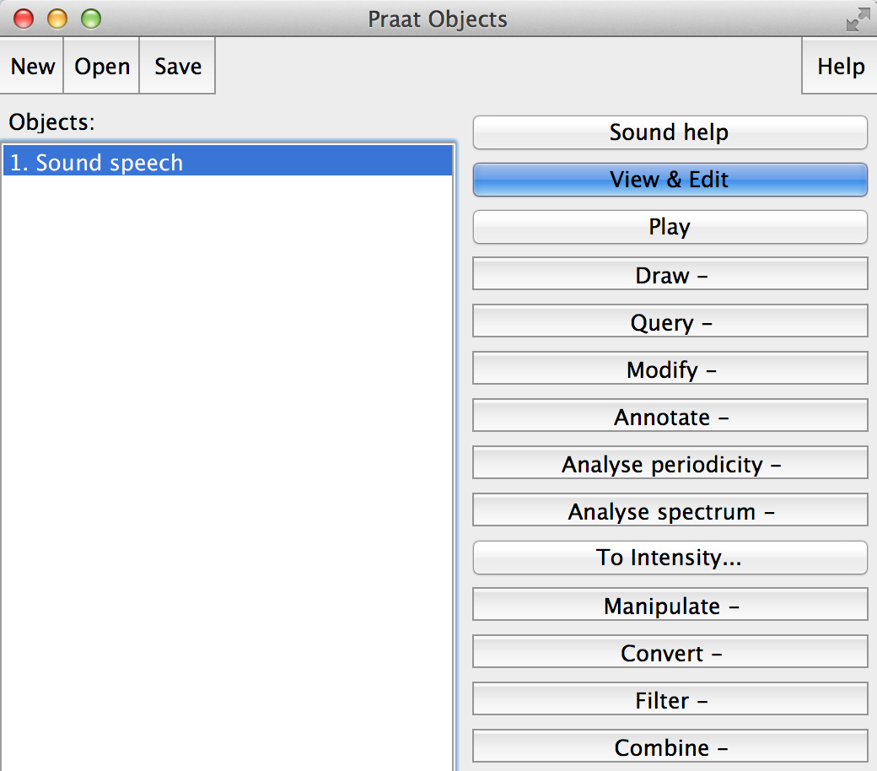
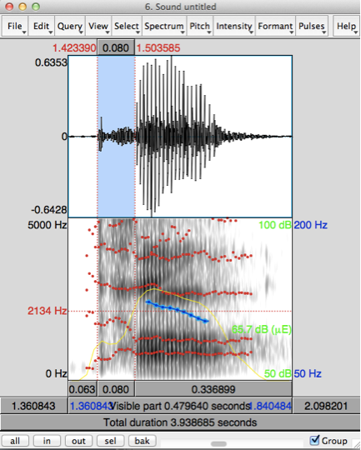
Duration, pitch, intensity, formant
duration (sec.)
pitch (Hz)
formant (Hz)
intensity (dB)

Slide 9
Hands-on experiments with Praat
Record yourself with the sentence:
“Your good pants look great”
Pitch
Labeling
Segmentation

