Slide 1
Common Representation Learning
By- Anchal Soni (2020201099)
MK Utkarsh (2020201027)
Varun Nambigari (2020201079)

Slide 2
Prerequisites for implementing this paper
Two categories for CRL
1) Canonical based approach - CCA,KCCA, etc.
Drawbacks: Scalability issues and poor performance for reconstruction.
2) Autoencoder based approach
Deep neural networks that try to optimize two objective functions
First is a compressed hidden representation of data in a low dimensional vector space.
Second is reconstruct the original data from the compressed low dimensional subspace.

Slide 3
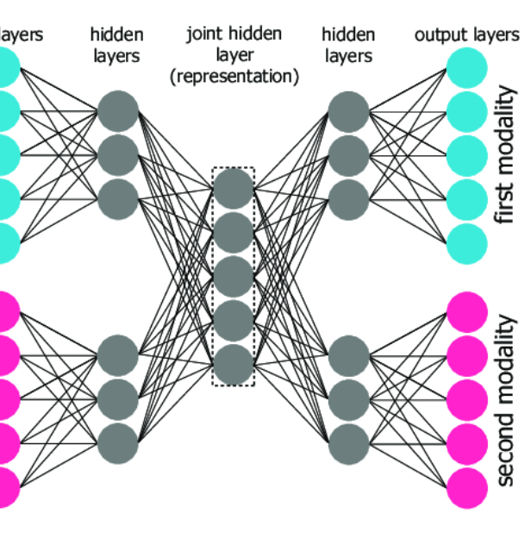
Multi Modal Auto encoders MAE :
Two channeled AE that specifically performs two types of reconstruction.
First is self-reconstruction of view from itself
Another is cross reconstruction where one view is reconstructed given the other.

Slide 4
CorrNet is an advanced MAE:
Correlational neural networks which presents an improvement to MAE by introducing a correlation term in the objective function that tries to maximize the correlation between the hidden representation of different views.
Limitations of corrNet : usage of simple neural layers for encoding and decoding and using the final hidden representations in the correlation loss function.

Slide 5
Main contributions of the paper :
Introduce convolutional layers to encoding phase of CorrMCNN and deconvolution is used in the decoding stage.
Batch normalization in the intermediate layers of proposed model along with tied weights architecture.
Instead of using final hidden representations in the correlation loss, we enforce correlation computation at each intermediate layer. We further experiment with reconstruction of hidden representation at every individual step.

Slide 6
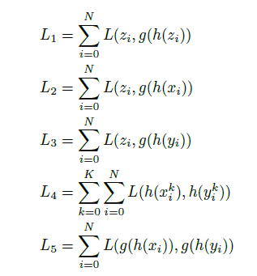
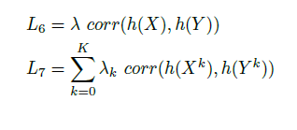

1) Problem statemen (Loss functions)

Slide 7
2) Weekly Plan
DATE | WORK
By 12 to 14/04/2021 | Mid eval. Some architecture and results
By 20/04/2021 | Add other losses , deconvolution layer
By 22/04/2021 | Testing and plotting
By 24/04/2021 | Documentation

Slide 8
3) Dataset Description
MNIST
View 1 – First half of the image 28 x 14 = 392
View 2 – Second half of the image 28 x 14 = 392

Slide 9
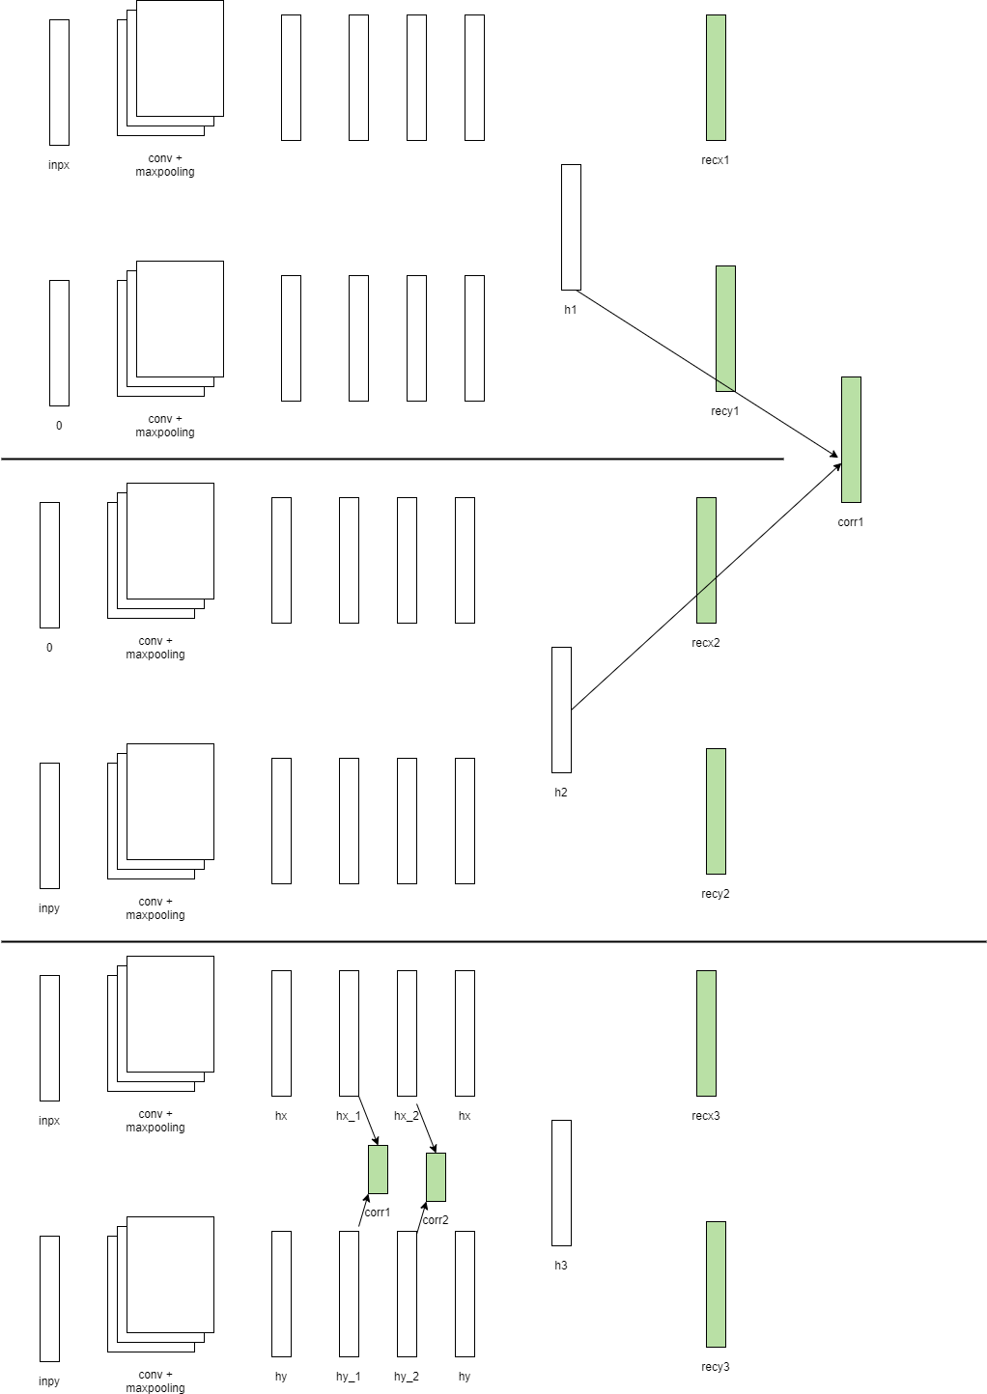
Current Implementation
X is Zero
Y is zero

Slide 10
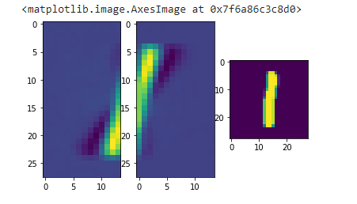
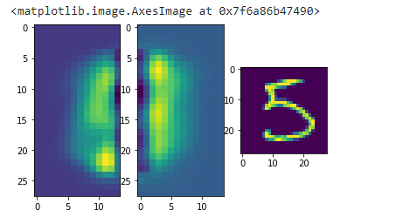
Testing

