Slide 1
架构图

Slide 2
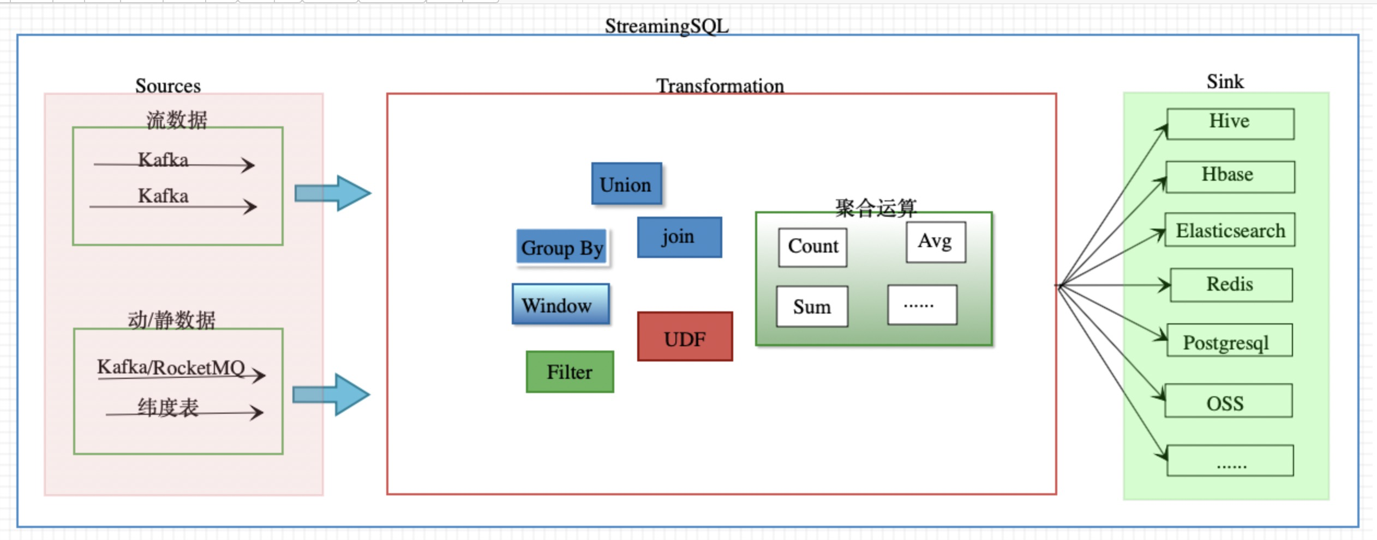
基础结构
StreamingSQL 是一款基于Flink SQL 开发并实现对流数据进行数据清洗，转换，聚合等操作的ETL工具。

Slide 3
源数据建表示例
流表
CREATE TABLE ride_info_table(
user_new_id varchar ,
end_point varchar ,
ride_status varchar ,
start_point varchar ,
start_time varchar ,
stop_time varchar,
order_id varchar,
bike_no varchar,
wal_operation_table varchar
)WITH(
type ='kafka11',
kafka.bootstrap.servers ='localhost:9092',
kafka.zookeeperQuorum ='localhost:2181',
kafka.groupId='t_kafka_consumer_20190806',
kafka.topic ='kafka_redis',
kafka.parallelism ='1'
);
纬度表
create table redis_table(
userNewId varchar ,
PRIMARY KEY(userNewId),
PERIOD FOR SYSTEM_TIME
)WITH(
type='redis',
url='10.111.10.63:8509',
database= '1',
password='tEStqu49GNos26tESt',
redisType='1',
tableName='affair:setting:userNewId'
);

Slide 4
目的表建表示例
CREATE TABLE kafka_redis_table(
user_new_id varchar ,
ride_status varchar ,
start_time varchar ,
start_point varchar ,
end_point varchar ,
stop_time varchar ,
order_id varchar,
bike_no varchar,
wal_operation_table varchar
)WITH(
type ='kafka11',
kafka.bootstrap.servers ='localhost:9092',
kafka.topic ='govaffair-monitor'
);
CREATE TABLE ESResult(
name varchar,
pv varchar
)WITH(
type ='elasticsearch6',
es_address ='newdev-es.hellobike.cn',
es_type ='lemon_result',
es_port = '9200',
es_index ='lemon_201908',
parallelism ='1'
);

Slide 5
逻辑处理
insert into kafka_redis_table
select d.user_new_id,d.ride_status,d.start_time,d.start_point,d.end_point,d.stop_time,d.order_id,d.bike_no,
d.wal_operation_table from (
select a.user_new_id,a.start_point,a.end_point,a.ride_status,a.start_time,a.stop_time,a.order_id,a.bike_no,
a.wal_operation_table from ride_info_table a
join redis_table s
on a.user_new_id = s.userNewId
) as d ;

Slide 6
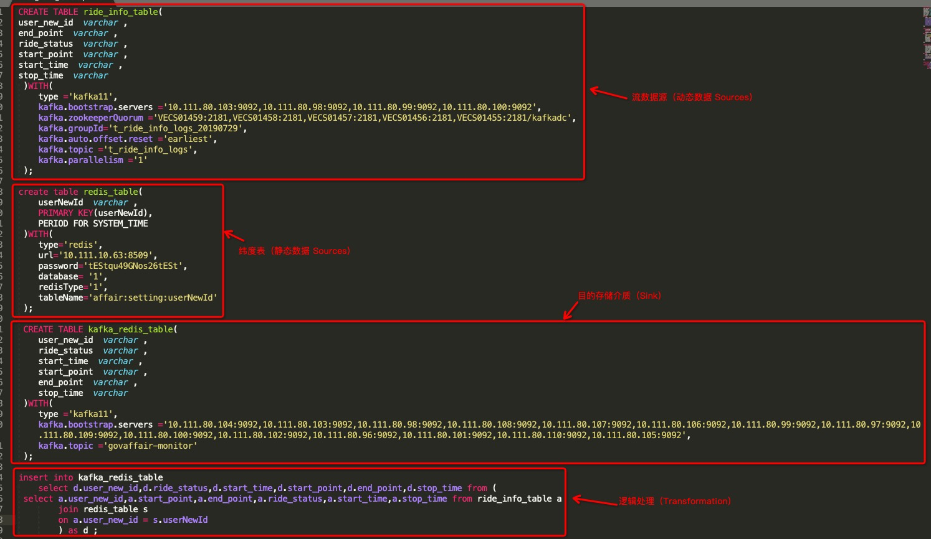
完整示例：kafka join redis write kafka

Slide 7
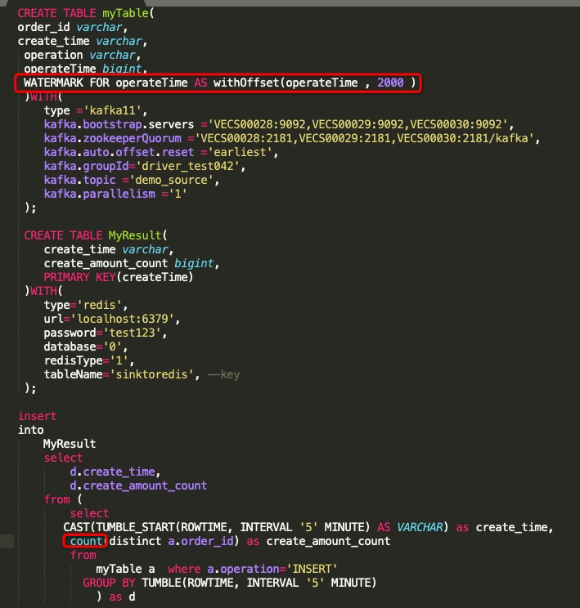
完整示例：数据聚合处理

Slide 8
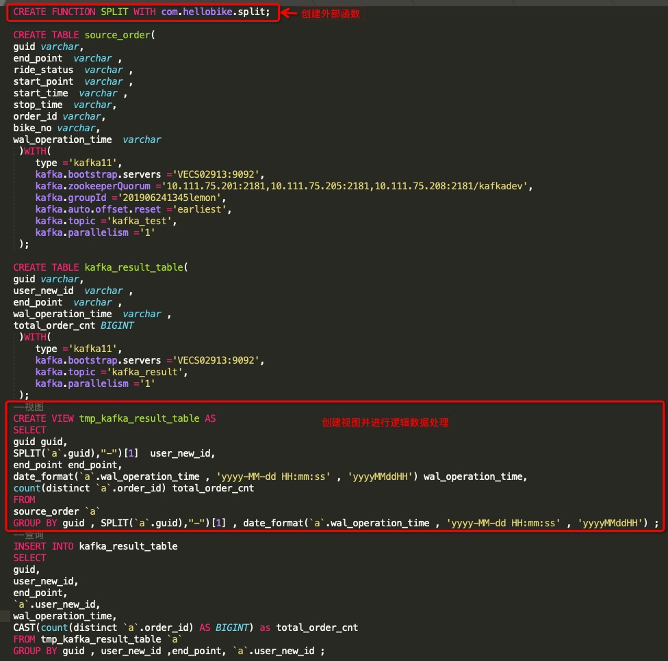
完整示例：自定义函数（UDF）

Slide 9
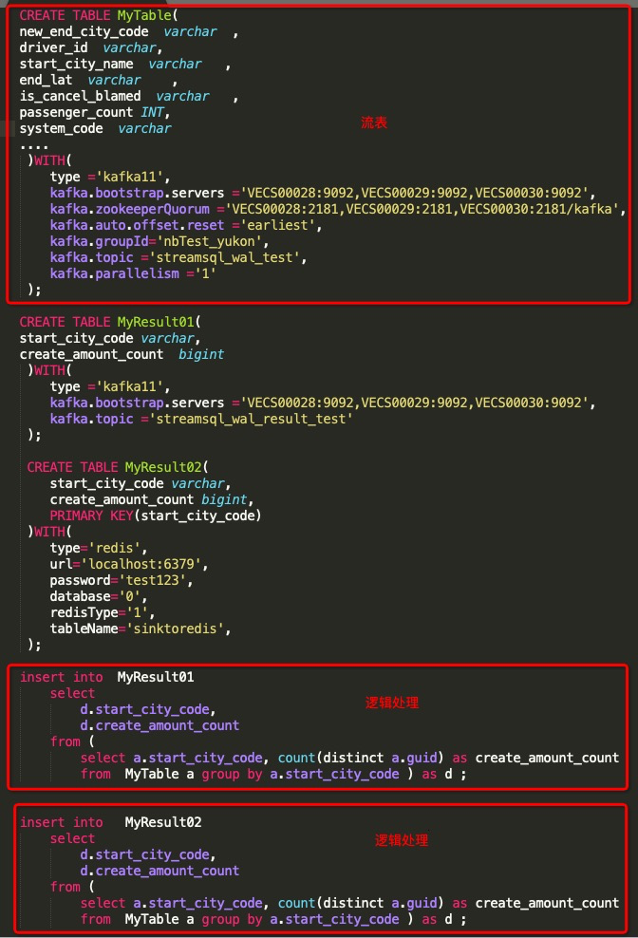
完整示例：临时表共享

Slide 10
