Slide 1
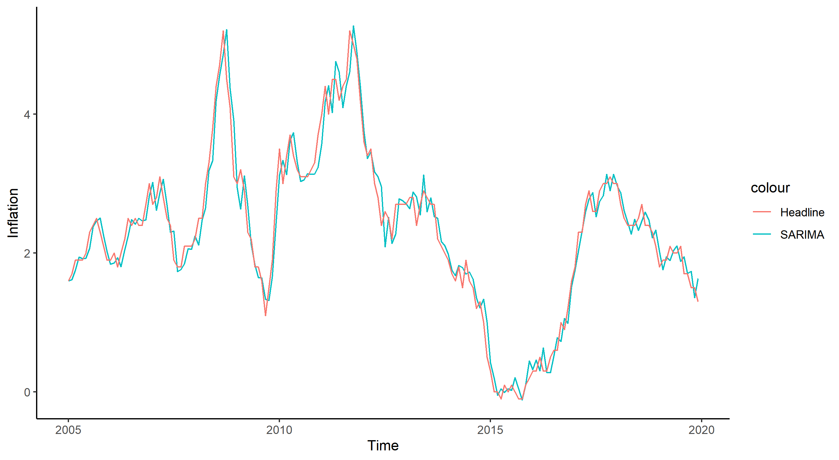

Slide 2
4
colour
Inflation
Headline
SARIMA
2
0
2005
2010
2015
2020
Time

