Slide 1
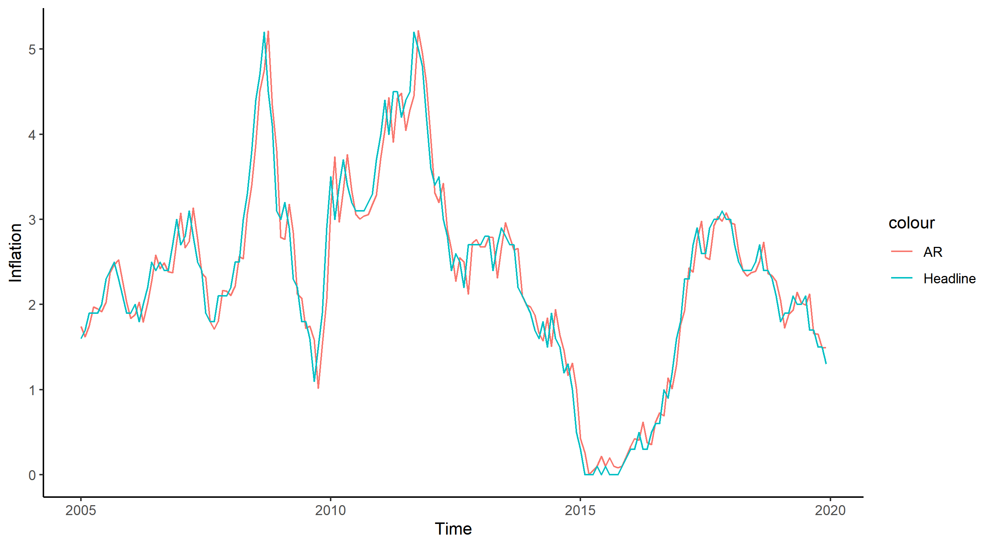

Slide 2
5
4
3
colour
Inflation
AR
Headline
2
1
0
2005
2010
2015
2020
Time

