Slide 1
Title of Project: Resume Analyzer
1

Slide 2
Name of Students: Mr. Padmanabhan Deokar (2020BTEIT00024) Mr. Harshad Jagadale(2020BTEIT00025) Mr. Vaibhav Done(2020BTEIT00028) Under the Guidance of Dr. S. P. Sonavane
2

Slide 3

Agenda:
Problem statement
Features
Objectives
Methodology
Tools and Technologies
References
3

Slide 4

Problem statement:
To provide admin with a dashboard to view the analyzed resumes and the scores assigned to them, allowing them to identify relevant resume for the task.
4

Slide 5
Features:
User’s and Admin section
Resume score
Career recommendations
Resume writing tips suggestions
Courses recommendations
Skills recommendations
Youtube video recommendations
5

Slide 6

Objectives:
To utilize Natural Language Processing (NLP) and ML algorithms to extract relevant skill-based information from the resumes.
To develop a system that can extract relevant skill-based information from student’s soft resumes.
To generate a report based on the user's skills that match the r recruiter’s skillset .
6

Slide 7

Methodology:
Using streamlit python library to develop web application for resume analyser.
Extracting of revelent information from resume using pyresparser(resume parser).
For natural language processing(NLP) operations use spacy and nltk.
Creating mysql databse using pymysql.
Inserting the extracted data into mysql databases.
Calculating score for uploaded resume.
T
7

Slide 8
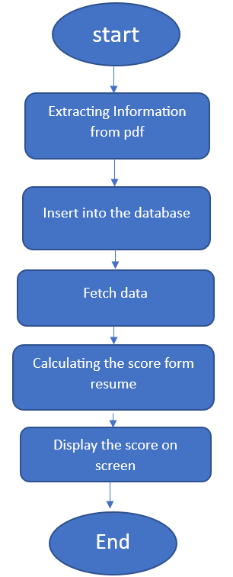
Flow of Application:
8

Slide 9




Tools and Technologies:
9

Slide 10
Reference:
“Resume Screening Using LSTM” International Journal of Research Publication and Reviews, Vol 3, no 4, pp 2567-2569, April 2022
“Resume Analyzer An automated solution to recruitment process .”International Journal of Engineering and Technical Research (IJETR) ISSN: 2321-0869 (O) 2454-4698 (P), Volume-3, Issue-8, August 2015
10

Slide 11
Title of Project: Generating QR code from resume
11

Slide 12
Name of Students: Mr. Padmanabhan Deokar (2020BTEIT00024) Mr. Harshad Jagadale(2020BTEIT00025) Mr. Vaibhav Done(2020BTEIT00028) Under the Guidance of Dr. S. P. Sonavane
12

Slide 13
Agenda:
Problem statement
Objectives
Methodology
Tools and Technologies
References

Slide 14
Problem statement:
To create a program using Python that can generate a QR code from a uploaded google drive link.

Slide 15
Objectives:
To create a web interface for QR code generator.
To create QR code for resume and video links.
To make resume available through internet.

Slide 16
Methodology:
Installing streamlit and other libraries(qrcode,pyqrcode).
Create user interface using streamlit.
Use qrcode library to generate qrcode from inserting gdrive link.
Writing the function to generate and save the QR Code.

Slide 17

Tools and Technologies:

Slide 18
Reference:
K. Kaarthik, T. Manibharathi, D. Rakshith,”QR Code based Shopping System”,IEEE- International Conference on Applied Artificial Intelligence and Computing (ICAAIC) 2022.
R. Dorado, E. Torress, C. Rus, "Mobile learning: Using QR codes to develop teaching material", IEEE - Technologies Applied to Electronics Teaching (TAEE) 2016, Seville, Spain,22-24 June 2016
Sumit Tiwari, Sandeep Sahu, “A Novel Approach for the Detection of OMR Sheet Tampering Using Encrypted QR Code”, IEEE - International Conference on Computational Intelligence And Computing Research (2014), Coimbatore – India, 2014.
Phaisarn Sutheebanjard, Wichian Premchaiswadi, “QR Code Generator”, IEEE 2010 8th International Conference on ICT and Knowledge Engineering (24-25 Nov. 2010).

