Slide 1
Fidelius: A Blockchain and SGX Based Data Collaboration System

Slide 2

Introduction
At present, data is the biggest driving force for the development of information technology.
Data providers want to make a profit by providing data services.
Data analyzers want to improve their technology and competitive power from those valuable data.
Since the data is easy to copy and modify, data holders are reluctant to sell their data to the technical factory manufacturers in case of data stealing and privacy leakage.
There is a gap between the data providers and the data analyzers.
Notes:
Moreover, a lot of data providers, who are subject to a rigorous law restriction on data usability—” Data not out of domain !”, e.g. GDPR, are prevented from making a profit from data collaboration.

Slide 3




Introduction
One typical solution is to find a trusted third party(TTP) C.
Third party C initially assigns the same public key to both the data provider and the data analyzer, C holds the corresponding private key.
The DP encrypts their own data and send the cryptographic text to C.
The DA sends its service fee and analyze program to C.
C decrypts the cryptographic text and execute the analyze program.
C sends the execution result to DB and the service fee to the DP.
encrypted data
TTP
Analyze program

Slide 4
Introduction
There are some flaws in such a design:
• Performance. Sending large encrypted data costs a lot of bandwidth and increase the risk of data leakage .
• Laws. There are laws make strict constrains on data privacy—” Data not out of domain !”, e.g. GDPR.
• Security. It is difficult to find a TTP, and it is a potential weakness of data privacy.
• For two parties who don’t trust each other, it is a challenge to prove verifiability of computing in data collaboration without a TTP.
encrypted data
TTP
Analyze program
Notes:
技术性能上， 现如今大数据时代，数据量动辄百G以上，远程发送进行计算，性能低效。
法律法规上，考虑到数据用户的隐私，法律上做了严格的约束，例如欧洲GDPR严格规定了数据的使用方案，数据不能出域。
在安全性方面，为了实现隐私保护的方案，引入了TTP，并且将加密的数据，尤其是非常重要的数据发送给TTP进行计算。然而针对于一般情况，对于两个不互信任的群体，很难找到一个能让双方共同信任的TTP，而且TTP的行为是否合法是无法检测的，对于重要的数据，引入TTP反而增加了数据隐私泄露的风险。
直接假设TTP存在的方案，在学术上是可行的，但是在现实中是存在风险的，数据合作双方信任的TTP亦有可能在不经意间泄露隐私，我们对于TTP的可信性存疑。
于是，我们需要考虑一种无可信第三方、数据不出域情况下的数据合作解决方案，在这种解决方案下，解决数据计算服务有如下挑战：
数据计算服务的可验证性。
数据隐私，包括数据提供者的数据和计算者的计算结果。
交易最终结算的原子性。
其他法律：GDPR，ISO/IEC 29100《隐私保护 框架》、ISO/IEC 29101《隐私体系架 构》、ISO/IEC 29190《隐私能力评估 模型》、ISO/IEC 29134《隐私影响评 估》、ISO/IEC29151《个人可识别信 息保护指南》。我国于2017年施行的《中华 人民共和国网络安全法》，强调了对 基础设施及个人信息的保护。2018年 实施的《信息安全技术个人信息安全 规范》，从国家标准层面，明确了企 业收集、使用、分享个人信息的合规 要求。2019年发布的《数据安全管理 20 办法》，从数据角度出发，确立数 据分级分类管理以及风险评估，检 测预警和应急处置等数据安全管理 各项基本制度；
参考： http://n0.sinaimg.cn/finance/9b213f90/20200903/YinSiJiSuanBaoGaoGengXinBanBen.pdf
典型的，Facebook在2018年将数据交由第三方Cambridge Analytica进行分析，结果导致5000万用户隐私泄露，数据出域或者交由第三方是非常危险的行为。

Slide 5
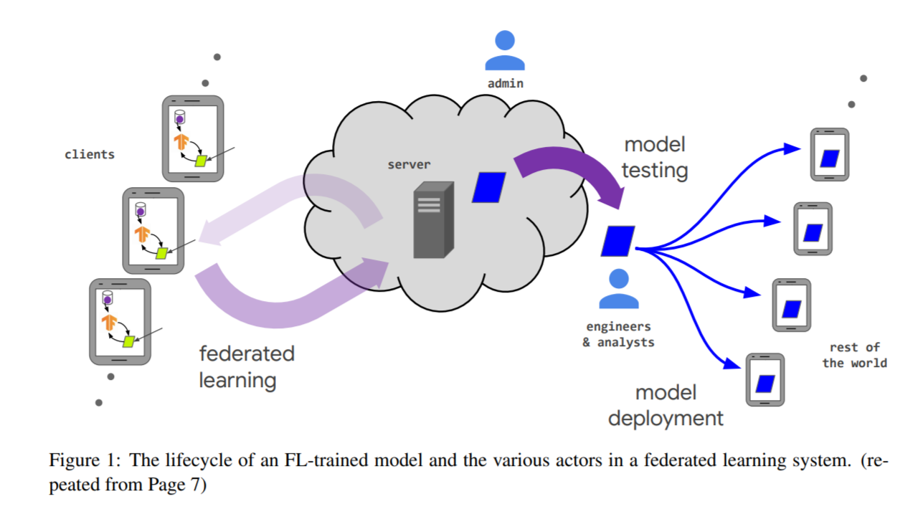
Introduction
Horizonal Federated learning(FL) is a bit like our data collaboration system, there are some differences:
•FL is a typical situation of data collaboration.
•FL mostly focus on training models and rarely concerns about the analyzer, who may be malicious and would steal raw data from the seller.
•FL does not concern service cost settlement for the seller.
•The solution in FL does not support data collaboration between two parties who don’t trust each other.
The current solution in FL is not robust and complete in data collaboration system.
Source:
https://arxiv.org/ftp/arxiv/papers/1911/1911.09824.pdf
Notes:
Reference :
https://arxiv.org/pdf/1812.03224.pdf keyword semi-honest
https://arxiv.org/pdf/1902.04885.pdf keyword semi-honest
https://ieeexplore.ieee.org/stamp/stamp.jsp?tp=&arnumber=9006280 semi-honest
图片链接：https://arxiv.org/ftp/arxiv/papers/1911/1911.09824.pdf
https://users.soe.ucsc.edu/~abadi/Papers/verif.pdf
The most important problem-verifiability, which pertains to the ability of a seller or the analyzer to prove to others in the system that they have executed the desired behavior faithfully, without revealing the potentially private data upon which they were acting.
横向联邦学习是我们数据合作场景下的一个特例，目前对联邦学习的研究，已经提出了一些解决方案，目前这些解决方案做出如下分析：
FL 基于数据不出域的约束下，更多的专注于机器学习模型的训练，在客户端训练完毕之后传输梯度数据。我们数据合作场景更关注一般性的数据计算，包括机器学习、数据查询、测量等操作，比FL更加关注client的隐私。
FL更多是基于clients和server都是semi-honest的场景，对于malicious的关注度不够，而在数据合作场景中，malicious participants是更为普遍的情况。
FL只关注数据计算服务，但是数据合作服务中服务费用结算问题完全不在考虑之中。我们认为，数据合作的重要基础是能够保证诚实的提供服务方能够获取应有的报酬。
基于上述原因，FL中的解决方案不足以支撑一个公平的、健壮的、数据计算可验证、保护双方隐私的解决数据合作过程。

Slide 6
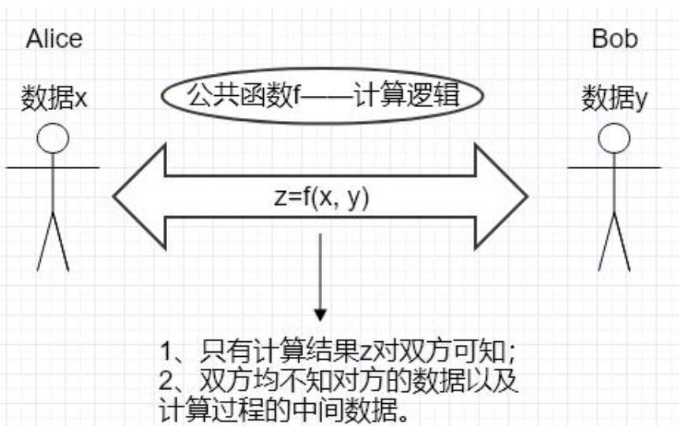
Introduction
Security Multi Party Computing(MPC) is another situation.
In MPC, at least two data providers participate in computation with their own data. In our data collaboration system , there is only one data provider.
The two data providers share the computing results. While our data analyzer do not share results with the data provider.
In MPC, there are no cost settlement system and data analyzers.
Like FL, MPC is mostly focus on semi-honest model instead of malicious model.
There needs a data collaboration system to guarantee fairness, verifiability and user’s privacy under the strict constraints(malicious participants, No TTP).
Source:
https://jugo.juzix.net/apiDocument
Notes:
MPC与我们数据合作场景差别更大一些，但是为了进一步厘清数据合作服务，我们进行简单地介绍。
MPC过程中至少有两个参与计算方，并且双方共享计算结果。
而数据合作服务中仅仅是一个数据计算方、一个数据提供方，结算结果是不共享的。
MPC也不关注合作双方后服务费用结算问题。
针对目前已有的解决方案和相似场景的对比，在当前没有可信第三方的数据合作场景中，需要一个，公平的、可验证的、保证数据计算以及数据提供方数据隐私的数据合作解决方案。
Reference: https://wemp.app/posts/ee2ce555-e6e7-490f-989e-fbdee8defa6c

Slide 7
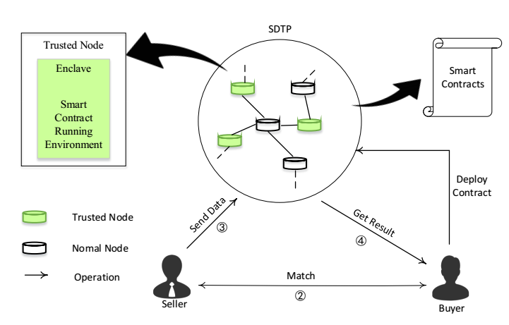
Related Work
There is a data collaboration system. E.g. SDTE.
Our situation is more general than SDTE.
The data goes out of its domain in SDTE.
The SDTE introduces the TTP who may increase the risk of data leakage.
SDTE couldn’t protect the data privacy of the data seller.
SDTE runs analyze program in ETH contract which is low efficient.
As far as we known, there still lacks of a robust, complete and fair data collaboration system.
Source:
Dai W, Dai C, Choo K K R, et al. SDTE: A secure blockchain-based data trading ecosystem[J]. IEEE Transactions on Information Forensics and Security, 2019, 15: 725-737.
Notes:
Reference: https://wemp.app/posts/ee2ce555-e6e7-490f-989e-fbdee8defa6c
SDTE首先提出了一种安全数据交易的环境，该系统只适用于数据可以出域的情况，无法应对更为严苛的数据不出域约束下的数据合作。
SDTE中目前的机制无法有效保护data provoder的数据隐私。在SDTE中，一旦发现Data analyzer输出数据，采用对输出数据收取费用的机制，然而这种机制不能有效保护数据提供方的隐私。
SDTE使用智能合约运行Analyzer的算法，在智能合约中运行算法具有很大的局限性，智能合约不能支持复杂的算法，并且效率低下。

Slide 8
Related Work
Zhao et al. proposed a blockchain-based fair data trading protocol, which integrates ring signature, double-authentication-preventing signature and similarity learning to protect the privacy of data seller. Although the data sellers private information is protected, it cannot prevent the data buyer from reselling the received raw data.
Shen et al proposed a remote data integrity auditing scheme that realizes data sharing with sensitive information hiding. They used a sanitizer to sanitize sensitive information and transform these sensitive information’s signatures into valid ones. This allows one to verify the integrity of the sanitized file. However, the scheme does not prevent the resale of shared data.
Y. Zhao, Y. Yu, Y. Li, G. Han, and X. Du, “Machine learning based privacypreserving fair data trading in big data market,” Information Sciences, vol. 478, pp. 449–460, 2019.
W. Shen, J. Qin, J. Yu, R. Hao, and J. Hu, “Enabling identity-based integrity auditing and data sharing with sensitive information hiding for secure cloud storage,” IEEE Trans. Information Forensics and Security, vol. 14, pp. 331–346, 2019.
Notes:
Reference: https://wemp.app/posts/ee2ce555-e6e7-490f-989e-fbdee8defa6c
SDTE首先提出了一种安全数据交易的环境，该系统只适用于数据可以出域的情况，无法应对更为严苛的数据不出域约束下的数据合作。
SDTE中目前的机制无法有效保护data provoder的数据隐私。在SDTE中，一旦发现Data analyzer输出数据，采用对输出数据收取费用的机制，然而这种机制不能有效保护数据提供方的隐私。
SDTE使用智能合约运行Analyzer的算法，在智能合约中运行算法具有很大的局限性，智能合约不能支持复杂的算法，并且效率低下。

Slide 9
Related Work
Su G et al. propose a novel blockchain-based data trading framework with Trusted Execution Environment (TEE) to provide a trusted decentralized platform for fair data trading.
Taeho Jung et al. Propose a set of accountable protocols for big data trading among dishonest consumers. the authors described how data exchange can perform a rigorous measurement of data uniqueness (i.e., uniqueness index) and detect and punish dishonest behaviors in their approach.
Su G, Yang W, Luo Z, et al. BDTF: A Blockchain-Based Data Trading Framework with Trusted Execution Environment[J]. arXiv preprint arXiv:2007.06813, 2020.
Jung, Taeho, et al. "Accounttrade: Accountable protocols for big data trading against dishonest consumers." IEEE INFOCOM 2017-IEEE Conference on Computer Communications. IEEE, 2017.

Slide 10
Related Work
Rosetta:矩阵元推出的面向广大AI开发者的隐私机器学习开源框架。
MesaTEE : 百度推出的基于可信 执行环境的通用计算架构，其宣城采用了混合内存安全技术、密文计算基数，以及可信计算技术(TPM)。
Asylo：Google基于Intel SGX推出的开源安全应用开发框架，可以使开发人员能够方便的使用TEE技术实现密文计算，并且支持企业内部到云端的部署。
ANT MORSE:蚂蚁金服结合区块林和安全计算技术推出的数据安全共享基础设施，其目标是为解决企业之间数据合作过程总的数据安全和隐私保护问题。但其计算结果的正确性和机密性难以有效的保证。
FATE:微众银行推出的基于联邦学习的工业级开源机器学习框架。FATE实现了基于同态加密和安全多方计算的安全计算协议，并支持联邦学习架构与各种机器学习算法的安全计算。
Notes:
相关参考：
http://n0.sinaimg.cn/finance/9b213f90/20200903/YinSiJiSuanBaoGaoGengXinBanBen.pdf

Slide 11
Summary
无论是学术界的模型，抑或是工业界成熟的商业产品，存在如下不足：
对于可信第三方的过度依赖，实际上可信第三方的行为是难以检测的，重要的隐私数据，交由第三方进行处理是不可靠的，也增加了数据泄露的风险。目前随着法律法规越来越严苛的要求，使用可信第三方的方案不能满足要求。
目前已有的数据交易解决方案无法适用于通用的数据合作交易系统，难以有效保护用户的隐私。
没有可行第三方情况下数据的可验证计算是一个巨大的挑战。
目前的方案都或多或少在计算可验证性、用户隐私可保护性、通用性方面存在不足，仍然不能满足具有严苛的数据使用规范场景下的数据合作需求，目前仍然缺乏一个可行的数据合作框架。
Notes:
相关参考：
http://n0.sinaimg.cn/finance/9b213f90/20200903/YinSiJiSuanBaoGaoGengXinBanBen.pdf

Slide 12


The System Property of a Data Collaboration system
seller
Settlement system
analyzer
The Data Analyzer
• Should pay for data provider’s services.
• Get correct execution results.
• The execution results can not be known by others.
The Data Provider
• The raw data can not be steal during the service.
• Should get payment for its service.
The Execution Environment
• Correctly execute analyze program.
• Degrade running performance as gracefully as possible.
• Do not leak data provider’s raw data.
The Settlement System
• Being able to validate the running result from execution environment.
• Finish the trading as a single "unit", which either succeeds completely, or fails completely.
• We advocate a robust and complete data collaboration system to guarantee fairness, verifiability and user’s privacy without a TTP.
data
Analyze program
Execute environment
Notes:
无论是学术界的模型，抑或是工业界成熟的商业产品，都或多或少在计算可验证性、用户隐私可保护性、通用性方面存在不足，仍然不能满足具有严苛的数据使用规范场景下的数据合作需求，目前仍然缺乏一个可行的数据合作框架。
我们对于一个合格的数据合作解决方案提出如下要求：balabala…

Slide 13
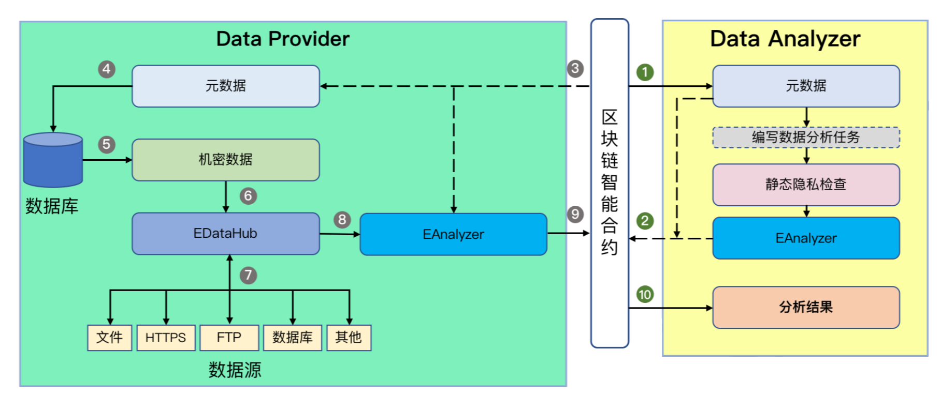
The Architecture of Fidelius

Slide 14
Roles in the Fidelius
The Data Seller
• The only owner of raw data.
• Define data privacy protection rules.
The Data Analyzer
• The one requires execution results of the analysis program whose input is the designated raw data.
The Blockchain
• Works as a trusted and no-failure third party for data transmission and storage.
• Whose smart contract verifies the correctness of the signature of analysis result.
• Mediates the payment of data collaboration.
The Fidelius admin (FA)
• Works as a trusted party used in setup process.

Slide 15
Trust Model of Fidelius
The TEE
• The enclave behaves honestly. (Correctly execute)
• For an Enclave-generated key pair, the private key is known only to the Enclave.
• The code in an enclave can not be altered, and the values of inside variables are inaccessible.
The Blockchain
• The contract to pair data provider and data analyzer is opensource.
• The contract behaves honestly.
The Fidelius Admin
• Works as a trusted party used in the setup process.
• FA’s job is to install open-source enclaves for a new user and authorize public keys.

Slide 16
Threat Model of Fidelius
The Data Seller
• Write malicious algorithms to steal raw data.
• Deny paying to data provider’s honest service.
The Data Analyzer
• Provides fake data that conflicts with the data it claims.
• Breaks, tampers, or steals the data provider’s algorithm or execution results.
The Contract
• Detains the asset of the data provider.
• Colludes with a data provider to fraud.
• Colludes with a data analyzer to steal data.

Slide 17
Contributions of Fidelius
We first propose the indispensable properties which a data collaboration system without third party should satisfy.
We implement a standard data collaboration system, which provides a new method for realizing data transmission between cross-platform enclaves.
The privacy protection covering the whole life cycle of data cooperation.
The calculation process is trustworthy and the execution results can be verified.

Slide 18
Data Collaboration Process of Fidelius
• DP register data
• DP creates meta data(A description of raw data) and publish it on the blockchain.
• Defines privacy protection rules.
• DA publish task
• Write data analyze program.
• Static privacy check.
• Send analyze program to blockchain.
• Fidelius Trust Execution Environment
• Loads analyze program from blockchain.
• Static privacy check.
• Loads raw data.
• Executes analyze program.
• Encrypts execution results and send them to blockchain.
• Fidelius Trust Execution Environment
• Smart contract validate results.
• DP gets results from blockchain and decrypts them.

Slide 19
Data Collaboration Process
DA writes the analysis_enclave and send it to oenclave_sign to get its signature.
DA packs analysis_enclave, H(analysis_enclave), the signature, pkRSA, and the license together as installation package and sent it to blockchain.
DA runs oenclave_a to send encp_ska to blockchain.
DP receives analysis_enclave and locally deploys it.
DP receives encp_ska and sends to oenclave_p.
DP runs analysis_enclave and oenclave_p to get analysis_result and signresult, and sends them to blockchain.
Verification contract verifies outputs by DP and completes data collaboration as in section 3.
Notes:
oenclave_a, the open-source enclave that generated the private key to be sent, deployed on DA’s platform.
oenclave_p, the open-source enclave that temporarily receives the private key, deployed on DP’s platform.
analysis_enclave, the enclave that finally receives the private key (for signing analysis result in data collaboration). We assume that enclave_analysis does not reveal the value of the private key (It is guaranteed by Fidelius’ static analysis. See next section).
skp, ska, the secret keys generate by oenclave_p, oenclave_a respectively. In setup process, they are generated by calling sgx_ecc256_create_key_pair(), and sealed locally. In the following we simply write the code “unseal” when they are used, moreover, ska is the private key to be sent.
pkp, pka, the public keys generate by oenclave_p, oenclave_a respectively, where they and their authorization are on blockchain.

Slide 20
Reference
https://www.secrss.com/articles/12695
https://www.chainnews.com/articles/630595638868.htm
https://www.zhihu.com/question/329518273/answer/717840293
https://developer.aliyun.com/article/714993
https://cloud.tencent.com/developer/news/581902
http://n0.sinaimg.cn/finance/9b213f90/20200903/YinSiJiSuanBaoGaoGengXinBanBen.pdf

Slide 21
Blanks--------------------Ending

Slide 22
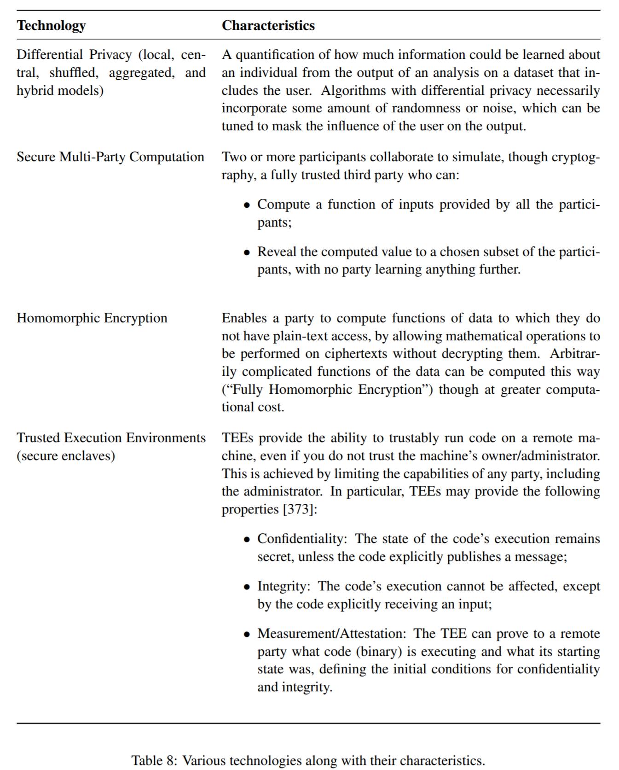
Technology in privacy

Slide 23
Introduction
A typical solution is to find a TTP that obtains data from the data provider and receives an analysis program and service fee from the data analyzer.
The analyze program to read data provider’s data as input and execute in the trusted environment.
After that, the TTP sends encrypted analysis results to the data analyzer and service fee to the data provider.
Researchers combine the blockchain with trusted hardware such as SGX to finish that data collaboration.
The TTP would be a blockchain.
The smart-contract in blockchain keeps atomicity and fairness of the transaction.
The TEE in EVM keeps the integrity and confidentiality.

Slide 24
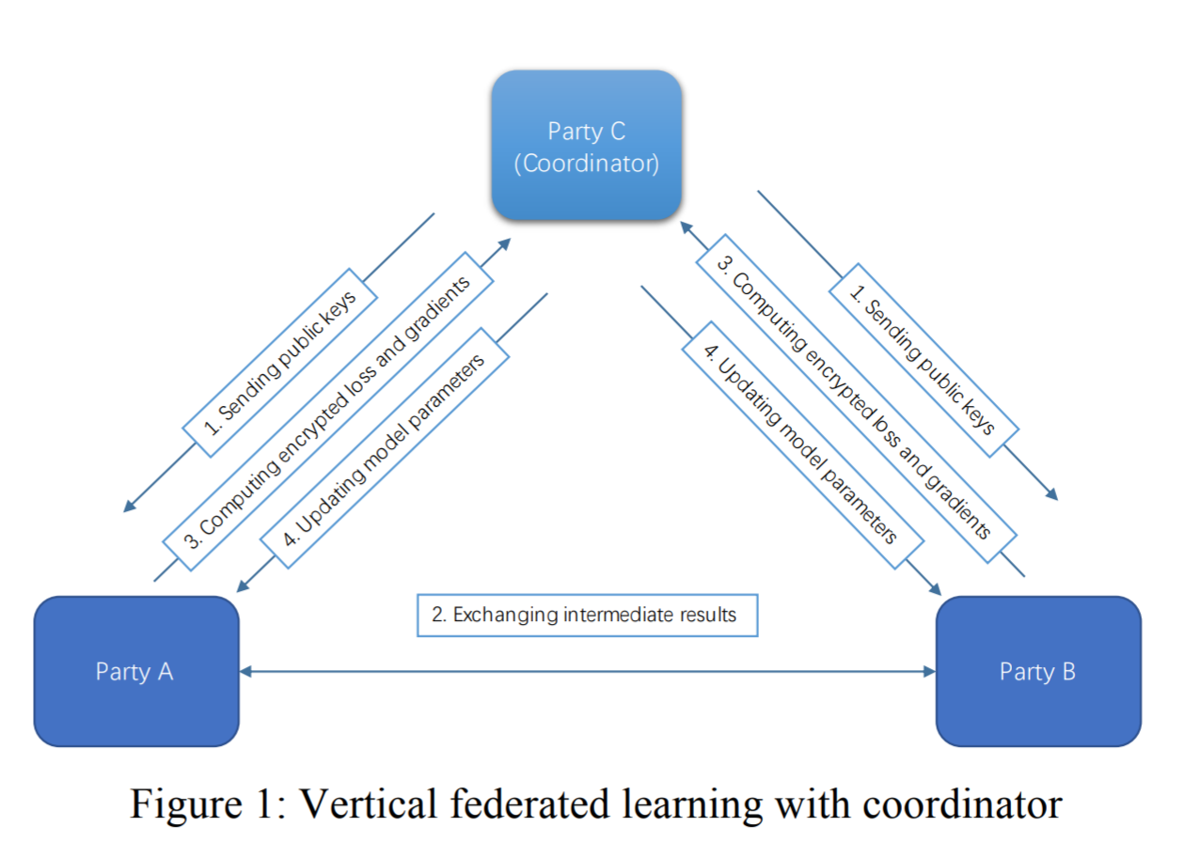
Introduction
In federated learning, there is always a semi-honest TTP, which is called coordinator.
In security multiparty computing, a Semi-honest Third Party (STP) is always introduced, in which case it is assumed that STP does not collude with either party.
Notes:
Reference :
https://arxiv.org/pdf/1812.03224.pdf keyword semi-honest
https://arxiv.org/pdf/1902.04885.pdf keyword semi-honest
https://ieeexplore.ieee.org/stamp/stamp.jsp?tp=&arnumber=9006280 semi-honest
图片链接：https://arxiv.org/ftp/arxiv/papers/1911/1911.09824.pdf

Slide 25
Introduction
In federated learning, there is always a semi-honest TTP, which is called coordinator.
It is difficult to find an authoritative third-party coordinator that can be trusted by all participants, and the existence of coordinator raises a risk of data leakage.
In most cases, the FL is based on the assumption that the participants are semi-honest.
While in our situation, the TTP and the participants can be malicious.
There is the problem of verifiability, which pertains to the ability of a client or the server to prove to others in the system that they have executed the desired behavior faithfully, without revealing the potentially private data upon which they were acting.
The situation of FL is similar with our data collaboration system, but its assumption is not robust and complete.
On the assumption of malicious participants, there is not a robust system to support fairness of trading, verifiability of computing and the privacy of users.
Notes:
Reference :
https://arxiv.org/pdf/1812.03224.pdf keyword semi-honest
https://arxiv.org/pdf/1902.04885.pdf keyword semi-honest
https://ieeexplore.ieee.org/stamp/stamp.jsp?tp=&arnumber=9006280 semi-honest
图片链接：https://arxiv.org/ftp/arxiv/papers/1911/1911.09824.pdf
https://users.soe.ucsc.edu/~abadi/Papers/verif.pdf

Slide 26
Introduction
The biggest challenge being that to guarantee the analyzer’s programs are faithfully executed with the data provider’s real data as input.
To address the concern, the data collaboration system should prove the following properties:
1. The input data of the analyzer program is consistent with the data claimed by the data provider.
2. The analyzer program itself is not tampered with.
3. The execution results are not tampered with.
4. The execution results are only known to the data provider.
5. The execution environment is safe enough to defend against attacks.
This situation is similar to federated learning(FL).

Slide 27
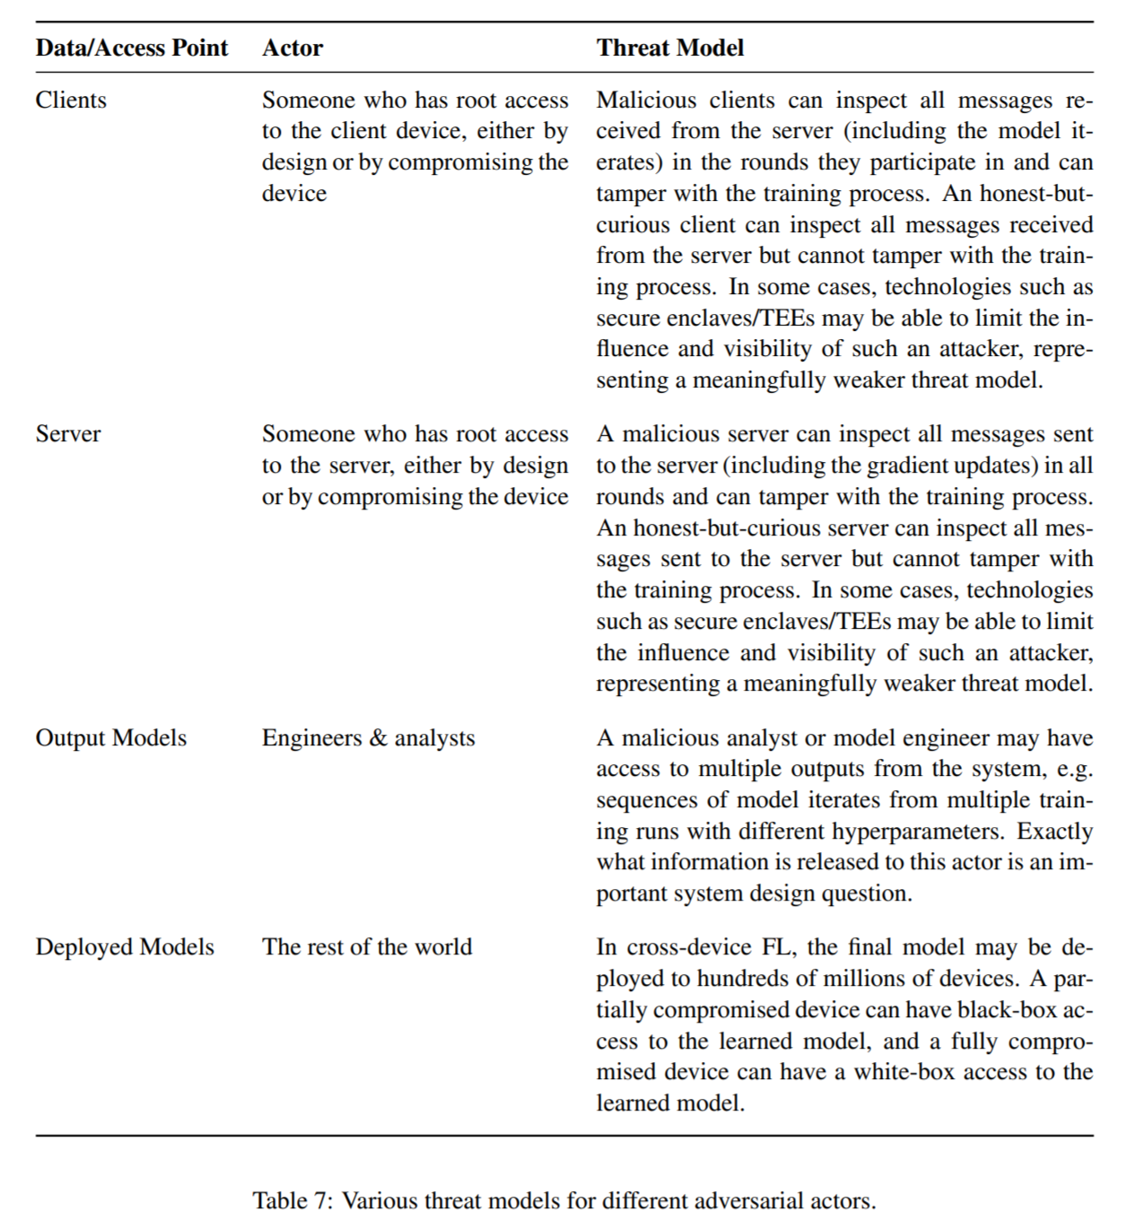
Roles && Threat Model in Federated Learning
Do not concern
The verification of process and results..
The settlement of the data trading.
Notes:
本文环境中用户出售数据服务之前，需要对数据摘要进行声明，本文的计算过程保证整个计算过程中输入数据和用户的声明完全一致。联邦学习的场景中因为没有用户对数据的声明这一项内容，因此训练过程中如果训练数据被修改是难以察觉的事情。
本文中的TEE执行环境，可以保证联邦学习场景中计算的机密性和完整性，这一特性很大程度上可以杜绝联邦学习过程中的攻击模型。
联邦学习场景没有处理数据服务双方交易结束后的结算过程，本文的数据合作过程作为一个完整的商业模式，将费用结算过程考虑在内。
联邦学习中存在一个服务器以及模型分析人员等用于对所有的训练模型进行整合和测试，这些作为第三方平台，有可能被adversary控制而做出不当行为，然而这些内容已经超出了本文数据交易的讨论范畴，因此这些攻击模型不在本文考虑的范围内。

Slide 28
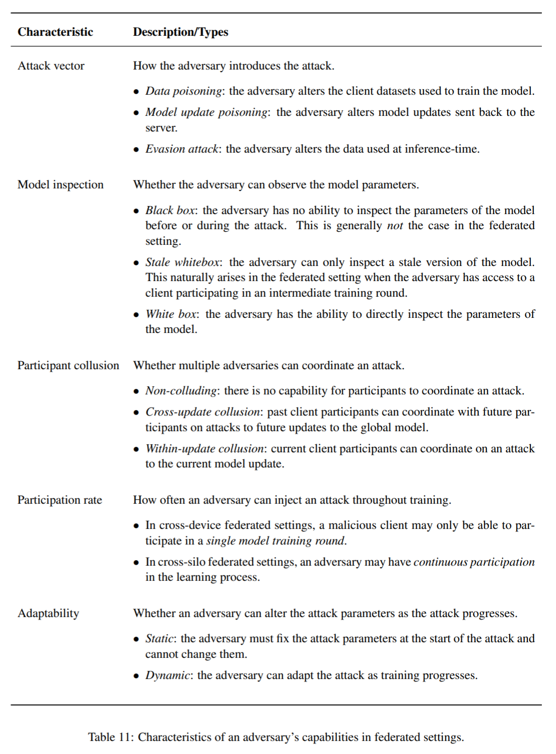
Threat Model In Federated Learning
FL attaches cares more about the security of ML models during the whole training process.
FL does not concern about the settlement of data collaboration.
FL does not care about the analysis program may steal the data of the provider.
FL does not care about the correctness and verifiability of execution result.
We propose the properties that a fair data collaboration system should satisfy.
Notes:
https://arxiv.org/pdf/1912.04977.pdf
page 62.

