Slide 1
Topic: Brain tumor MRI image 44 classes
Instructor: Dr. Raihan Ul Islam
cse 366: Artificial Intelligence
Associate professor – East West university
Group: 7
Section:1
Tamim Rafi Ahmed
Mahadi Haaan
2021-3-60-089
2021-3-60-270
Md. Sakib husen
Md Moynul Haque Tuhin
2022-1-60-274
2021-1-60-062

Slide 2
Research Context
Introduction
Clinical Challenge
Target Classification
Brain tumor classification is critical for medical diagnosis and treatment planning. Manual analysis by radiologists is time-consuming and susceptible to human error, creating urgent need for automated systems.
44 granular subclasses mapped to three primary diagnostic categories for multi-class classification:
0
Glioma
Objective: Develop robust deep learning system capable of differentiating between complex tumor types from MRI scans
Astrocitoma, Glioblastoma, Oligodendroglioma, etc.
1
Meningioma
Meningioma variants across MRI sequences
Dataset Complexity
The "brain-tumor-mri-images-44c" dataset contains 4,479 images across 44 highly granular clinical subclasses with various MRI contrast sequences.
2
Pituitary
Pituitary adenoma and related tumors
44
3
3
Subclasses
MRI Types
Parent Categories
Research Contribution
This study establishes a fundamental performance baseline using a Custom CNN, enabling future comparative analyses against pre-trained architectures to measure exact performance gains from transfer learning.

Slide 3
Theoretical Foundation
Related Work & Literature Review
Deep Residual Networks
Lightweight Architectures
Optimized Scaling
ResNet50 introduced "skip connections" (residual blocks) allowing gradients to bypass certain layers, enabling training of substantially deeper networks (50+ layers).
MobileNetV3 utilizes depthwise separable convolutions, drastically reducing parameter count and memory requirements while maintaining diagnostic accuracy.
EfficientNetV2 uses compound scaling balancing network depth, width, and resolution with Fused-MBConv layers for state-of-the-art accuracy.
Key Innovation:
Key Innovation:
Key Innovation:
Mitigates vanishing gradient problem for complex MRI contrast interpretation
Optimized for resource-constrained clinical and mobile deployment
Systematic optimization for high-resolution medical scan processing
Reference: He et al. (2016), CVPR
Reference: Howard et al. (2019), ICCV
Reference: Tan & Le (2021), ICML
Foundational Literature
Litjens et al. (2017) and Shen, Wu, and Suk (2017) demonstrated CNNs excel at learning spatial features from MRI. Ronneberger et al. (2015) introduced U-Net for biomedical segmentation. Deepak and Ameer (2019) showed pre-trained models yield high accuracy for brain tumor classification. Khan et al. (2024) proved custom CNNs can be competitive alternatives to massive pre-trained models.

Slide 4
Experimental Design
Methodology: Dataset & Preprocessing
Dataset Composition
Total MRI Scans
4,479
Granular Subclasses
44
Parent Categories
3
MRI Contrast Types
T1, T1C+, T2
Splitting overview
PyTorch Models (Custom CNN, ResNet50, EfficientNetV2,MobilenetV3,Attentionnet)
70%
15%
15%
Training
Validation
Testing
5-Fold Stratified K-Fold (applied only within the 70% training set)
Stratified splitting maintains class distributions

Slide 5
Model Implementation
CNN Architectures: Four Strategic Approaches
Custom CNN Baseline
ResNet50
Built from Scratch
Transfer Learning
Sequential network with 2D Convolutional layers for feature extraction and MaxPooling layers for spatial downsampling.
Deep network with residual blocks and skip connections mitigating vanishing gradients across 50 layers for complex abstract features.
Architecture Details:
Architecture Details:
Sequential convolutional blocks
50-layer deep architecture
ReLU activation functions
Skip connections (residual blocks)
Batch normalization layers
Pre-trained on ImageNet
Dropout (0.5) for regularization
Frozen base + custom classification head
Low
Multi-Class
High
Multi-Class
Computational Load
Target Task
Computational Load
Target Task
MobileNetV3-Large
EfficientNetV2-S
Lightweight Deployment
State-of-the-Art
Utilizes depthwise separable convolutions with Global Average Pooling, Dense layer (256 nodes, ReLU), and Dropout (0.3).
Uses compound scaling and Fused-MBConv layers optimizing training speed and parameter efficiency for high-resolution data.
Architecture Details:
Architecture Details:
Depthwise separable convolutions
Compound scaling method
Global Average Pooling layer
Fused-MBConv layers
Dense layer (256 nodes, ReLU)
Class-weighted loss function
Optimized for mobile deployment
Optimized training speed
Very Low
Binary
Medium-High
Multi-Class
Computational Load
Target Task
Computational Load
Target Task

Slide 6
Comparative Analysis
Results: Architectural Performance Comparison
Performance Summary Table
Architecture | Paradigm | Target Task | Notable Features | Computational Load
Custom CNN | Built-from-scratch | Multi-Class | Foundational baseline; Task 5.2 Generalization | Low
ResNet50 | Transfer Learning | Multi-Class | Residual blocks; High abstract feature extraction | High
MobileNetV3 | Transfer Learning | Binary Screening | Depthwise separable conv; High ROC-AUC | Very Low
EfficientNetV2 | Transfer Learning | Multi-Class / Granular | Compound scaling; Fused-MBConv; Class-weighted | Medium-High
Key Finding 1
Key Finding 2
Key Finding 3
Key Finding 1
Custom CNN provides competitive baseline with remarkably low computational requirements, making it suitable for rapid prototyping and resource-limited environments.
ResNet50 excels at abstract feature extraction but requires substantial computational resources, trading efficiency for superior performance on complex patterns.
MobileNetV3 achieves optimal efficiency with very low computational overhead, making it ideal for real-time clinical screening and mobile deployment scenarios.
Key Finding 4
+3.86% accuracy gain over CustomCNN on the held-out test set (0.7932 → 0.8318). Recall improved most (+6.54%), meaning the model misses fewer tumor cases — critical in medical imaging. CBAM gave the largest gains on visually ambiguous classes like Astrocitoma T2 (F1: 0.58 → 0.74). The computational load is still Low-Medium.
AttentionCNN

Slide 7
Custom CNN Methodology
Data Preparation
44-class Brain Tumor MRI dataset split 70/15/15 via stratified sampling
Augmentation
Training: flip, rotation ±15°, color jitter | Val/Test: resize + normalize only
Architecture
5 Conv blocks (3→32→64→128→256→512) each with BN → ReLU → MaxPool
Global Average Pooling
Replaces flatten to reduce overfitting and make model resolution-agnostic
Classification Head
Dropout(0.5) → FC(512→256) → ReLU → Dropout(0.4) → FC(256→44)
Optimizer & Scheduler
Adam (lr=1e-3, wd=1e-4) with ReduceLROnPlateau (factor=0.5, patience=3)
Early Stopping
Patience of 5 epochs, activates after epoch 5, restores best weights
Cross-Validation
5-fold stratified K-fold on training split; test set never touched
Evaluation Metrics
Accuracy, Macro Precision/Recall/F1, Confusion Matrix, ROC-AUC (OvR)
Statistical Testing
Paired t-test vs MobileNetV3, ResNet50, EfficientNetV2 (p < 0.05 threshold)

Slide 8
Attention-Enhanced CNN (CBAM) Methodology
Base Architecture
Built on Task 3 CustomCNN; CBAM attention module inserted after every Conv block
Channel Attention
AvgPool + MaxPool fed through shared MLP, summed and gated with Sigmoid to weight channels
Spatial Attention
Channel-wise AvgPool & MaxPool concatenated, passed through 7×7 Conv + Sigmoid to weight locations
CBAM Flow
x → Channel Attention → x' → Spatial Attention → x'' (both applied multiplicatively)
Reduction Ratios
Ratio scaled by block depth: 4 (Block 1), 8 (Block 2), 16 (Blocks 3–5)
Training Setup
Adam (lr=1e-3), ReduceLROnPlateau, Early Stopping (patience=5, min epoch=5)
Max Epochs
Extended to 60 epochs (vs 50 in Task 3) to allow attention layers more time to converge
Cross-Validation
Same 5-fold stratified K-fold on 70% training split; held-out 15% test untouched
Evaluation
Accuracy, Macro Precision/Recall/F1, ROC-AUC + confusion matrix diff vs Task 3
Statistical Testing
Paired t-test between AttentionCNN and CustomCNN fold scores (p < 0.05 threshold)

Slide 9
Comparative Analysis
Results: Architectural Performance Comparison
Model | MobileNetV3 | ResNet50 | EfficientNetV2 | CustomCNN | AttentionCNN
Accuracy | 0.8175 | 0.8715 | 0.8715 | 0.7932 | 0.8318

Slide 10
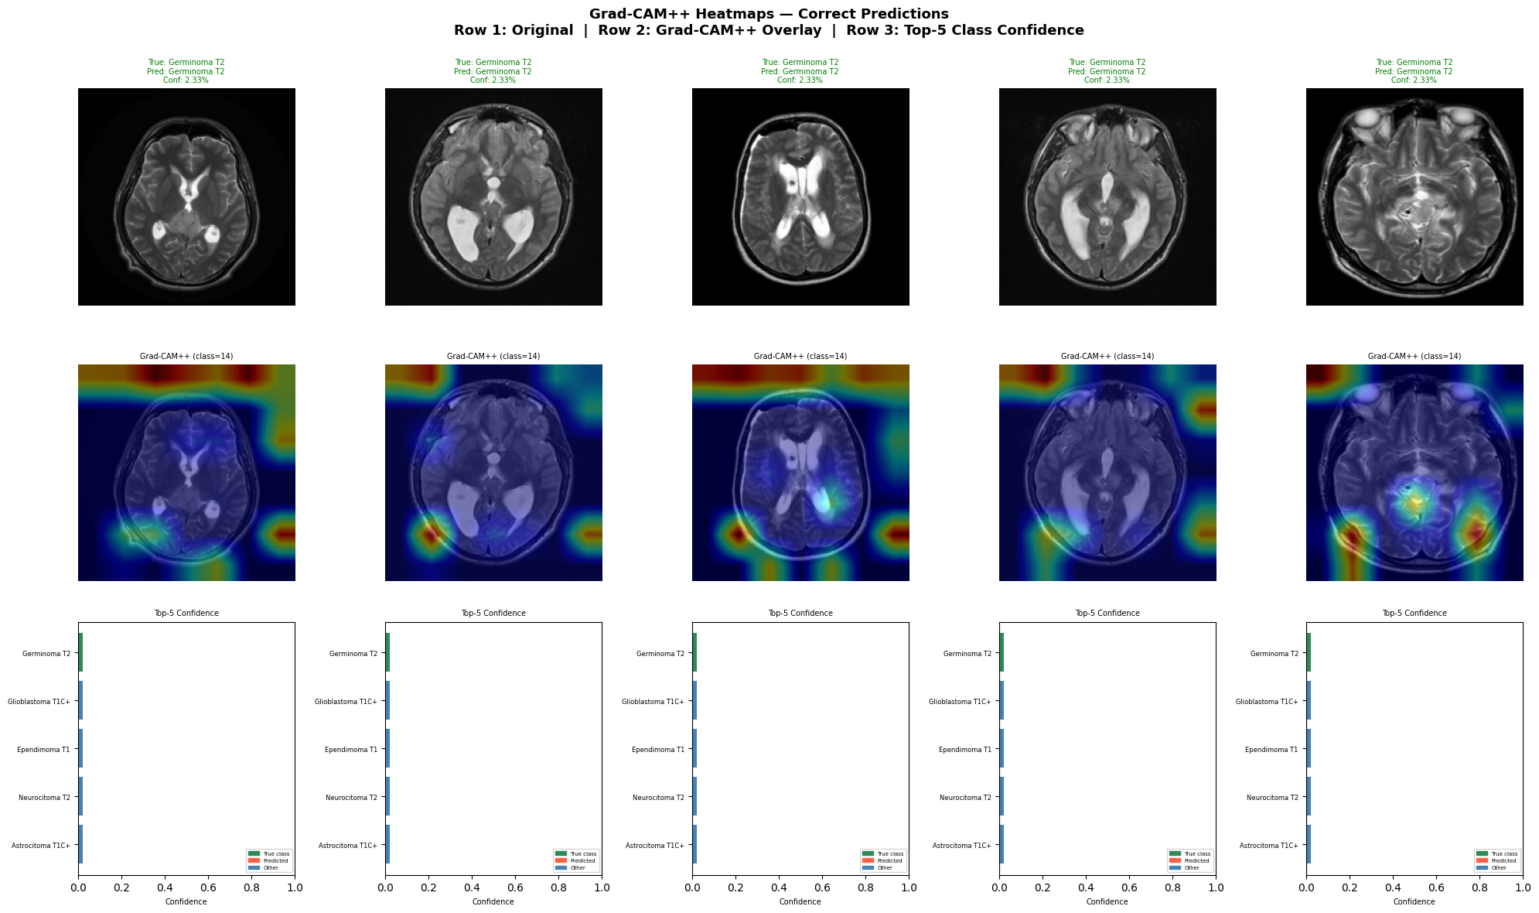
Gradcam++ prediction

Slide 11
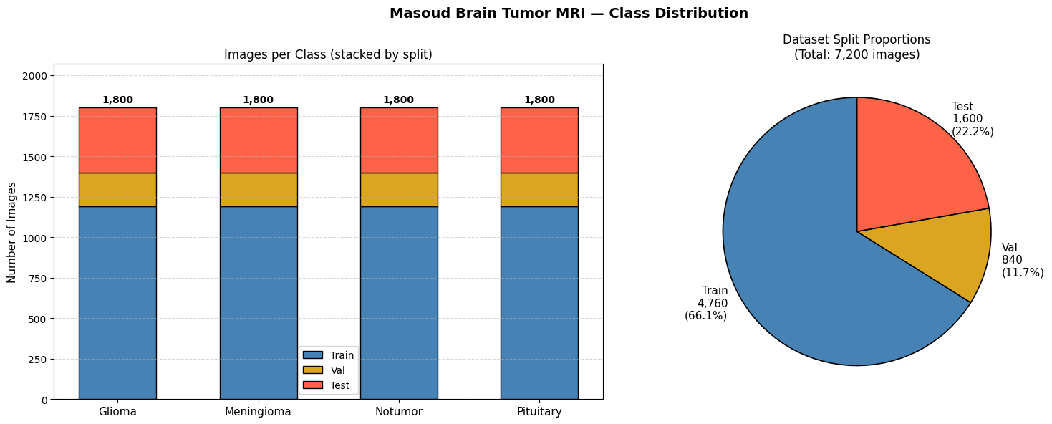
Second dataset overview

Slide 12
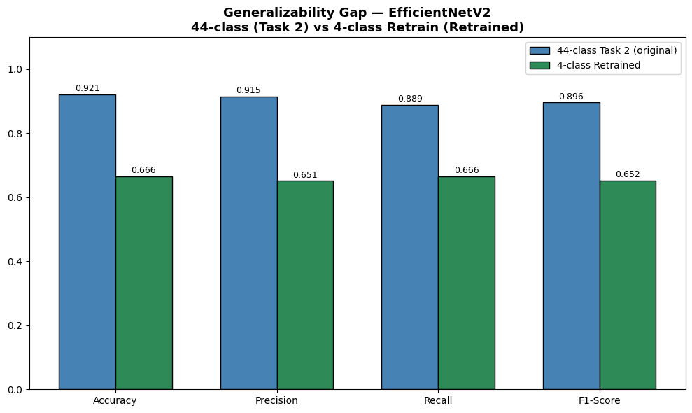
Generablity comparisons
Results: Confusion Matrices & Analysis

Slide 13
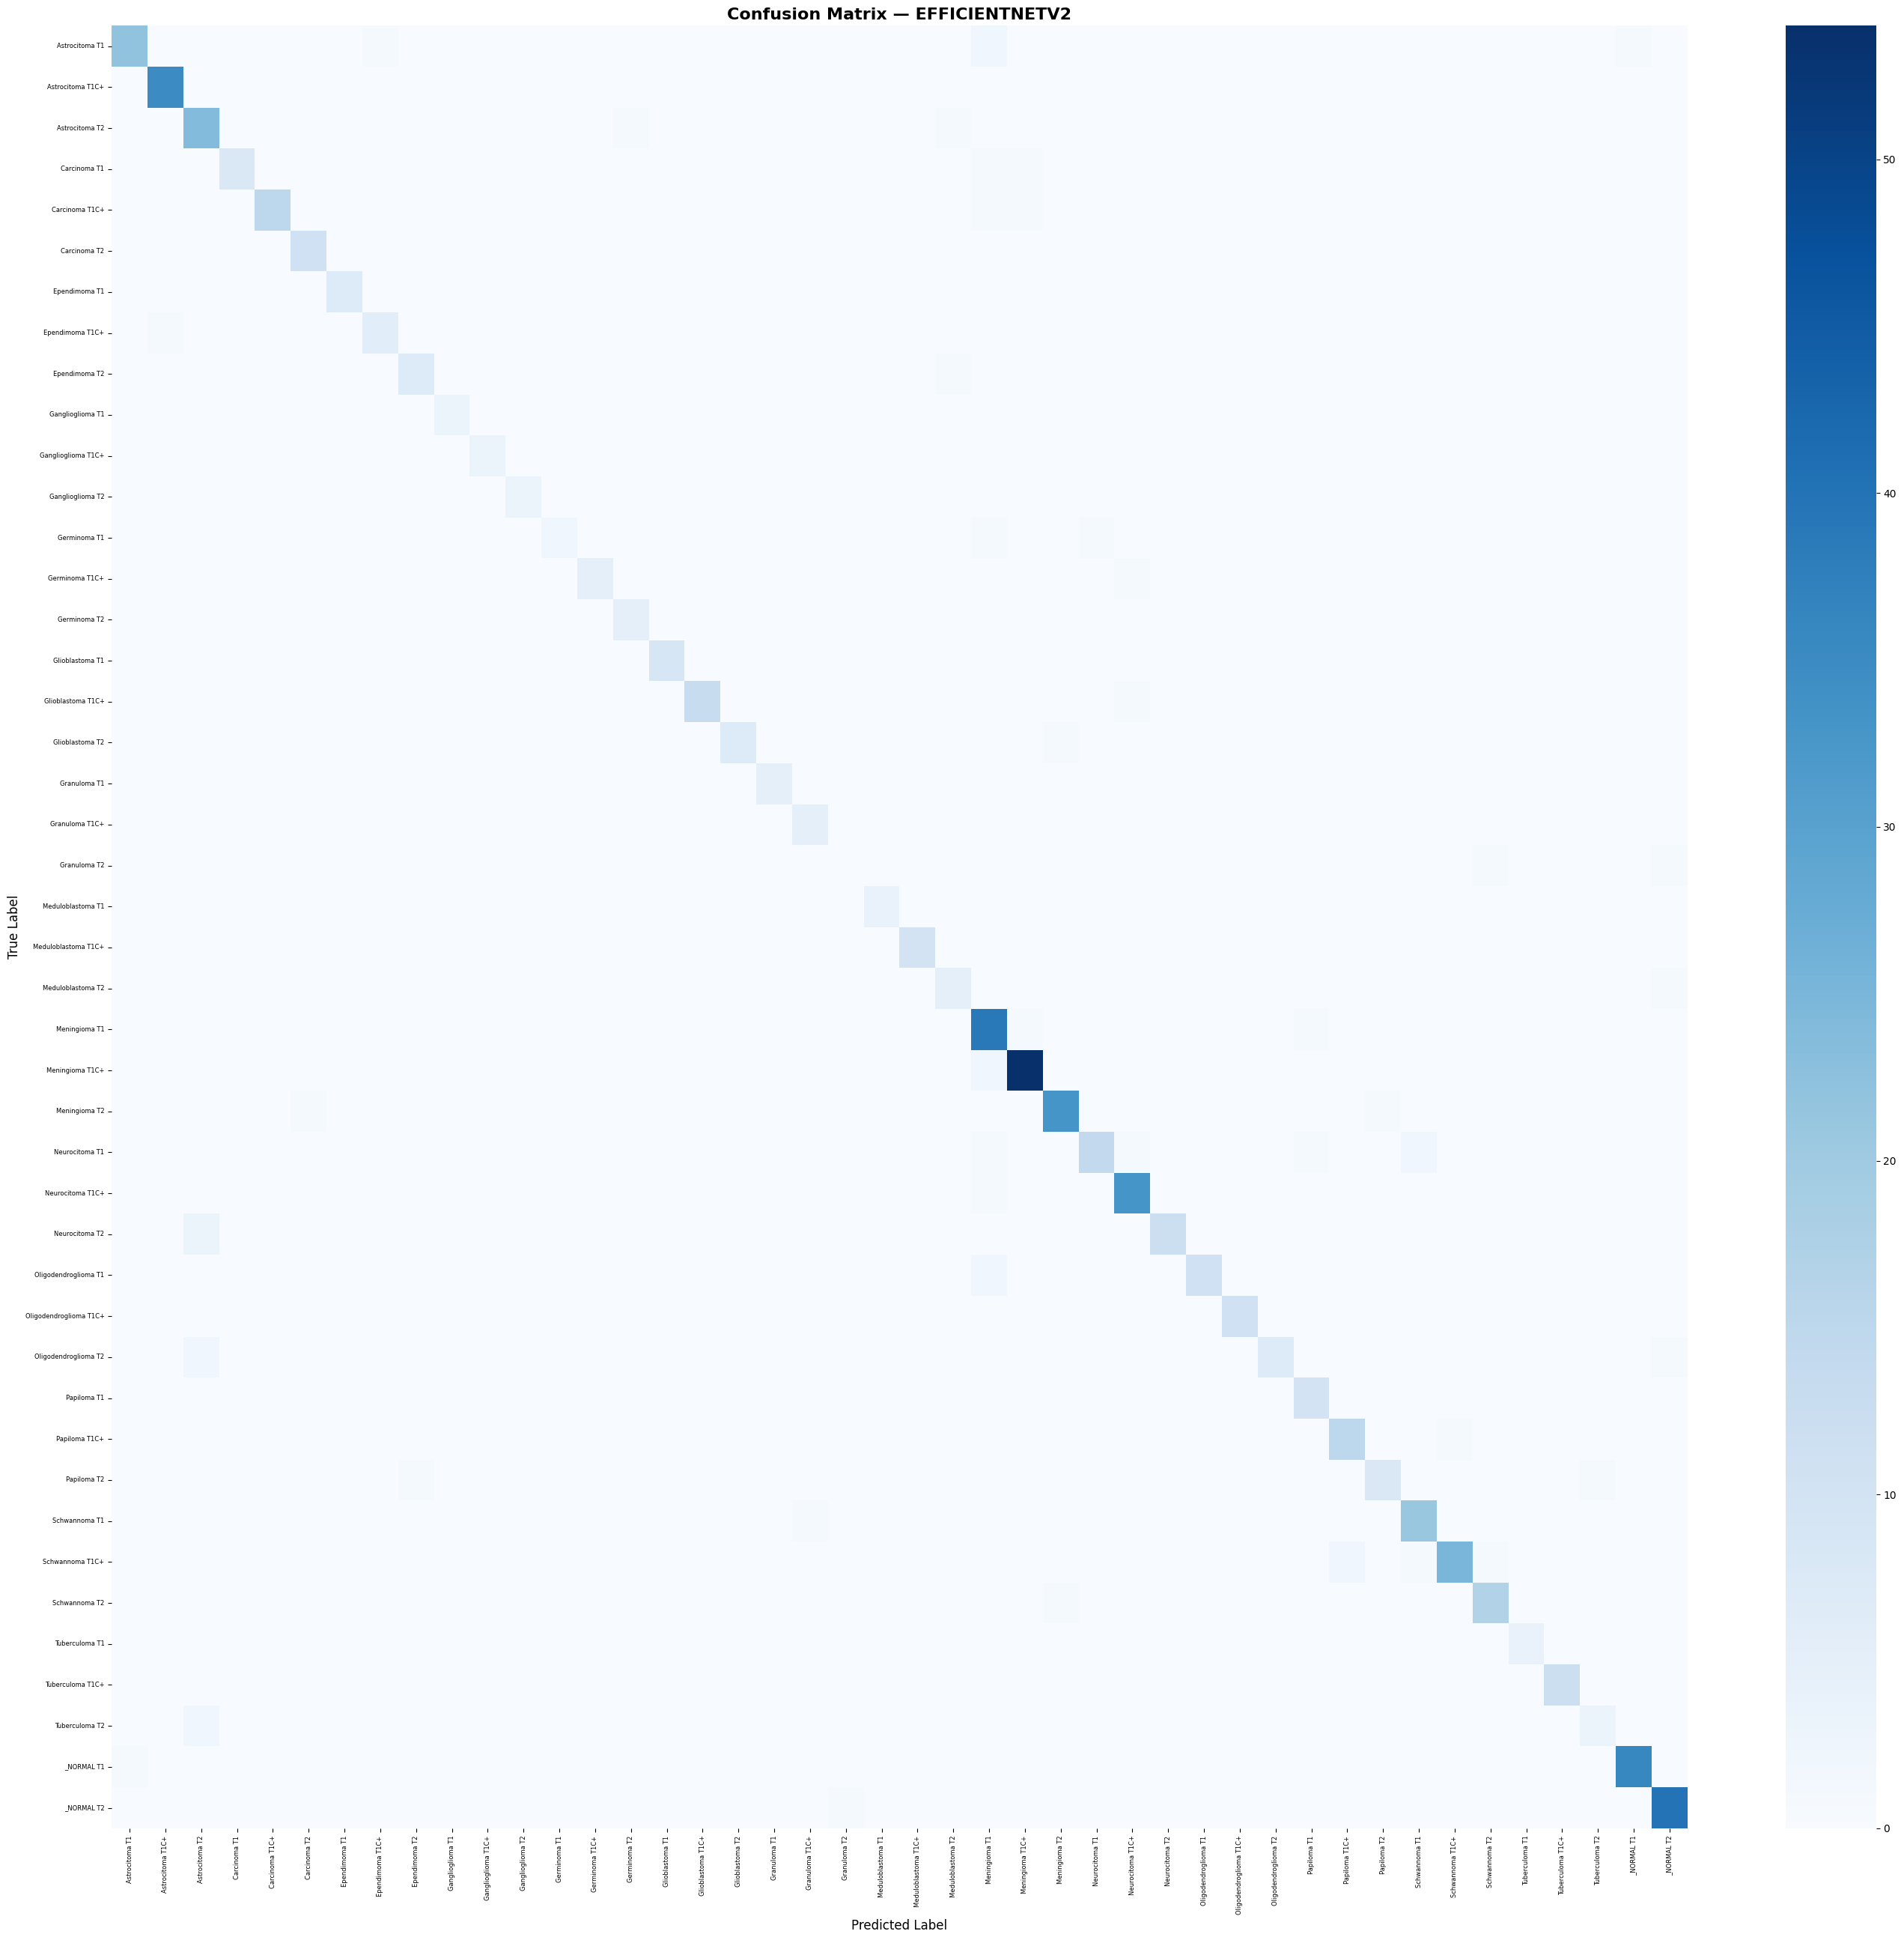
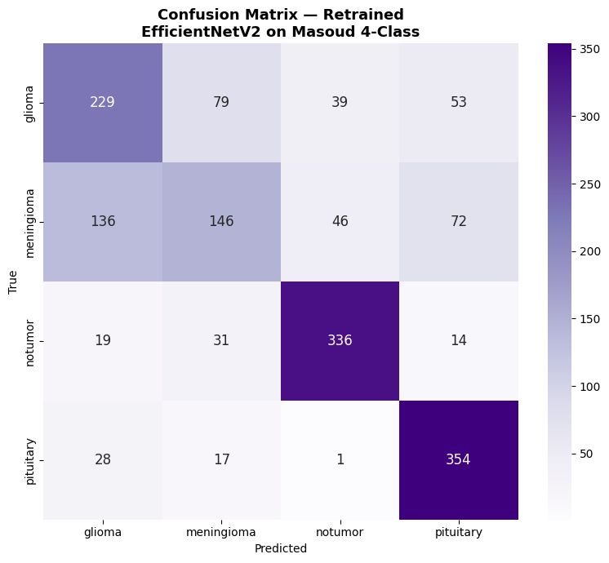
Diagnostic Performance: confusion matrics comparisons

Slide 14
Github link
https://github.com/2021-3-60-089-art/BrainTumorMiniProject
Dataset link
Original dataset: https://www.kaggle.com/datasets/fernando2rad/brain-tumor-mri-images-44c
Generablity testing dataset: https://www.kaggle.com/datasets/masoudnickparvar/brain-tumor-mri-dataset

Slide 15
Thank you

