Slide 1
Custom Dataloader Practice Lab

Slide 2
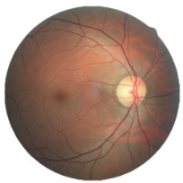
Lab Objective
Classifier for diabetic retinopathy (糖尿病所引發視網膜病變) analysis with ResNet architecture
This dataset provided with a large set of high-resolution retina images taken under a variety of imaging conditions. Format: .jpeg
Class .
0 - No DR 1 - Mild 2 - Moderate 3 - Severe 4 - Proliferative DR
Reference : https://www.kaggle.com/c/diabetic-retinopathy-detection#description

Slide 3
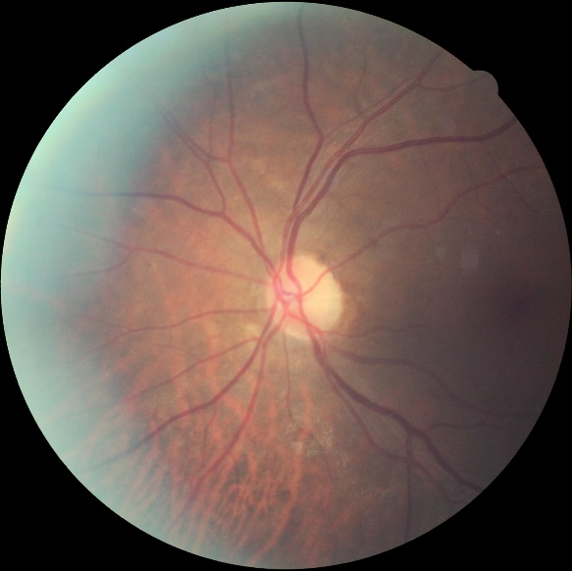
Prepare Data
Download data
28,099 images for training
7025 for testing
The image resolution is 512x512 and has been preprocessed.
Input: [B, 3, 512, 512] Output: [B, 5] Ground truth: [B]
512 x 512

Slide 4
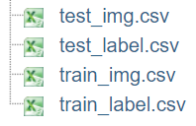
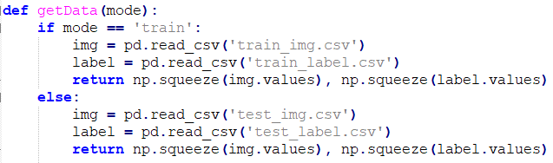
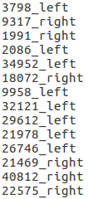
Prepare Data
Image Format: .jpeg
Please do not sort !!!

Slide 5
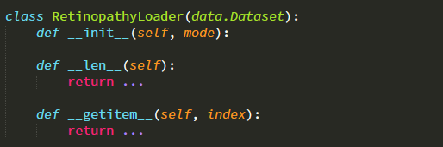
Dataloader
Implement your own custom DataLoader
Below is the skeleton that you have to fill to have a custom dataset, refer to “dataloader_practice.py”

Slide 6
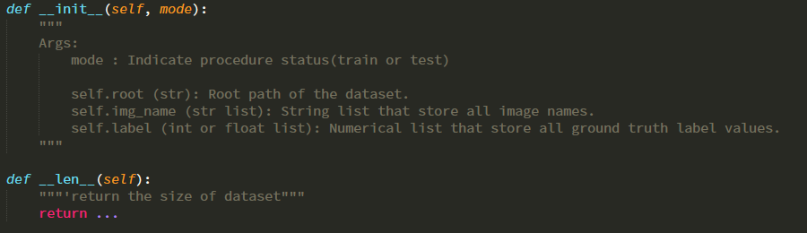
Dataloader

Slide 7
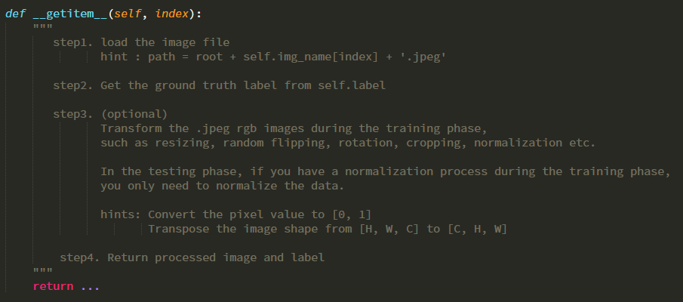
Dataloader

Slide 8
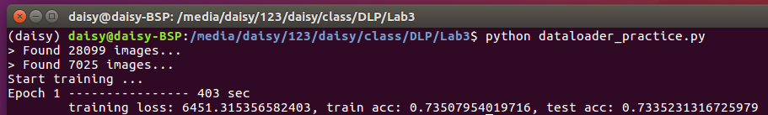
Result

