Slide 1
Supplementary Material

Slide 2
Implement DQN

Slide 3
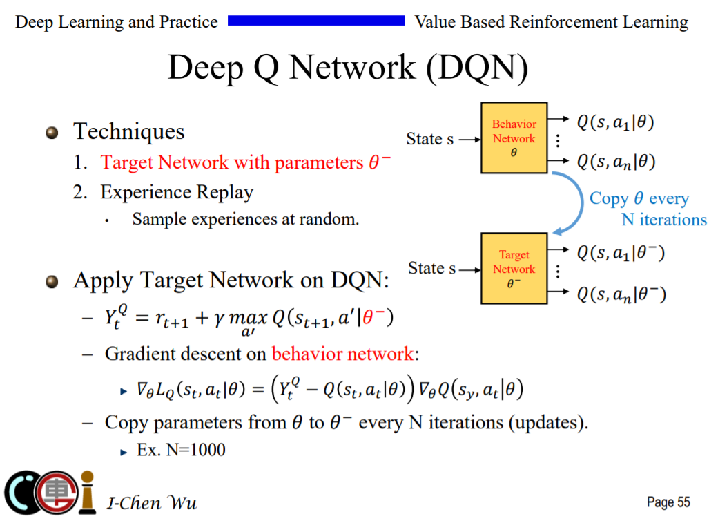

Slide 4
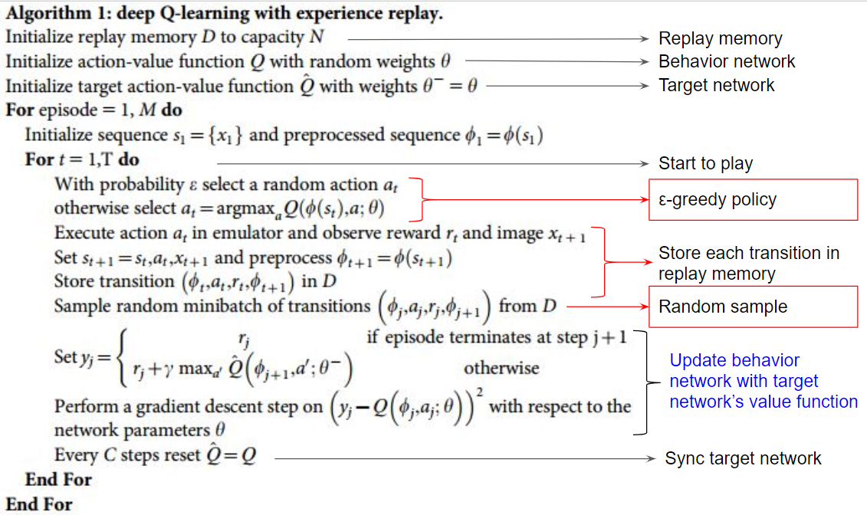

Slide 5
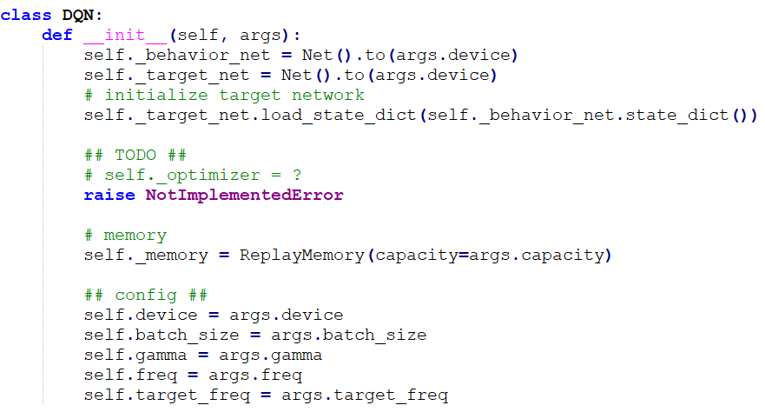
Initialization for all components

Slide 6
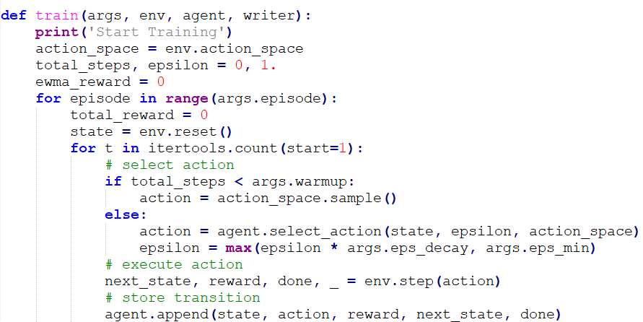
Select action 1. [warm-up phase] greedy policy
2. According to ε-greedy policy
Apply action to the environment
Store transition to replay buffer

Slide 7
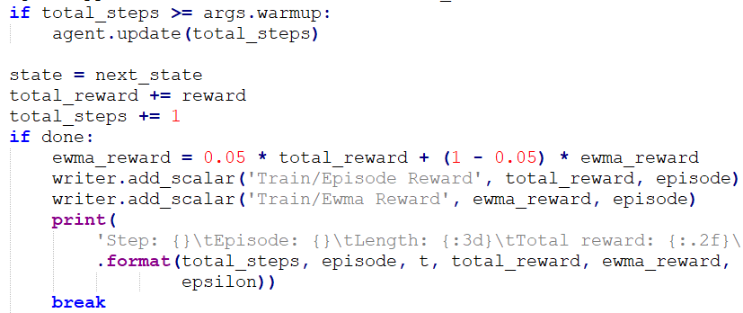
Change state transition

Slide 8
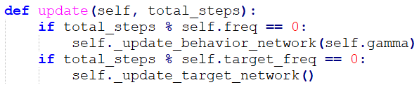

Slide 9
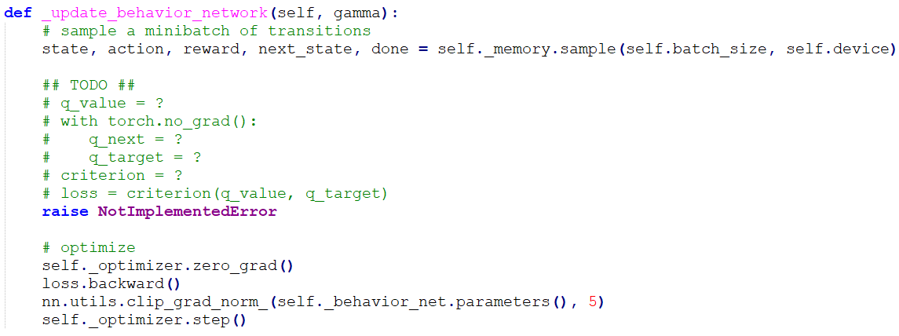

Slide 10
TODO
Construct the neural network
Selection action according to ε-greedy policy
Compute Q-values [q_value] and target Q-values [q_target]
Calculate loss function
Update behavior and target network
Modify code dqn-example.py
1. Find #TODO comments with hints
2. remove the raise NotImplementedError

Slide 11
Implement DDPG

Slide 12
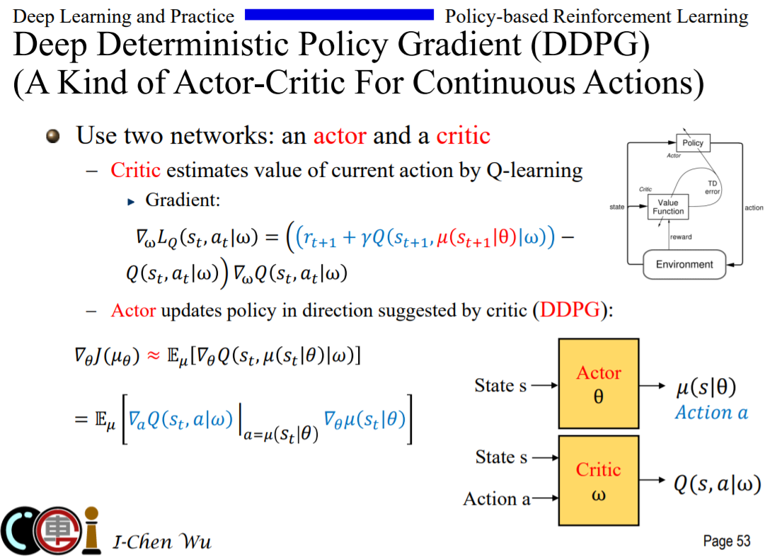

Slide 13
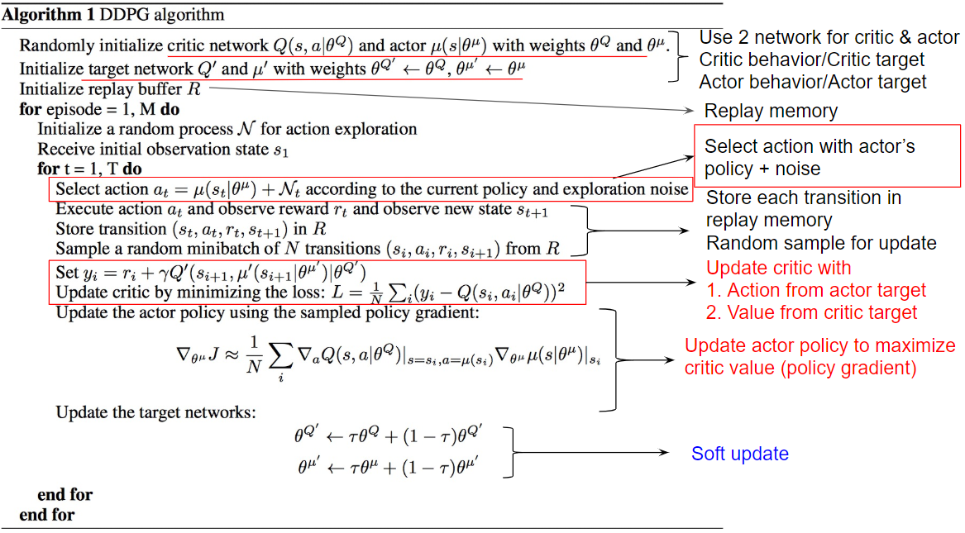

Slide 14
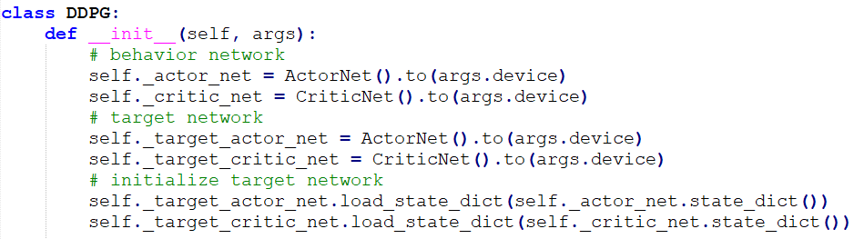

Slide 15
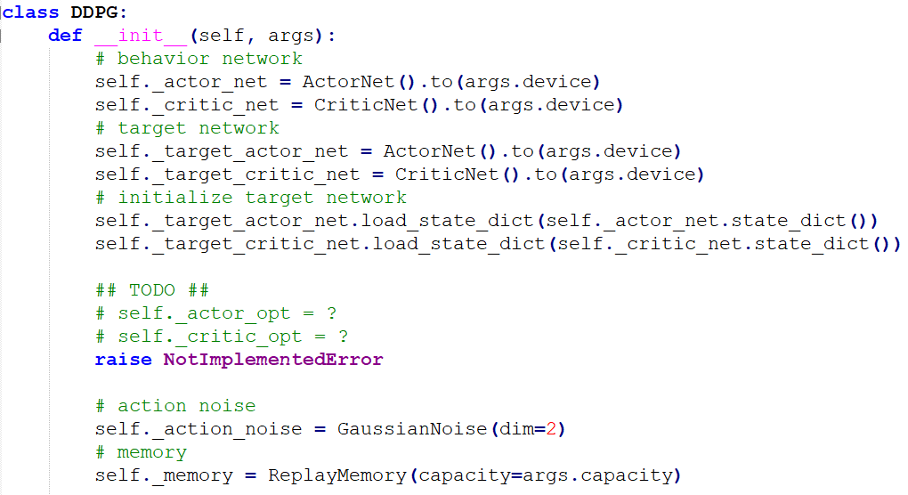

Slide 16
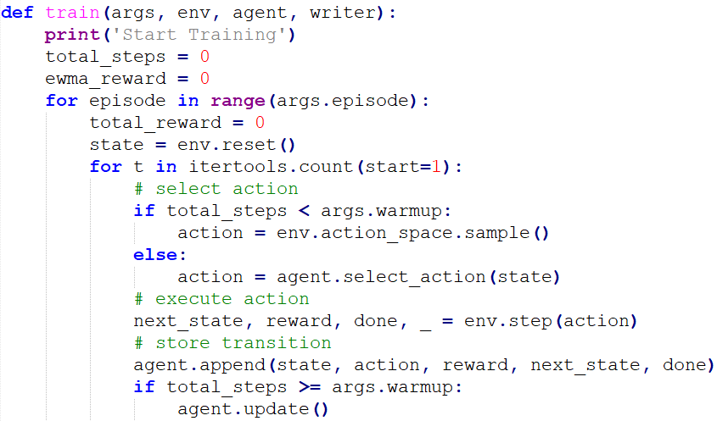
Reset random process
Select action 1. [warm-up phase] random sample
2. According to policy (with noise)
Change state transition
Update network

Slide 17
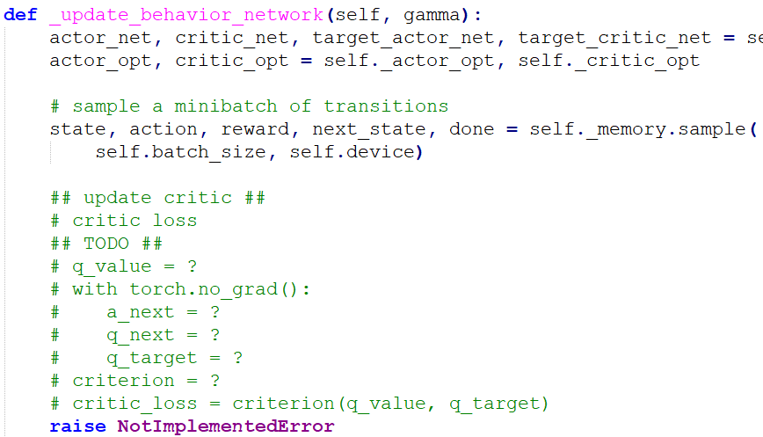
Update critic first
The action for next state uses the output from target actor The value for next state uses the output from target critic
Compute critic loss

Slide 18
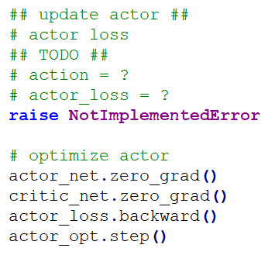
Update actor by the critic’s value

Slide 19
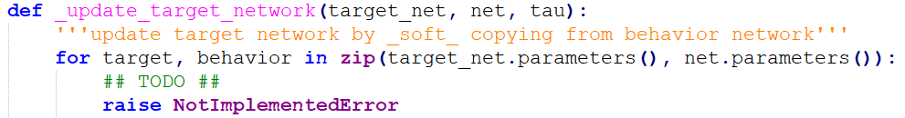

Slide 20
TODO
Construct the neural network
Selection action according to policy (with noise) [select_action]
In test mode, close the noise (implement test by you [test])
Compute critic loss
Compute actor loss
Soft-Update behavior and target network
Modify code ddpg-example.py
1. Find #TODO comments with hints
2. remove the raise NotImplementedError

Slide 21
TD3

Slide 22
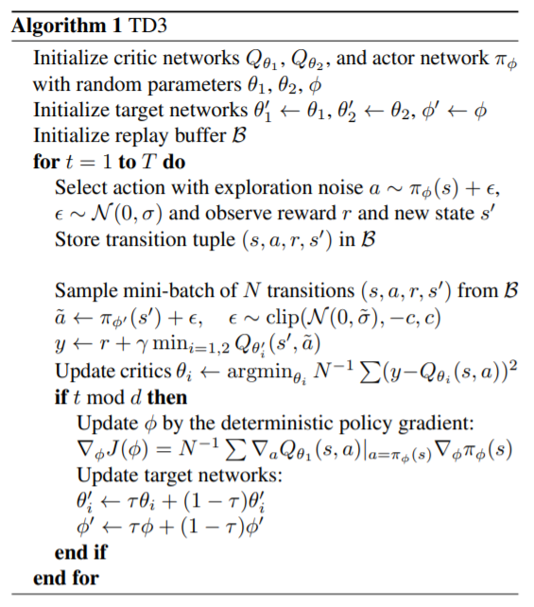
1. Clipped Double Q-Learning for Actor-Critic

Slide 23
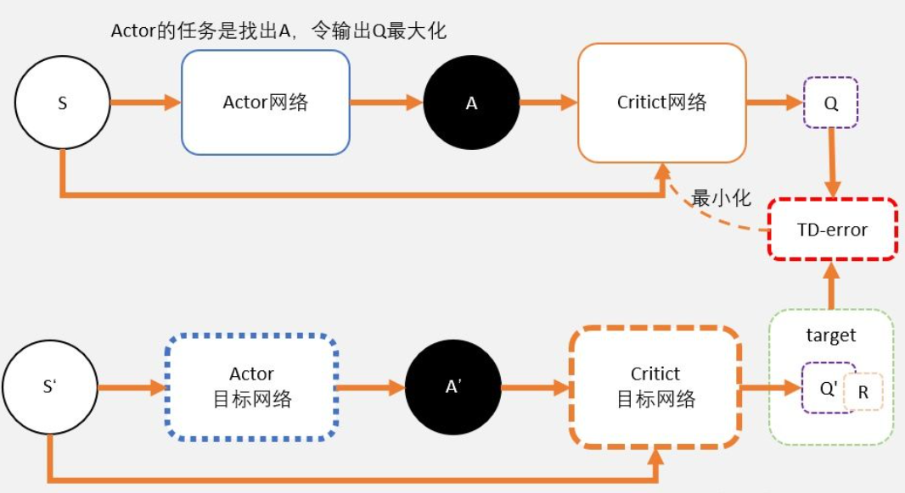
DDPG

Slide 24
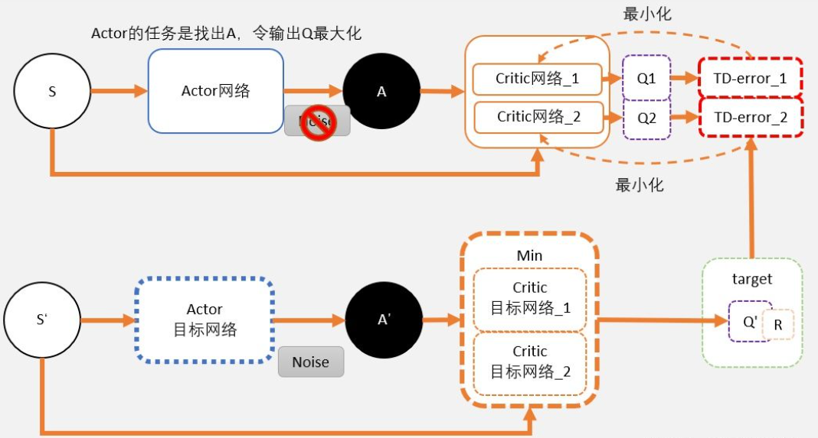
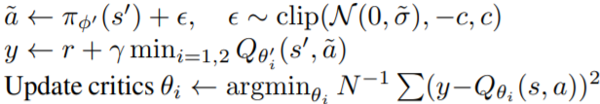
TD3

Slide 25
1. Clipped Double Q-Learning for Actor-Critic
2. Delayed Policy Updates

Slide 26
1. Clipped Double Q-Learning for Actor-Critic
2. Delayed Policy Updates
3. Target Policy Smoothing Regularization

Slide 27
TD3

Slide 28
References
Mnih, Volodymyr et al. “Playing Atari with Deep Reinforcement Learning.” ArXiv abs/1312.5602 (2013).
Mnih, Volodymyr et al. “Human-level control through deep reinforcement learning.” Nature 518 (2015):529-533.
Van Hasselt, Hado, Arthur Guez, and David Silver. “Deep Reinforcement Learning with DoubleQ-Learning.” AAAI. 2016.
Lillicrap, Timothy P. et al. “Continuous control with deep reinforcement learning.” CoRRabs/1509.02971 (2015).
Silver, David et al. “Deterministic Policy Gradient Algorithms.” ICML (2014).
OpenAI. “OpenAI Gym Documentation.” Retrieved from Getting Started with Gym: https://gym.openai.com/docs/ .
OpenAI. “OpenAI Wiki for Pendulum v0.” Retrieved from Github: https://github.com/openai/gym/wiki/Pendulum-v0 .
PyTorch. “Reinforcement Learning (DQN) Tutorial.” Retrieved from PyTorch Tutorials: https://pytorch.org/tutorials/intermediate/reinforcement_q_learning.html .
(TD3) Scott Fujimoto, Herke van Hoof and David Meger. “Addressing Function Approximation Error in Actor-Critic Methods.” ICML (2018).
TD3 Github: https://github.com/sfujim/TD3
https://zhuanlan.zhihu.com/p/111334500

