Slide 1
LAB 6 TA 何國豪, 江凡

Slide 2
Deadline: 2022/3/2(Wed) 11:59 am No Demo

Slide 3
Must use sample code, otherwise no credit.
In this lab,

Slide 4
Outline
Solve LunarLander-v2 using DQN
Solve LunarLanderContinuous-v2 using DDPG
Modify and Run the Sample Code
Scoring Criteria
Training Time
Reminders

Slide 5
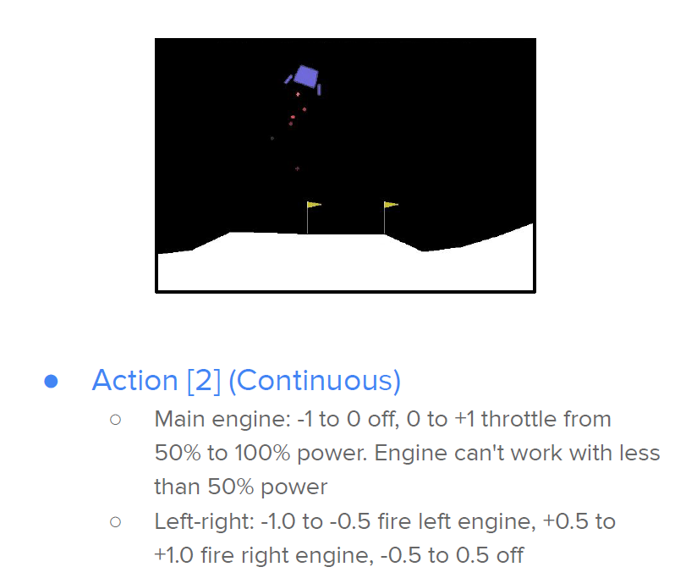
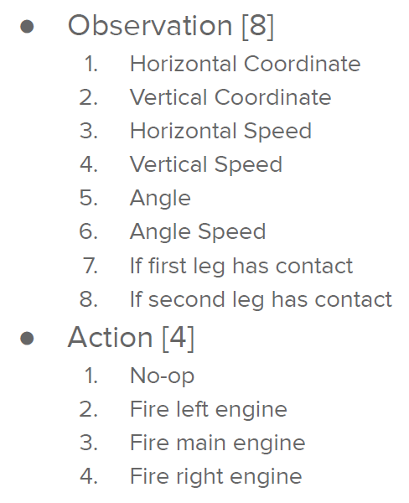
LunarLander-v2

Slide 6
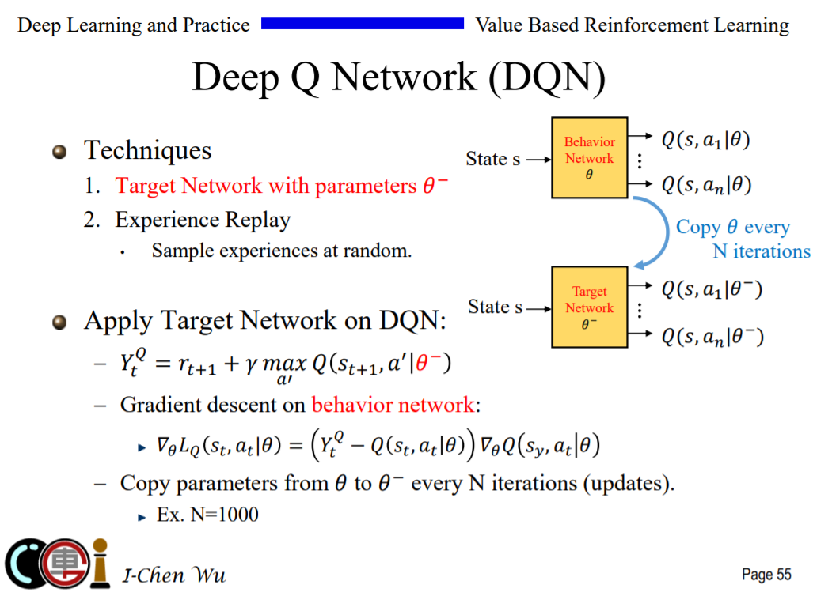

Slide 7
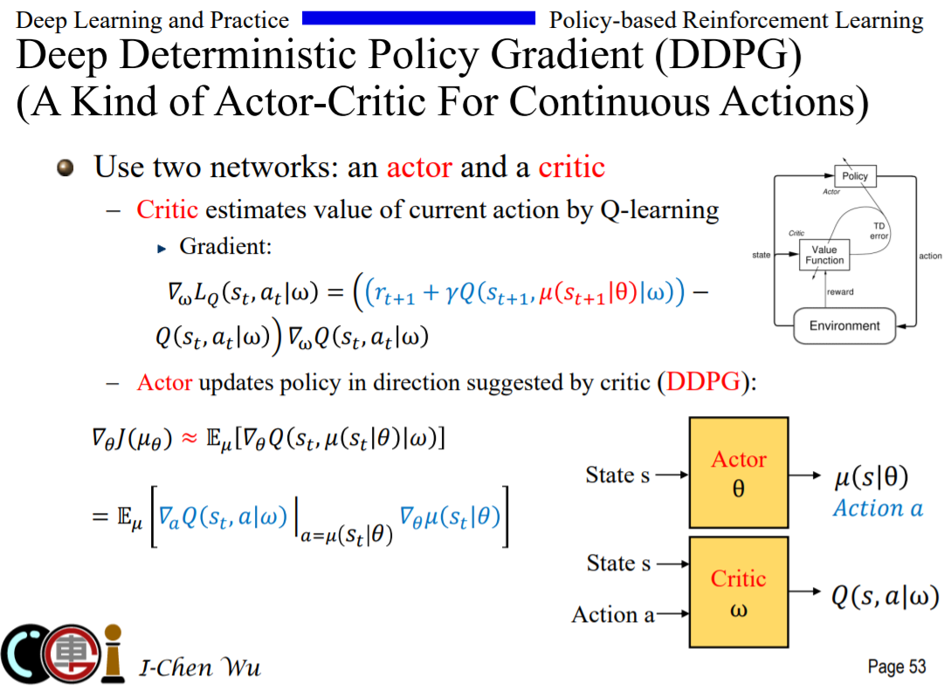

Slide 8
3. Modify and Run the Sample Code
Find #TODO comments with hints and remove “raise NotImplementedError”.
Simply train and test: python dqn.py
Only test: python dqn.py --test_only

Slide 9
4. Scoring Criteria
Show your work, otherwise no credit will be granted.
Report (80%)
(DO explain; do not only copy and paste your codes.)
Report Bonus (20%)
Implement and Experiment on Double-DQN. (5%)
Implement and Experiment on TD3. (15%)
Performance (20%, snapshot)
[LunarLander-v2] Average reward of 10 testing episodes: Average ÷ 30
[LunarLanderContinuous-v2] Average reward of 10 testing episodes: Average ÷ 30

Slide 10
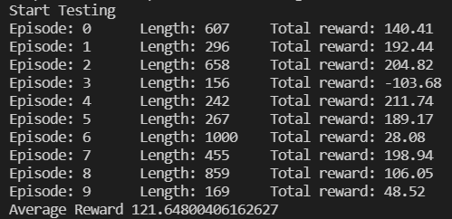
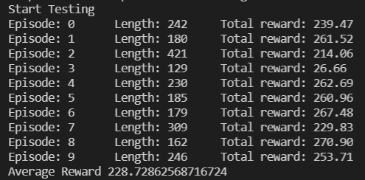
5. Training Time
Under default hyperparameters (1200 epoch)
GeForce GTX 1080
LunarLander-v2: 25 min
LunarLanderContinuous-v2: 52 min
LunarLander-v2 Result
LunarLanderContinous-v2 Result

Slide 11
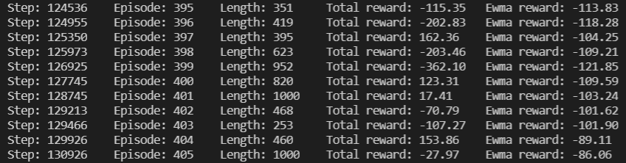
5. Training Time
How to check whether the model is correct?
Total reward
Ewma reward
Length
Ewma reward(T) = 0.05 * episode reward + (1 - 0.05) * Ewma reward(T-1)

Slide 12
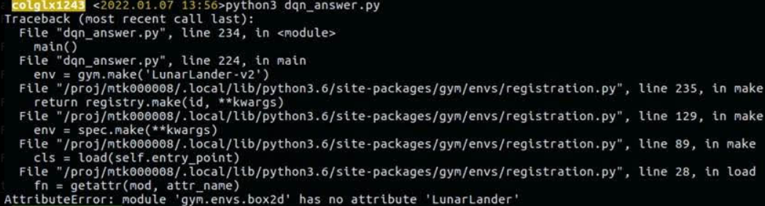
6. Reminders
Install package
pip install gym
Version: 0.21.0
pip install box2d
Your network architecture and hyper-parameters can differ from the defaults.
Ensure the shape of tensors all the time especially when calculating the loss.
When testing DDPG, action selection need NOT include the noise.

Slide 13
References
Mnih, Volodymyr et al. “Playing Atari with Deep Reinforcement Learning.” ArXiv abs/1312.5602 (2013).
Mnih, Volodymyr et al. “Human-level control through deep reinforcement learning.” Nature 518 (2015):529-533.
Van Hasselt, Hado, Arthur Guez, and David Silver. “Deep Reinforcement Learning with DoubleQ-Learning.” AAAI. 2016.
Lillicrap, Timothy P. et al. “Continuous control with deep reinforcement learning.” CoRRabs/1509.02971 (2015).
Silver, David et al. “Deterministic Policy Gradient Algorithms.” ICML (2014).
OpenAI. “OpenAI Gym Documentation.” Retrieved from Getting Started with Gym: https://gym.openai.com/docs/ .
OpenAI. “OpenAI Wiki for Pendulum v0.” Retrieved from Github: https://github.com/openai/gym/wiki/Pendulum-v0 .
PyTorch. “Reinforcement Learning (DQN) Tutorial.” Retrieved from PyTorch Tutorials: https://pytorch.org/tutorials/intermediate/reinforcement_q_learning.html .
(TD3) Scott Fujimoto, Herke van Hoof and David Meger. “Addressing Function Approximation Error in Actor-Critic Methods.” ICML (2018).

