Slide 1
Group 7
Quantifying uncertainty in power system design using distributed computing
Leads: David Brayshaw & Sarah Sparrow
Team: Matthew Patterson, Yifu Ding, Changlong Wang, Andy Bowery & Francesco Lombardi
And input from many others, especially Hannah Bloomfield, David Wallom & Bryn Pickering.

Slide 2
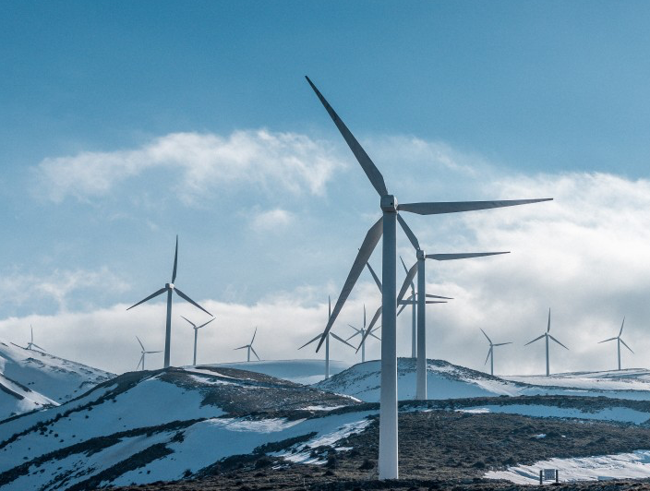
Group 7: Quantifying uncertainty in power system design using distributed computing Leads: David Brayshaw & Sarah Sparrow Team: Matthew Patterson, Yifu Ding, Changlong Wang, Andy Bowery & Francesco Lombardi
Climate change driving a complete transformation of the electricity sector
Rapid growth of renewables such as wind & solar (global investment of US$242 billion in 2020)
Electrification of other sectors: transport & heating
Fundamentally changes exposure of energy-system to weather
Central issue is supply (generation) and demand (use of power) must balance
Ability of existing infrastructure to cope with impacts of a changing climate
Ensuring new infrastructure design is robust to climate uncertainty
Profound need to explore role of key uncertainties, e.g.:
Climate scenario (emissions pathway)
Internal variability (natural climate fluctuations)
Climate model uncertainty (biases and deficiencies)
Power system modelling assumptions (e.g., costs, efficiencies, discount rates)
Figure: pxhere.com/en/photo/1408472

Slide 3
Group 7: Quantifying uncertainty in power system design using distributed computing Leads: David Brayshaw & Sarah Sparrow Team: Matthew Patterson, Yifu Ding, Changlong Wang, Andy Bowery & Francesco Lombardi
Climate change driving a complete transformation of the electricity sector
Rapid growth of renewables such as wind & solar (global investment of US$242 billion in 2020)
Electrification of other sectors: transport & heating
Fundamentally changes exposure of energy-system to weather
Central issue is supply (generation) and demand (use of power) must balance
Ability of existing infrastructure to cope with impacts of a changing climate
Ensuring new infrastructure design is robust to climate uncertainty
Profound need to explore role of key uncertainties, e.g.:
Climate scenario (emissions pathway)
Internal variability (natural climate fluctuations)
Climate model uncertainty (biases and deficiencies)
Power system modelling assumptions (e.g., costs, efficiencies, discount rates)
UK exemplar: peak demand-net-wind
Need power system planning models
e.g.,Calliope, PyPSA
Figure: pxhere.com/en/photo/1408472

Slide 4


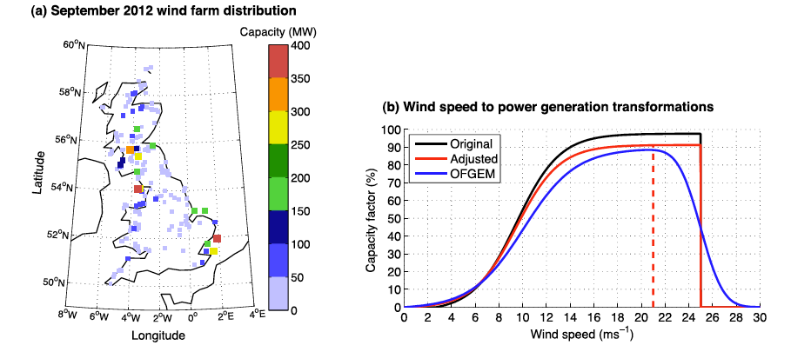
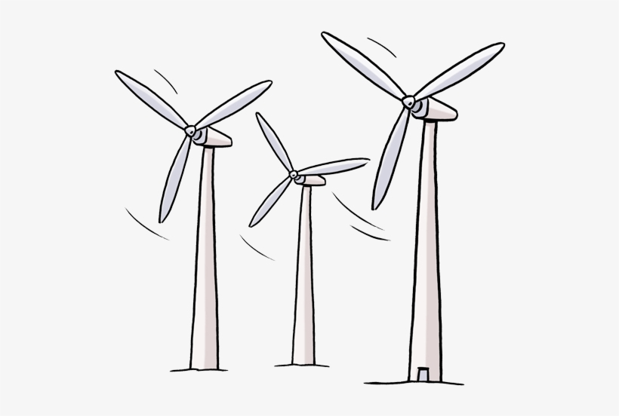
The modelling challenge
“Direct” function-based relationships possible
Wind_power = function(wind)
Solar_PV = function(insolation, temperature)
Demand = function(temperature, …)
Demand
Climate data
Wind power potential
Cannon et al (2015)
Notes:
https://www.seekpng.com/png/detail/388-3881701_wind-turbine-clip-art.png

Slide 5

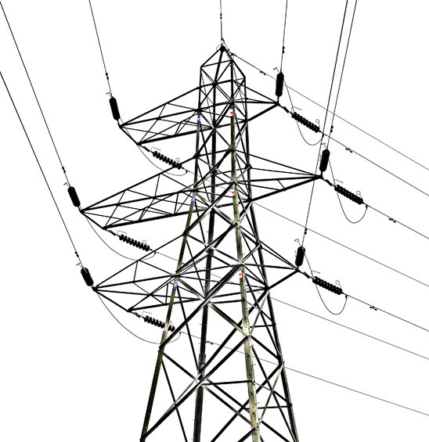
A (harder!) modelling challenge
Complex relationships
No “function” connecting, e.g., weather inputs to transmission requirements
Power system model (e.g., optimization) is essential
Demand
Optimization
Estimated capacities
Wind
Transmission
Coal
Gas
Nuclear
…
Power System
Planning
Model
Solution
Climate data
Wind power potential
Other inputs
(economic, tech, social)
Conventional
sources
Transmission
Notes:
https://www.seekpng.com/png/detail/388-3881701_wind-turbine-clip-art.png

Slide 6
A (harder!) modelling challenge
Complex relationships
No “function” connecting, e.g., weather inputs to transmission requirements
Power system model (e.g., optimization) is essential
Computationally expensive
(often max ~few years)
Demand
Optimization
Estimated capacities
Wind
Transmission
Coal
Gas
Nuclear
…
Power System
Planning
Model
Solution
Climate data
Wind power potential
Issues:
Availability of hourly data
Data size
Other inputs
(economic, tech, social)
Are solutions “robust”?
Climate sample
Modelling assumptions
Conventional
sources
Transmission
Notes:
https://www.seekpng.com/png/detail/388-3881701_wind-turbine-clip-art.png

Slide 7
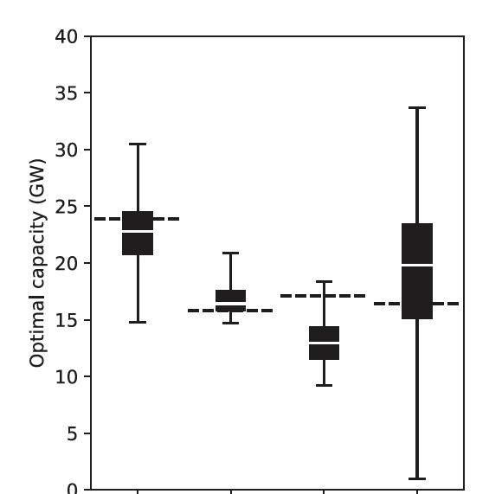
Evidence of a problem
Hilbers et al 2019
choice of historic weather year
“best” single year 35GW
Estimated capacity (GW)
“many single years” average 20GW
“True optimum” 17 GW
(optimized over all years)
“worst” single year 1GW
Baseload
Peaking
Wind
Mid-merit
Different generation technologies

Slide 8
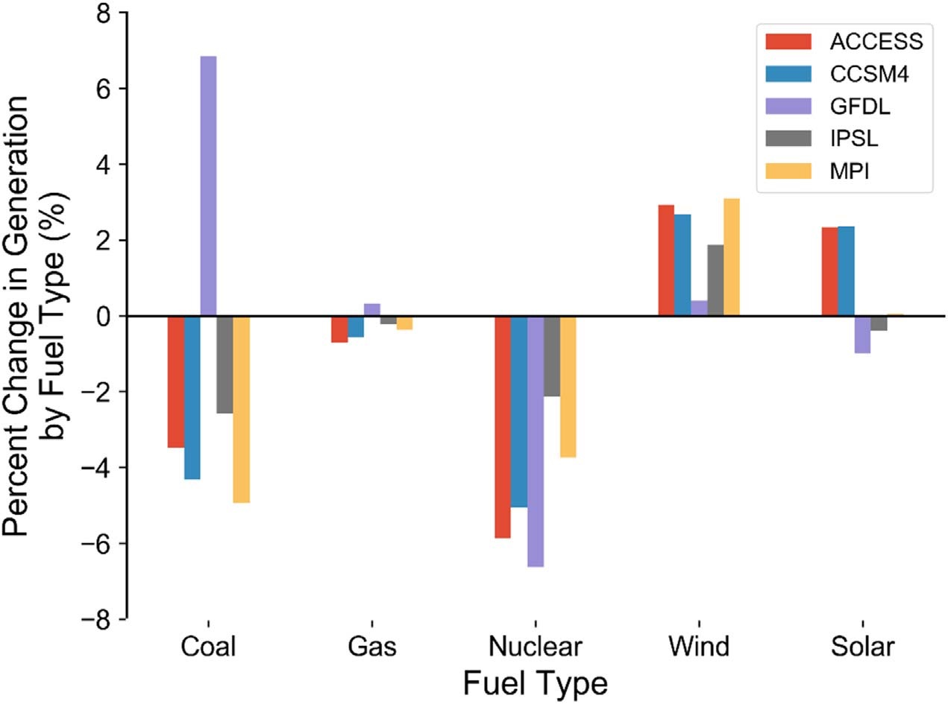
Evidence of a problem
Hilbers et al 2019
choice of historic weather year
Craig et al 2019
choice of climate model
Estimated capacity (GW)
Baseload
Mid-merit
Peaking

Slide 9
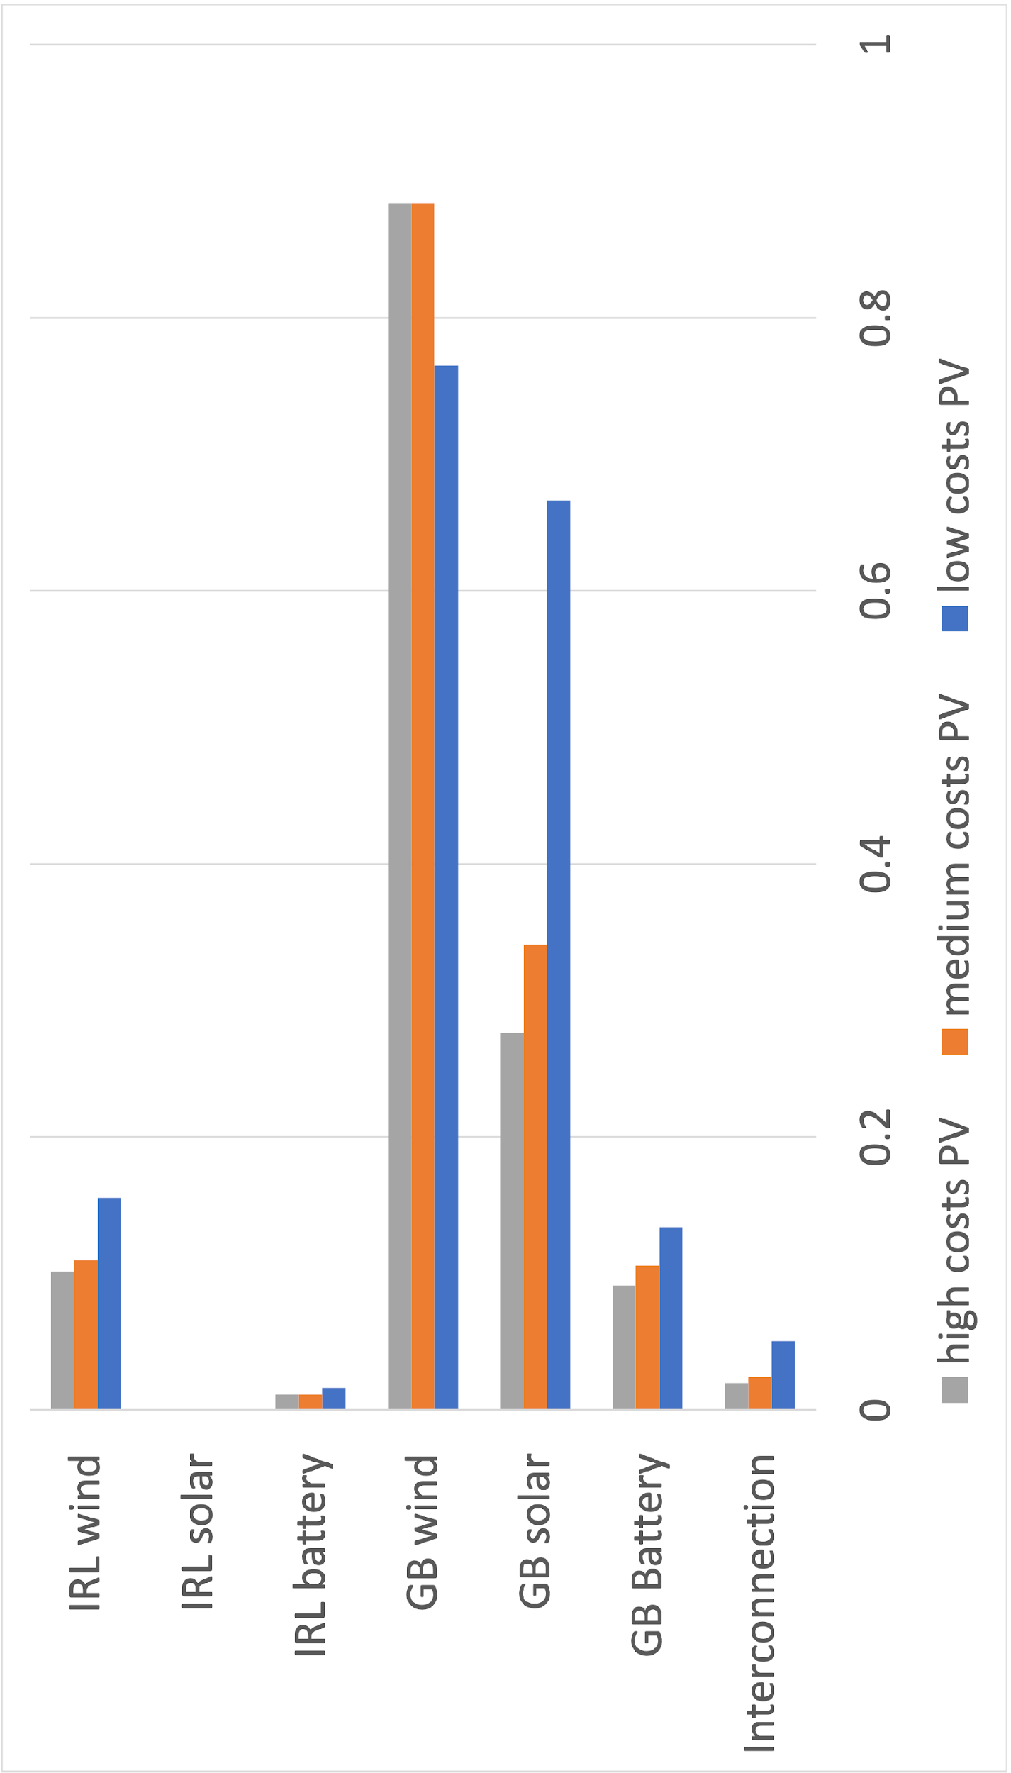
Evidence of a problem
Changlong, Yifu and the hackathon team 2021
Choice of energy parameters
(based on Lombardi et al 2020)
Hilbers et al 2019
choice of historic weather year
Craig et al 2019
choice of climate model
Estimated capacity (GW)
Baseload
Mid-merit
Peaking

Slide 10
Evidence of a problem
Changlong, Yifu and the hackathon team 2021
Choice of energy parameters
(based on Lombardi et al 2020)
Hilbers et al 2019
choice of historic weather year
Craig et al 2019
choice of climate model
Estimated capacity (GW)
Would like to run many simulations to explore uncertainty (~Monte Carlo methods)
… but is computationally intractable
Baseload
Mid-merit
Peaking

Slide 11
The ambition – a distributed climateprediction.net experiment
On 1000’s of home computers
Climate model
Bias correct
Convert to energy
Energy model
Rich
open
dataset
Community designed
“experiment”
Community analysis
Investigate sensitivity of, e.g., energy system cost or installed capacity distributions to:
Climate forcing scenario
Climate model parameter ensemble (“perturbed physics”)
Initial condition ensemble (“natural variability”)
Choices made in bias correction and conversion (e.g., BC method, conversion model)
Energy scenario (e.g., future demand)
Energy model parameters (e.g., assumptions on technology build costs)
Possible aim: funding proposal later this year to execute this work

Slide 12
The hackathon
Jasmin
HadAM3/
HadRM3P
1yr, 25km
Minimal
bias correct
Convert to
PV, wind, demand
Euro-
Calliope
2-zone, simplified
Test
dataset
Sensitivity test
Hackathon aims:
Develop a working ”prototype” on Jasmin
Identify how the prototype can be developed into a “release” version
Begin process of “community design” of final experimental format

Slide 13
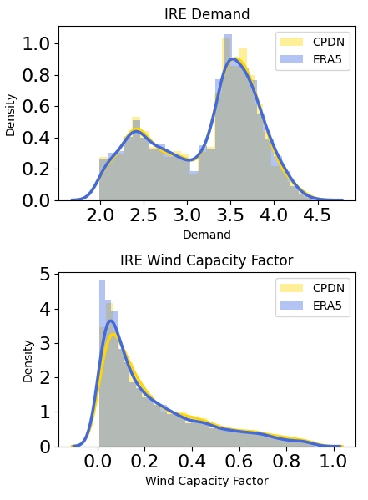
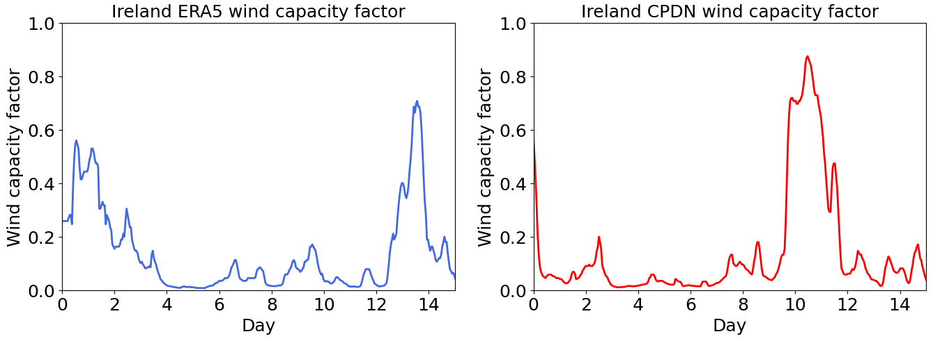
“Acceptable” probability distributions
Bias adjusted, converted weather-energy variables:
6 variables, hourly for 1 year
Based on UReading models (Bloomfield et al 2020)
For each of Great Britain and Island of Ireland:
Wind capacity factor
Solar PV capacity factor
Electricity demand
“Plausible” hourly timeseries
Matt Patterson, Sarah Sparrow

Slide 14
Running 2-zone “EuroCalliope” GB-IRL
(based on group 2 / Bryn Pickering’s model)
Sensitivity test to cost of solar PV (after Lombardi et al 2020)
GB
IRL
Wind
Solar
Demand
(+other techs)
Interconnect
Wind
Solar
Demand
(+other techs)
Yifu Ding, Changlong Wang + help from Bryn Pickering, Francesco Lombardi

Slide 15
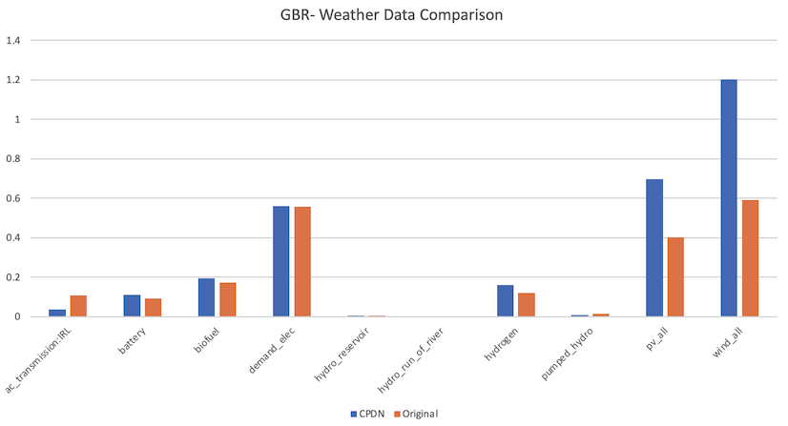
Stop the press!!!
Model run with 1-year samples of CPDN vs ERA5 data converted to energy
-- Thanks Changlong!
Blue = CPDN
Orange = ERA5

Slide 16
The way forward
On 1000’s of home computers
Climate model
Bias correct
Convert to energy
Energy model
Rich
open
dataset
Community designed
“experiment”
Community analysis
Design for technical operationalization
Andy Bowery, Francesco Lombardi & Bryn Pickering
Packaging up to single executable transferable to user’s computer
Issues of data size (Input and Output)
Avoiding installing software permanently on user machine, use on multiple OS’s etc

Slide 17
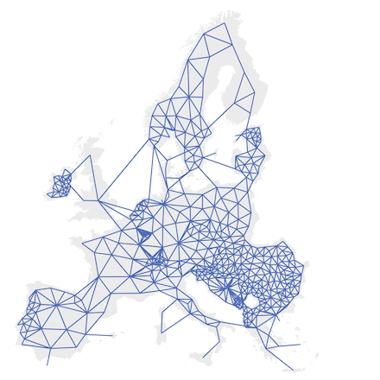
The way forward
On 1000’s of home computers
Climate model
Bias correct
Convert to energy
Energy model
Rich
open
dataset
Community designed
“experiment”
Community analysis
Community experimental design - joint meeting across groups (1h, Thursday 1400; 17 attendees)
Wide-spread support!
Euro-Calliope (34 zone, national) staring point
Importance of hydro (and modelling tools/limitations!)
Initial parameter space for energy model uncertainty sampling (Trondle et al 2020)
Target climate periods (2030-2060)
Data needs
Provoked wider discussion on potential uses:
Possible Horizon call HORIZON-CL5-2022-D3-01-13
Two-step approach to CPDN experiment; and use of other energy models
Access to CPDN “BOINC” framework: for other models/experiments; to access larger servers (e.g. AWS)
Euro-Calliope

Slide 18
Summary and next steps
End-to-end prototype (demo of principle) working on Jasmin
Bias correction
Conversion-to-energy
Implementation into simplified energy model
Identification and experiments of key energy param uncertainty
Group learning: simple “how to’s” for setting up software etc on Jasmin
Transferred to github
Identifying what is needed for operational version (technical/computational)
Productive community discussions about format of “release” version
Take forward to, e.g., research proposal (EPSRC/Horizon)
Likely breakout/splinter session at NextGenEC21 (16th/17th Sept 2021):
https://research.reading.ac.uk/met-energy/next-generation-challenges-workshop/
Contact: d.j.brayshaw@reading.ac.uk
Thanks to the whole team (Sarah, Matt, Andy, Changlong, Yifu, Francesco + supporters) and Gurobi for letting us use their solver!

