Slide 1


Can we develop methods to create sub-daily energy relevant climate variables from daily data?
Leads:
Kate Brown (Met Office)
Hannah Bloomfield (Reading University)
Members:
Luca Di Carlo, Jake Bland, Deepali Singh, Natalia Sirotko-Sibirskaya, Lina Taube

Slide 2
Content
Overview of problem
Methods studied
Key results
Summary
Future work

Slide 3
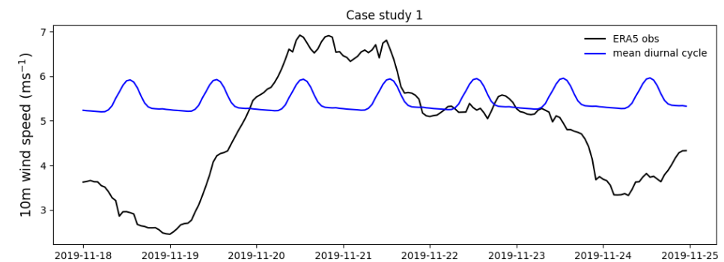
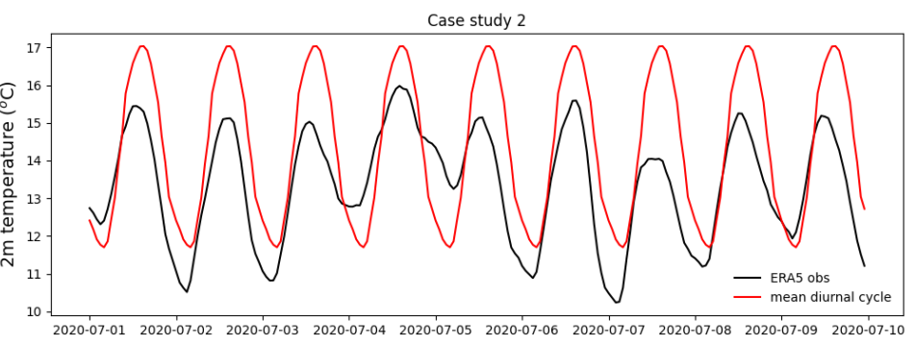
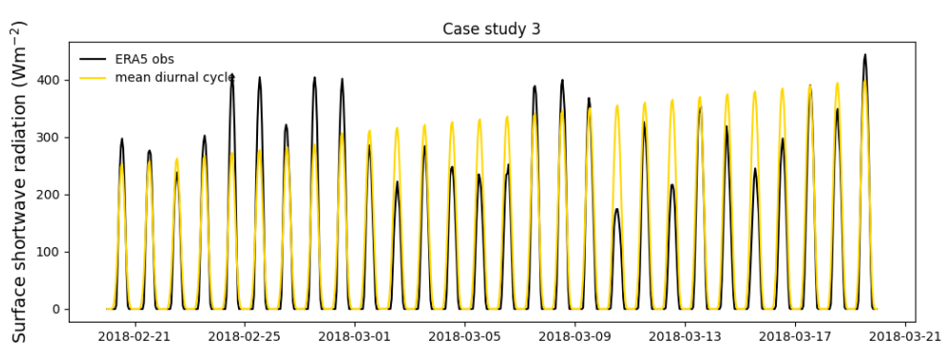
Aim of project
To develop and assess temporal
downscaling methodologies that will
convert meteorological data from
daily to sub-daily variables
Focus on ERA5 reanalysis
1979-2020
2m temperatures
10m wind speed
Surface solar irradiance
Can the methodologies account for:
Diurnal cycle
Synoptic scale meteorology?
Benchmark to beat: mean seasonal diurnal cycle

Slide 4
ERA5 Reanalysis
Hourly data, ~30km grid boxes
Training period 1979-2017. Validation 2018-2020
Any of the fields below can be used as model inputs
ERA5 Downloaded variables
Net surface shortwave radiation (W/m²) | Cloud cover (%) | Precipitation mm/day
sea level pressure (hPa), | Max temperature (1.5m) | Specific humidity (%)
Temperature mean (1.5m) | Min temperature (1.5m) | Snow variables
wind speed( at 10m in m/s) | Eastwards wind speed (m/s)
 | Northwards Windspeed (m/s)

Slide 5
The 3 UK case study periods
National Grid have chosen some cases studies with which we can assess the downscaling methodologies.
Case study 1: Nov 18-25 2019
Very high energy demand, and variable wind speeds
Case study 2: Jul 1-10 2020
Low energy demand: In addition it was sunny and windy, plus within the first lockdown covid period.
First time solar PV were asked to reduce generation
Case study 3: 20 Feb – 20 Mar 2018
Beast from the East: cold temperatures = high energy demand, and low wind speed
Data sets contain hourly observations for temperature (2m), windspeed (10m) and surface shortwave radiation.

Slide 6
Methods investigated
Jake Bland Mean-diurnal cycles with perfect foresight
Natalia Sirotko-Sibirskaya
Fourier Decomposition
Kate Brown Generalised Additive Models
Luca Di Carlo Linear Regression,
Random Forests
Lina Taube Linear Regression
Hannah Bloomfield Analogue
method
Deepali Singh Linear Regression, Neural Networks
National level time series
Gridded reanalysis
Combining both

Slide 7
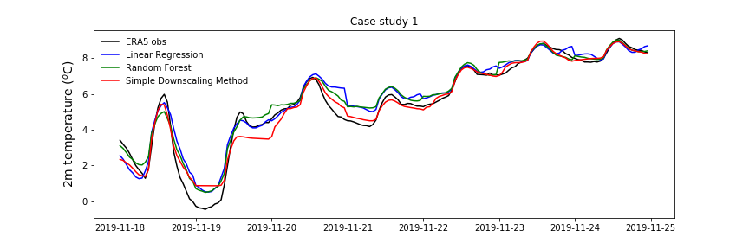
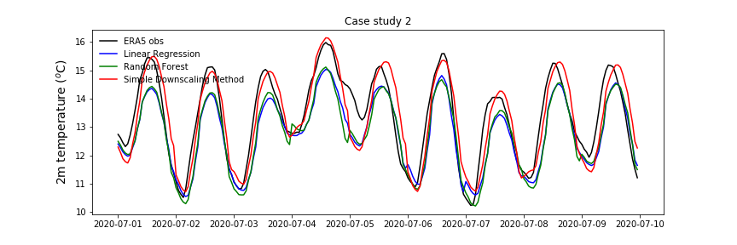
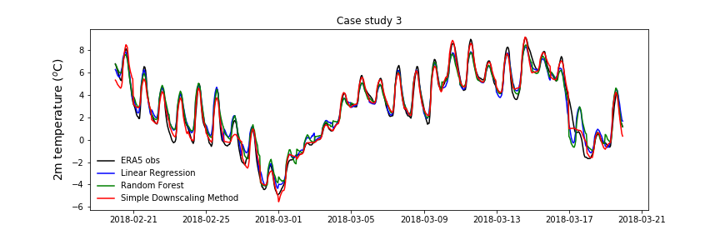
Temperature
Machine learning v.s. downscaling method.
National scale data (UK).
Machine learning methods used temperatures, cloud cover, maximum & minimum temperatures, and solar radiation as inputs.
Model error increased in the cold season.
Both out-performed benchmark methods, however downscaling was superior.
LR: 0.55 RF: 0.54 DOWN: 0.49
LR: 0.79 RF: 0.78 DOWN: 0.64
LR: 0.70 RF: 0.70 DOWN: 0.50

Slide 8
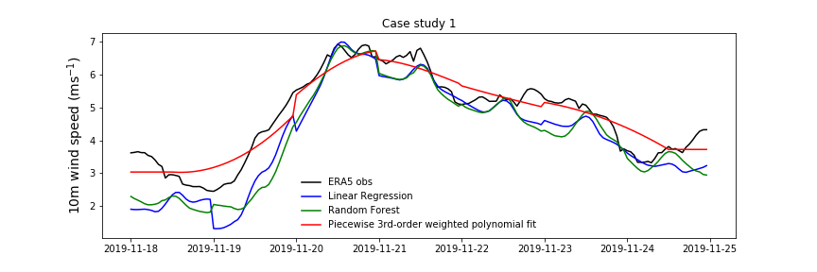
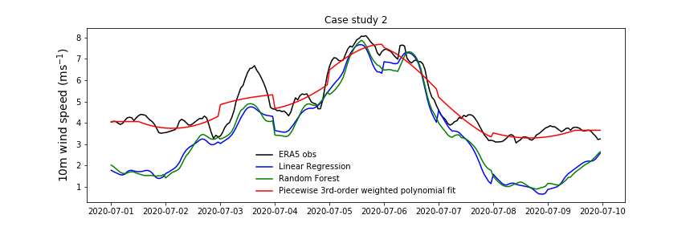
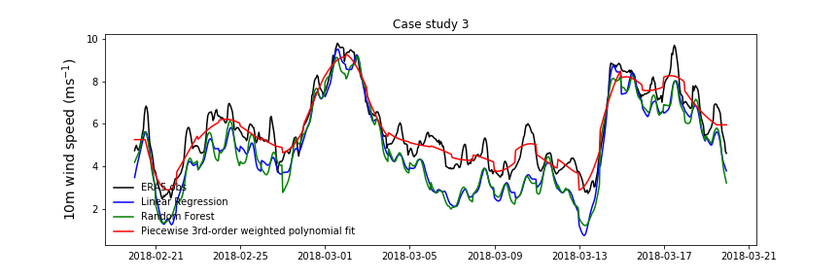
Wind Speed
 | LR | RF | POLY
MSE | 0.76 | 0.77 | 0.39
Linear Regression and Random Forests - very similar.
Both under predict the absolute wind speeds but are able to capture the ramps relatively well.
It is not clear why the weight assigned to the daily mean wind speed is not larger, see case 2.
Inadequate/ insufficient information to the model?
Is RMSE the right metric?
Probabilistic approaches?
 | LR | RF | POLY
MSE | 1.5 | 1.5 | 0.45
 | LR | RF | POLY
MSE | 1.14 | 1.17 | 0.5

Slide 9
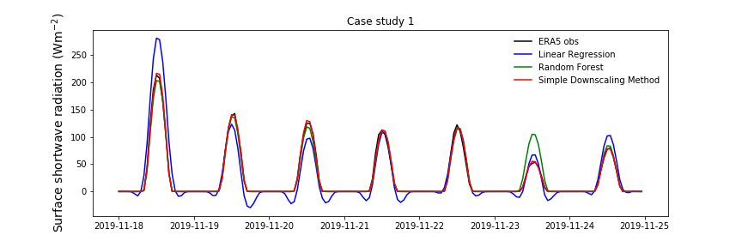
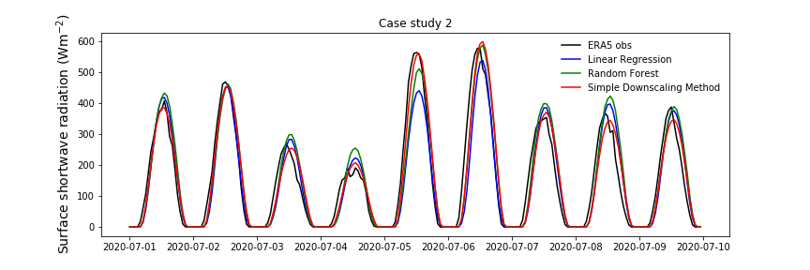
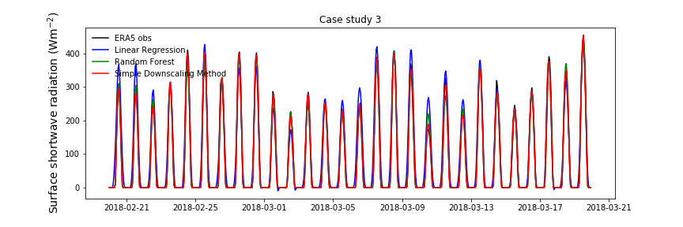
Solar Radiation
 | LR | RF | SD
RMSE | 17.7 | 8.99 | 2.95
Linear regression can lead to negative surface shortwave radiation
Both linear regression and random forest do well at reproducing diurnal cycle
Both are out-performed by
taking the historical mean diurnal cycle, and re-scaling to match the mean daily radiation
This is for the national average - would more input variables and sophisticated methods be better for smaller scales?
 | LR | RF | SD
RMSE | 56.6 | 55.7 | 46.1
 | LR | RF | SD
RMSE | 29.6 | 12.2 | 8.92

Slide 10
Gridded approach
Hypothesis: more accurate information and easier to model extremes as data is not averaged
More challenging in terms of data handling and necessary computation effort
Therefore not complete dataset used but only specific range of longitudes and latitudes to reduce computation time
Variable execution needed to be implemented
Usage of analysis results for National grid scale
Results from neighbouring grid should also be considered

Slide 11
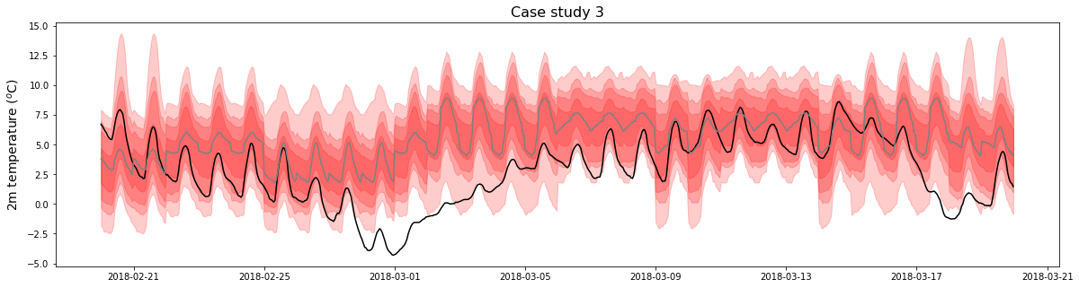
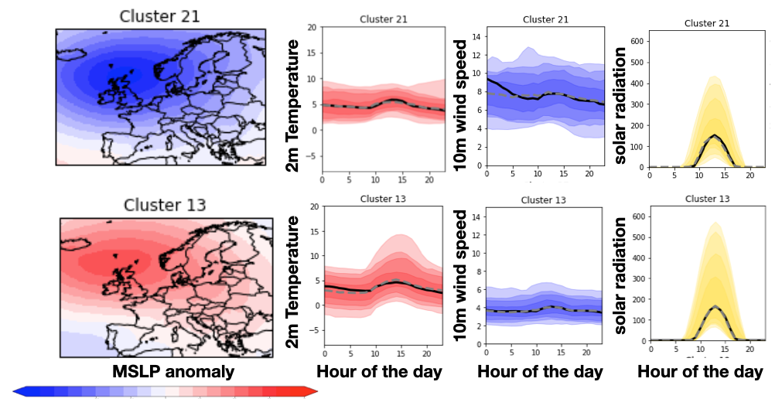
Analogues
K-means clustering principal components of gridded MSLP.
30 Clusters, December-March similar to Neal et al., (2016)
Analogues are a diurnal cycle conditioned on the large scale weather.
Problems from midnight -1am (jumpy) and with extremes (out of sample)

Slide 12
Summary
For fields with well pronounced diurnal cycles (2m temperature and net shortwave irradiance) we have made good progress in recreating diurnal cycles.
The simple models have proved hard to beat
Issues still exist in transition from midnight to 1am in multiple methods
Making use of our ‘perfect foresight/hindsight’ to create lagged variables improved the downscaling skill.
Potentially more value in the machine learning methods at a gridded scale.

Slide 13
Summary
Downscaling wind speed has proved quite a challenge!
New methods are much better than a mean diurnal cycle, but do not contain all small scale features.
Future work refining the analogue methods, fourier analysis and the gridded approaches may help with this
Best suitable methods as of now:
2m Temperature:
Mean normalised historical diurnal cycles, smoothed to neighboring days
10m Wind speed:
Linear Regression
Solar Radiation:
Mean normalised historical diurnal cycles

Slide 14
Future work
Can we use large-scale features (e.g. Euro-Atlantic principal component time series) to improve model skill?
Can we make the methods applicable to smaller regions, such as the National grid GSP zones?
Do the methods used here still work well in a future climate?
Are we using the most appropriate verification methods?

Slide 15
Extra slides

Slide 16
