Slide 1
Hypothesis Testing: Summarizing Information about Causal Effects
Fill In Your Name

Slide 2
Table of Contents
Key Points for this lecture
The Role of Hypothesis Tests in Causal Inference
Ingredients of a hypothesis test
A hypothesis is a statement about or model of a relationship between potential outcomes
Test statistics summarize treatment to outcome relationships
Linking test statistic and hypothesis.
Generating the distribution of hypothetical test statistics
Plot the randomization distributions under the null
P-values summarize the plots
How to do this in R.
How to do this in R.
Next topics:
Testing the weak null of no average effects
Testing the weak null of no average effects
Testing the weak null of no average effects
Rejecting hypotheses and making errors
Decision imply errors
Diagnosing false positive rates by simulation
Diagnosing false positive rates by simulation
Diagnosing false positive rates by simulation
Diagnosing false positive rates by simulation
Diagnosing false positive rates by simulation
False positive rate with $N=60$ and binary outcome
False positive rate with $N=60$ and continuous outcome
Topics for later
Summary:
What else to know about hypothesis tests.
What else to know about hypothesis tests.
Exercise: Hypothesis Tests and Test Statistics
Report and Discuss the Results of the Exercise
References

Slide 3
Key Points for this lecture
Statistical inference (e.g. hypothesis tests and confidence intervals) is inference — reasoning about the unobserved.
$p$-values require probability distributions.
Randomization (or Design) + a Hypothesis + a Test Statistic Function $→$ probability distributions representing the hypothesis (reference distributions)
And Observed Values of Test Statistics + Reference Distribution $→$ $p$-value.

Slide 4
The Role of Hypothesis Tests in Causal Inference
The Fundamental Problem of Causal Inference says that we can see only one potential outcome for any given unit.
So, a counterfactual causal effect of the treatment, $Z$, for Jake is occurs when $y_{Jake,Z=1}≠y_{Jake,Z=0}$, then how can we learn about the causal effect?
One solution is Estimation of Averages of Causal Effects (the ATE, ITT, LATE). (What we call Neyman’s approach.)
Another solution is to make claims or guesses about the causal effects. We could say, “I think that the effect on Jake is 5.” or “This experiment had no effect on anyone.” And then we ask “How much evidence does this experiment have about that claim?” (This evidence is summarized in a $p$-value.) (We call this Fisher’s approach).
Notice: The hypothesis testing approach to causal inference doesn’t provide a best guess but instead tells you about evidence or information about a best guess. Meanwhile, the estimation approach provides a best guess but doesn’t tell you how much you know about that guess. Both approach can converge and we nearly always report both: “Our best guess of the treatment effect was 5, and we could reject the idea that the effect was 0 ($p$=.01).”

Slide 5
Ingredients of a hypothesis test
A hypothesis is a statement about a relationship among potential outcomes (Strong or Weak)
A test statistic summarizes the relationship between treatment and observed outcomes.
The design allows us to link the hypothesis and the test statistic: calculate a test statistic that describes a relationship between potential outcomes.
The design also generates a distribution of possible test statistics implied by the hypothesis
A $p$-value describes the relationship between our observed test statistic and the possible hypothesized test statistics

Slide 6
A hypothesis is a statement about or model of a relationship between potential outcomes
Y | Z | y0 | tau | y1 | Ybin
0 | 0 | 0 | 10 | 10 | 0
30 | 1 | 0 | 30 | 30 | 0
0 | 0 | 0 | 200 | 200 | 0
1 | 0 | 1 | 90 | 91 | 0
11 | 1 | 1 | 10 | 11 | 0
23 | 1 | 3 | 20 | 23 | 0
34 | 1 | 4 | 30 | 34 | 0
45 | 1 | 5 | 40 | 45 | 0
190 | 0 | 190 | 90 | 280 | 1
200 | 0 | 200 | 20 | 220 | 1

Slide 7
For example, the sharp, or strong, null hypothesis of no effects is $H_{0}:y_{i,1}=y_{i,0}$

Slide 8
Test statistics summarize treatment to outcome relationships
[1] -49.6
[1] 1

Slide 9
Linking test statistic and hypothesis.
What we observe for each person, $i$, ($Y_{i}$) is either what we would have observed in treatment ($y_{i,1}$) or what we would have observed in control ($y_{i,0}$).
$$Y_{i}=Z_{i}y_{i,1}+(1−Z_{i})*y_{i,0}$$
So, if $y_{i,1}=y_{i,0}$ then: $Y_{i}=y_{i,0}$: What we actually observe is what we would have observed in the control condition.

Slide 10
Generating the distribution of hypothetical test statistics
We need to know how to repeat our experiment:
Then we repeat it, calculating the implied test statistic each time:

Slide 11
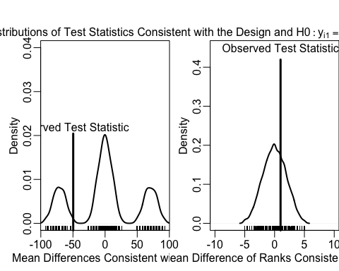
Plot the randomization distributions under the null
An example of using the design of the experiment to test a hypothesis.

Slide 12
P-values summarize the plots
[1] 0.7785
[1] 0.3198

Slide 13
How to do this in R.
[1] 0.451 99 percent confidence interval: 0.4102843 0.4921886
[1] 0.636 99 percent confidence interval: 0.5957254 0.6749611
hexbin (NA -> 1.27.3 ) [CRAN] ddst (NA -> 1.4 ) [CRAN] kSamples (NA -> 1.2-9 ) [CRAN] orthopolynom (NA -> 1.0-5 ) [CRAN] evd (NA -> 2.3-3 ) [CRAN] SuppDists (NA -> 1.1-9.4) [CRAN] The downloaded binary packages are in /var/folders/8g/6v5gz3w53jjfqv8z6ylrdq6c0000gn/T//RtmpgQe2GU/downloaded_packages checking for file ‘/private/var/folders/8g/6v5gz3w53jjfqv8z6ylrdq6c0000gn/T/RtmpgQe2GU/remotes22e862961f39/markmfredrickson-RItools-94a2e84/DESCRIPTION’ ... ✔ checking for file ‘/private/var/folders/8g/6v5gz3w53jjfqv8z6ylrdq6c0000gn/T/RtmpgQe2GU/remotes22e862961f39/markmfredrickson-RItools-94a2e84/DESCRIPTION’ (565ms) ─ preparing ‘RItools’: (1.7s) checking DESCRIPTION meta-information ... ✔ checking DESCRIPTION meta-information ─ excluding invalid files (355ms) Subdirectory 'man' contains invalid file names: ‘AVOID-EDITING-Rd-FILES.md’ ─ checking for LF line-endings in source and make files and shell scripts ─ checking for empty or unneeded directories ─ looking to see if a ‘data/datalist’ file should be added ─ building ‘RItools_3.0.0.tar.gz’
Call: RItest(y = dat$Y, z = dat$Z, test.stat = meanTZ, sampler = thedesignA, samples = 1000) Value Pr(>x) Observed Test Statistic -49.6 0.7817
Call: RItest(y = dat$Y, z = dat$Z, test.stat = meanrankTZ, sampler = thedesignA, samples = 1000) Value Pr(>x) Observed Test Statistic 1 0.3175

Slide 14
How to do this in R.
term estimate two_tailed_p_value 1 Z -49.6 0.4444444
term estimate two_tailed_p_value 1 Z 1 0.6349206

Slide 15
Next topics:
Testing weak null hypotheses $H_{0}:{\overline{y}}_{1}={\overline{y}}_{0}$
Rejecting null hypotheses (and making false positive and/or false negative errors)
Power of hypothesis tests
Maintaining correct false positive error rates when testing more than one hypothesis.

Slide 16
Testing the weak null of no average effects
The weak null hypothesis is a claim about aggregates, and is nearly always stated in terms of averages: $H_{0}:{\overline{y}}_{1}={\overline{y}}_{0}$ The test statistic for this hypothesis nearly always is the difference of means (i.e. meanTZ() above.
Z 0.3320959 0.3587401 0.3587401
Why is the OLS $p$-value different? What assumptions is it making?

Slide 17
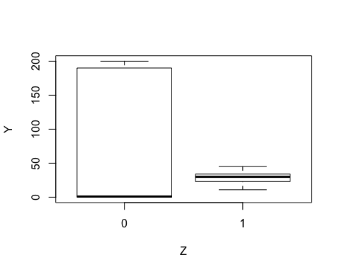
Testing the weak null of no average effects

Slide 18
Testing the weak null of no average effects
observedTestStat stderror tstat pval -49.6000000 48.0447708 -1.0323704 0.3320959

Slide 19
Rejecting hypotheses and making errors
How should we interpret 0.7785? What about 0.3198?
What does it mean to “reject” $H_{0}:y_{i,1}=y_{i,2}$ at $α=.05$?
“In typical use, the level of the test [$α$] is a promise about the test’s performance and the size is a fact about its performance…” (Rosenbaum 2010, Glossary)

Slide 20
Decision imply errors
If errors are necessary, how can we diagnose them? How to learn whether our hypothesis testing procedure might generate too many false positive errors?
Diagnose by simulation:

Slide 21
Diagnosing false positive rates by simulation
Across repetitions of the design:
Create a true null hypothesis.
Test the true null.
The $p$-value should be large.
The proportion of small $p$-values should be no larger than $α$.

Slide 22
Diagnosing false positive rates by simulation
Example with a binary outcome.

Slide 23
Diagnosing false positive rates by simulation
lmp neyp rtp rtpRank [1,] 2225 2225 2225 2225 [2,] 2775 2775 2775 2775

Slide 24
Diagnosing false positive rates by simulation
lmp neyp rtp rtpRank 0 0 0 0
lmp neyp rtp rtpRank 0.445 0.445 0.000 0.000

Slide 25
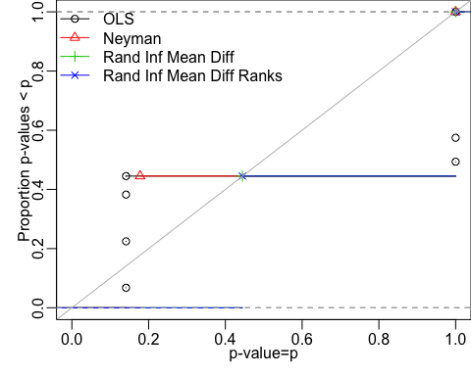
Diagnosing false positive rates by simulation

Slide 26
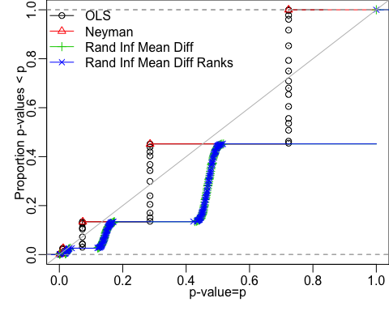
False positive rate with $N=60$ and binary outcome

Slide 27
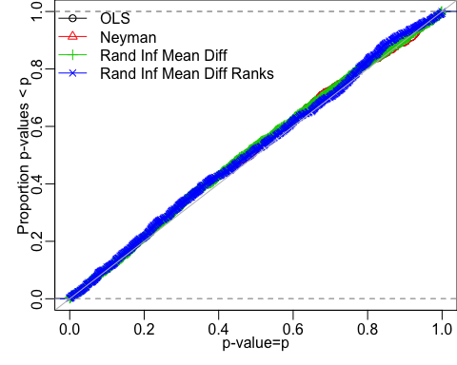
False positive rate with $N=60$ and continuous outcome

Slide 28
Topics for later
Power of tests

Slide 29
Summary:
A good test (1) casts doubt on the truth rarely and (2) easily distinguishes signal from noise (casts doubt on falsehoods often).
We can learn whether our testing procedure controls false positive rates given our design.
When false positive rates are not controlled, what might be going wrong? (often has to do with asymptotics)

Slide 30
What else to know about hypothesis tests.
Here we list a few other important but advanced topics connected to hypothesis testing:
Even if a given testing procedure controls the false positive rate for a single test, it may not control the rate for a group of multiple tests. See 10 Things you need to know about multiple comparisons for a guide to the approaches to controlling such rejection-rates in multiple tests.
A $100α$% confidence interval can be defined as the range of hypotheses where all of the $p$-values are greater than or equal to $α$. This is called inverting the hypothesis test. (Rosenbaum (2010)). That is, a confidence interval is a collection of hypothesis tests.
A point estimate based on hypothesis testing is called a Hodges-Lehmann point estimate. (Rosenbaum (1993),Hodges and Lehmann (1963))

Slide 31
What else to know about hypothesis tests.
A set of hypothesis tests can be combined into one single hypothesis test (Hansen and Bowers (2008),Caughey, Dafoe, and Seawright (2017))
In equivalence testing, one can hypothesize that two test-statistics are equivalent (i.e. the treatment group is the same as the control group) rather than only about one test-statistic (the difference between the two groups is zero) {Hartman and Hidalgo (2018)}
Since a hypothesis test is a model of potential outcomes, one can use hypothesis testing to learn about complex models, such as models of spillover and propagation of treatment effects across networks (Bowers, Fredrickson, and Panagopoulos (2013), Bowers, Fredrickson, and Aronow (2016), Bowers et al. (2018))

Slide 32
Exercise: Hypothesis Tests and Test Statistics
If an intervention was very effective at increasing the variability of an outcome but did not change the mean, would the $p$-value reported by R or Stata if we used lm_robust() or difference_of_means() or reg or t.test be large or small?
If an intervention caused the mean in the control group to be moderately reduced but increased a few outcomes a lot (like a 10 times effect), would the $p$-value from R lm_robust() or difference_of_means() be large or small?

Slide 33
Report and Discuss the Results of the Exercise

Slide 34
References
Bowers, Jake, Bruce A Desmarais, Mark Frederickson, Nahomi Ichino, Hsuan-Wei Lee, and Simi Wang. 2018. “Models, Methods and Network Topology: Experimental Design for the Study of Interference.” Social Networks 54. Elsevier: 196–208.
Bowers, Jake, Mark Fredrickson, and Peter M Aronow. 2016. “Research Note: A More Powerful Test Statistic for Reasoning About Interference Between Units.” Political Analysis 24 (3): 395–403.
Bowers, Jake, Mark M Fredrickson, and Costas Panagopoulos. 2013. “Reasoning about Interference Between Units: A General Framework.” Political Analysis 21 (1). SPM-PMSAPSA: 97–124.
Caughey, Devin, Allan Dafoe, and Jason Seawright. 2017. “Nonparametric Combination (Npc): A Framework for Testing Elaborate Theories.” The Journal of Politics 79 (2). University of Chicago Press Chicago, IL: 688–701.
Hansen, Ben B., and Jake Bowers. 2008. “Covariate Balance in Simple, Stratified and Clustered Comparative Studies.” Statistical Science 23 (2): 219–36.
Hartman, Erin, and F Daniel Hidalgo. 2018. “An Equivalence Approach to Balance and Placebo Tests.” American Journal of Political Science 62 (4). Wiley Online Library: 1000–1013.
Hodges, J.L., and E.L. Lehmann. 1963. “Estimates of location based on rank tests.” Ann. Math. Statist 34: 598–611.
Rosenbaum, Paul R. 1993. “Hodges-Lehmann Point Estimates of Treatment Effect in Observational Studies.” Journal of the American Statistical Association 88 (424). American Statistical Association: 1250–3.
Rosenbaum, P R. 2010. “Design of observational studies.” Springer Series in Statistics. New York [etc.]: Springer.

