Slide 1

UGRP Report
Resource Optimization :
Wireless Communication Deep Learning Cooperation
201511080 박준서
201911035 김진휘

Slide 2
Index
Intermediate Report
Implementation Model
Plan

Slide 3
Intermediate Report
AI Application - Object Detection YoloV4 : Python & C++
Why did we implement object detection applications in both Python and C++ versions? - To compare the realistic performance differences of two versions. - To justify why we should use an AI application of a specific language.

Slide 4
Intermediate Report
Python Version - Python Darknet Framework
C++ Version - C++ Darknet Framework (Original version of darknet) -
Implementation Method - We chose a GPU model for the AI application - It is expected to make our system more efficiently because it can guarantee CPU usage.

Slide 5
Intermediate Report
Communication Module - Data Communication Module Template was successfully made in both Python and C++ versions. - It can transmit image, string data, etc. - We will apply decentralized system model policies. # Issue : must develop a policy for data transmission about some devices.
Data
Jetson
Jetson

Slide 6
Implementation Model
Core 1
Core 2
Core 3
…
Core n
GPU
Cores
Local Pre-
Processing
Bottleneck
Detection
Communi-cation
Jetson 1
Jetson 2
Inference
Result
Com.
Ack.
Coop.
Result
Jetson N
Inference
Result
Notes:
간단하게 생각하면 이런 식이 될 듯? (Local Processing Latency) * (Cooperation Devices)> (Communication Latency) * (Cooperation Devices)+ Inference Latency

Slide 7
Implementation Model
CPU
Local Processing
Images
Local Queue
Bottleneck
Check
Cooperation
Cooperation Queue
Inference Result
Merge

Slide 8
Implementation Model
Implementation Plan About Issues a. How to share data with each cores? - In python, use a queue structure for threading. - In C++, use a shared memory structure on a memory. b. How to communicate with other Jetson devices? - Algorithm team will develop a policy for this communication. - For now, make a communication module of unintelligent cooperation.

Slide 9
Implementation Model
Two Communication Method a. Multi-threading Cooperation - Multiple threads involve in communication for a cooperation. - Issue : About a merging issue. b. Single Thread Cooperation - Only one thread involves in communication for a cooperation.
Transmission
Cooperation

Slide 10
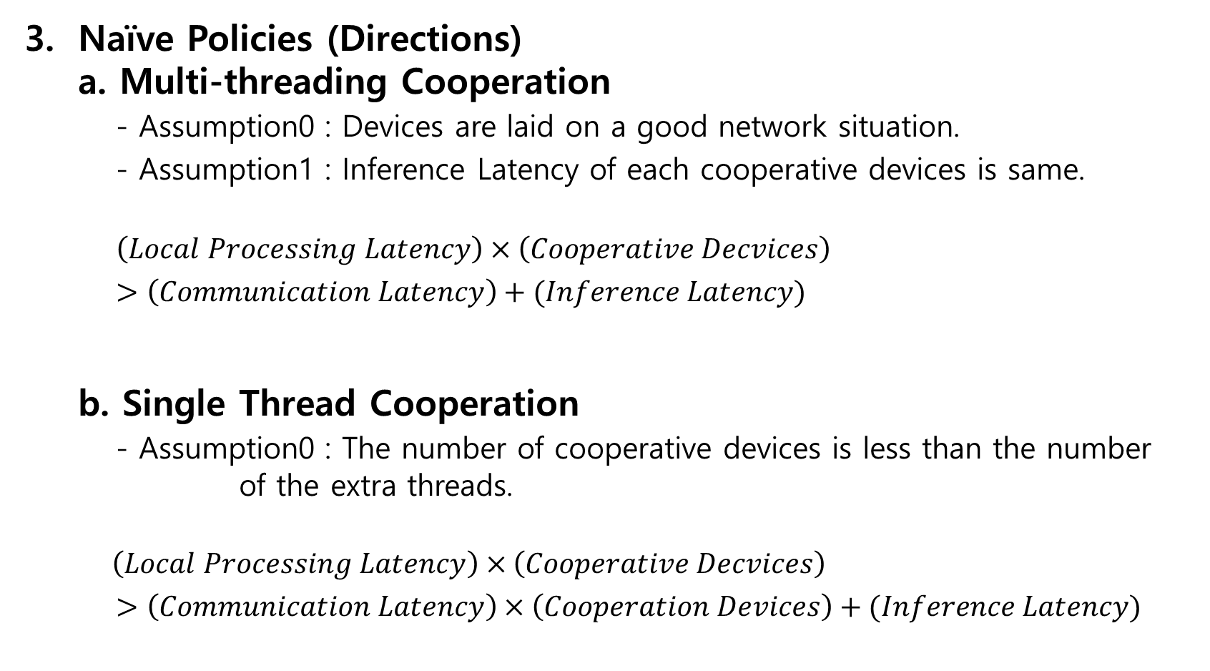
Implementation Model
Naïve Policies (Directions) a. Multi-threading Cooperation - Assumption0 : Devices are laid on a good network situation. - Assumption1 : Inference Latency of each cooperative devices is same. $\left(Local Processing Latency\right)×\left(Cooperative Decvices\right)$ $>\left(Communication Latency\right)+(Inference Latency)$ b. Single Thread Cooperation - Assumption0 : The number of cooperative devices is less than the number of the extra threads. $\left(Local Processing Latency\right)×\left(Cooperative Decvices\right)$ $>\left(Communication Latency\right)×\left(Cooperation Devices\right)+(Inference Latency)$

Slide 11
Plan
Plans for the Implementation Team - (IN TWO WEEKS) - Comparison of Yolo model between Python and C++. - Comparison of communication module performance between Python and C++. - Code modification for cooperation communication among the devices.
Curiosity - Task A: 0.5 sec & Task B: 0.7 sec → By Task A, if setting one timeslot is 0.5 sec, then can we say Task B consume two time slots? - Are two mentioned comparisons reasonable? - Is it a correct approach about mathematical formulas for an algorithm? - And which policy is more realizable and valid? - How to approach to a cooperation algorithm more reasonably?

Slide 12
THANK YOU!

