Slide 1
IT550 - Introduction to Information Retrieval
Parth Mehta
NLP Research Scientist, Parmonic

Slide 2
What this course will be…
Up to date with the latest breakthroughs like Neural IR, LLMs and RAG
Less theory and more hands on. Some lectures will be converted to labs.
Programming heavy

Slide 3
What this course will not be…
Easy
Something that can be done in the week before exams. If you just want to skim through, this course is not for you
Programming class. If you are not at least decent in coding, this course is not for you

Slide 4
Expected outcome
Good grasp of traditional as well as neural IR
Fluency in some of the most popular IR / NLP / ML concepts
Exposure to at least one open source search engine (Terrier / Elastic / Vector DBs)
“Some” exposure to what is directly useful in the industry

Slide 5
Class and Lab Format
Topics to be discussed in class during a week will be shared in the preceding week (starting next week)
Relevant datasets and lab manual of a lab session will be shared in the preceding week
Participants are expected to come prepared with some background reading / code for classes and labs
Notes:
Having some exposure helps in discussing the topics in more detail.

Slide 6
Key Dates
First Insem ( 29 August - 2 September)
Project Topic Finalization - 5 min lightning talk (3-5 September)
End Sem Exam (23 November - 02 December)
Final Project Presentation - (04 - 06 December)*
* Tentative

Slide 7
Grading Scheme
In-sem - 20%
End-sem - 20%
Lab - 20%
Project - 40%
Extraordinary effort bonus - 10%
Notes:
Extra ordinary - wrote a indexing code thats faster than terrier, insightful question, successfully completed a very difficult project. This bonus will be discretionary. It will be declared, just like other components, so a student knows
If you have 100% and still score the extra 10% - a special treat at the end of the course.

Slide 8
Course outline
Classical IR (15 Lectures + 4 Labs) ~Insem 1
Basics of IR
Term weighting and Ranking
Evaluation
Query Operations
Probabilistic IR
Web Search

Slide 9
Course outline
Neural IR (11 Lectures + 4 Labs) ~Endsem
Distributed Word Representations (AKA embeddings)
Neural Information Retrieval
Search in Post LLM Era
Domain Specific Applications

Slide 10
Course Outline
Lab Only Topics (8 Lectures converted to 4 labs)
Text Classification
Text Clustering
Distributed IR
Elasticsearch and Kibana

Slide 11
Call for Voluntary TAs
Help with planning and running the lab sessions, creating baseline systems
Why?
Chance to learn something extra. More in-depth discussions with me then possible in lab/lectures
No extra credits for volunteering
Possible extra credits IF the extra learning leads to better projects
Volunteers will not be performing any type of grading

Slide 12
Useful Resources
Books
Introduction to Information Retrieval - Christopher Manning, Prabhakar Raghavan and Hinrich Schütze
An Introduction to Neural Information Retrieval - Bhaskar Mitra and Nick Crasswell
Mailing lists
SIGIR, ML-NEWS, FIRE, CORPORA
Evaluation Forums
TREC, CLEF, FIRE, NTCIR

Slide 13
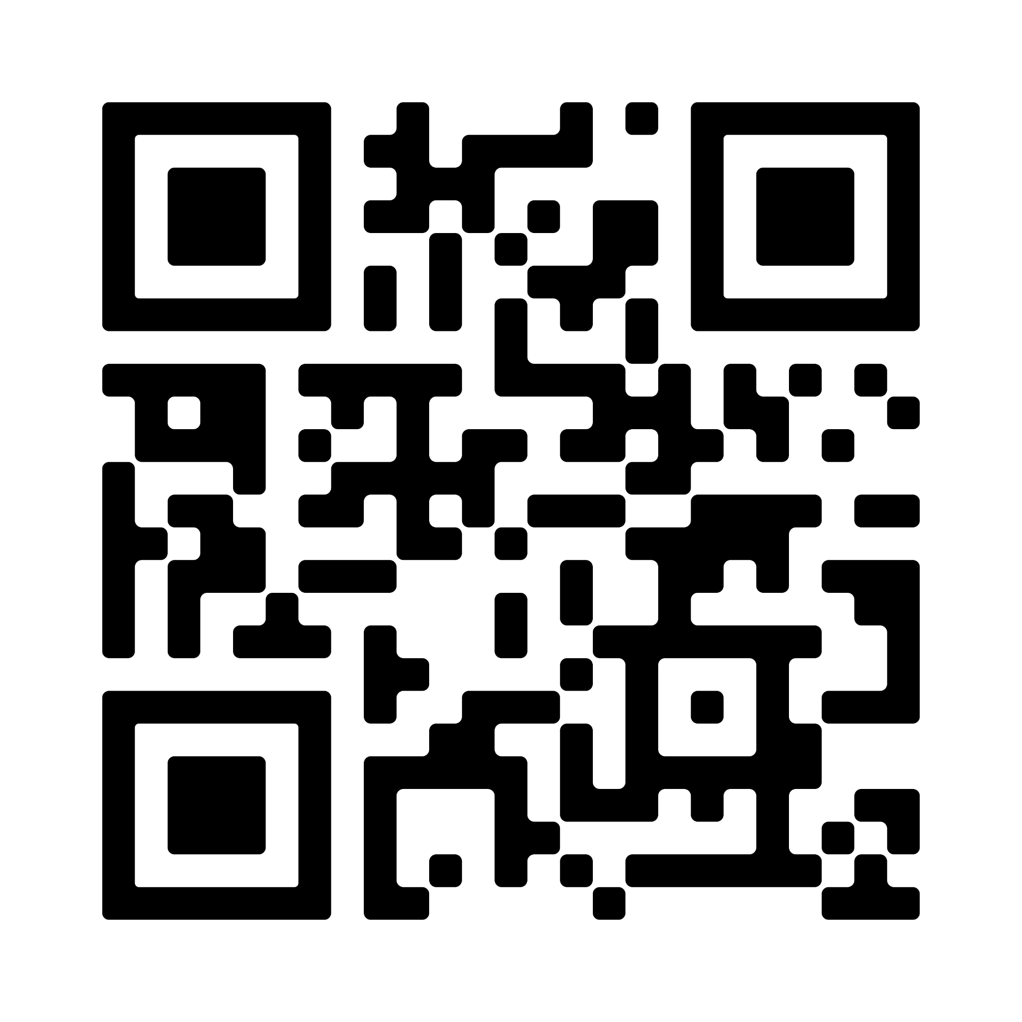
Questions?
parth.mehta126@gmail.com

