Slide 1
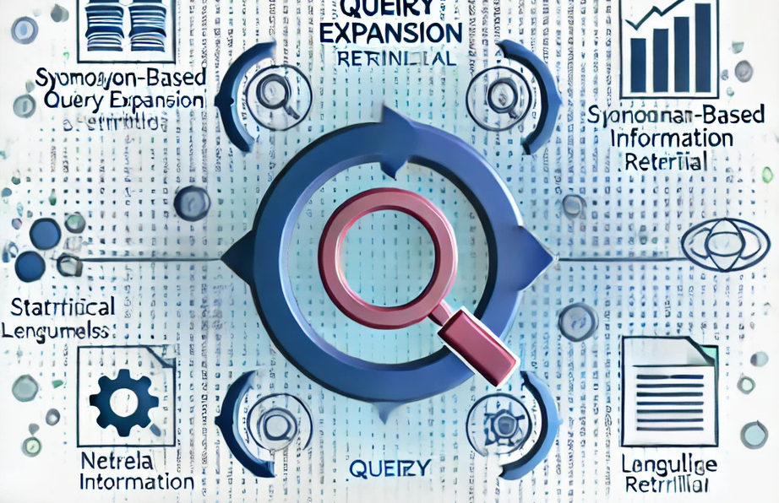
QUERY EXPANSION & RANKING EVALUATION.
BHAVIK MANWANI
MANTHAN SOLANKI
ANMOL POONIA
KANISHK PAREEK
ISSUE NO: 15

Slide 2
IR
INTRODUCTION
Title: Advanced Query Expansion & Ranking Evaluation.
Content:
Objective: Leverage advanced query expansion techniques to enhance document retrieval accuracy in the TREC-COVID dataset.
Problem: Improve retrieval by addressing:
Ambiguity in user queries.
Insufficient term matching.
Core methods:
Synonym-based semantic expansion.
Co-occurrence (PMI)-based statistical relevance.
Neural model-based contextual suggestions.
Highlights: Combines traditional and advance methods with measurable improvements in ranking metrics.

Slide 3
IR
DATASET OVERVIEW:
Content:
Dataset Source: TREC-COVID (CORD-19 subset).
Documents: Biomedical articles (title + abstract combined).
Queries: 50 query descriptions reflecting real-world search tasks.
Relevance Judgements: Links queries to relevant documents (qrels).
Insights:
Conversion of dataset fields (title, abstract) into text ensures uniformity.
Pre-sampling 15,000 in for-loop records reduces computational overhead while maintaining relevance diversity.

Slide 4
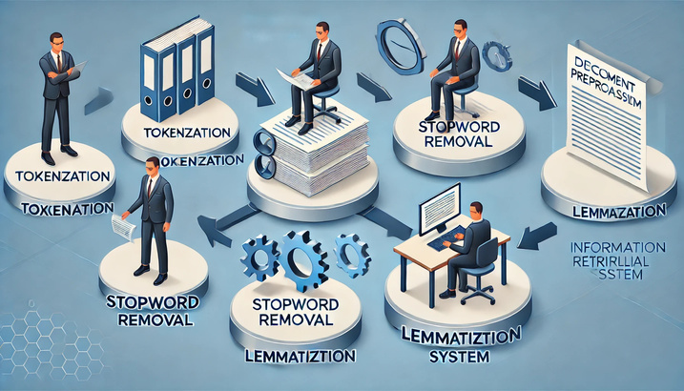
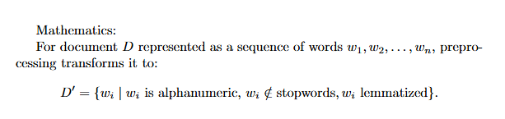
IR
PREPROCESSING:
Steps:
Tokenization: Breaking text into words.
Stopword Removal: Eliminates frequent but irrelevant terms.
Lemmatization: Reduces words to their base forms (e.g., "running" → "run").
Insights:
nltk.word_tokenize: Splits text.
stopwords.words('english'): Ensures critical terms are not overshadowed by noise.
WordNetLemmatizer: Links to WordNet for robust word base extraction.

Slide 5

IR
SYNONYM-BASED EXPANSION:
Content:
Approach: Expands queries using synonyms retrieved from WordNet.
Example:
Input Query: “virus” → Expansion: “virus, microorganism, pathogen”.
Insights:
wordnet.synsets: Fetches synsets for a term.
lemma.name(): Extracts human-readable synonyms.
Strength: Low-cost semantic enrichment improves recall.

Slide 6
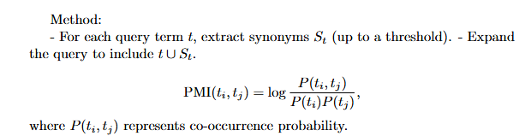
IR
PMI-BASED EXPANSION:
Content:
Approach: Captures statistically co-occurring terms using Pointwise Mutual Information.
Features:
CountVectorizer: Converts text into term frequency matrix.
Co-occurrence matrix calculated as XT⋅XX^T \cdot XXT⋅X.
Impact: Links terms with contextually strong associations.

Slide 7
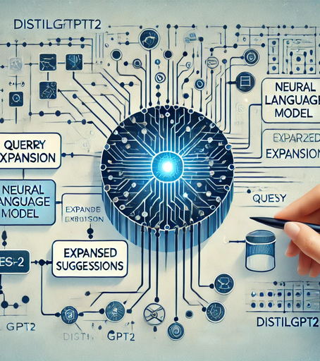
IR
PAGE 04
NEURAL MODEL-BASED EXPANSION:
Content:
Approach: Uses a transformer-based language model (distilgpt2) to generate context-rich expansions.
Code Insights:
pipeline('text-generation'): Predicts semantically and contextually relevant terms.
Temperature Control: Balances randomness and specificity in the output.
Strength: Captures nuanced, contextual relationships beyond explicit co-occurrence.
Example:
Query: “COVID symptoms” → Expanded Query: “COVID symptoms include fever, fatigue, and shortness of breath.”

Slide 8
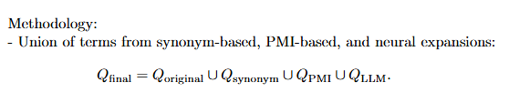
IR
COMBINING EXPANSIONS:
Content:
Objective: Unify strengths of all expansion techniques.
Insights:
Set operations ensure unique term inclusion.
Filters redundant or irrelevant terms to improve precision.
Impact: Balances statistical relevance, semantic richness, and contextual depth.

Slide 9

IR
DOCUMENT RANKING:
Content:
Primary Model: BM25 Algorithm
Neural Reranking: Sentence Transformers refine BM25-ranked documents based on embedding similarity.
Insights:
BM25 implemented using rank-bm25.
SentenceTransformer leverages vector embeddings for semantic similarity.

Slide 10
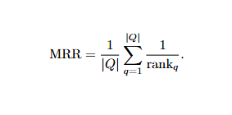
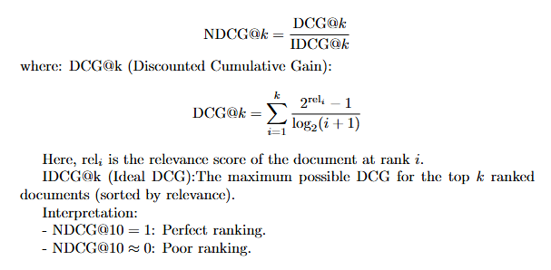
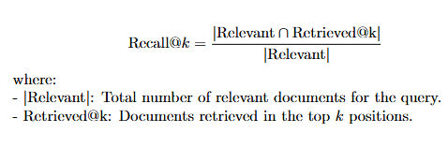
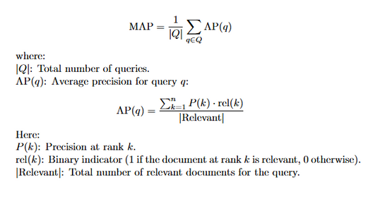
IR
EVALUATION METRICS:
MRR (Mean Reciprocal Rank):
NDCG@10: Normalized cumulative gain for top-10 results:
Recall@10: Fraction of relevant documents retrieved in top-10.
MAP (Mean Average Precision): Averages precision over ranks of relevant results

Slide 11

IR
ADVANCED OPTIMIZATIONS:
Content:
Query Reweighting: Balances the contribution of original and expanded terms:
Filtered Expansions: Retain only terms contributing to relevant document ranking.
Insights:
filter_expanded_terms evaluates term-document overlap.
reweight_query rebalances term importance dynamically.

Slide 12
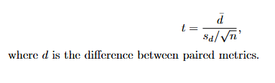
IR
STATISTICAL INSIGHTS:
Baseline vs. Expanded Query Metrics:
The code compares metrics like Mean Reciprocal Rank (MRR), Recall@10, and NDCG@10 for:
Baseline queries (original query without expansion).
Queries enhanced with expansions (synonym, PMI, and LLM).
Paired T-Test for Statistical Significance:
The paired t-test evaluates if the mean difference between two correlated sets of scores (e.g., baseline MRR and expanded MRR) is statistically significant.
Results from Code
T-Test Outputs:
Comparing baseline vs. expanded metrics:
T-statistic: -4.3359
P-value: 7.2099e-05
Interpretation: The p-value is well below 0.05, indicating significant improvement in retrieval performance using expanded queries.
Filtered Query Testing:
For filtered expanded queries:
T-statistic: 8.3126
P-value: 6.3802e-11
Interpretation: Filtering expands the gap further, showing that carefully curated expanded terms improve performance even more.

Slide 13
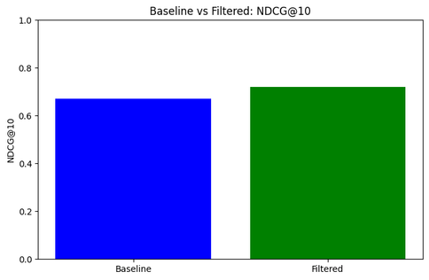
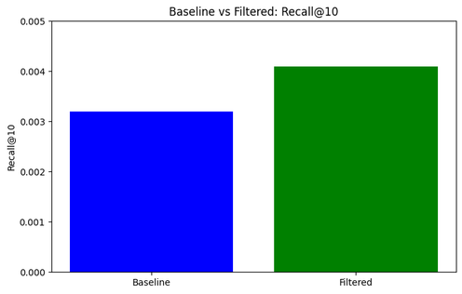
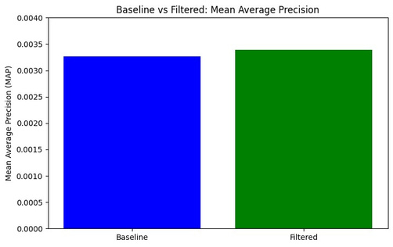
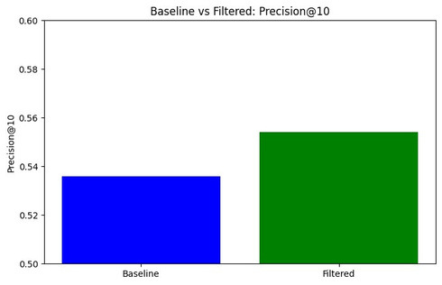
IR
RESULTS:
Results:
Baseline NDCG@10: 0.6902 → Filtered: 0.7531
Baseline Recall@10: 0.0032 → Filtered: 0.0043

Slide 14
IR
CONCLUSIONS:
Key Achievements:
Significant gains across all metrics (MRR, NDCG, Recall,Precision).
Demonstrated the effectiveness of combining expansion techniques.
Future Directions:
Adapt models for real-time retrieval.
Explore unsupervised query expansion for low-resource domains.

Slide 15
IR
THANK YOU

