Slide 1
https://github.com/20210330-12/COMP3011-Coursework1
Football Analytics & Community REST API
COMP3011 – Web Services and Web Data
Name
ID
Hany Song
202049082

Slide 2
COMP3011 Coursework 1
Project Motivation
Problem
Goal
Key Idea
Football statistics are widely available but often fragmented across multiple platforms.
Create a unified REST API that provides:
football analytics
community interaction
Combine football analytics and community interaction in a single API platform.

Slide 3
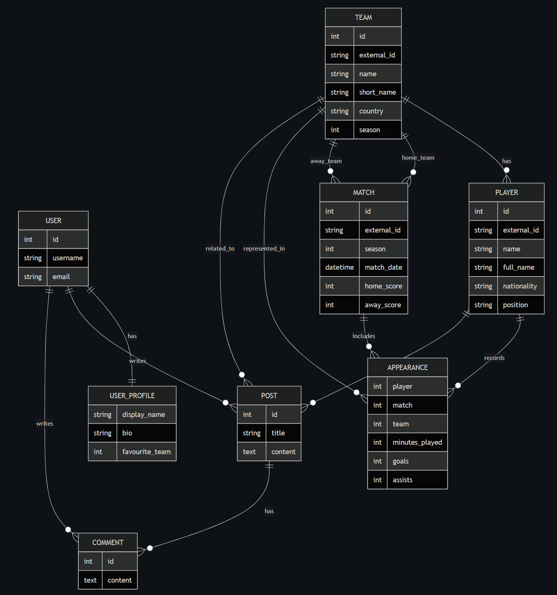
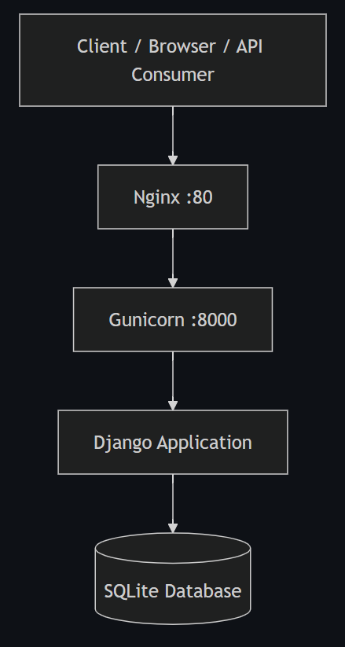
COMP3011 Coursework 1
System Architecture & Database Design
AWS EC2
Deployment challenge:
EC2 t3.nano memory limitation
Solution:
Reduced Gunicorn workers
Production Deployment Diagram
ERD →

Slide 4
COMP3011 Coursework 1
API Features & Analytics Example
Main API Features
Analytics
Football data endpoints
Player statistics
Match information
Analytics endpoints
Community posts and comments
Token authentication
ex. League standings calculation
Matches → appearances→ aggregated statistics
Win = 3 points
Draw = 1 point
Loss = 0 points

Slide 5
COMP3011 Coursework 1
Conclusion
Key Outcomes
Future Work
RESTful football analytics API
Community discussion system
Real dataset integration
External deployment
Advanced analytics
Frontend interface
Live sports data
Performance optimization (caching)

Slide 6
Next Pages → Dedicated Sections
Thank you, Questions?
https://github.com/20210330-12/COMP3011-Coursework1
Name
ID
Hany Song
202049082

Slide 7
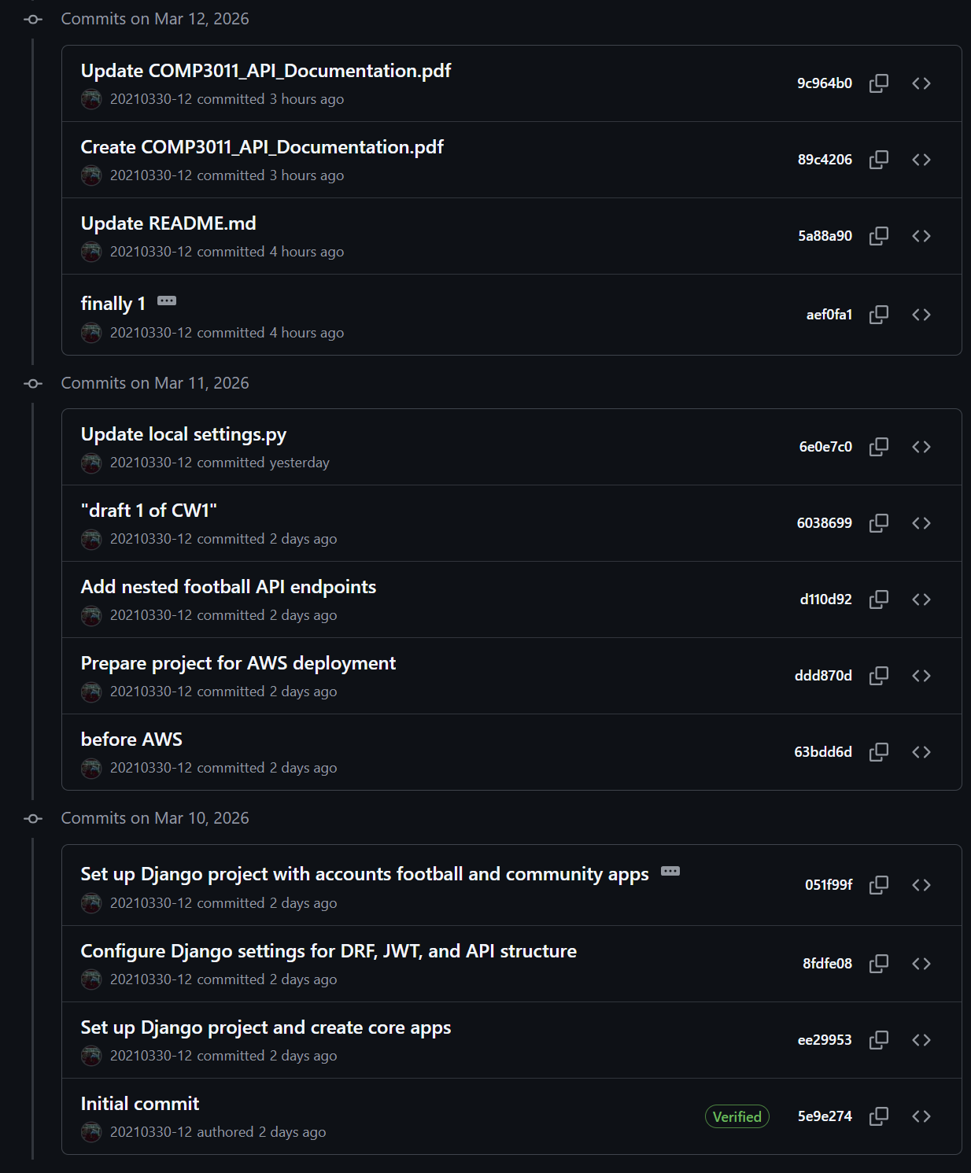
COMP3011 Coursework 1
Version Control Practices and Commit History
Repository: https://github.com/20210330-12/COMP3011-Coursework1
Continuous commits throughout development
Separate commits for features, fixes, and documentation
Version control used to track API implementation and deployment changes
Commit history demonstrates iterative development

Slide 8
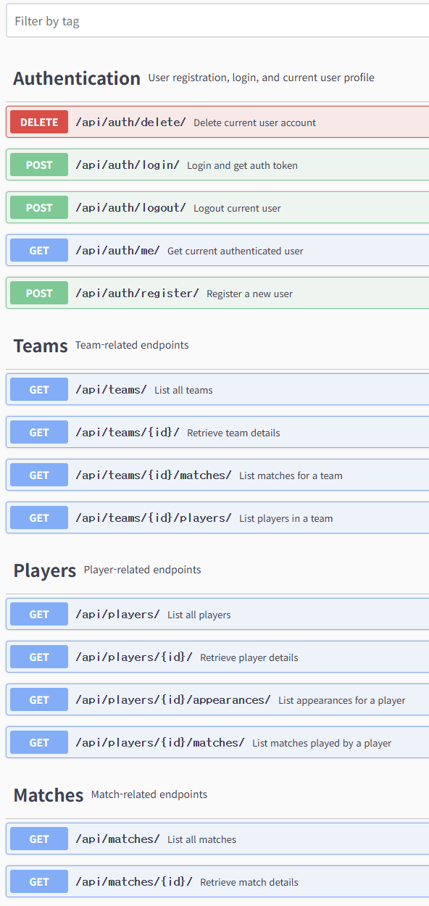
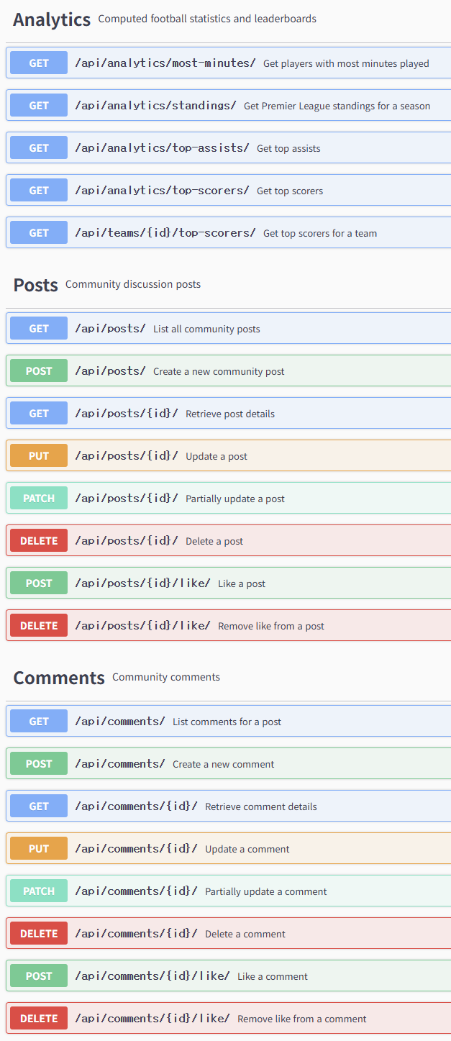
COMP3011 Coursework 1
API Documentation Overview
The documentation includes:
Available endpoints
Request parameters
Response schemas
Authentication requirements
Example responses and error codes
The documentation is exported as a PDF(using OpenAPI schema) and referenced in the project README & also Swagger UI

Slide 9
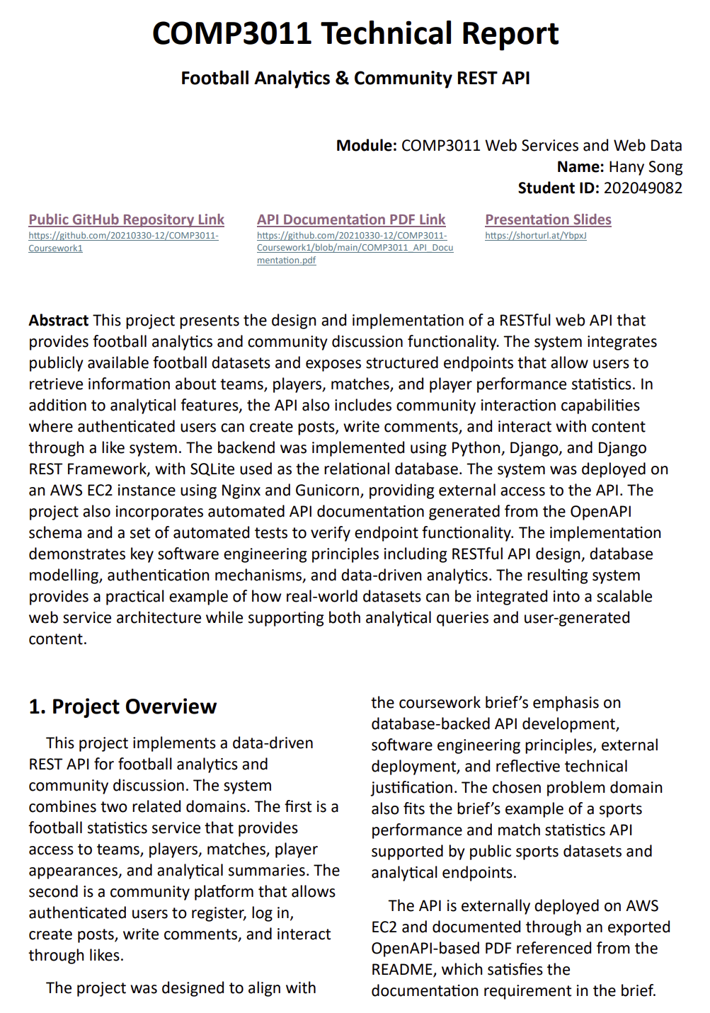
COMP3011 Coursework 1
Technical Report Highlights
The technical report documents the full development process.
Key aspects discussed in the report include:
System architecture and technology stack
Database schema and entity relationships
API design and analytics endpoints
Dataset import workflow
Deployment on AWS EC2 using Nginx and Gunicorn
Testing and evaluation of the API
Reflection on Generative AI usage

Slide 10
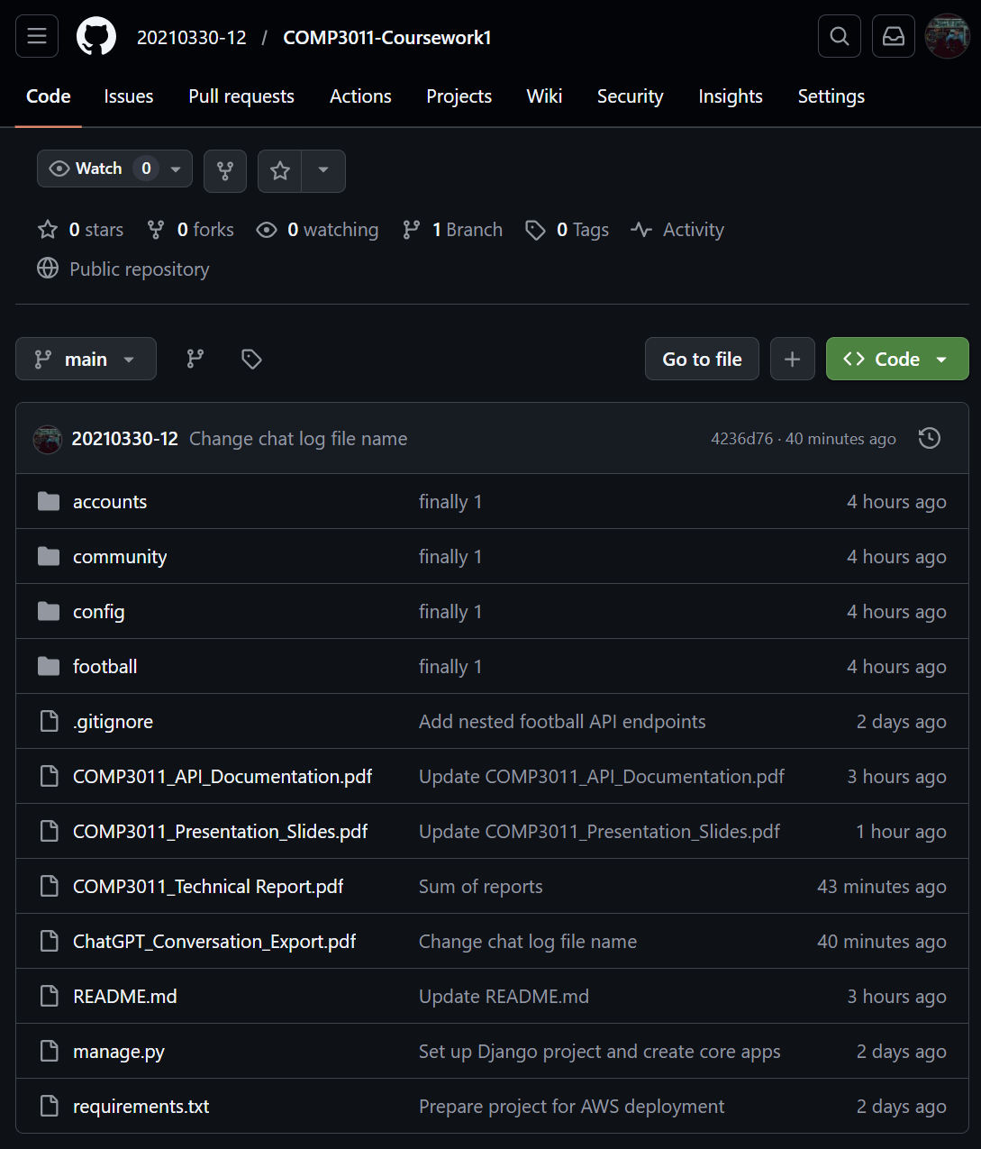
COMP3011 Coursework 1
Submission Deliverables
The following deliverables are provided for the coursework submission:
Public GitHub repository containing the source code
README file with project overview and setup instructions
API documentation exported as a PDF
Technical report describing system design and implementation
Presentation slides used for the oral examination
ChatGPT conversation export provided as supplementary material

