Slide 1
Autoencoder-based Feature Extraction for Scene Search in Live Nature Camera
Yukito Seo, Rafly Arief Kanza, Nobuya Watanabe, Kin Fun Li, Kosuke Takano
Notes:
Hello everyone.
皆さんこんにちは
My name is Yukito SEO
私の名前は瀬尾幸斗です．
I belong to the Department of Information Technology in Kanagawa Institute of Technology
神奈川工科大学，情報工学科に所属しています．
Thank you for giving me the opportunity to present today.
本日は発表の機会を頂き，ありがとうございます。
My theme is 「Autoencoder-based Feature Extraction for Scene Search in Live Nature Camera」
私の研究テーマは，「ライブネイチャーカメラでのシーン検索のためのオートエンコーダーベースの特徴抽出」です．

Slide 2
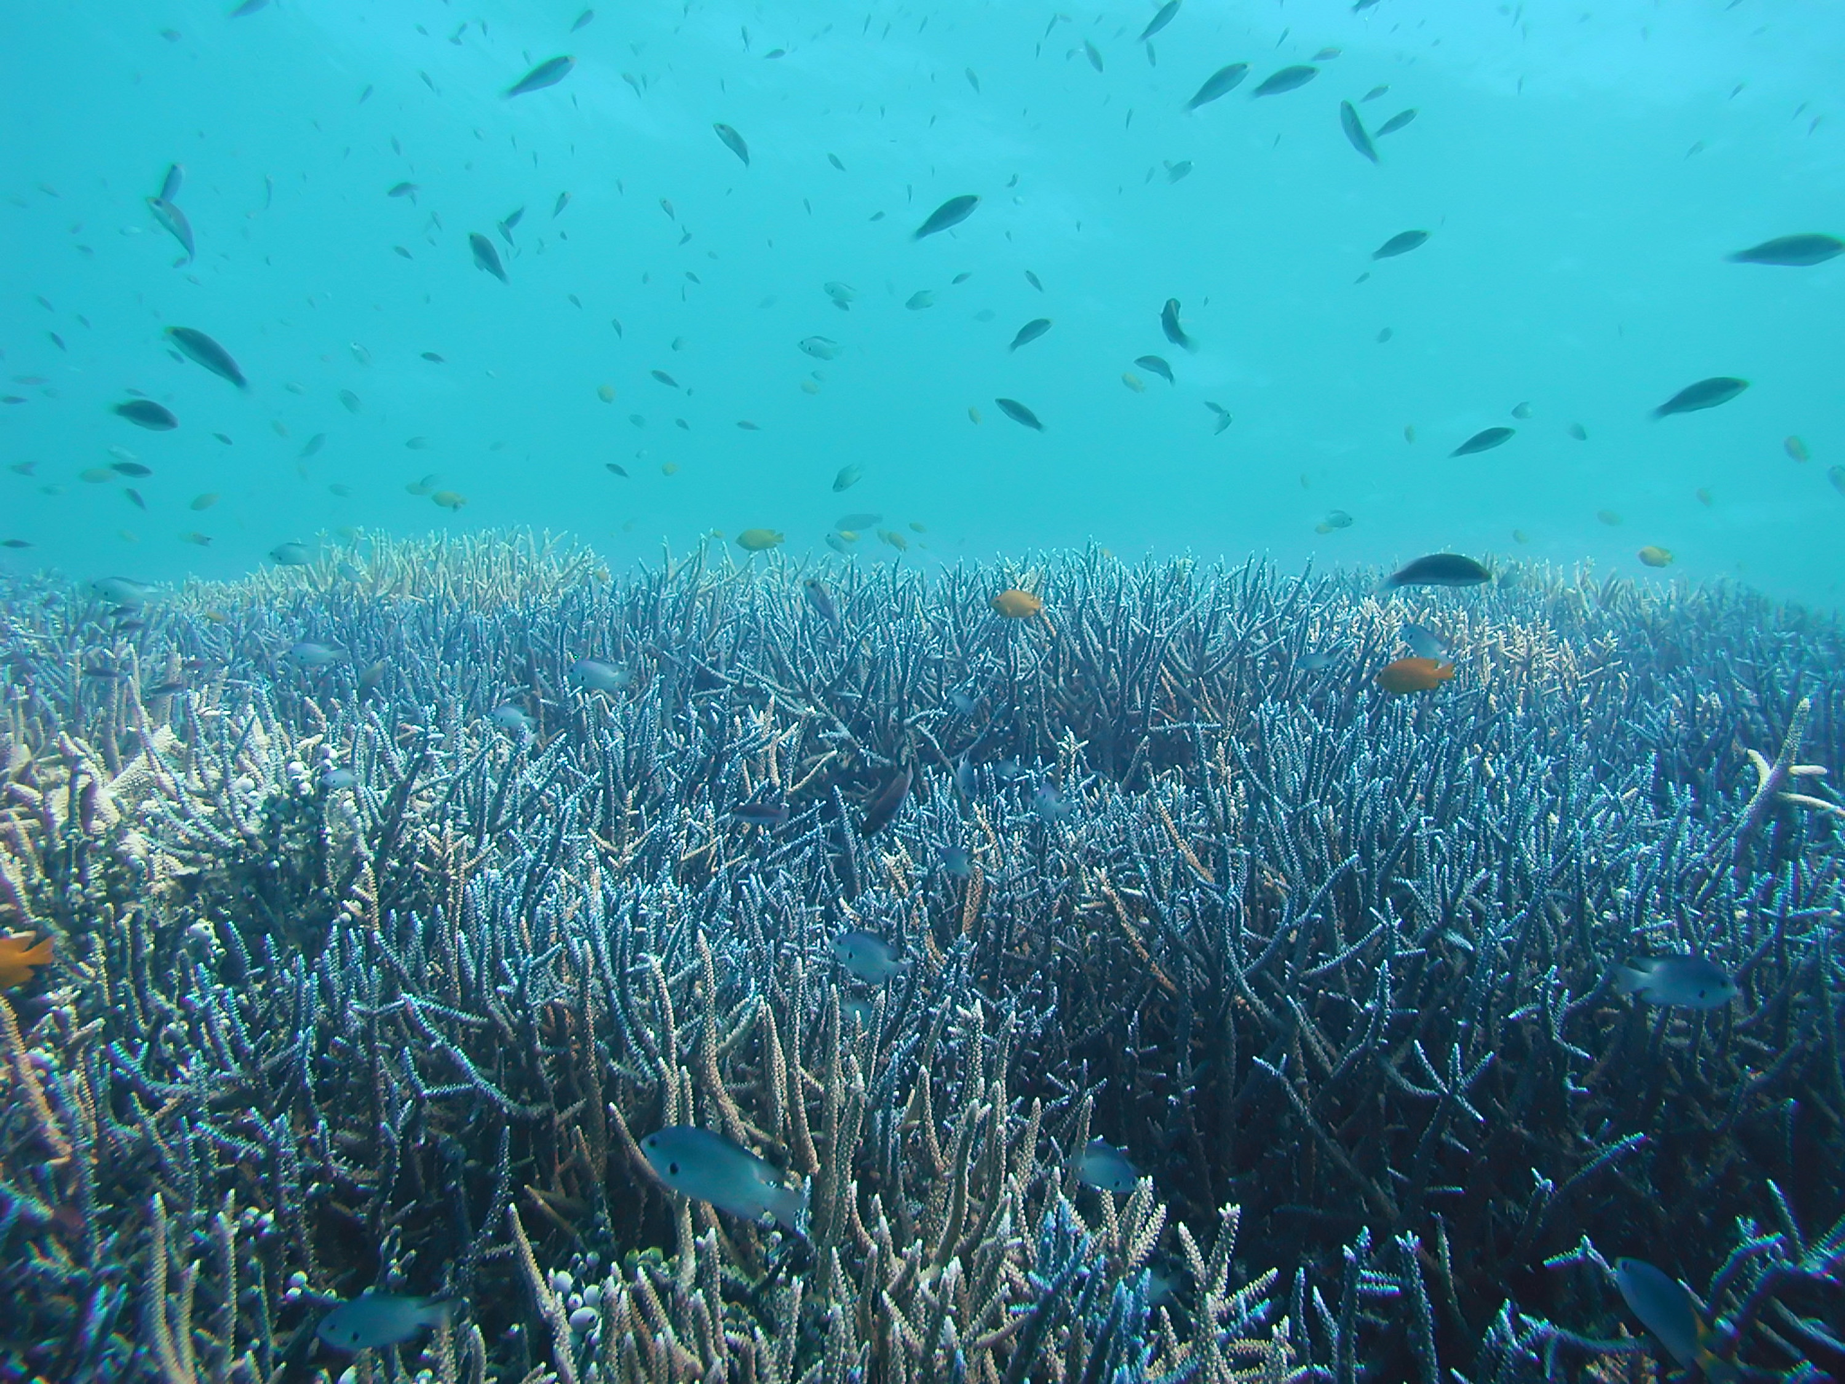
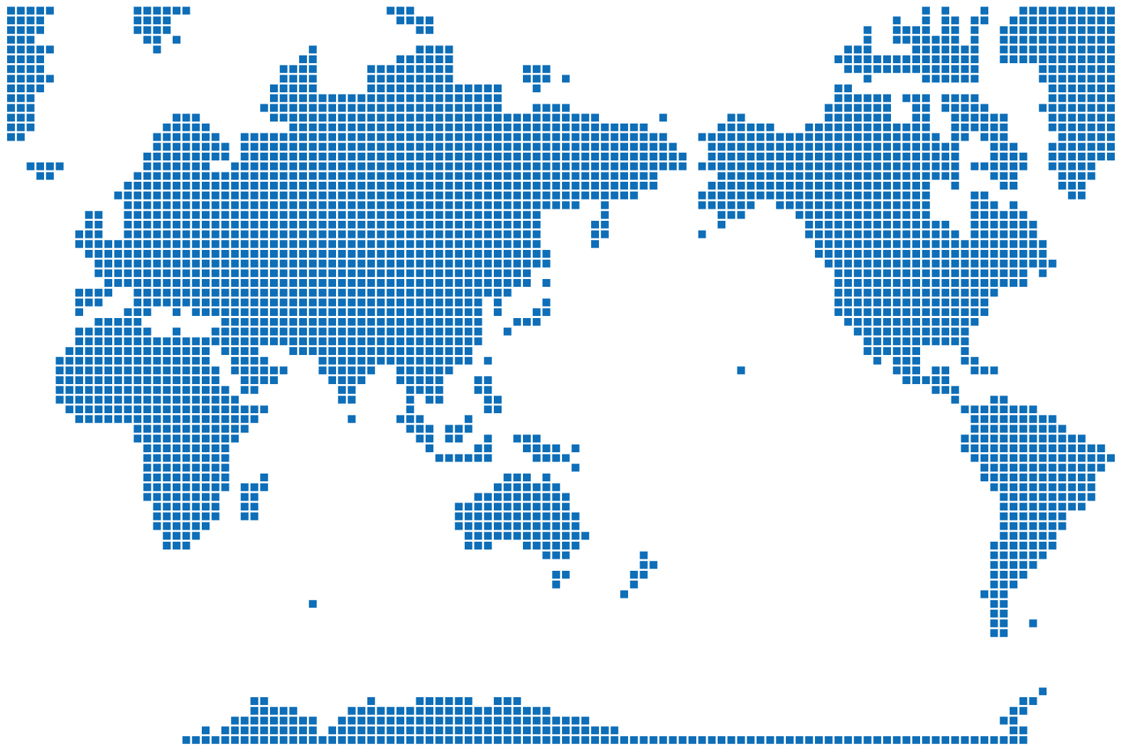
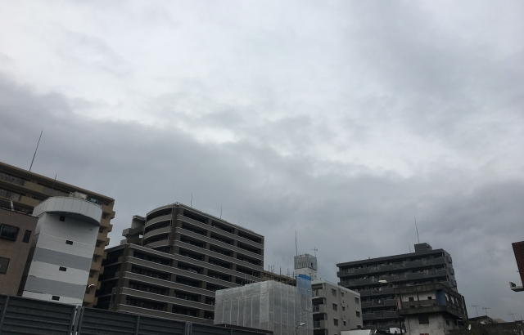
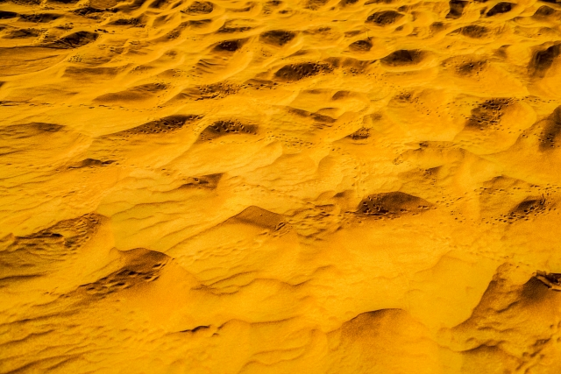
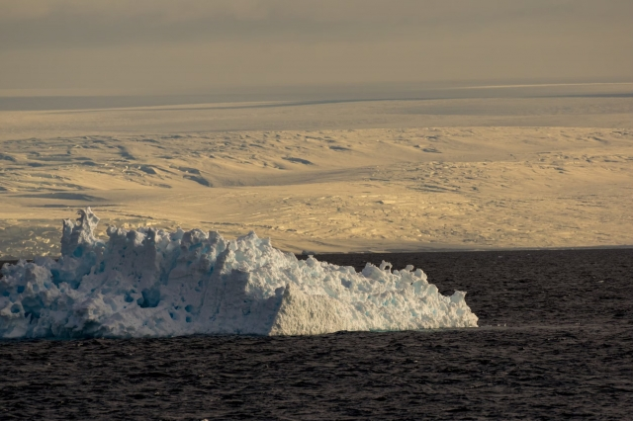
Background
Currently, the destruction of the natural environment due to global climate change has become a problem.
Destruction of coral reefs
Abnormal weather
Desertification
Sea level rise due to ice melting
Notes:
Currently, we are facing many problems due to global climate change.
現在，我々は地球規模の気候変動により，多くの問題に直面しています．
Examples include Destruction of coral reefs, Abnomal weather, Desertification, and Sea level rise due to ice melting.
例としては、サンゴ礁の破壊、異常気象、砂漠化、氷の融解による海面上昇などが挙げられます。

Slide 3





Background
Observation of the natural environment through monitoring is important to protect the natural environment.
By providing the monitored video as an archive, it can be analyzed by humans or machines.
Live camera
Scene search server
researcher
we will implement a system that can search scenes from data collected by live cameras.
Notes:
In order to protect the global environment, it would be useful to offer archives of video data of monitoring natural environment in as many spots as possible.
地球環境を守るためには、できるだけ多くの地点で自然環境をモニタリングした映像データのアーカイブを提供することが有益です。
Therefore, I am thinking of implementing a nature observation system that can search for scenes from archives collected with live cameras.
そのため，私はライブカメラで収集したアーカイブからシーン検索できる自然観察システムを実装しようと考えています．
By implementing a natural observation system, it will be possible to provide data of similar natural environments from the archive.
自然観察システムを実装することで，アーカイブから類似した自然環境のデータを提供ことができるようになります．

Slide 4



Problem
It is difficult to predict changes in the natural environment.
When changes in the natural environment occur suddenly, prompt responses are required.
it is necessary to share information quickly
change
rescue worker
Researcher
AI
Scene retrieval using natural images is computationally expensive and requires a long processing time.
Notes:
However, it is extremely difficult to predict when changes in the natural environment will occur.
しかしながら，自然環境の変化がいつ起こるかを予測することは，非常に難しいです．
Some things change slowly over a long period of time, while others change suddenly.
長い期間をかけて，ゆっくりと変化するものもあれば，突然変わることもあります．
Therefore, a high-speed scene search function is essential for natural observation systems.
そのため，自然観測システムには，高速なシーン検索機能が必要不可欠です．
This is because the high-speed scene search function allows you to quickly analyze changes in the natural environment from past archives, even within one minute or one second.
高速なシーン検索機能により，自然環境の変化を過去のアーカイブから，１分，１秒でも迅速に分析できるからです．
However, scene retrieval using natural images and archive footage is extremely computationally expensive, and there is a problem in that it takes a long time to process when searching for similar data.
ですが，自然画像やアーカイブ映像を使ったシーン検索は非常に計算コストが高く，類似するデータを探すときに，処理に長い時間を必要とする問題があります．

Slide 5



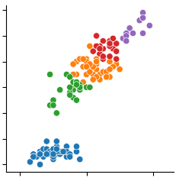


Proposed method
Indexing with representative vectors
In this study,
we propose a method for extracting and indexing image feature vectors to reduce the computational cost of image retrieval using an autoencoder model.
Cluster | Index
Red | Vector4
Green | Vector2
...
Images from live nature camera
Feature vector extraction
Compressed Feature vectors
Indexing with representative vectors
Clustering
Notes:
Therefore, in this study, we propose a method for natural observation systems to extract image feature vectors using an autoencoder model and reduce the amount of calculation through indexing.
そのため，本研究では、自然観察システムにおいて，オートエンコーダモデルを用いて画像特徴ベクトルを抽出し，インデクシングにより計算量削減を実現する手法を提案する。
This method uses an autoencoder to compress an image with a large amount of data into a small feature vector containing semantic information.
この手法は，オートエンコーダーを用いてデータ量の大きい画像を，意味情報をもつ小さな特徴ベクトルに圧縮します．
Then, similar feature vectors are analyzed using clustering.
そして，クラスタリングにより，似ている特徴ベクトルを分析します．
Finally, the representative feature vector, which is the centroid of each cluster, is registered as an index.
最後に，各クラスタの重心となる代表特徴ベクトルを，インデックスとして登録します．
To make it easier to understand, we will explain each step.
わかりやすくするために，ステップごとに説明します．

Slide 6



Step-1:Preparing the trained autoencoder
An autoencoder model is trained with a set of nature images such as landscape, animals, and plants.
Encoder
Decoder
Compressed
Feature vector
Images
Generated images
Notes:
In this step, the autoencoder adjusts the neural network parameters so that it can extract compressed feature vectors with semantic information.
このステップでは，オートエンコーダが，意味情報をもった圧縮された特徴ベクトルを，抽出できるようにニューラルネットワークのパラメータを調整します．
An autoencoder model is trained with a set of nature images such as landscape, animals, and plants. オートエンコーダー モデルは、風景、動物、植物などの自然画像のセットを使用してトレーニングされます。

Slide 7

Step-2:Feature extraction from natural images
Image data from live nature camera is sent to the trained autoencoder model in Step-1, and the feature vector is extracted.
Encoder
・・・
Input
nature images
Encoder part of trained autoencoder
Compressed Feature vectors

Slide 8



Step-3,Step-4:Clustering of feature vectors
The feature vectors extracted in Step-2 are classified based on the vector similarities.
A representative feature vector such as centroid vector is extracted in each cluster.
・・・
Compressed Feature vectors
Indexing feature vectors
by representative vectors
Clustering

Slide 9
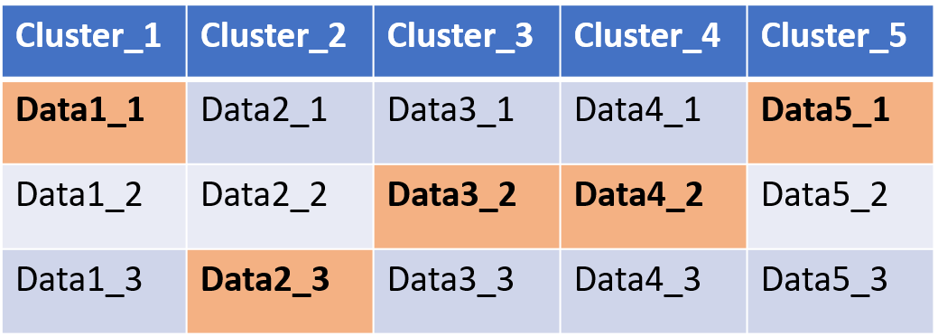

Step-5:Indexing of representative vectors
Each representative feature vector is indexed for the image search.
Indexing feature vectors
by representative vectors
: Representative vector

Slide 10
Conclusion and future work
We are currently implementing a prototype of the natural environment system.
Notes:
Currently, we are implementing the prototype of monitoring nature environment. We will evaluate the feasibility and effectiveness of the proposed system in our future work.
現在、自然環境モニタリングのプロトタイプを実装中です。今後の研究において、提案したシステムの実現可能性と有効性を評価していきます。

