Slide 1

Gamified Learning : Learn With Engagement
Jayaram A ( 2021115043)
V Priyadarshini (2021115078)
Yuthikshaa M (2021115123)
Yuvaraj T (2021115124)
GUIDED BY
Dr. Bama Srinivasan, Associate Professor
DEPT OF IST,
CEG CAMPUS.

Slide 2
Introduction
Our gamified learning project blends storytelling-based education with interactive game mechanics to create an engaging learning experience for students.
So far, we have completed 30-40% of the project, focusing on key features that integrate learning and evaluation.
We used advanced techniques like multi-linear models and regression to predict the difficulty level of students, ensuring a personalized learning path.
The learning part is centered around a Snake game, where students progress by answering questions.
This approach is designed to make learning interactive and adaptive to each student’s pace.

Slide 3
Introduction
In the learning part, we included storytelling combined with interleaved questions that drive the characters towards their goals.
These questions are accompanied by step-by-step explanations guided by JavaScript animations.
The evaluation part is also integrated into the Snake game, where students answer questions every time they catch food.
This dynamic interaction ensures continuous assessment and personalized feedback for improved learning outcomes.

Slide 4
Problem Statement
The core problem is to make learning engaging and adaptive, allowing students to learn at their own pace while maintaining educational rigor.
We addressed this by synthesizing a dataset based on the learning difficulties of 5th-grade students.
The evaluation dynamically adjusts itself based on the user's performance using a multi-linear model and regression techniques.
Additionally, reinforcement learning is used to generate stone configurations that keep the experience fun and challenging.

Slide 5
Literature Survey
Sno | Title | Journal/Conference | Methodologies/ Approaches | Pros | Cons
[1] | Gamification of Education: A Review of Literature | International Conference on HCL in Business,2022 | To include game design elements that are used in education | Bringing in student engagement | More options available which leads to a confusion what to choose
[2] | Personality Effects on Students' Intrinsic Motivation in a Gamified Learning Environment | International Conference on Advanced Learning Technologies (ICALT),2021 | gamified Moodle environment for a semester | Self-determined environments allow students to learn at their own pace | Setting up and managing a gamified environment can be resource-intensive.
[3] | Prediction of Student’s Performance With Learning Coefficients Using Regression Based Machine Learning Models | 2021 47th Hawaii International Conference on System Sciences | learning coefficients from adaptive assessments to predict student performance | Learning coefficients enhance the accuracy of performance | Calculating and integrating learning coefficients adds complexity to the predictive models and data analysis.

Slide 6
Literature Survey
Sno | Title | Journal/Conference | Methodologies/ Approaches | Pros | Cons
[4] | Promoting Student Thinking and Engagement Through Question-Based and Gamified Learning | 2022 IEEE 14th International Conference on HNICEM | Gamified activities like Jeopardy were used. | Boosts participation and enthusiasm significantly. | Time-consuming and potential unequal participation.
[5] | Does Gamification Work? -- A Literature Review of Empirical Studies on Gamification | 2021 47th Hawaii International Conference on System Sciences | Analyzed various gamification studies' outcomes. | Detailed analysis of gamification's effects. | Unclear effectiveness of specific game elements.
[6] | Gamification of e-Learning in Higher Education: A Systematic Literature Review | Smart Learning Environments ,2023 | Reviewed 39 studies on gamified e-learning. | Insights into innovative gamification strategies. | Lack of theoretical foundation in studies.

Slide 7
Literature Survey
Sno | Title | Journal/Conference | Methodologies/ Approaches | Pros | Cons
[7] | The Effect of Challenge-Based Gamification on Learning | International Journal of Human-Computer Studies Volume 144, December 2020, 10249 | Compared gamified vs. non-gamified groups. | Empirical data on gamification's impact. | Focused on a specific subject area.
[8] | Creating G-Class: A Gamified Learning Environment for Freshman Students | E-Learning and Digital Media 2020, Vol. 17(2) 94–110 | Single group exposed to gamified material. | Detailed approach with structured evaluation. | Limited generalizability to other contexts.
[9] | Students' Approaches to Learning in a Gamified Course in Higher Education | 2021 19th International Conference on Information Technology Based Higher Education and Training (ITHET) | Used gamification elements and student surveys. | Comprehensive view of Gamification's impact. | Self-reported data may introduce bias.

Slide 8
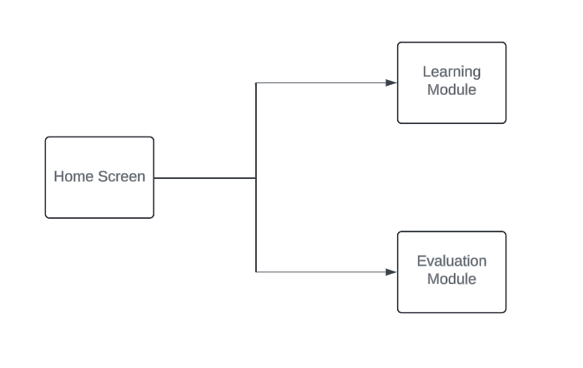
Overall architecture

Slide 9
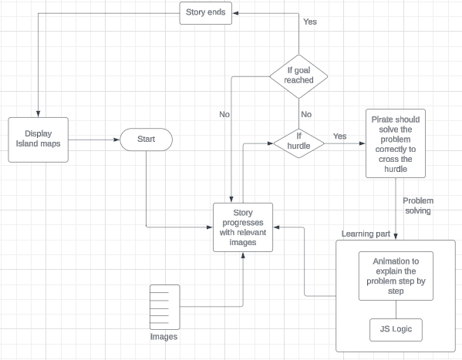
Learning module with a pirate story

Slide 10
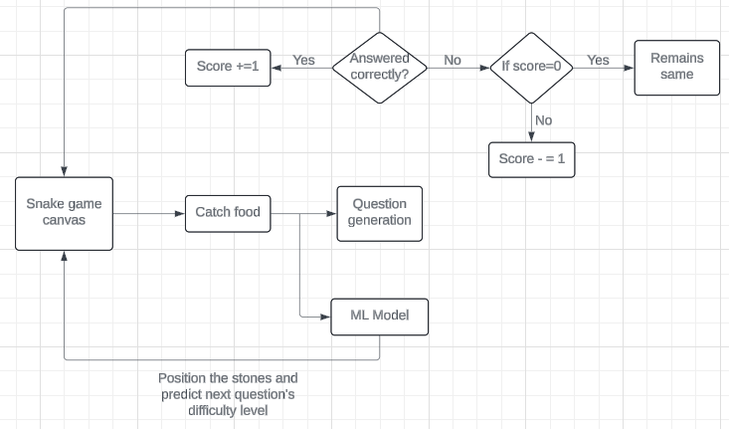
Evaluation module using Game
Game UI

Slide 11
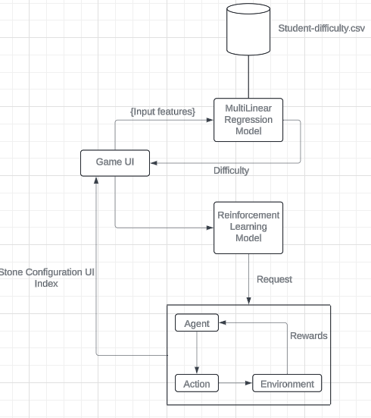
ML Model

Slide 12
Dataset Information
We created the dataset specifically for 5th-grade students, focusing on key aspects such as question difficulty, and time taken to answer.
This data helps model individual learning behaviors.
Data was synthesized by carefully analyzing learning patterns to ensure a realistic learning experience.
This allows us to effectively train and test our models.

Slide 13
Details of data to be used
1.Synthesized Dataset:
Name of the Data: Synthesized User Interaction Dataset
Fields:
time taken: The time taken by the user to answer a question. (Numeric)
operation performed: The type of operation the user performed. (String)
difficulty: The difficulty level of the question. (Categorical)
correct: Indicates whether the user's answer was correct. (Boolean)
Size: 5 kB
Purpose:
To predict the difficulty of the user’s next question.
This dataset will be used to train the Linear model to adapt to the user's performance dynamically.

Slide 14
Dataset Information
Our dataset includes both quantitative and qualitative features such as response accuracy, time spent per question
Each data point is mapped to specific learning objectives, allowing the model to align predictions with expected outcomes.
This helps in tracking whether students meet the learning goals.

Slide 15
Dataset Description
This dataset is crucial for analyzing the gap between actual task difficulty and the model’s prediction, helping to improve the adaptive learning system.
The dataset allows us to assess how well the model performs across different operations, difficulty levels, and time spent on tasks.
By examining the time taken and correctness, the system can dynamically adjust the difficulty of future tasks to provide a personalized learning experience.
The dataset supports continuous improvement of the prediction model, ensuring that it becomes more accurate over time.

Slide 16
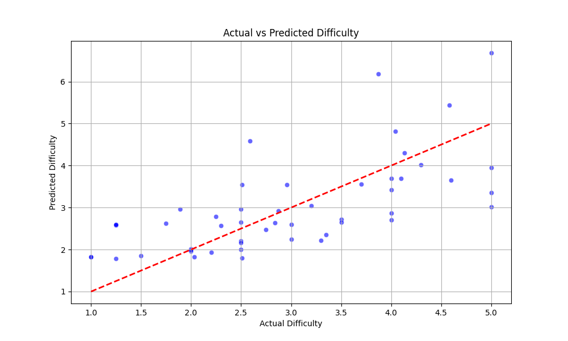
Visualization Plot

Slide 17
Model Metrics
Linear Regression:
Mean Squared Error (MSE) is used to calculate the average of squared differences between predicted and actual values. This metric ensures that the model minimizes large prediction errors.
R² Score helps determine how well our model fits the data by showing the proportion of variance explained by the independent variables. A high R² score means the model accurately captures the student's difficulty.

Slide 18
Learning Component
The learning component is based on storytelling, where students progress by answering interleaved questions. Each question moves the characters closer to their goal, making the learning experience immersive and engaging.
We use JavaScript animations to guide students through step-by-step explanations for each question. This visual aid helps break down complex concepts, making learning more accessible.
The learning module is designed to adapt to the student’s progress, ensuring they receive the appropriate level of difficulty as they move forward. This allows for a personalized learning journey at their own pace.

Slide 19
Evaluation Component
The evaluation component integrates into the Snake game, where students answer questions after catching food. This real-time assessment helps continuously monitor progress and adjust the game's difficulty.
The evaluation adapts dynamically based on the student’s previous answers and performance, ensuring that they learn at their own pace. This personalized feedback loop improves learning outcomes.
Reinforcement learning dynamically adjusts the game’s challenge level by selecting different configurations. This ensures that the game remains engaging and challenging, promoting learning through fun.

Slide 20
References
[1] Nah, F., Telaprolu, V., Rallapalli, S., Venkata, P.: Gamification of Education using Computer Games. In: Yamamoto, S. (ed.) HCI 2013, Part III. LNCS, vol. 8018, pp. 99–107. Springer, Heidelberg (2021)
[2] Eschenbrenner, B., Nah, F., Siau, K.: 3-D Virtual Worlds in Education: Applications, Benefits, Issues, and Opportunities. Journal of Database Management 19(4), 91–110 (2023)
[3] P. Buckley and E. Doyle, "Gamification and student motivation", Interactive Learning Environments, vol. 22, no. 6, pp. 1-14, (2020).

Slide 21
THANK YOU

