Slide 1
CAPSTONE PROJECT
MOVIE TICKET BOOKING
Presented By:
1. DANIKA A-ACTECH, ANNA UNIVERSITY-TEXTILE DEPARTMENT

Slide 2
OUTLINE
Problem Statement
Proposed System/Solution
System Development Approach
Algorithm & Deployment
Result
Conclusion
Future Scope
References

Slide 3
PROBLEM STATEMENT
PYTHON PROGRAM FOR MOVIE TICKET BOOKING

Slide 4
PROPOSED SOLUTION
A streamlined online platform that allows users to easily browse movie listings, select their preferred showtimes, choose seating arrangements, and securely purchase tickets. It should also include features like real-time seat availability updates, seat selection, and integration with popular payment gateways for smooth transactions. Additionally, a user-friendly interface and responsive customer support would enhance the overall experience.

Slide 5
SYSTEM APPROACH
A system approach for movie ticket booking involves creating a seamless process for customers to browse movie listings, select showtimes, choose seats, and complete transactions. Here's a structured breakdown of such a system:
1. User Interface
2. Movie Database
3. Theater and Showtime Management
4. Seat Selection and Reservation
5.Ticket Pricing and Discounts
6.Payment Processing
7. Booking Confirmation and Tickets Issuance
8. Integration with Cinema Systems
9. Customer Support and Feedback
10. Security and Data Privacy
11. Analytics and Reporting

Slide 6
ALGORITHM & DEPLOYMENT
1. User Authentication: The user logs in or creates an account if they're a new user.
2. Movie Selection: The user browses available movies, either by title, genre, or location.
3. Showtime Selection: The user selects their desired movie and the preferred showtime.
4. Seat Selection: The user chooses their seats from a seating layout displayed on the screen.
5. Payment Processing: The user enters payment information and completes the transaction securely.
6. Ticket Confirmation: The system confirms the booking and generates a booking reference or ticket QR code
.7. Notification: The user receives a confirmation email or SMS with the booking details and QR code if applicable.Behind the scenes, the system manages seat availability, updates the seating layout in real-time, processes payments securely, and generates booking records for both the user and the theater. It also handles scenarios like seat reservations timing out if payment isn't completed within a certain timeframe and refunds if necessary. Additionally, the system may include features like loyalty rewards, discounts, and integration with third-party platforms for promotional offers.

Slide 7
DEPLOYMENT
1. Server Setup: Begin by setting up the necessary servers to host the ticket booking system. This includes selecting a reliable hosting provider, configuring server settings, and ensuring scalability to handle varying levels of traffic.
2. Database Configuration: Establish a robust database architecture to store information such as movie listings, showtimes, seating availability, user accounts, and transaction records. Implement efficient database queries to optimize performance and responsiveness.
3. Frontend Development: Design and develop the user interface (UI) of the ticket booking platform. Create intuitive layouts that allow users to easily search for movies, view showtimes, select seats, and complete transactions. Ensure compatibility across different devices and browsers for a seamless user experience.
4. Backend Development: Build the backend logic of the ticket booking system to handle user requests, process payments, manage inventory, and generate booking confirmations. Implement secure authentication mechanisms to protect user accounts and sensitive information.
5. Payment Gateway Integration: Integrate a secure payment gateway to facilitate online transactions. Ensure compliance with industry standards such as PCI DSS to safeguard payment data and prevent unauthorized access.

Slide 8
6. Testing and Quality Assurance: Conduct thorough testing of the ticket booking system to identify and resolve any bugs or usability issues. Perform functional testing, performance testing, and security testing to ensure reliability and stability.
7. Deployment and Monitoring: Deploy the ticket booking system to production servers once testing is complete. Monitor system performance and user feedback closely to address any issues that may arise post-deployment. Implement logging and analytics tools to gather insights into user behavior and system usage.
8. Continuous Improvement: Continuously iterate on the ticket booking system based on user feedback and changing requirements. Implement new features, optimize performance, and enhance security to provide an exceptional booking experience for users.

Slide 9
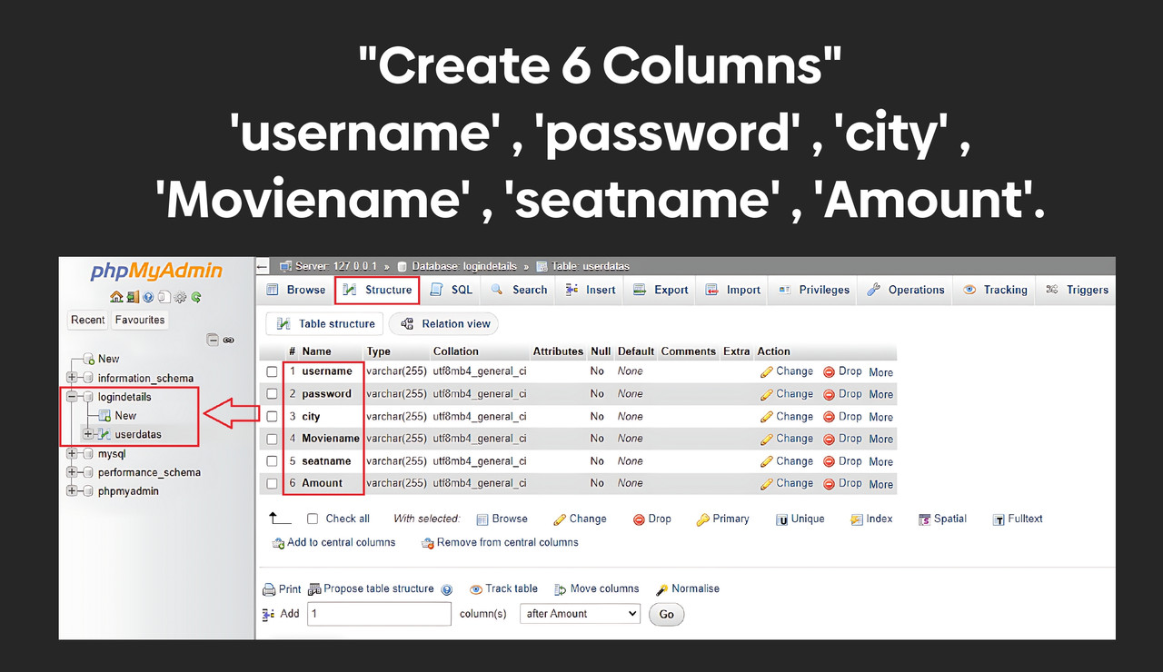
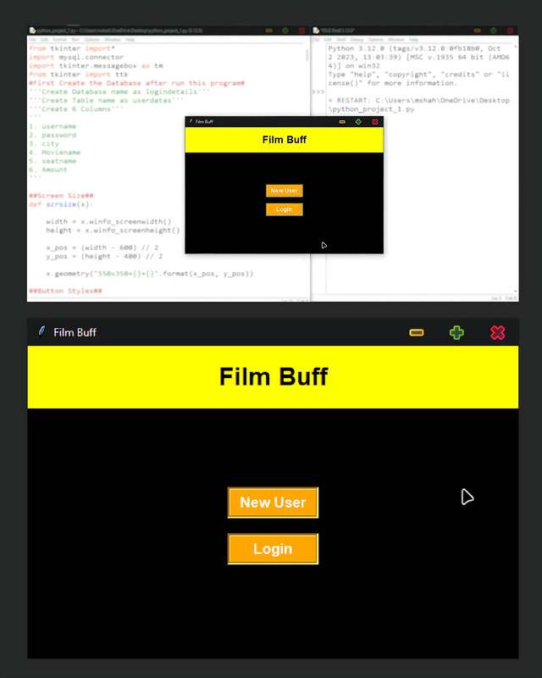
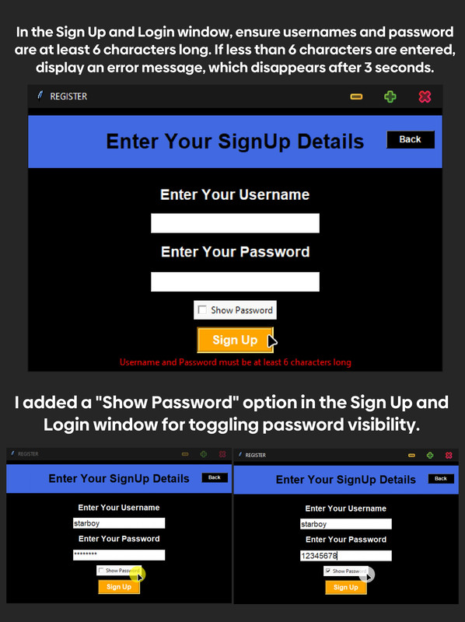
RESULT

Slide 10
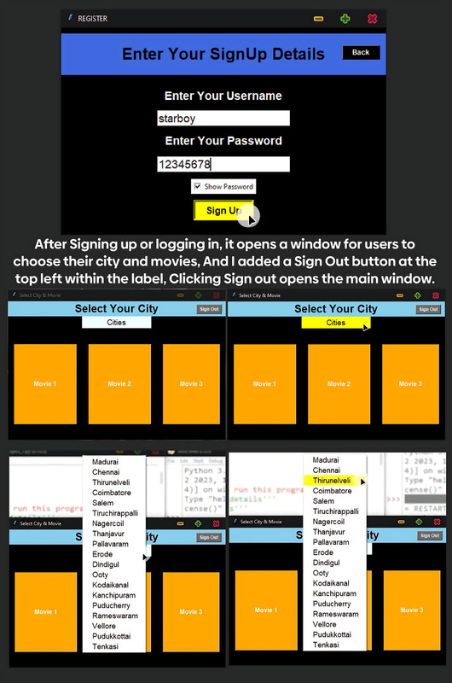
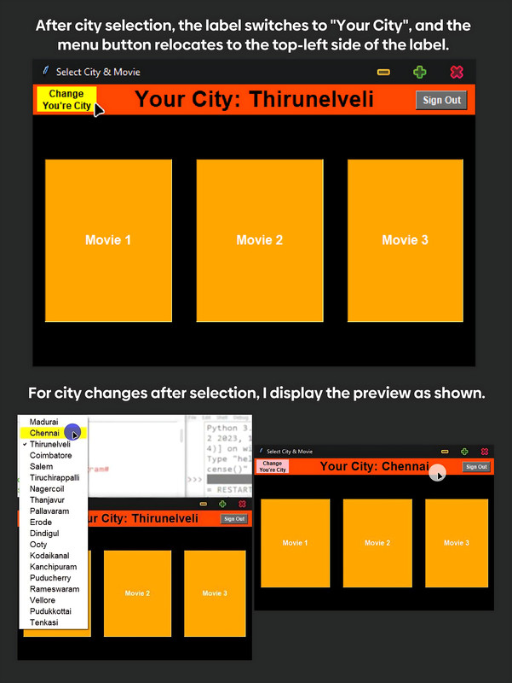
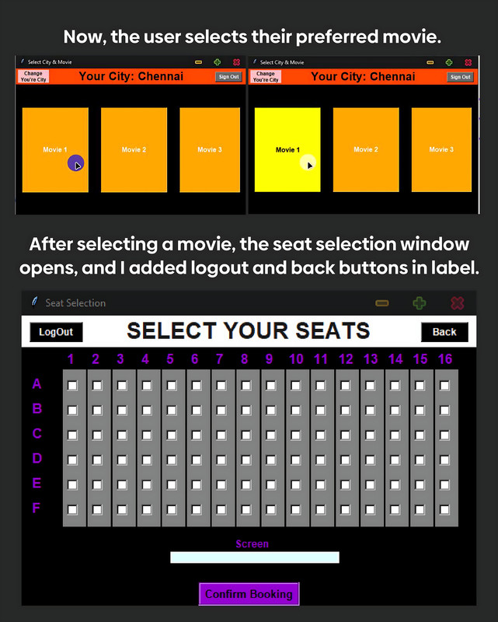

Slide 11
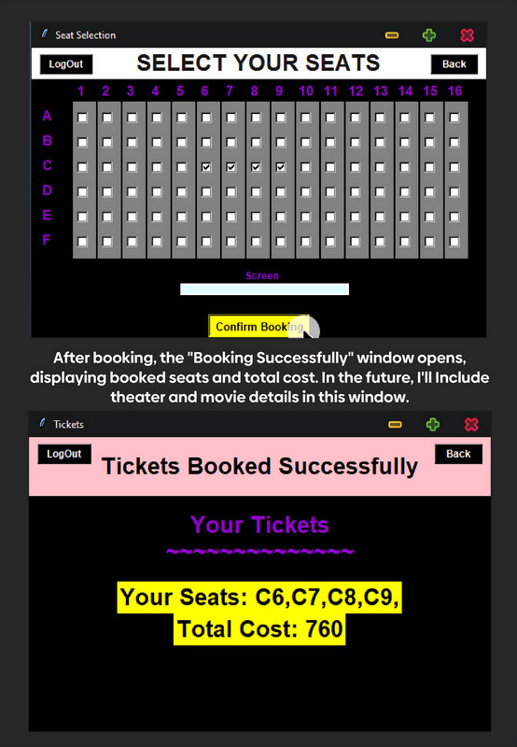
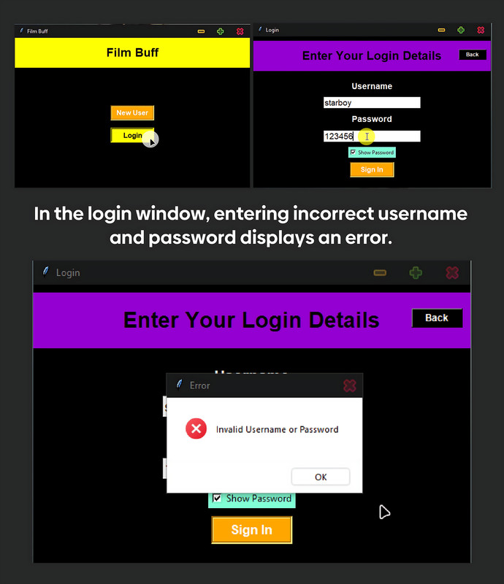
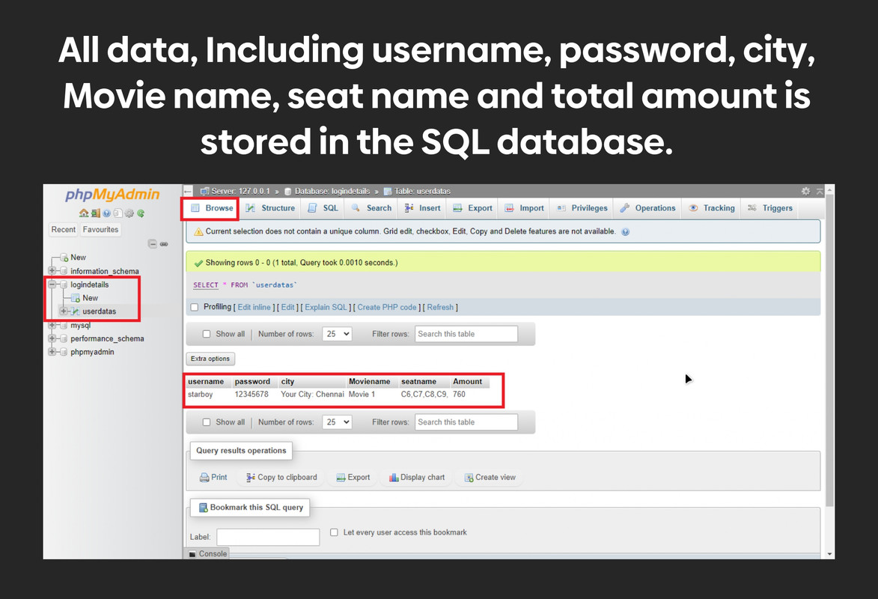

Slide 12
CONCLUSION
In conclusion, movie ticket booking has evolved significantly over the years, transitioning from traditional box office sales to online platforms and mobile applications. This transformation has brought about convenience and efficiency for moviegoers, allowing them to browse showtimes, select seats, and make purchases from the comfort of their own homes or on the go. Additionally, advancements in technology such as AI-driven recommendation systems and virtual reality experiences have enhanced the overall movie ticket booking process, providing personalized suggestions and immersive previews.
Furthermore, the integration of social media and user reviews has empowered audiences to make more informed decisions when choosing which movies to see. Despite these advancements, challenges such as ticket scalping and fraudulent transactions persist, necessitating continued efforts in security and regulation.
Overall, the future of movie ticket booking holds promise for further innovation and enhancement of the moviegoing experience, ensuring that audiences can easily access and enjoy their favorite films with just a few clicks or taps

Slide 13
FUTURE SCOPE
The future of movie ticket booking could involve advancements in technology such as augmented reality (AR) for virtual seat previews, personalized recommendations based on user preferences and past viewing history, seamless integration with smart home devices for ticketless entry, and enhanced social features like group bookings and shared experiences. Additionally, advancements in data analytics could enable theaters to optimize scheduling based on demand patterns and offer dynamic pricing models. Overall, the future scope lies in creating a more personalized, convenient, and immersive movie-going experience for audiences

Slide 14
REFERENCES

Slide 15
THANK YOU

