Slide 1
CAPSTONE PROJECT
PROJECT TITLE
Presented By:
1. Dharshini J – 2021310007

Slide 2
OUTLINE
Problem Statement
Proposed System/Solution
System Development Approach
Algorithm & Deployment
Result
Conclusion
Future Scope

Slide 3
PROBLEM STATEMENT
Python programming for Movie ticket booking
Notes:
Python programming for Movie ticket booking

Slide 4
PROPOSED SOLUTION
1.User-Friendly Interface:
Develop a clean and intuitive user interface that allows users to easily search for movies, view showtimes, and select seats.
Implement a responsive design to ensure accessibility across various devices, including smartphones, tablets, and desktop computers.
2. Real-Time Seat Availability:
Integrate a dynamic seat map that updates in real-time to show available seats, booked seats, and seat preferences (e.g., aisle, window, wheelchair-accessible).
Enable users to select their preferred seats from the interactive seat map, providing a visual representation of the theater layout.
3. Secure Payment Gateway:
Partner with reputable payment processors to implement a secure payment gateway that supports multiple payment methods, including credit/debit cards, mobile wallets, and digital payment platforms.
Ensure compliance with industry-standard security protocols (e.g., PCI DSS) to protect users' payment information.
4. Personalized Recommendations:
Utilize machine learning algorithms to analyze users' movie preferences, viewing history, and ratings to provide personalized movie recommendations.
Offer curated lists, personalized movie suggestions, and tailored promotions based on individual user profiles.

Slide 5
SYSTEM APPROACH
User Interface Development:
Use HTML, CSS, and JavaScript to create responsive web interfaces for users to browse movies, view showtimes, and select seats.
Implement mobile app interfaces using frameworks like React Native or Flutter for a native-like experience on iOS and Android devices.
Use UI libraries like Bootstrap or Material-UI for styling and layout consistency.
Backend Development:
Choose a backend programming language and framework such as Node.js with Express, Django with Python, or Ruby on Rails.
Develop APIs to handle user authentication, movie information retrieval, seat availability, booking requests, and payment processing.
Integrate with external APIs for fetching movie data, payment gateway services, and SMS/email notifications.
Database Management:
Use a relational database like MySQL, PostgreSQL, or SQLite to store movie details, theater information, showtimes, seat availability, user profiles, and booking records.
Design database schemas to efficiently represent relationships between entities and optimize query performance.

Slide 6
4.Authentication and Authorization:
Implement authentication mechanisms using JWT (JSON Web Tokens), OAuth, or session-based authentication to verify user identities.
Use middleware functions to authenticate API endpoints and authorize access based on user roles and permissions.
5.Booking Engine:
Develop algorithms to manage seat availability, prevent double bookings, and handle concurrency issues.
Implement logic to reserve seats for a limited time while users complete the booking process.
6.Payment Gateway Integration:
Integrate with payment gateway APIs such as Stripe, PayPal, or Braintree to enable secure online transactions.
Handle payment processing, including tokenization of sensitive card data and handling payment failures.
7.Real-time Updates:
Use WebSocket technology or server-sent events (SSE) to provide real-time updates on seat availability and booking status.
Implement event-driven architecture to notify users of changes in showtimes or seat availability.

Slide 7
ALGORITHM & DEPLOYMENT
Algorithm:
User Authentication:
Users should be authenticated before proceeding with ticket booking. Ensure users are logged in or provide a guest checkout option.
Movie Selection:
Display a list of available movies along with their showtimes.
Allow users to select a movie and view available showtimes.
Seat Selection:
Present a seating layout for the selected showtime.
Allow users to choose their desired seats from the available ones.
Implement logic to prevent double booking of seats.
Payment Processing:
Once seats are selected, proceed to the payment stage.
Collect payment information securely.
Process the payment using a payment gateway API.
Handle payment failures gracefully and provide appropriate feedback to the user.

Slide 8
5.ooking Confirmation:
Upon successful payment, confirm the booking to the user.
Generate a booking reference number and provide the user with a confirmation message or email.
6.Cancellation and Refunds:
Implement functionality to allow users to cancel their bookings within a certain time frame.
Process refunds if applicable and update seat availability accordingly.
Deployment:
Cloud Deployment:
Utilize cloud platforms like AWS, Azure, or Google Cloud for scalable and reliable deployment.
Deploy backend services, databases, and static assets (like HTML, CSS, and JavaScript) to cloud servers.
Leverage cloud services for autoscaling and load balancing to handle varying levels of traffic.
Containerization:
Containerize your application using Docker for consistency across different environments.
Orchestrate containers using Kubernetes for easy deployment, scaling, and management

Slide 9
3.Serverless Architecture:
Adopt a serverless approach for certain components of your application, such as APIs or event-driven functions.
Use services like AWS Lambda or Azure Functions to execute code without managing servers.
4.Continuous Integration/Continuous Deployment (CI/CD):
Implement CI/CD pipelines to automate the testing, building, and deployment process.
Use tools like Jenkins, GitLab CI/CD, or AWS CodePipeline for seamless integration and deployment.
5.Monitoring and Logging:
Set up monitoring and logging tools to track the performance and health of your application in real-time.
Utilize services like AWS CloudWatch, Prometheus, or ELK Stack for monitoring and logging.
6.Security Measures:
Implement security best practices such as HTTPS encryption, data encryption, and secure authentication mechanisms.
Regularly update dependencies and libraries to patch security vulnerabilities.
7.Geographic Distribution:
Consider deploying your application across multiple regions to improve availability and reduce latency for users in different geographical locations.
Use content delivery networks (CDNs) to cache static assets and deliver them to users more efficiently.

Slide 10
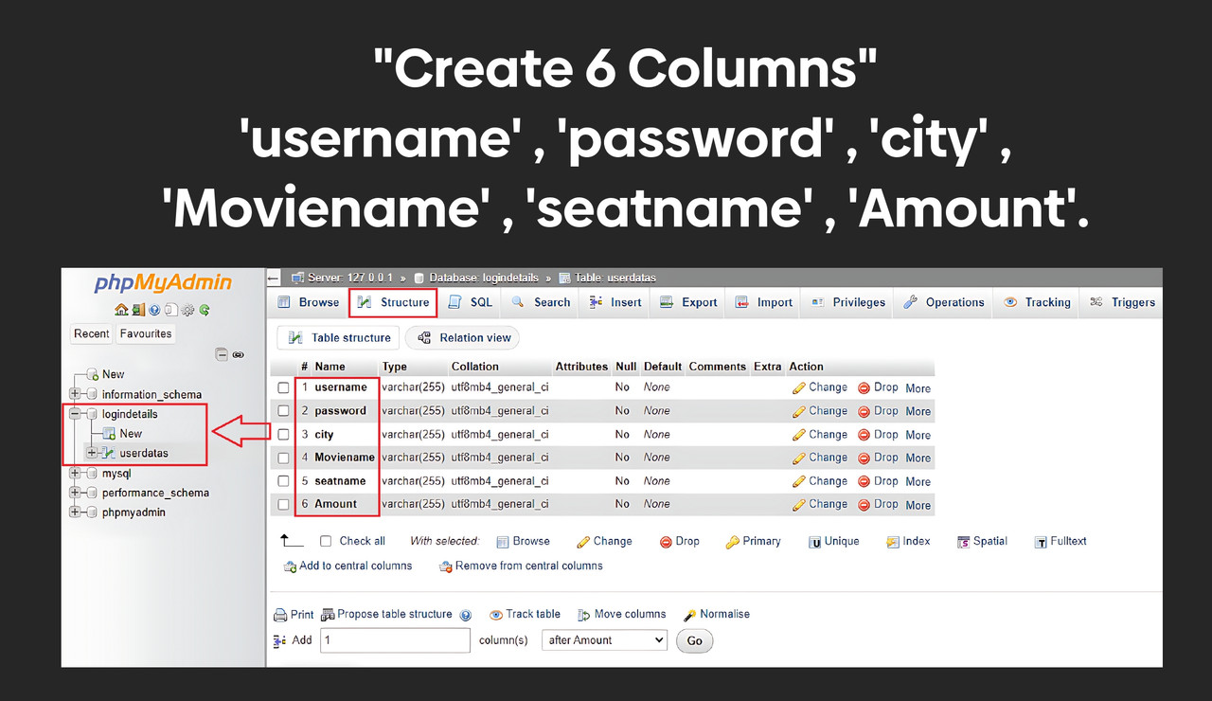
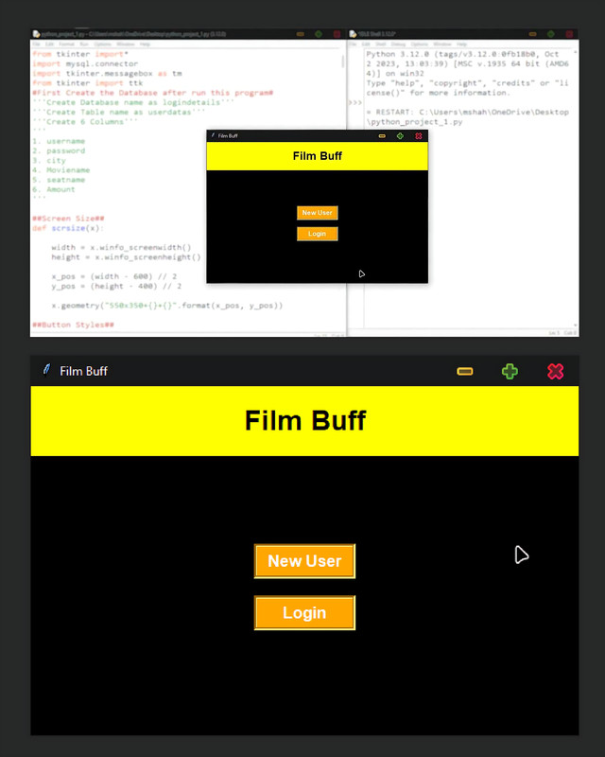
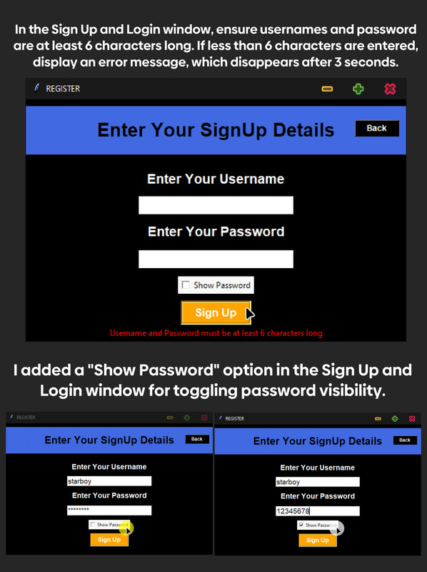
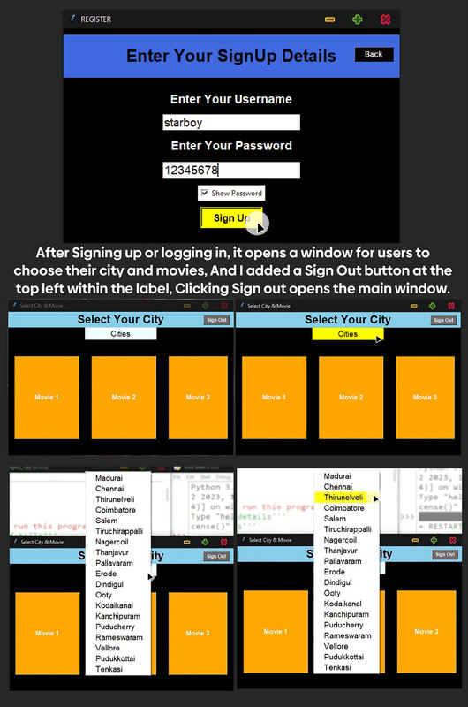
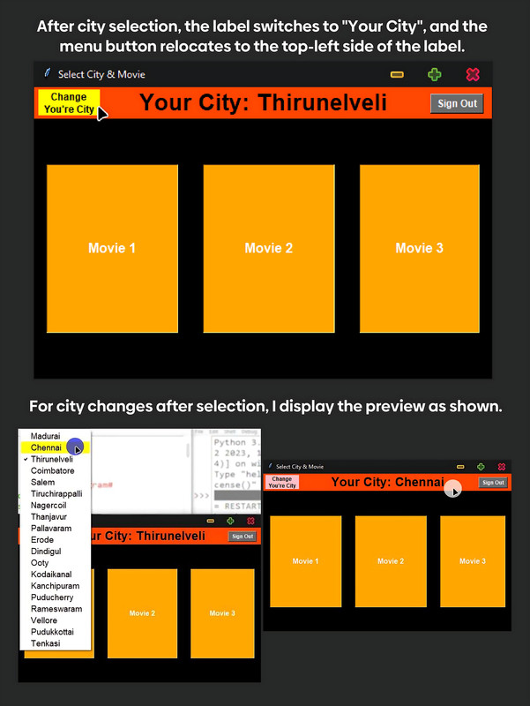
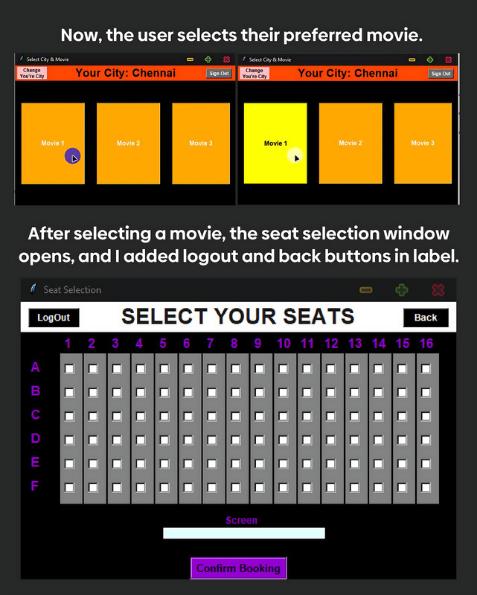
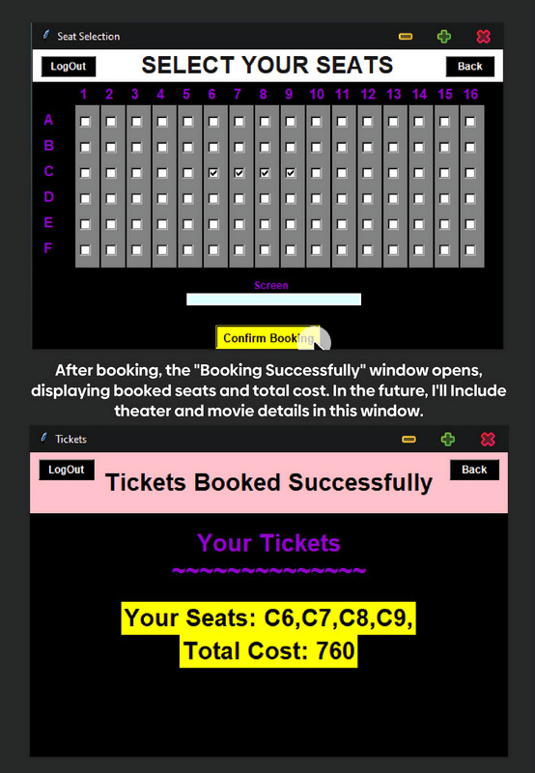
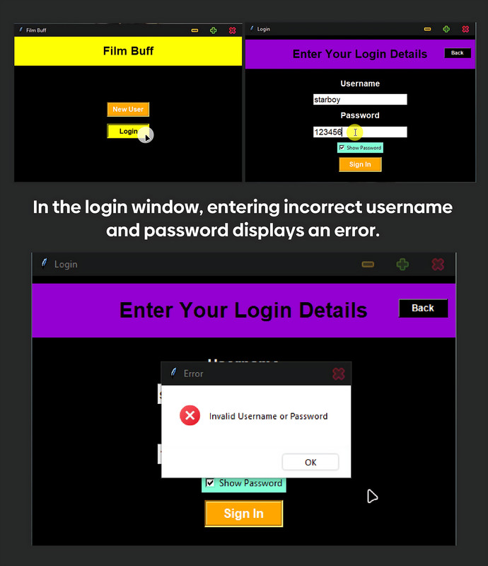
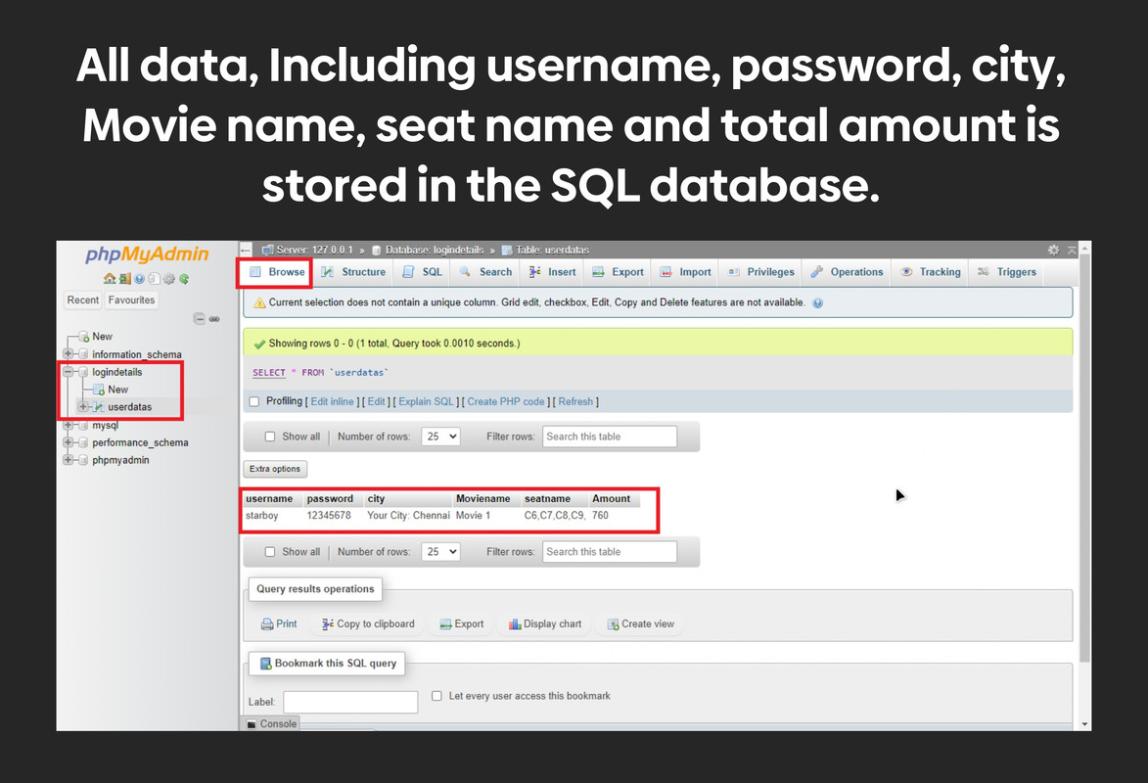
RESULT

Slide 11
CONCLUSION
The movie ticket booking program provides a seamless and efficient solution for users to reserve seats for their favorite movies.
With its user-friendly interface, secure payment gateway, and real-time seat availability updates, the program enhances the movie-going experience for both customers and theater administrators alike.
By automating the booking process, it reduces waiting times and streamlines operations, resulting in improved customer satisfaction.
Looking ahead, there are opportunities to further enhance the program by integrating additional features such as personalized recommendations based on user preferences, loyalty rewards programs, or support for multiple languages. Additionally, expanding the program to include partnerships with more theaters and cinemas could broaden its reach and impact.
Overall, the movie ticket booking program represents a valuable tool for movie enthusiasts and industry professionals, offering convenience, reliability, and innovation in the world of entertainment."

Slide 12
FUTURE SCOPE
Personalization: Implementing algorithms to analyze user preferences and behavior could enable personalized movie recommendations. By understanding each user's movie tastes and viewing history, the program could suggest relevant films, enhancing the overall user experience.
Augmented Reality (AR) Integration: Integrating AR technology could revolutionize the ticket booking experience. Users could virtually explore theaters, view seat availability in real-time, and even preview the view from different seats before making a selection, all from the comfort of their own home.
Enhanced Social Features: Incorporating social media features within the booking platform could allow users to see which movies their friends are interested in or attending. Additionally, enabling group bookings and shared experiences could encourage social interaction and make movie outings more engaging.
Dynamic Pricing: Implementing dynamic pricing algorithms could optimize ticket prices based on factors such as demand, time of day, or seat location. This would not only maximize revenue for theaters but also offer more affordable options for users during off-peak times.
Integration with Emerging Technologies: As new technologies like blockchain and virtual reality (VR) continue to evolve, integrating them into the ticket booking process could further enhance security, transparency, and immersive experiences for users.

Slide 13
THANK YOU

