Slide 1
CAPSTONE PROJECT
MOVIE TICKET BOOKING
Presented By:
1. Mythili M-ACTech, Anna university-Textile Department

Slide 2
OUTLINE
Problem Statement
Proposed System/Solution
System Development Approach
Algorithm & Deployment
Result
Conclusion
Future Scope
References

Slide 3
PROBLEM STATEMENT
PYTHON PROGRAM FOR MOVIE TICKET BOOKING

Slide 4
PROPOSED SOLUTION
A proposed solution for movie ticket booking could involve creating a user-friendly mobile app or website where users can browse movies, select showtimes, choose seats, and make payments securely. Additionally, incorporating features like seat selection, real-time seat availability updates, and integration with payment gateways for seamless transactions would enhance the user experience. It's also essential to include features for user account management, such as booking history, preferences, and loyalty programs, to encourage repeat usage. Lastly, implementing robust security measures to protect users' personal and financial information is crucial for building trust and ensuring data privacy.

Slide 5
SYSTEM APPROACH
A system approach for movie ticket booking would involve various components such as user interface for booking, backend database for storing movie and seat information, payment gateway for transactions, and an admin panel for managing bookings and theater schedules.
It would also require integration with movie APIs for real-time updates on showtimes and availability.
Additionally, considerations for user experience, security, scalability, and performance would be essential in the design and implementation of such a system.

Slide 6
ALGORITHM & DEPLOYMENT
Algorithm:
User Interface - User selects movie, theater, date, and time. - User selects seats from the seating layout.
Validation and Availability Check: - Validate user inputs. - Check seat availability for the selected showtime.
Authentication: - If necessary, authenticate the user (login/signup).
Payment Processing: - User provides payment information. - Payment gateway processes the transaction securely.
Confirmation - Generate booking confirmation with a unique reference number. - Notify the user via email or SMS.
Update Database - Update seat availability in the database. - Store booking details for reference.
Admin Panel - Provide an admin interface for managing bookings, showtimes, and theater details.
Ticket Retrieval - User retrieves the ticket either by printing it or showing it digitally at the theater.

Slide 7
Deployment:
Server Setup - Deploy backend services on a cloud server (e.g., AWS, Azure, Google Cloud) using appropriate infrastructure (VMs, containers, serverless).
Database - Utilize a relational database (e.g., MySQL, PostgreSQL) or a NoSQL database (e.g., MongoDB) to store movie, theater, user, booking, and seat availability information.
Backend Development - Develop backend APIs using a suitable framework (e.g., Node.js with Express, Django, Flask) to handle user requests, seat availability checks, payment processing, and database interactions.
Frontend Development - Develop a user-friendly web or mobile frontend (HTML/CSS/JavaScript, React, Angular, Vue.js) for users to interact with the booking system.
Payment Gateway Integration - Integrate a payment gateway (e.g., Stripe, PayPal) to handle secure transactions.
Security - Implement security measures such as HTTPS, encryption, and input validation to protect user data and prevent fraud.
Scalability - Design the system to handle high traffic loads by using scalable infrastructure and efficient coding practices.

Slide 8
8. *Testing*: - Perform thorough testing (unit tests, integration tests, and end-to-end tests) to ensure the system works as expected and is bug-free.
9. *Deployment and Monitoring*: Deploy the application to production environment and set up monitoring tools (e.g., Prometheus, Grafana) to track performance and detect issues.
10. *Continuous Improvement*: - Regularly update and maintain the system, incorporating user feedback and adding new features to enhance the user experience.
By following this approach, you can create a robust and efficient movie ticket booking system that meets the needs of both users and administrators.

Slide 9
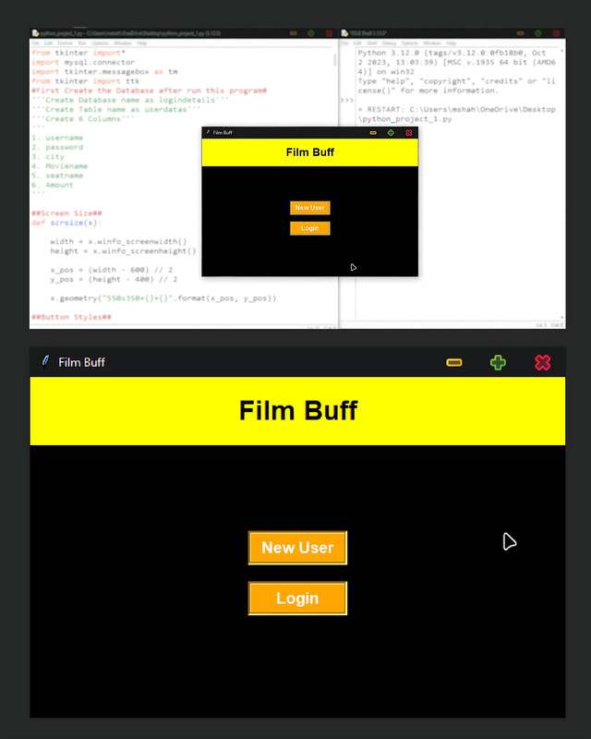
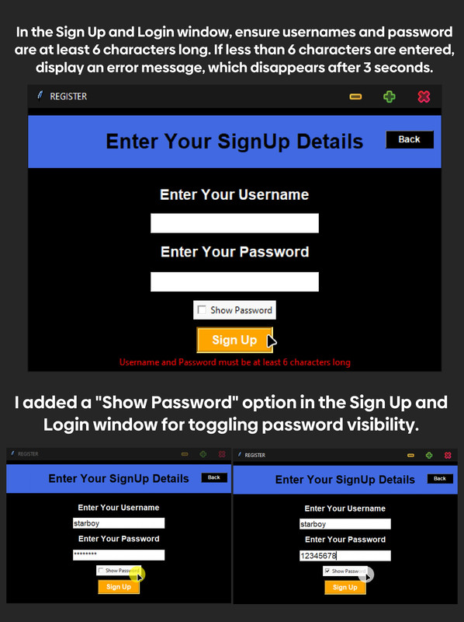
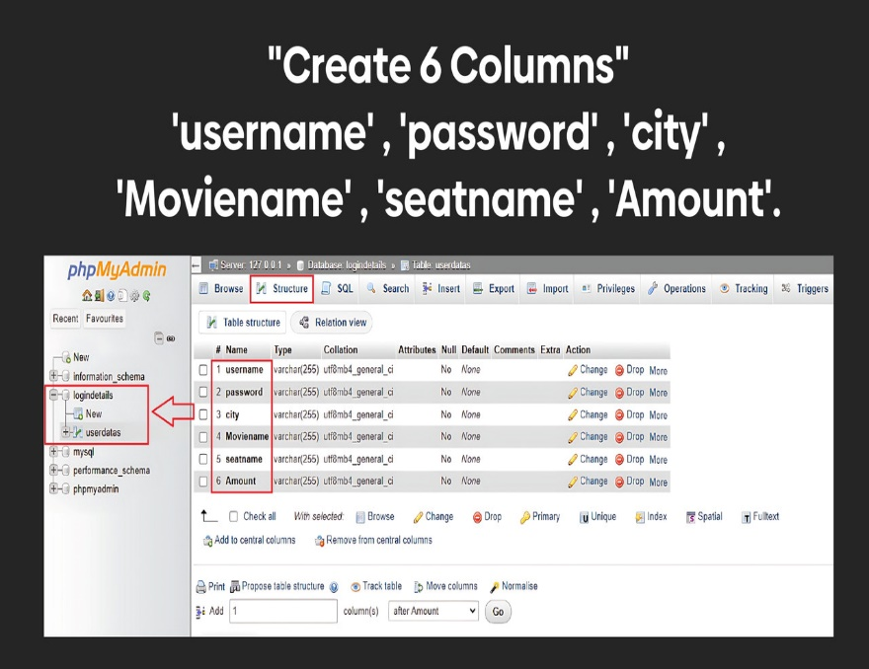
RESULT

Slide 10
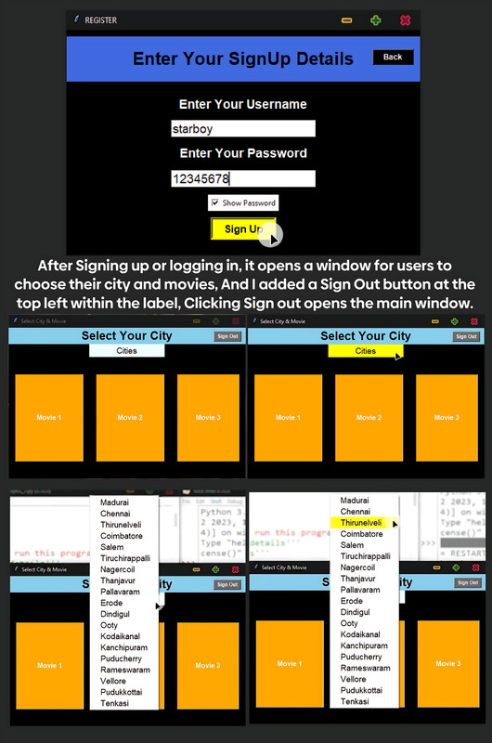
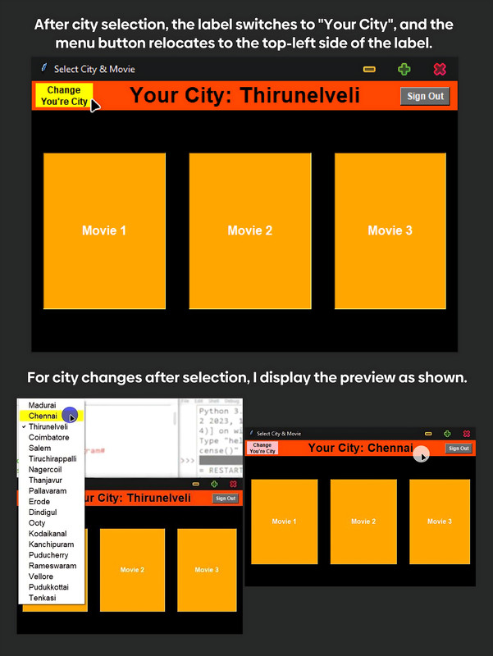
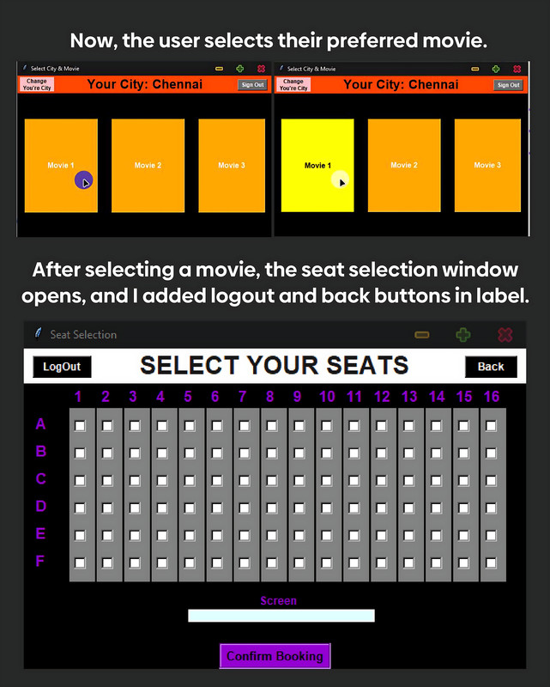

Slide 11
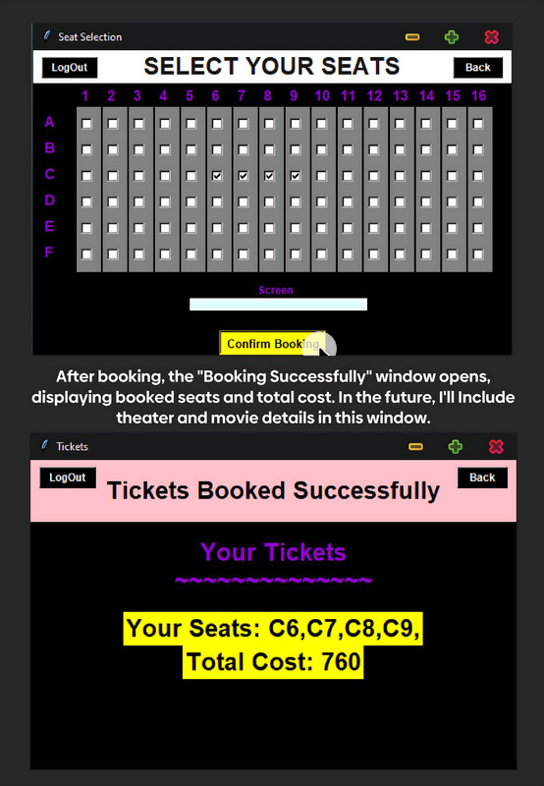
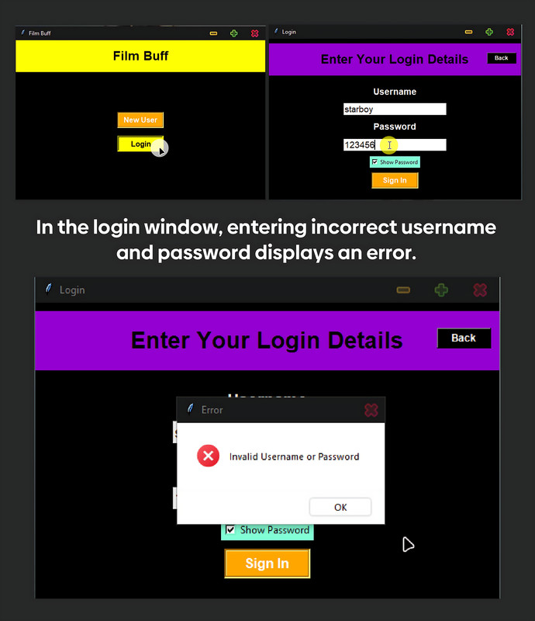
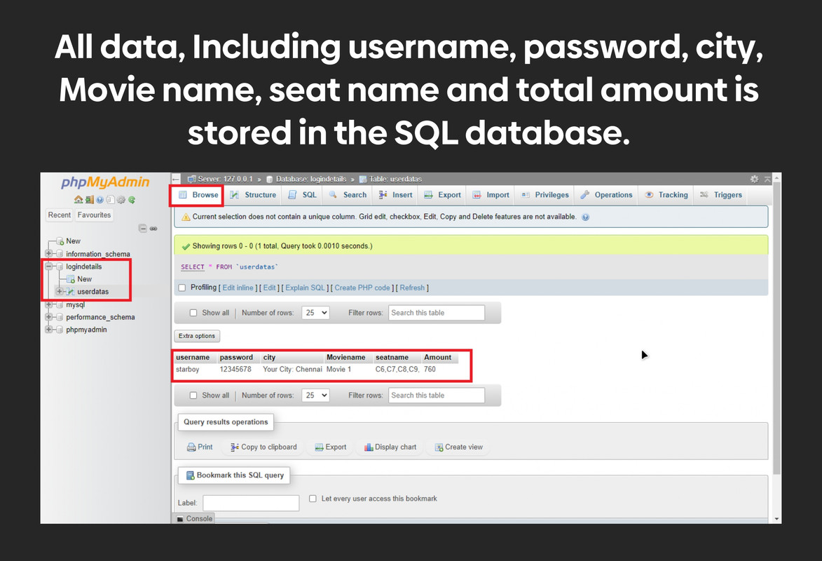

Slide 12
CONCLUSION
The movie ticket booking process is essential for ensuring a smooth and enjoyable cinema experience. By providing convenient online booking options, streamlined payment processes, and effective communication channels, cinemas can enhance customer satisfaction and loyalty. Additionally, leveraging data analytics to understand customer preferences and trends can further optimize the booking experience and drive business success. Ultimately, a well-executed movie ticket booking system not only benefits customers but also strengthens the relationship between cinemas and their audience.

Slide 13
FUTURE SCOPE
Enhanced Personalization: Movie ticket booking platforms may utilize AI and data analytics to offer highly personalized recommendations based on individual preferences, past viewing history, and social interactions.
Virtual Reality (VR) Experiences: Virtual reality could revolutionize the movie-going experience by allowing users to preview seating options, explore theaters, and even watch trailers in immersive VR environments before booking tickets.
Augmented Reality (AR) Integration: AR could be used to enhance the in-theater experience, offering interactive elements such as movie-related games, digital overlays, or real-time information about nearby amenities.
Blockchain Ticketing: Blockchain technology could provide secure and transparent ticketing solutions, reducing fraud and scalping while also enabling peer-to-peer ticket transfers.
Voice-Activated Booking: With the rise of smart assistants, voice-activated booking systems could become more prevalent, allowing users to seamlessly book tickets using voice commands.

Slide 14
REFERENCES

Slide 15
THANK YOU

