Slide 1
2022高考英语
答 案 详 解

Slide 2
A
Grading Policies for Introduction to Literature
Grading Scale
90-100, A; 80-89, B; 70-79, C; 60-69, D; Below 60, E.
Essays (60%)
Your four major essays will combine to form the main part of the grade for this course: Essay 1 = 10%; Essay 2-15%; Essay 3= 15%; Essay 4 = 20%.
Group Assignments (30%)
Students will work in groups to complete four assignments (作业) during the course. All the assignments will be submitted by the assigned date through Blackboard, our online learning and course management system.
Daily Work/In-Class Writings and Test/Group Work/Homework (10%)
n Class activities will vary from day to day, but students must be ready to complete short in-class writings or tests drawn directly from assigned readings or notes from the previous class’ lecture/discussion, so it is important to take careful notes during class. Additionally, from time to time I will assign group work to be completed in class or short assignments to be completed at home, both of which will be graded.
Late Work
An essay not submitted in class on the due date will lose a letter grade for each class period it is late. If it is not turned in by the 4th day after the due date, it will earn a zero. Daily assignments not completed during class will get a zero. Short writings missed as a result of an excused absence will be accepted.

Slide 3
21.Where is this text probably taken from?
A. A textbook. B. An exam paper.
C. A course plan. D. An academic article.
22.How many parts is a student’s final grade made up of?
A. Two. B. Three. C. Four. D. Five.
23.What will happen if you submit an essay one week after the due date?
A. You will receive a zero. B. You will lose a letter grade.
C. You will be given a test. D. You will have to rewrite it.
Essays (60%) + Group Assignments (30%) + Daily Work ... (10%)
If it is not turned in by the 4th day after the due date, it will earn a zero.

Slide 4
词 汇 复 习
1. grading scale
2. submit the assignment
3. assigned date
4. vary from ... to ...
5. from time to time
6. due date
7. turn in
分级量表，评价等级
提交作业
指定日期
因......而异
有时，偶尔
截止日期，到期日
上交

Slide 5
B
Like most of us, I try to be mindful of food that goes to waste. The arugula (芝麻菜) was to make a nice green salad, rounding out a roast chicken dinner. But I ended up working late. Then friends called with a dinner invitation. I stuck the chicken in the freezer. But as days passed, the arugula went bad. Even worse, I had unthinkingly bought way too much; I could have made six salads with what I threw out.
In a world where nearly 800 million people a year go hungry, “food waste goes against the moral grain,” as Elizabeth Royte writes in this month’s cover story. It’s jaw-dropping how much perfectly good food is thrown away - from “ugly” (but quite eatable) vegetables rejected by grocers to large amounts of uneaten dishes thrown into restaurant garbage cans.
Producing food that no one eats wastes the water, fuel, and other resources used to grow it. That makes food waste an environmental problem. In fact, Royte writes, “if food waste were a country, it would be the third largest producer of greenhouse gases in the world.”
If that’s hard to understand, let’s keep it as simple as the arugula at the back of my refrigerator. Mike Curtin sees my arugula story all the time - but for him, it’s more like 12 boxes of donated strawberries nearing their last days. Curtin is CEO of DC Central Kitchen in Washington. D.C., which recovers food and turns it into healthy meals. Last year it recovered more than 807,500 pounds of food by taking donations and collecting blemished (有瑕疵的) produce that otherwise would have rotted in fields. And the strawberries? Volunteers will wash, cut, and freeze or dry them for use in meals down the road.
Such methods seem obvious, yer so often we just don’t think. “Everyone can play a part in reducing waste, whether by not purchasing more food than necessary in your weekly shopping or by asking restaurants to not include the side dish you won’t eat.” Curtin says.

Slide 6
24.What does the author want to show by telling the arugula story?
A. We pay little attention to food waste.
B. We waste food unintentionally at times.
C. We waste more vegetables than meat.
D. We have good reasons for wasting food.
25.What is a consequence of food waste according to the text?
A. Moral decline. B. Environmental harm.
C. Energy shortage. D. Worldwide starvation.
26.What does Curtin’s company do?
A. It produces kitchen equipment. B. It turns rotten arugula into clean fuel.
C. It helps local farmers grow fruits. D. It makes meals out of unwanted food.
27.What does Curtin suggest people do?
A. Buy only what is needed. B. Reduce food consumption.
C. Go shopping once a week. D. Eat in restaurants less often.
我们有时会无意中浪费食物。
Para 3 : Producing food that no one eats wastes the water, fuel, and other resources used to grow it. That makes food waste an environmental problem.
Para 4 : Curtin is CEO of DC Central Kitchen in Washington. D.C.,
which recovers food and turns it into healthy meals.
最后一段 : Everyone can play a part in reducing waste, whether by not purchasing more food than necessary in your weekly shopping or by asking restaurants to not include the side dish you won’t eat

Slide 7
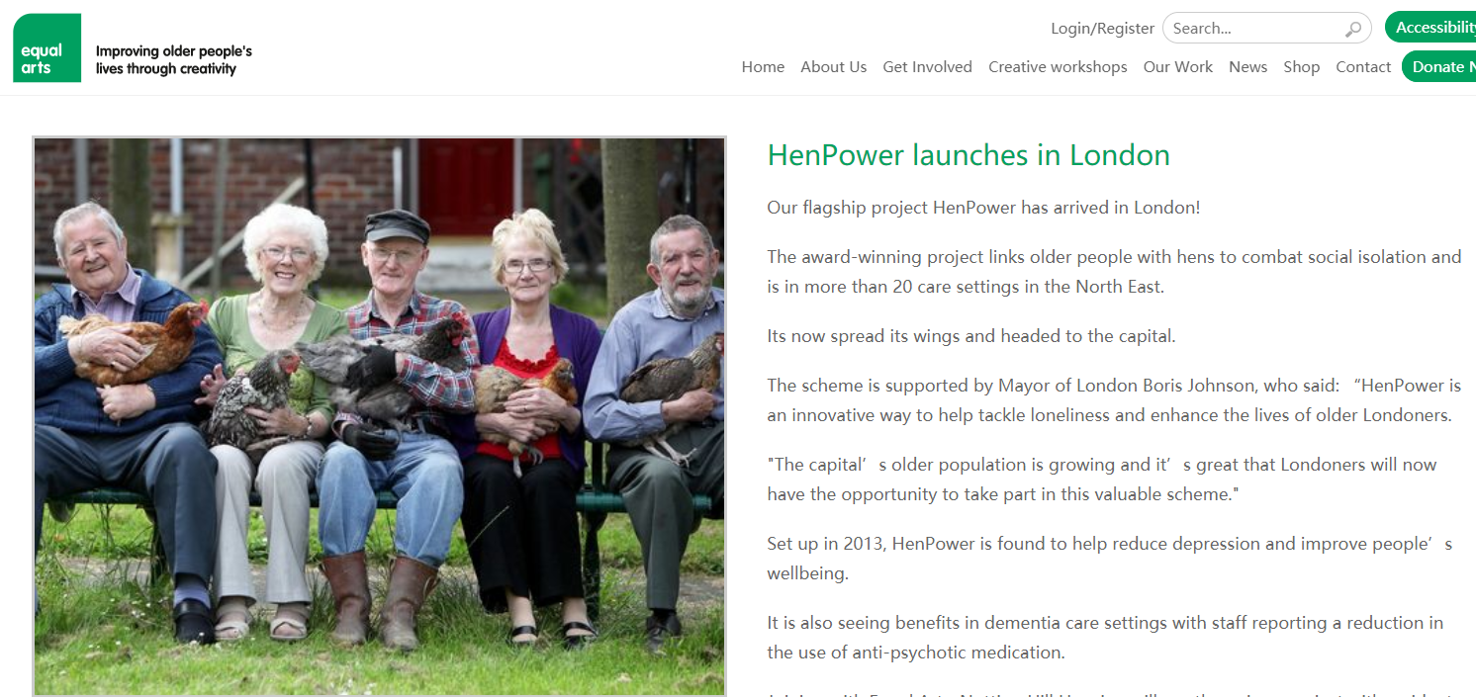
阅读理解C篇：来自一个帮助老年人的公益网站，该机构倡导用母鸡帮助
老年人解决孤独问题。

Slide 8
C
The elderly residents (居民) in care homes in London are being given hens to look after to stop them feeling lonely.
The project was dreamed up by a local charity (慈善组织) to reduce loneliness and improve elderly people’s wellbeing. It is also being used to help patients suffering dementia, a serious illness of the mind. Staff in care homes have reported a reduction in the use of medicine where hens are in use.
Among those taking part in the project is 80-year-old Ruth Xavier. She said: “I used to keep hens when I was younger and had to prepare their breakfast each morning before I went to school.
“I like the project a lot. I am down there in my wheelchair in the morning letting the hens out and down there again at night to see they’ve gone to bed.
“It’s good to have a different focus. People have been bringing their children in to see the hens and residents come and sit outside to watch them. I’m enjoying the creative activities, and it feels great to have done something useful.”
There are now 700 elderly people looking after hens in 20 care homes in the North East, and the charity has been given financial support to roll it out countrywide.
Wendy Wilson, extra care manager at 60 Penfold Street, one of the first to embark on the project, said: “Residents really welcome the idea of the project and the creative sessions. We are looking forward to the benefits and fun the project can bring to people here.”
Lynn Lewis, director of Notting Hill Pathways, said: “We are happy to be taking part in the project. It will really help connect our residents through a shared interest and creative activities.”

Slide 9
28.What is the purpose of the project?
A. To ensure harmony in care homes. B. To provide part-time jobs for the aged.
C. To raise money for medical research. D. To promote the elderly people’s welfare.
29.How has the project affected Ruth Xavier?
A. She has learned new life skills. B. She has gained a sense of achievement.
C. She has recovered her memory. D. She has developed a strong personality.
30.What do the underlined words “embark on” mean in paragraph 7?
A. Improve. B. Oppose. C. Begin. D. Evaluate.
31.What can we learn about the project from the last two paragraphs?
A. It is well received. B. It needs to be more creative.
C. It is highly profitable. D. It takes ages to see the results.
improve wellbeing = promote welfare
提高幸福
Para 2 : The project was dreamed up by a local charity (慈善组织) to reduce loneliness and improve elderly people’s wellbeing.
Para 5 : I’m enjoying the creative activities, and it feels great to have done something useful.”
“Residents really welcome the idea of the project and the creative sessions.
well received 深受欢迎的

Slide 10
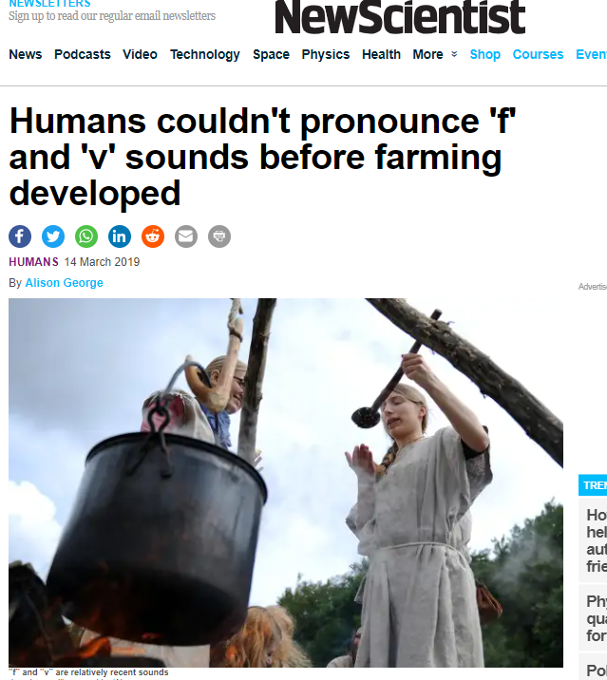
阅读理解D篇：原文选自《New Scientist》杂志，发表于2019年3月。

Slide 11
D
Human speech contains more than 2,000 different sounds, from the common “m”and “a” to the rare clicks of some southern African languages. But why are certain sounds more common than others? A ground-breaking, five-year study shows that diet-related changes in human bite led to new speech sounds that are now found in half the world’s languages.
More than 30 years ago, the scholar Charles Hockett noted that speech sounds called labiodentals, such as “f” and “v”, were more common in the languages of societies that ate softer foods. Now a team of researchers led by Damián Blasi at the University of Zurich, Switzerland, has found how and why this trend arose.
They discovered that the upper and lower front teeth of ancient human adults were aligned (对齐), making it hard to produce labiodentals, which are formed by touching the lower lip to the upper teeth. Later, our jaws changed to an overbite structure (结构), making it easier to produce such sounds.
The team showed that this change in bite was connected with the development of agriculture in the Neolithic period. Food became easier to chew at this point. The jawbone didn’t have to do as much work and so didn’t grow to be so large.
Analyses of a language database also confirmed that there was a global change in the sound of world languages after the Neolithic age, with the use of “f” and “v” increasing remarkably during the last few thousand years. These sounds are still not found in the languages of many hunter-gatherer people today.
This research overturns the popular view that all human speech sounds were present when human beings evolved around 300,000 years ago. “The set of speech sounds we use has not necessarily remained stable since the appearance of human beings, but rather the huge variety of speech sounds that we find today is the product of a complex interplay of things like biological change and cultural evolution,” said Steven Moran, a member of the research team.

Slide 12
32.Which aspect of the human speech sound does Damián Blasi’s research focus on?
A. Its variety. B. Its distribution.
C. Its quantity. D. Its development.
33. Why was it difficult for ancient human adults to produce labiodentals?
A. They had fewer upper teeth than lower teeth.
B. They could not open and close their lips easily.
C. Their jaws were not conveniently structured.
D. Their lower front teeth were not large enough.
Para 2 : Now a team of researchers led by Damián Blasi at the University of Zurich, Switzerland, has found how and why this trend arose.
Para 3 : They discovered that the upper and lower front teeth of ancient human adults were aligned . Later, our jaws changed to an overbite structure (结构), making it easier to produce such sounds.

Slide 13
34.What is paragraph 5 mainly about?
A. Supporting evidence for the research results.
B. Potential application of the research findings.
C. A further explanation of the research methods.
D. A reasonable doubt about the research process.
35.What does Steven Moran say about the set of human speech sounds?
A. It is key to effective communication.
B. It contributes much to cultural diversity.
C. It is a complex and dynamic system.
D. It drives the evolution of human beings.
Para 5 : Analyses of a language database also confirmed that there was a global change in the sound of world languages after the Neolithic age, with the use of “f” and “v” increasing remarkably during the last few thousand years.
Para 6 : the huge variety of speech sounds that we find today is the product of a complex interplay of things like biological change and cultural evolution

Slide 14
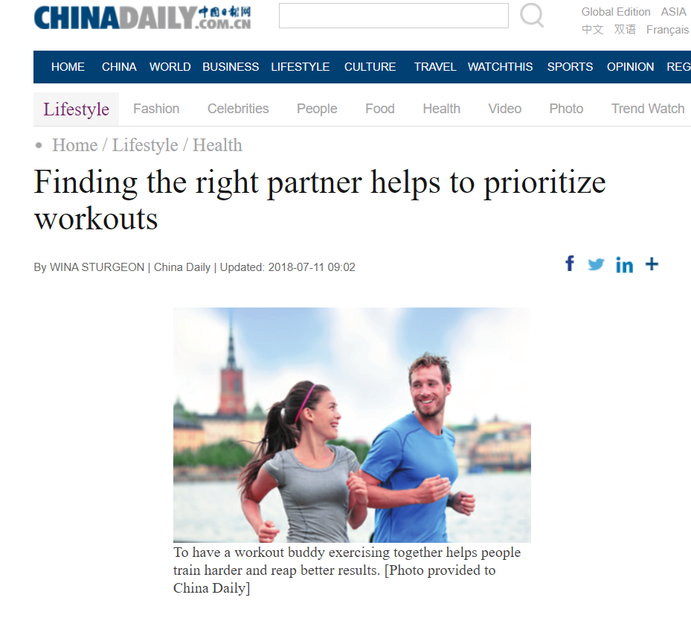
七选五：选自国内媒体《China Daily》，发表于2018年7月。
C D B G F

Slide 15
Fitness Magazine recently ran an article titled “Five Reasons to Thank Your Workout Partner.” One reason was: “You’ll actually show up if you know someone is waiting for you at the gym,” while another read: “ 36 ” With a workout partner, you will increase your training effort as there is a subtle (微妙) competition.
A. Your first meeting may be a little awkward.
B. A workout partner usually needs to live close by.
C. You'll work harder if you train with someone else.
D. Do you want to be a better athlete in your favorite sport?
E. How can you write a good "seeking training partner" notice?
F. Just accept your differences and learn to work with each other.
G. Any notice for a training partner should include such information.

Slide 16
So, how do you find a workout partner?
First of all, decide what you want from that person. 37 Or do you just want to be physically fit, able to move with strength and flexibility? Think about the exercises you would like to do with your workout partner.
A. Your first meeting may be a little awkward.
B. A workout partner usually needs to live close by.
C. You'll work harder if you train with someone else.
D. Do you want to be a better athlete in your favorite sport?
E. How can you write a good "seeking training partner" notice?
F. Just accept your differences and learn to work with each other.
G. Any notice for a training partner should include such information.

Slide 17
You might think about posting what you are looking for on social media, but it probably won’t result in a useful response. 38 If you plan on working out in a gym, that person must belong to the same gym.
讨论选择什么样的伙伴比较合适
A. Your first meeting may be a little awkward.
B. A workout partner usually needs to live close by.
C. You'll work harder if you train with someone else.
D. Do you want to be a better athlete in your favorite sport?
E. How can you write a good "seeking training partner" notice?
F. Just accept your differences and learn to work with each other.
G. Any notice for a training partner should include such information.

Slide 18
My partner posted her request on the notice board of a local park. Her notice included what kind of training she wanted to do, how many days a week and how many hours she wanted to spend on each session, and her age. It also listed her favorite sports and activities, and provided her phone number. 39
段尾设空一般是总结。
A. Your first meeting may be a little awkward.
B. A workout partner usually needs to live close by.
C. You'll work harder if you train with someone else.
D. Do you want to be a better athlete in your favorite sport?
E. How can you write a good "seeking training partner" notice?
F. Just accept your differences and learn to work with each other.
G. Any notice for a training partner should include such information.

Slide 19
You and your partner will probably have different skills. 40 Over time, both of you will benefit-your partner will be able to lift more weights and you will become more physically fit. The core (核心) of your relationship is that you will always be there to help each other.
A. Your first meeting may be a little awkward.
B. A workout partner usually needs to live close by.
C. You'll work harder if you train with someone else.
D. Do you want to be a better athlete in your favorite sport?
E. How can you write a good "seeking training partner" notice?
F. Just accept your differences and learn to work with each other.
G. Any notice for a training partner should include such information.

Slide 20

完形填空
主题语境：人与社会
语篇类型：记叙文
文章介绍作者一家在过去露营中令作者印象深刻的经历，其中一次得到了陌生人的帮助，让作者对于未来的冒险更加充满期待。

Slide 21
My husband, our children and I have had wonderful camping experiences over the past ten years.
Some of our 41 are funny, especially from the early years when our children were little. Once, we 42 along Chalk Creek. I was 43 that our 15-month-old boy would fall into the creek (小溪). I tied a rope around his waist to keep him near to our spot.
41. A. ideas B. jokes C. memories D. discoveries
42. A. camped B. drove C. walked D. cycled
43. A. annoyed B. surprised C. disappointed D. worried
考查名词及上文提示。作者在过去这几年有很多美好的露营经历，其中一些回忆是有趣的。
考查动词及上文提示。作者在Chalk Greek露营的经历。
考查形容词及下文提示。根据下文作者在孩子腰部系上绳索让其靠近我们，可知作者担心孩子，防止掉入小溪。

Slide 22
That lasted about ten minutes. He was 44 , and his crying let the whole campground know it. So 45 tying him up, I just kept a close eye on him. It 46 -he didn’t end up in the creek. My three-year-old, however, did.
44. A. unhurt B. unfortunate C. uncomfortable D. unafraid
45. A. due to B. instead of C. apart from D.as for
46. A. worked B. happened C. mattered D. changed
考查形容词及下文提示。从下文孩子的哭声可知，该做法应该是让孩子不舒服。
考查短语及逻辑关系。根据后文作者只是密切关注孩子的举动可知，作者反过来不是系着孩子，而是近距离关注孩子。
考查动词及下文提示。根据后一句话转折可知，不把孩子系上绳索的做法确实起到了效果。15个月大的孩子没有掉到小溪，而是三岁大的孩子掉入。

Slide 23
Another time, we rented a boat in Vallecito Lake. The sky was clear when we 47 , but storms move in fast in the mountains, and this one quickly 48 our peaceful morning trip. The 49 picked up and thunder rolled. My husband stopped fishing to 50 the motor.
47. A. signed up B. calmed down C. checked out D. headed off
48. A. arranged B. interrupted C. completed D. recorded
49. A. wind B. noise C. temperature D. speed
50. A. find B. hide C. start D. fix
考查动词短语及上下文提示。根据上文作者在回忆另外一次露营经历，可知作者应该在出发要天气晴朗，之后在遭遇暴风雨。
考查动词及上文提示。暴风雨逼近快速的打断了作者安静的早晨。
考查名词及上文提示。根据上文暴风雨逼近，山里面风加剧，天空出现轰隆雷声。
考查动词及上文提示。根据前文天气发生变化，作者一家发动摩托赶紧离开。

Slide 24
Nothing. He tried again. No 51 . We were stuck in the middle of the lake with a dead motor. As we all sat there 52 , a fisherman pulled up, threw us a rope and towed (拖) us back. We were 53 .
Now, every year when my husband pulls our camper out of the garage, we are filled with a sense of 54 , wondering what camping fun and 55 we will experience next.
51. A. luck B. answer C. wonder D. signal
52. A. patiently B. tirelessly C. doubtfully D. helplessly
53. A. sorry B. brave C. safe D. right
54. A. relief B. duty C. pride D. excitement
55. A. failure B. adventure C. performance D. conflict
考查名词及上文提示。运气不佳。
考查副词及上文提示。根据上文作者发动车辆无望，一家人只能无助的坐在原地。
考查形容词及上文提示。根据上文一渔民向作者提供援助，可知作者一家是安全。
考查名词及下文提示。作者对以后的露营都充满了兴奋。
考查名词及上下文提示。作者一家都期待以后的露营带来怎样的乐趣和冒险。

Slide 25
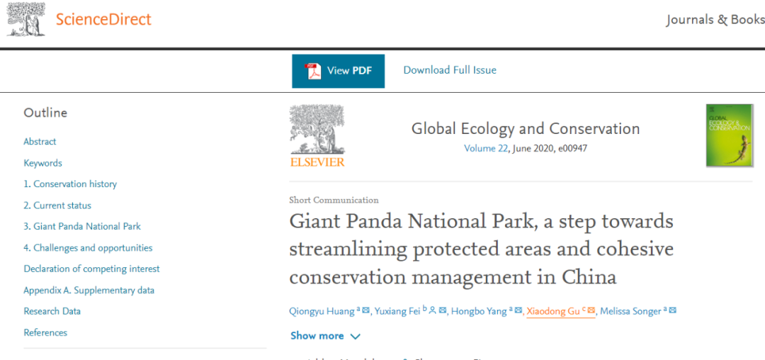
语法填空：选自新晋SCI期刊《Global ecology and conservation》，创刊于荷兰，致力于发表生态与保护科学相关的论文。发表于2020年。

Slide 26
语法填空
主题语境：人与自然
语篇类型：说明文
中国政府最近敲定了一项建立大熊猫国家公园的计划，将成为中国最早的国家公园之一。它的主要目标是改善大熊猫种群和大熊猫家园之间的连通性，最终使其达到预期的野生种群水平。 大熊猫也将作为一种保护伞物种，为许多植物和动物带来保护。

Slide 27
倍数表达：倍数＋the＋名词(size/weight/length ...)＋of B，表示“是B（大小/重量/长度...）的多少倍”。
The Chinese government recently finalized a plan to set up a Giant Panda National Park (GPNP). 56 (cover) an area about three times 57 size of Yellowstone National Part, the GPNP will be one of the first national park in the country. The plan will extend protection to a significant number of areas that 58 (be) previously unprotected, bringing many of the existing protected areas for giant pandas under one authority 59 (increase) effectiveness and reduce inconsistencies in management.
Covering
考查非谓语，与主语是主动关系
完整的主系表句子结构
the
were
to increase
考查非谓语。
不定式作目的状语。

Slide 28
After a three-year pilot period, the GPNP will be officially set up next year. The GPNP 60 (design) to reflect the guiding principle of "protecting the authenticity and integrity (完整性) of natural ecosystems, preserving biological diversity, protecting ecological buffer zones, 61 leaving behind precious natural assets (资产) for future generations". The GPNP's main goal is to improve connectivity between separate 62 (population)and homes of giant pandas, and 63 (eventual) achieve a desired level of population in the wild.
考查被动语态。陈述一般事实，故用一般现在时。
is designed
and
考查并列连词。用and 连接了三个指导原则
populations
考查名词复数。
eventually
查词性转换。修饰动词achieve应用副词。

Slide 29
as
固定搭配，serve as...表示“ 作为...”。
Giant pandas also serve 64 an umbrella species (物种), bringing protection to a host of plants and animals in the southwestern and northwestern parts of China. The GPNP is intended to provide stronger protection for all the species
65 live within the Giant Panda Range and significantly improve the health of the ecosystem in the area.
that
考查连词。引导定语从句并在从句中作主语，先行词是 all the
species, 指物并有all修饰。
当先行词指物，且被all, every, any, the very, the only, the just等修饰时，只使用that不用which引导。）

Slide 30
PART
1
书 面 表 达

Slide 31
假定你是校广播站英语节目“Talk and Talk”的负责人李华，请给外教Caroline写邮件邀请她做一次访谈。内容包括： 1.节目介绍； 2.访谈的时间和话题。 注意： 1.写作词数应为80左右； 2.请按如下格式在答题卡的相应位置作答。

Slide 32
Dear Caroline,
I'm Li Hua, who is in charge of the English programme called“Talk and Talk”on our school's radio station. I'm writing to invite you to our live interview.
The programme“Talk and Talk”, which is highly popular among us students, mainly focuses on the hottest topic that students may be concerned about, ranging from science news to fun general knowledge. What is the most inspiring lately is studying abroad. I'd appreciate it if you could share something interesting about campus life and shed some light on application for admission to overseas universities. The interview will begin at 2:00 p.m. and last for 30 minutes. We do hope you could come and have fun with us.
Looking forward to your reply.
Yours sincerely,
LiHua
自我介绍+发出邀请
访谈话题+时间+希望收到早日回复
运用定语从句，主语从句等多样句式。

Slide 33
作者：梁向群 Kelly Liang
Dear Caroline,
I’m Li Hua, the student in charge of the English channel“ Talk and Talk” of our school broadcasting station. It’s such an honor for me, on behalf of our team , to invite you to be a special guest in an interview of our programme.
Beginning:自我介绍+发出邀请（写作背景的合理化内容）

Slide 34
“Talk and Talk”, an English learning platform and eye-opener, has been appealing to a large audience on campus for a decade. A special feature on “how to efficiently improve our listening and speaking skills in English” is scheduled to be on air from 5:30pm to 6:30pm next Friday ( June 17). Students will be invited to share their experience as well as confusion in this feature, where your professional guidance from a foreign teacher’s perspective will be a valuable addition.
Body: 1.节目介绍；2.访谈的时间和话题。以where引导的非限制性定语从句表明Caroline会在节目中添彩，其实在重申邀请。细品：节目话题是为对方量身定做的，where定从的内容显得自然又真诚。

Slide 35
No one else can be a better choice than you, for your name alone will be the best advertisement for our programme. Looking forward to your positive reply and further discussion at your earliest convenience. Thank you in advance. Best wishes.
Yours sincerely
Li Hua
Ending:呼应开头的邀请，表达强烈的需求和期待。明显的读者意识。细品：本文三段都在“邀请”，三段的邀请手法和遣词有何特点？

Slide 36
读后续写原文故事情节简单清晰，讲述了David因为脑部疾病影响行动，教练担心他被嘲笑而让他选择是否继续参加比赛。David选择放弃，而“我”作为该学校特殊教育老师，决定帮助鼓励他参加比赛。故事语言相对易懂，内容贴近学生生活，让学生有话可写。所给两段段首句没有生词，降低了学生在审题上的困难。根据第二段段首句，David和其他选手一起站在起跑线，可以反推出作者在写作第一段成功说服David 参加比赛，而从全文立意，情节传达正能量的考量，可以推出David 跑完了比赛。在情节设计上，宜以作者与David的互动为落脚点。从语言一致角度考虑，续写宜选择较常见的动作描写、心理描写等。

Slide 37
情节设计思路：
第一段： 我引起David注意——说服David参加比赛——David思考后
决定参加比赛
第二段：我给予David鼓励——David坚持跑完——情感升华：David感
受到挑战自我的成就感
David 情绪变化：惊讶——犹豫——决心——成就感——感恩
我的情绪： 坚定——为David骄傲

Slide 38
We sat down next to each other, but David wouldn’t look at me. I patted him to get his attention. I tried to persuade him that just being afraid of being laughed at was no reason to give up. He seemed to be a little bit surprised but he thought for a while and accepted my advice to take part in the running. I felt some kind of relief and convinced him of his capability to fulfill this ambition since he had had sufficient practice and strong determination. Then the running was about to begin.

Slide 39
I watched as David moved up to the starting line with the other runners. He looked back at me and I signaled to him with a thumb up, feeling proud of him. He smiled，took a deep breath and got ready for the race. When the running began, he ran with all his strength, is spite of his abnormal steps. Eventually, he finished the running. Nearly out of breath, he walked to me and then gave me a hug. "Thank you!" he uttered, "Without you, I would never taste such a sense of achievement of challenging myself. "

Slide 40
Kelly’s version
We sat down next to each other, but David wouldn’t look at me. His wandering eyes betrayed his painful struggle. I must help him make a brave decision-----the true one deep down inside him. “Are you sure you’ll give up the opportunity you’ve been sweating for all these years? Are you sure you won’t regret not taking this chance when looking back some day later? Will others’ opinions define what you are?” I gently patted him on the skinny yet powerful shoulder and encouraged him to be honest with himself. However, I wasn’t forcing him, for he’s wise enough to know what he really wanted. He slowly raised his head, looking at me with a twinkle in his eye. A silent exchange of glance told me his final decision.

Slide 41
I watched as David moved up to the starting line with the other runners. Then started the fierce competition , taking away the audience’s breath. Everybody’s heart went out to him when the poor little boy was left farther and farther behind. Worse still, he tripped and fell when I was cheering loudly for him! “Was I to blame for all these embarrassments? “ I guiltily thought to myself. David managed to pick himself up before anybody was able to help. He continued to drag his legs towards the destination. Thunderous applause and cheers filled the air with a chorus of “Come on, David!” blowing in the balmy breeze. David, no doubt, was the last one, but the greatest hero shining with the awesome sportsmanship!” It feels so good when hesitation gives way to determination! ” With this conclusion, the breathless boy threw himself into my arms and thanked me with his toothy grin. For me, the greatest privilege of being a teacher is that you never know how your pupil will teach you!

