Slide 1
读后续写真题
2021年6月浙江卷:“我”的工资

Slide 2
目录
1
试题再现
2
试题分析
CONTENTS
3
写作思路
4
范文赏析

Slide 3
01
历年高考英语读后续写真题分析
2021
试题再现

Slide 4
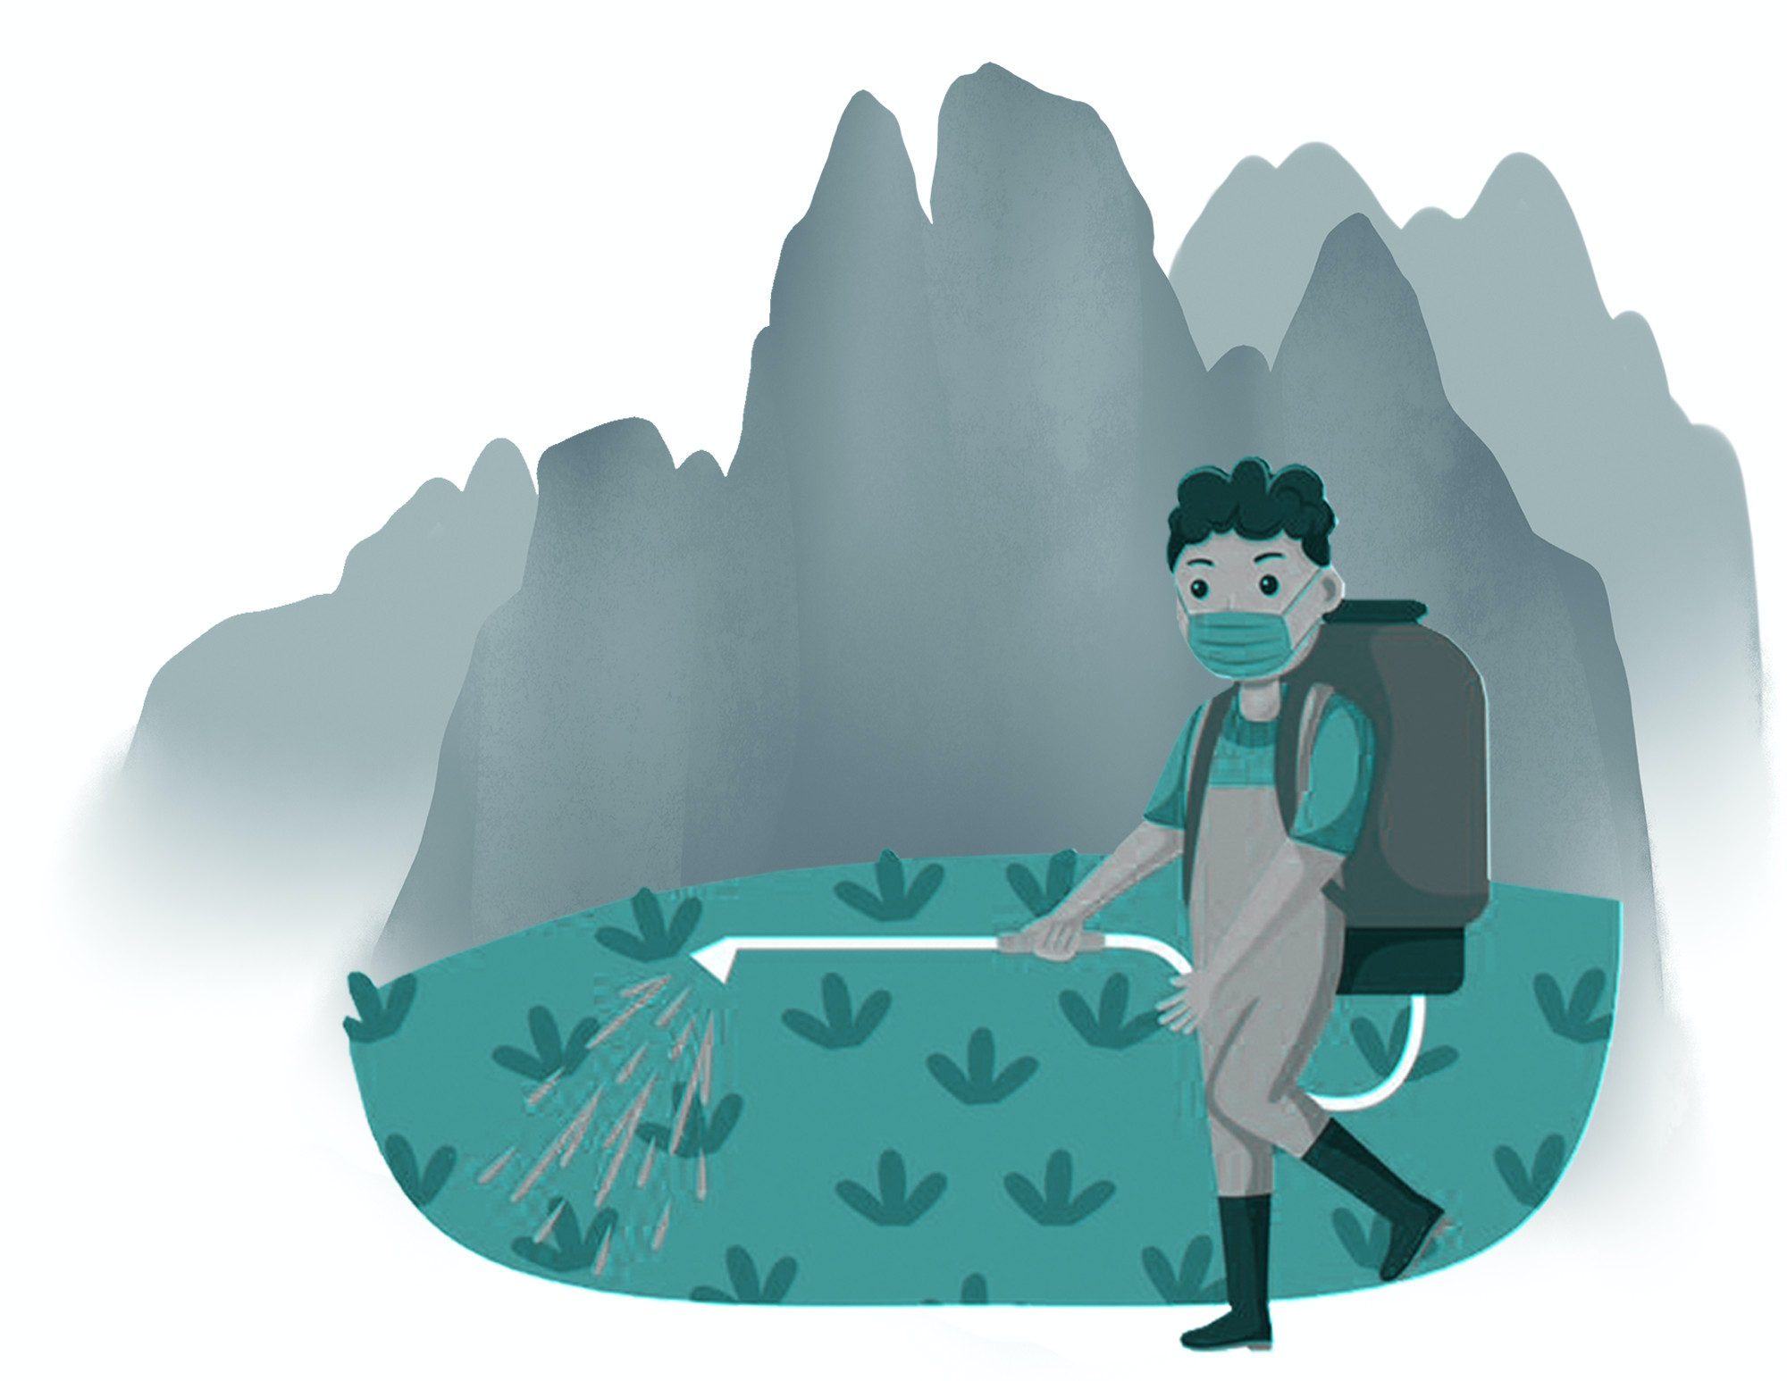
试题再现
阅读下面短文，根据所给情节进行续写，使之构成一个完整的故事。
My dad, George, only had an eighth grade education. A quiet man, he didn’t understand my world of school activities. From age 14, he worked. And his dad, Albert, took the money my dad earned and used it to pay family expenses.
I didn’t really understand his world either: He was a livestock (牲畜) trucker, and I thought that I would surpass (超过) anything he had accomplished by the time I walked across the stage at high school graduation.
Summers in the mid-’70s were spent at home shooting baskets, hitting a baseball, or throwing a football, preparing for my future as a quarterback (四分卫) on a football team. In poor weather, I read about sports or practiced my trombone (长号).
The summer before my eighth grade I was one of a group of boys that a neighboring farmer hired to work in his field. He explained our basic task, the tractor (拖拉机) fired up and we were off, riding down the field looking for weeds to spray (喷洒) with chemicals. After a short way, the farmer stopped and pointed at a weed which we missed. Then we began again. This happened over and over, but we soon learned to identify different grasses like cockleburs, lamb’s-quarters, foxtails, and the king of weeds, the pretty purple thistle. It was tiring work, but I looked forward to the pay, even though I wasn’t sure how much it would amount to.

Slide 5
试题再现
阅读下面短文，根据所给情节进行续写，使之构成一个完整的故事。
At home, my dad said, “A job’s a big step to growing up. I’m glad you will be contributing to the household.” My dad’s words made me realize that my earnings might not be mine to do with as I wished.
My labors lasted about two weeks, and the farmer said there might be more work, but I wasn’t interested. I decided it was not fair that I had to contribute my money.
注意：1. 所续写短文的词数应为150左右；
2. 续写部分分为两段，每段的开头语已为你写好；
The pay day arrived at last. _____________________________________________________________________
I understood immediately what my parents were worried about. __________________________________________

Slide 6
02
历年高考英语读后续写真题分析
2021
试题分析

Slide 7
材料分析：
这篇读后续写以人物为线索展开，讲述了作者高中毕业后，参加农场工作，辛辛苦苦挣到的钱，不情愿贡献给家庭，后来在看到父亲的辛劳之后，理解了父母担心的是自己太过自私而不知奉献，终于想通，并自豪地将自己劳动所得交给父亲的故事。故事容易读懂，开放性却很强，可以发挥的余地很大。

Slide 8
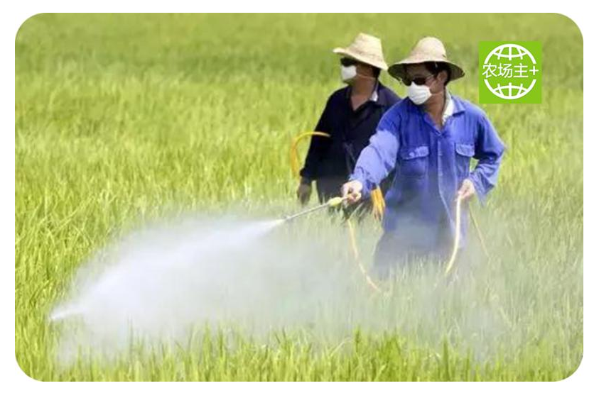
How to read
My dad, George, only had an eighth grade education. A quiet man, he didn’t understand my world of school activities. From age 14, he worked. And his dad, Albert, took the money my dad earned and used it to pay family expenses.
I didn’t really understand his world either: He was a livestock trucker, and I thought that I would surpass (超过) anything he had accomplished by the time I walked across the stage at high school graduation.
Summers in the mid-70s were spent at home shooting baskets, hitting a baseball, or throwing a football, preparing for my future as a quarterback on a football team. In poor weather, I read about sports or practiced my trombone (长号).
Who: My dad, I, a neighboring farmer
What: work in the farm field
how to use money I earned

Slide 9
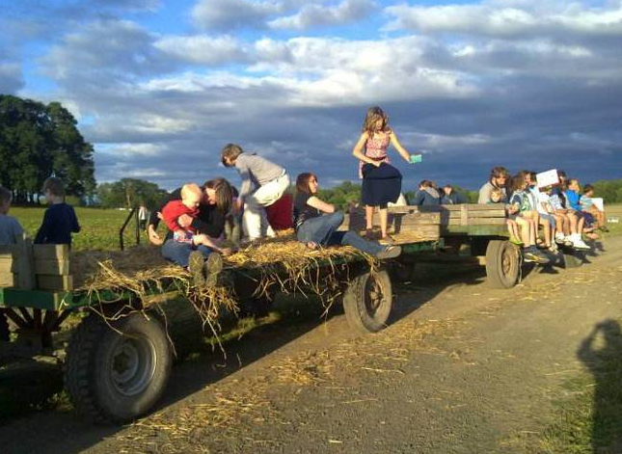
How to read
The summer before my eighth grade I was one of a group of boys that a neighboring farmer hired to work in his field. He explained our basic task, the tractor fired up and we were off, riding down the field looking for weeds to spray with chemicals. After a short way, the farmer stopped and pointed at a weed which we missed. Then we began again. This happened over and over, but we soon learned to identify different grasses like cockleburs, lamb’s-quarters, foxtails, and the king of weeds, the pretty purple thistle. It was tiring work, but I looked forward to the pay, even though I wasn't sure how much it would amount to.
At home, my dad said, “A job’s a big step to growing up. I’m glad you will be contributing to the household.” My dad’s words made me realize that my earnings might not be mine to do with as I wished.
My labors lasted about two weeks, and the farmer said there might be more work, but I wasn’t interested. I decided it was not fair that I had to contribute my money.
When: the summer before my eighth grade
Where: a neighboring farmer's field
at home

Slide 10
Read for the plot clue
my dad with little education
didn't understand each other
my dream to be a quarterback
work on the farm in summer
money I earned
do something for the household
unfair not to use my own money

Slide 11

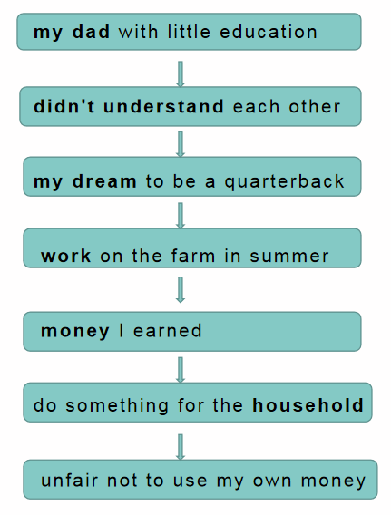
Read for the emotion clue:
confident
delighted
uninterested

Slide 12
Two clues in the story
The surface level
The deep level
The plot line
The emotion line

Slide 13
根据短文内容填空。
My dad is a _____ man and he only had an _____ grade education.
quiet
eighth
He was glad that I could earn money and _________ to the household.
He started to work from age ____ and his money was spent to pay ______ _________.
14
contribute
family
My Dad
expenses
didn’t
understand
He thought that a job’s a big step to _______ ___.
He ______ _________
my world of school activities.
growing
up

Slide 14
阅读完材料，试着完成下面的故事山吧！
3. Climax
My father praised me since I could work for the family. Hearing that, I felt unfair not being able to use my own money and lost the interest in more work.
4. Resolution
2. Build-up
The pay day arrived at last. How would I cope with my depression caused by my dad’s words?
I spent my summer vacation before the eighth grade working in my neighbor's field and looked forward to the pay.
5. Ending
I understood immediately what my parents were worried about. Would I understand my dad finally?
1. Opening
My dad and I didn’t understand each other.

Slide 15
03
历年高考英语读后续写真题分析
2021
写作思路

Slide 16
研读两段的给出句，想想它们给我们提供了哪些续写线索？
Para 1: The pay day arrived at last.
“I decided it was not fair that I had to contribute my money” mentioned in the text suggests “I was upset”. Would this feeling continue as the pay day arrived? What happened in Para. 1 to make me “understand immediately what my parents were worried about” in Para. 2?
Para 2: I understood immediately what my parents were worried about.
What was my reaction after learning about my parents’ worries? “I understood my dad, contributed my money willingly, learned about shouldering responsibilities” all seem good morals I got at last. How can the ending be designed to achieve some or all of them?

Slide 17


二、分析续写段首，确定续写方向
由第一段首句内容The pay day arrived at last.（工资终于到了。）及时间线索词The pay day可知，第一段可描写作者的工资到手后，高兴地计划自己用这笔钱，不愿意交给父亲，因此此时应该表达开心→失落→不想把钱交给父亲的场景。设问如下：
①Which words or phrases should be focused on in the given sentence?
(pay，arrived )
②How did I feel when I got payment from my work?
③ How did I plan the money at first?
④What did his father say?

Slide 18
二、分析续写段首，确定续写方向
根据第二段首句 I understand immediately what my parents were worried about.（我立刻明白了父母的担心。）及时间线索词immediately可知，本段一定是描写我发现父亲的辛劳→突然明白了父母的焦虑→把钱给父母→自豪的场景。设问如下：
⑤Which words or phrases should be focused on in the given sentence?
(understand，worried about)
⑥What did I see and understand?
⑦What did I realize and decide to do?
⑧What’s the end of the story?

Slide 19
How to write
[coherent]
para 1 and para 2 {逻辑要连贯}
Plot and emotion with appropriate language

Slide 20
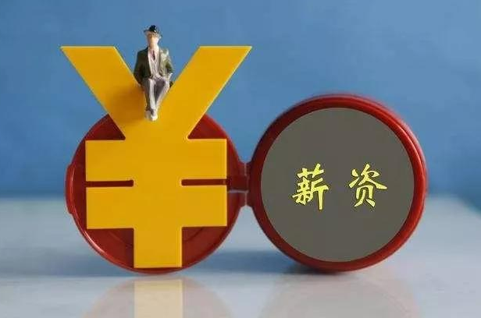
How to write
pay
①由第一段首句内容“拿到工资”。可知，第一段可描写作者的工资到手后，高兴地计划自己用这笔钱，不愿意交给父亲。
②由第二段首句内容“我明白了父母的难处。”可知，续写内容本着正能量的方向发展，应该为家庭有所付出。

Slide 21
How to write
续写线索：
高兴 ——不情愿 ——理解 —— 为家庭付出

Slide 22
How to write
词汇激活
①计划： programme/plan
②.奉献：give/devote
③发现： see/find

Slide 23
How to write
情绪类
①.不情愿的：unwilling/reluctant
②.自豪地： proudly/with pride
③.高兴的: be delighted to do...

Slide 24
润色句式：
段首：On doing...,
His face lit up
I suddenly realized that...

Slide 25
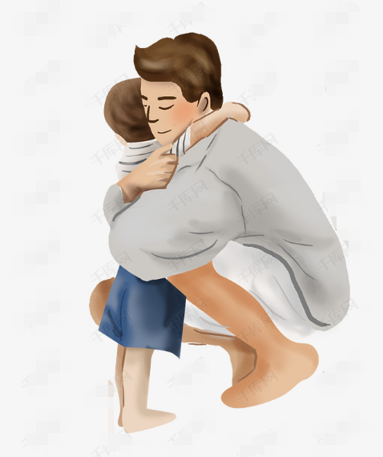
润色句式：
结尾升华：
不情愿为家庭付出 明白父母的难处 愿意付出
I took out my own money with pride and was delighted to hand it to my dad. He gave me a tight hug with tears streaming down his cheeks.

Slide 26
②挖掘文章人物的情感
My dad, George, only had an eighth grade education. A quiet man, he didn’t understand my world of school activities.…
I didn’t really understand his world either: He was a livestock trucker, and I thought that I would surpass（超过）anything he had accomplished …
读懂开头这两句可知父子两人彼此不理解，这是读后续写的伏笔，表达故事发展从负面情感到积极情感的变化过程（最后两人彼此理解了）
伏笔指将上文看似无关紧要的人物或事件作为在续写下文时可能出现的人物或事件的预先提示或暗示，目的达到“前有伏笔，后有照应”的效果。

Slide 27
②挖掘文章人物的情感
这也是读后续写的铺垫，表达作者父亲很小开始工作，而且爷爷拿走作者爸爸所以赚的钱，铺垫了续写的两方面内容：一是作者一家生活很辛苦，二是作者家庭传统，赚钱上交帮助家庭开支
… From age 14. he worked. And his dad, Albert, took the money my dad earned and used it to pay family expenses. …
铺垫指故事高潮的前奏，如环境描写、对话描述等，推动主要人物主要内容的展示，帮助制造悬念和矛盾冲突。

Slide 28
②挖掘文章人物的情感
Summers in the mid-70s were spent at home shooting baskets, hitting a baseball, or throwing a football, preparing for my future as a quarterback on a football team. In poor weather, I read about sports or practiced my trombone（长号）.
这也是读后续写的伏笔，本段通过恰当使用一连串的节奏动词，生动具体地描述了主人公对体育的酷爱，展示了极强的画面感，我们据此可以设想作者赚钱后一定会得意洋洋地去计划如何去花钱的故事

Slide 29
②挖掘文章人物的情感
The summer before my eighth grade I was one of a group of boys …. Then we began again. This happened over and over, … It was tiring work, but I looked forward to the pay, even though I wasn’t sure how much it would amount to.
通过began again及happened over and over，加上情绪的形容词tiring来体现作者不肯出苦耐劳，但为了达成愿望的不得不辛苦的矛盾心理

Slide 30
②挖掘文章人物的情感
At home, my dad said, “A job’s a big step to growing up. I’m glad you will be contributing to the household.” My dad’s words made me realize that my earnings might not be mine to do with as I wished.
为后文作者最终把赚的钱资助家用，最终“长大” 埋下了伏笔

Slide 31
②挖掘文章人物的情感
My labors lasted about two weeks, and the farmer said there might be more work, but I wasn’t interested. I decided it was not fair that I had to contribute my money.
这里使用精准化动词decided，contribute渲染作者因为要把赚钱交给爸爸，感觉工作起来没有动力，衬托了作者极不情愿交钱给爸爸的心理活动描写，也为后续解决冲突埋下了伏笔

Slide 32
04
历年高考英语读后续写真题分析
2021
范文赏析

Slide 33
根据括号中的提示，补出范文缺失的部分，并关注哪些语言回答了“首句精研”的问题。
The pay day arrived at last. _________________________________________ (虽然我口袋里一共有100美元，我还是带着沉重的心情回家了。让步状语从句和with结构). ______________________________________________ (我多希望用这些钱买一双自己想要很久的新运动鞋。感叹句和省略that的定语从句). Not much was said over dinner. However, before I went to bed that night, _______________________ (然而，晚上睡觉前，我无意中听到从父母房间传来的谈话。时间状语从句和非谓语动词作后置定语). “Sam can do without a personal football coach. Our budget is really tight this month,” said my mom. “Don’t worry. I just need to do some extra driving. A professional can help him make great progress in football. You know the boy’s future dream,” said my dad.
I understood immediately what my parents were worried about. _________________ (一直误会爸爸的人是我。强调句), not the other way around. The next morning, I handed Dad my hard-earned cash. It only seemed fair. But he just took some of it. “That’ll do for now and thanks for helping with the family expenses, son. You are really growing up,” he said. After the talk, I went straight back to the farmer and took the extra work.

Slide 34
阅读以下参考范文，核对一下你是否补出范文缺失的部分。
The pay day arrived at last. Though I had a total of $100 in my pocket, I still went home with a heavy heart. How I wished I could use the money to buy a pair of new sports shoes I’d wanted for ages. Not much was said over dinner. However, before I went to bed that night, I overheard a conversation coming from my parents’ bedroom. “Sam can do without a personal football coach. Our budget is really tight this month,” said my mom. “Don’t worry. I just need to do some extra driving. A professional can help him make great progress in football. You know the boy’s future dream,” said my dad.
I understood immediately what my parents were worried about. It was me who had misunderstood my dad all the time, not the other way around. The next morning, I handed Dad my hard-earned cash. It only seemed fair. But he just took some of it. “That’ll do for now and thanks for helping with the family expenses, son. You are really growing up,” he said. After the talk, I went straight back to the farmer and took the extra work.

Slide 35
2021年6月浙江卷读后续写——逻辑连贯 (coherent)
重复、指代、同义替换等 (cohesive)
What did I feel when I got the pay? What made me understand my parents’ worries?
The pay day arrived at last.
Though I had a total of $100 in my pocket, I still went home with a heavy heart. How I wished I could use the money to buy a pair of new sports shoes I’d wanted for ages. Not much was said over dinner. However, before I went to bed that night, I overheard a conversation coming from my parents’ bedroom. “Sam can do without a personal football coach. Our budget is really tight this month,” said my mom. “Don’t worry. I just need to do some extra driving. A professional can help him make great progress in football. You know the boy’s future dream,” said my dad.

Slide 36
2021年6月浙江卷读后续写——逻辑连贯 (coherent)
重复、指代、同义替换等 (cohesive)
What did I react after knowing my parents’ worries?
I understood immediately what my parents were worried about.
It was me who had misunderstood my dad all the time, not the other way around. The next morning, I handed Dad my hard-earned cash. It only seemed fair. But he just took some of it. “That’ll do for now and thanks for helping with the family expenses, son. You are really growing up,” he said. After the talk, I went straight back to the farmer and took the extra work.

Slide 37
2021年6月浙江卷读后续写——精彩语言
让步状语从句
The pay day arrived at last. Though I had a total of $100 in my pocket, I still went home with a heavy heart. How I wished I could use the money to buy a pair of new sports shoes I’d wanted for ages. Not much was said over dinner. However, before I went to bed that night, I overheard a conversation coming from my parents’ bedroom. “Sam can do without a personal football coach. Our budget is really tight this month,” said my mom. “Don’t worry. I just need to do some extra driving. A professional can help him make great progress in football. You know the boy’s future dream,” said my dad.
with结构
感叹句
省略that的定语从句
被动语态
时间状语从句
现在分词作后置定语
形容词搭配

Slide 38
2021年6月浙江卷读后续写——精彩语言
I understood immediately what my parents were worried about. It was me who had misunderstood my dad all the time, not the other way around. The next morning, I handed Dad my hard-earned cash. It only seemed fair. But he just took some of it. “That’ll do for now and thanks for helping with the family expenses, son. You are really growing up,” he said. After the talk, I went straight back to the farmer and took the extra work.
强调句
固定搭配
合成形容词
时间状语从句
生动的副词

Slide 39
检测一下你对范文的亮点语块掌握了吗？
高级语块
a total of
at last
总计
心情沉重
没有……也行
取得巨大进步
一直，始终
目前
最后
想要某物很久了
倒过来
辛苦挣得的钱
家庭支出
径直走向
a heavy heart
want sth. for ages
do without
the other way around
make great progress
hard-earned cash
all the time
family expenses
for now
go straight to

Slide 40
赏析范文的亮点语句。
亮点评述
Though I had a total of $100 in my pocket, I still went home with a heavy heart. How I wished I could use the money to buy a pair of new sports shoes I’d wanted for ages. Not much was said over dinner. (Para. 1)
本部分从作者的心理活动和外部情景两方面描写了作者的愤懑情绪。这种直接描写和间接描写穿插使用的方式值得借鉴。

Slide 41
THANK YOU

