Slide 1


202304广东湛江二模
阅读-语法讲解PPT +二次开发

Slide 2
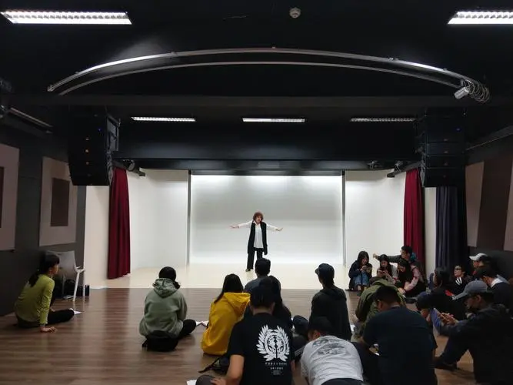
Passage A
语篇类型：应用文
主题语境：人与社会
介绍了如何报名艺术和表演课。

Slide 3
We offer art and performing classes to children, teens and adults. Our classes are listed on our website with direct links to register. Registration for our classes begins on May 25th.
Our Classes
We teach after-school programs, private and semi-private art classes. Summer, March Break and Christmas Day camps are available as well. Check out our online classes.
Join our art classes and develop your skills and creativity in painting, printmaking drawing, architecture, sculpture, fabric art, movie making, script writing, poetry confidence building skills and more. New programs are always being developed and are rarely repeated.
What Else We Do
We offer fun and exciting performance classes in our home base. Our home base is a beautiful studio designed by an architect as well as our two studios by the sea in Ambleside. We provide a creative setting for a hand on art and acting experience through classes and work-shops. Specialized art education develops engaged, confident, well-rounded and creative chil-dren. Artistic activities train the brain to think spatially （空间地），solve problems creatively and support development in other subjects. Our elementary school programs bring' exciting opportunities for students to explore techniques and materials that are often beyond schools' art classroom resources.
Where We Offer Classes
For parents looking for the convenience of extracurricular opportunities for their chil-dren,they can have experience by bringing our classes to their local school with a choice of lunchtime and after-school classes. We love our group of mobile schools with their greatly supportive volunteers! Or you can have us come to you for private classes!

Slide 4

21. How can the readers register the class?
A. By telephone. B. By website. C. By telegraph. D. By mobile app
Our classes are listed on our website with direct links to register

Slide 5
22. What can students learn in the studios by the sea in Ambleside?
A.Performance. B.Architecture. C.Dancing. D.Painting.
We offer fun and exciting performance classes in our home base.Our home base is a beau-tiful studio designed by an architect as well as our two studios by the sea in Ambleside.

Slide 6
23. What can we know about the class from the last paragraph?
A.Most parents want extra classes for their children.
B.Students can have classes in their local schools.
C.Volunteers in the training offer lunch to students.
D.Students can choose any place to attend the training.
原词定位
For parents looking for the convenience of extracurricular opportunities for their children,they can have experience by bringing our classes to their local school with a choice of lunchtime and after-school classes. We love our group of mobile schools with their greatly supportive volunteers! Or you can have us come to you for private classes!

Slide 7
重要词汇
registration
available
architecture
sculpture
fabric
script
poetry
spatially
techniques
登记
可获得的
建筑
雕刻
织物
剧本
诗歌
空间地
技巧

Slide 8
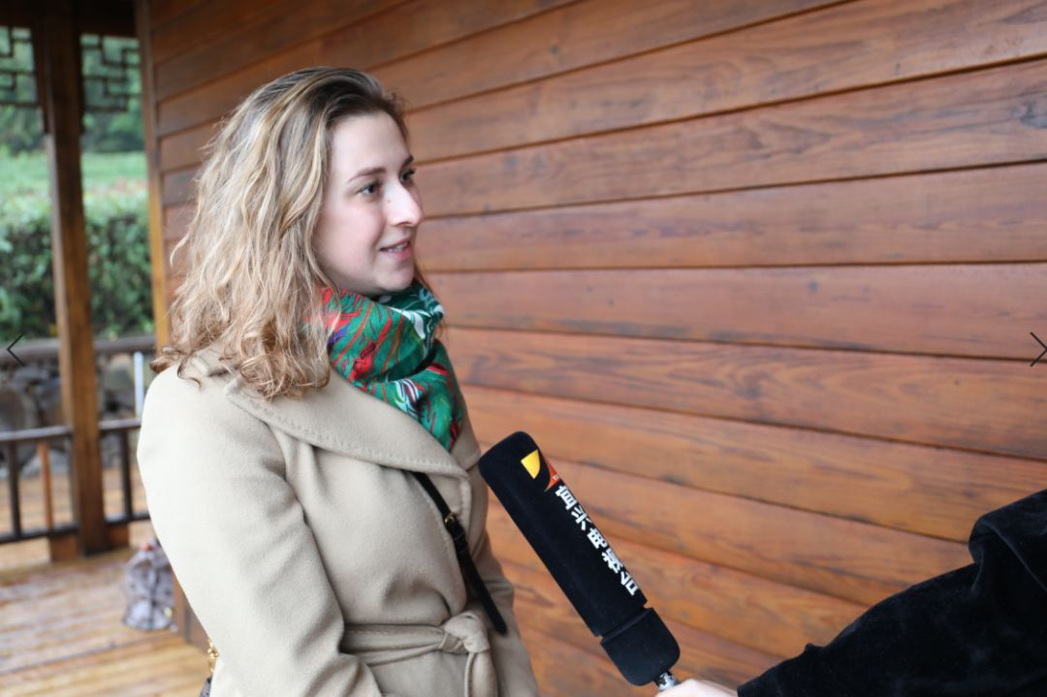
Passage B
语篇类型：记叙文
主题语境：人与社会
介绍了一位记者记录社区,遇到一对母女的故事。

Slide 9
I look forward to my half-hour train ride to work every morning. I can look out of the window as it twists and turns itself through neighborhoods with the sun casting its strong lighting on the floor of the train car. I sometimes get lost in thought while following the light. But the reason I love this ride is that it's a reminder of how neighborhoods can change from block to block.
For almost a year now I have been riding this train as I head into the office where I work as a reporter for a local magazine. I am one of 13 journalists who help report community news in areas that are often forgotten. And for me, that means covering areas like the one I grew up in.
Last week, as I was on the way to my office, I started wondering how neighborhoods have changed since the 2008 housing crisis. I searched addresses on the city's southwest side, a neighborhood that has seen a significant number of residential homes pulled down. I scanned the street views recorded on my phone and saw how the neighborhood looked in 2007. Then I set out to visit the city block, and that's when I met 3-year-old Harmony.
P1:介绍了作者为啥喜欢坐火车
P2: 介绍了作者的职业
P3: 作者偶遇3岁小孩Harmony

Slide 10
Harmony loved collecting rocks for me to hold as I walked down the street with her mother, Marquita. I already knew what the neighborhood looked like in the past, but Mar-quita shared more details of the people who once lived on her block, who were really friendly to each other. However, people today in the neighborhood are busy with life and seldom say hello to each other. Marquita has lived on this block her entire life, and Harmony has for most of her short life as well. But the neighborhood that Marquita grew up in will be one obviously different than the one Harmony will grow to know.
In the end, they smiled at my camera. And then I got back on the train and headed back to the office to tell their stories.
P4:Harmony不太爱沟通反馈出的社会问题
P5: 我决定坐火车回去报道她们的故事

Slide 11
24.What makes the author love his train ride to work?
A. Being lost in thought. B. Admiring the outside views.
C. Enjoying the warm sunshine. D. Knowing the change of blocks.
同义替换reminder of ≈ Knowing
I look forward to my half-hour train ride to work every morning. I can look out of the window as it twists and turns itself through neighborhoods with the sun casting its strong lighting on the floor of the train car. I sometimes get lost in thought while following the light. But the reason I love this ride is that it's a reminder of how neighborhoods can change from block to block.

Slide 12
25. How did the author find out what the city's southwest side looked like in the past?
A. By reading earlier reports. B. By interviewing local people.
C. By watching past street views. D.By searching his memories.
同义替换2008...2007 ≈ past
I started wondering how neighborhoods have changed since the 2008 housing crisis. I searched addresses on the city's southwest side.....I scanned the street views recorded on my phone and saw how the neighborhood looked in 2007

Slide 13
26. How might Marquita feel when she talked with the author?
A. Sad. B.Nervous. C.Touched. D.Confused.
同义替换were friendly, however...seldom say hello ≈ sad
but Marquita shared more details of the people who once lived on her block, who were really friendly to each other. However, people today in the neighborhood are busy with life and seldom say hello to each other.

Slide 14
27. What is the main purpose of the text?
A.To share a pleasant train ride with us.
B. To tell us the work of a news reporter.
C.To show us a crowded community.
D. To introduce a new neighborhood.
同义替换the neighborhood....be different ≈ a new neighborhood
But the neighborhood that Marquita grew up in will be one obviously different than the one Harmony will grow to know.

Slide 15
重要词汇
twist
cast
get lost in
block
journalist
crisis
pulled down
scan
entire
使弯曲
投掷
快被它迷住了
街区
记者
危机
推倒
扫描
整个

Slide 16
长难句分析
定语从句
表语从句
宾语从句
But the reason I love this ride is that it's a reminder of how neighborhoods can change from block to block.
句子主干： the reason is that
句子翻译：但我喜欢这趟旅程的原因是，它提醒我，社区是如何从一个街区变成另一个街区的。

Slide 17
长难句分析
who引导的定语从句
Marquita shared more details of the people who once lived on her block, who were really friendly to each other.
第二个who引导非限制性定语从句修饰同一个名词people
句子主干： Marquita shared more details of the people
句子翻译：但Marquita分享了她所在街区曾经住过的人的更多细节，他们彼此非常友好。

Slide 18
语法填空
1.But the reason I love this ride is that it's a reminder of how neighborhoods can change from block _________ block
2.I started wondering how neighborhoods ____________(change) since the 2008 housing crisis.
3.Marquita shared more details of the people who once lived on her block, ________ were really friendly to each other.
4.But the neighborhood that Marquita grew up in will be one obviously different ________ the one Harmony will grow to know.
to
have changed
who
than

Slide 19


Passage C
语篇类型：说明文
主题语境：人与社会
本文介绍了英国人佩戴水仙花的背后含义和玛丽・居里癌症护理协会的情况。

Slide 20
As you walk around the UK in March, you might notice that some people are wearing a daffodil（水仙花）on their coats. The British wear these yellow flowers to show they support one of this country's best-known charities: the Marie Curie Cancer Care.
The Marie Curie Cancer Care tries to ensure everyone diagnosed with cancer is cared for in the best possible way. It also helps fund research into possible cures through other organizations. Founded in 1948, it has been continuing with its goal ever since.
The charity was named after Marie Curie, a renowned scientist. She experimented with newly-discovered elements to create the theory of radioactivity. Unfortunately,over-exposure to the radioactive elements made her develop a disease and die in 1934. Marie Curie won the Nobel Prize in two different fields. Because of her pioneering work which led to chemotherapy （化学疗法），the charity shared the name of Marie Curie.
The daffodil is one of the first plants to flower during spring in the UK,which marks the return of flowering plants to the ecosystem after winter. Because of this,the charity uses the daffodil as a metaphor for bringing life to other people through charitable giving.
Everyone you see wearing a daffodil has donated money to the charity, but each daffodil is worth only what you want to pay for it. The charity does ask that you stick to a minimum amount of £1.
The charity encourages people to start wearing their daffodils at the start of March, when the “Great Daffodil Appeal” kicks off. But that doesn't mean you can only wear them in March. People are sometimes seen walking around with daffodils on their clothes all year round.
P1: 英国人为什么佩戴水仙花？
P2: 介绍玛丽·居里癌症护理中心的目标。
P3:介绍该慈善机构的名字由来。
P4:解释为什么以水仙花作为象征。
P5:佩戴水仙花的人都是捐赠者。
P6:该慈善机构鼓励人们佩戴水仙花。

Slide 21
As you walk around the UK in March, you might notice that some people are wearing a daffodil（水仙花）on their coats. The British wear these yellow flowers to show they support one of this country's best-known charities: the Marie Curie Cancer Care.
目的
28. What does it mean when the British wear a daffodil on their coats?
A.They support a charity.
B.They are recovering from cancer.
C.They've been helped by a charity.
D.They've been diagnosed with cancer.
细节题。英国人佩戴这些黄色的花是为了表示他们支持这个国家最著名的慈善机构之一:玛丽·居里癌症护理中心。
此信息的其它出题角度：
Why did the British wear a daffodil on their coats?

Slide 22
The charity was named after Marie Curie, a renowned scientist. She experimented with newly-discovered elements to create the theory of radioactivity. Unfortunately,over-exposure to the radioactive elements made her develop a disease and die in 1934. Marie Curie won the Nobel Prize in two different fields. Because of her pioneering work which led to chemotherapy （化学疗法），the charity shared the name of Marie Curie.
29. What does the underlined word “renowned” in paragraph 3 mean?
A. Beautiful. B. Famous. C. Modest. D. Humorous.
推测词义题。该慈善机构以著名科学家玛丽·居里的名字命名，简介她的重大发现，肯定是著名的。

Slide 23
The charity was named after Marie Curie, a renowned scientist. She experimented with newly-discovered elements to create the theory of radioactivity. Unfortunately,over-exposure to the radioactive elements made her develop a disease and die in 1934. Marie Curie won the Nobel Prize in two different fields. Because of her pioneering work which led to chemotherapy （化学疗法），the charity shared the name of Marie Curie.
30. Why was the charity named after Marie Curie?
A.Because patients required that.
B.Because it was launched by her.
C. Because it could show respect for her.
D.Because she greatly supported it.
细节判断题。由于她的开创性工作导致了化疗，该慈善机构以玛丽·居里的名字命名，是为了表达对她的尊敬之情。

Slide 24
The daffodil is one of the first plants to flower during spring in the UK,which marks the return of flowering plants to the ecosystem after winter. Because of this,the charity uses the daffodil as a metaphor for bringing life to other people through charitable giving.
31. What can we learn about the daffodil from the text?
A.It can be used as medicine.
B.It's widely worn worldwide.
C.It's sold to the wearers at a high price.
D.It's thought to stand for hope.
细节判断题。该协会以水仙花作为一个象征，认为通过慈善捐赠可以给他人带来生命。由此推断，水仙花象征着希望。
同义替换：bring life to = hope

Slide 25
重要词汇
ensure
diagnose
care for
fund
cure
renowned
over-exposure
charitable
donate
minimum
kick off
v. 确保
v. 诊断
v. 关心，照顾
v. 资助
n. 治愈方法/v. 治愈
adj. 著名的
n. 过度暴露
adj. 慈善的
v. 捐赠
adj. 最低的，最小的
v. 开始

Slide 26
长难句分析
which引导定语从句。
1.Because of her pioneering work which led to chemotherapy （化学疗法），the charity shared the name of Marie Curie.
主干：the charity shared the name of Marie Curie.
翻译：由于她的开创性工作导致了化疗，该慈善机构以玛丽·居里的名字命名。

Slide 27
长难句分析
定语从句
2. Everyone you see wearing a daffodil has donated money to the charity, but each daffodil is worth only what you want to pay for it.
what引导宾语从句。
主干：Everyone ... has donated ..., but each daffodil is worth...
翻译：你看到的每个佩戴水仙花的人都向慈善机构捐款，但每朵水仙花只值你想付的钱。

Slide 28
语法填空
1. The Marie Curie Cancer Care tries to ensure everyone_________
(diagnose) with cancer is cared for in the best possible way.
2. ___________(found) in 1948, it has been continuing with its goal ever since.
3. ____________(fortunate), over-exposure to the radioactive elements made her develop a disease and die in 1934.
4. Each daffodil is worth only ________ you want to pay for it.
diagnosed
Founded
Unfortunately
what

Slide 29
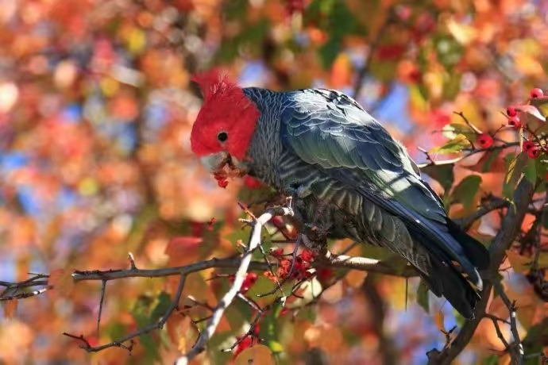
Passage D
语篇类型：说明文
主题语境：人与自然
澳大利亚某地区的人们正在跟凤头鹦鹉进行着一场特殊的比拼和较量——前者处心积虑的去盖好垃圾桶的盖子，而后者却想方设法地去打开它们。

Slide 30
Sulphur-crested cockatoos（葵花凤头鹦鹉）are common in western Australia，where they normally live in wooded areas. But as forests have been cut down, cockatoos have gotten used to living near people. Scientists report that people in Sydney, Australia are in a battle with these birds.
Last year,scientists at the Max Planck Institute reported that the cockatoos had learned how to open the covers of trash bins. That's not an easy job. The cockatoos must lift the heavy cover with their beaks （喙） and then walk along，pushing the cover up until it falls over.
When scientists first began studying the cockatoos in 2018, only three areas near Sydney had cover-opening cockatoos. A year and a half later, cockatoos in 44 different areas knew the trick. This time the scientists weren't just studying cockatoos. They were also studying humans.
The scientists spent weeks studying more than 3,200 trash bins in four different areas of Sydney. They wanted to see how many bins were protected and what methods were used.
In one area,over half the bins were protected. The most common way of protecting the bins was to put a brick or some other heavy objects on the cover. Some people put things like rubber snakes on the top of their bins. The scientists discovered that the humans were teaching each other tricks, too. In most neighborhoods, many people used the same cockatoo-stopping methods as their neighbors.
The researchers say it's like a race between humans and cockatoos to learn new ways of doing things. Now many cockatoos have learned how to push heavy items off the bins. As a result, humans have figured out ways to attach the items to the top of their bins. The scientists describe the situation as a “human-wildlife conflict”. They expect these conflicts will become more common as humans take over more areas that used to be wild.
P1：介绍澳大利亚的凤头鹦鹉并引入主题；
P2:凤头鹦鹉的特别之处会打开垃圾桶盖；
P3:科学家研究凤头鹦鹉的历程；
P4:科学家研究四个地区的鹦鹉是怎样打开垃圾桶盖的；
P5:人们在想方设法地盖住垃圾桶；
P6:凤头鹦鹉也在用各种方法打开盖子，与人类进行着比拼和较量。

Slide 31
Last year, scientists at the Max Planck Institute reported that the cockatoos had learned how to open the covers of trash bins. That's not an easy job. The cockatoos must lift the heavy cover with their beaks （喙） and then walk along，pushing the cover up until it falls over.
推理判断：通过阅读第二段和最后一段可知，凤头鹦鹉很聪明它们打开垃圾桶盖子找食物吃，并且想出各种办法来应对人们设置的障碍。
32. What can we learn about the cockatoos in the text?
A.They are very clever birds.
B.They are newly found in Australia.
C.They don't like living with people.
D.They like copying humans' behavior.

Slide 32
The scientists spent weeks studying more than 3,200 trash bins in four different areas of Sydney. They wanted to see how many bins were protected and what methods were used.
推理判断：第四段说明科学家为了找出鹦鹉掀垃圾桶盖子的原因在不同的地区对3200多只鹦鹉进行了一系列的调查。所以可推知答案选C。
respond to 意思是“回应”
33. What did the scientists want to know in paragraph 4?
A.How the cockatoos learned the trick.
B. Why the birds in more areas did the trick.
C.How humans responded to the birds' trick.
D. Why humans taught the birds to do the trick

Slide 33
The researchers say it's like a race between humans and cockatoos to learn new ways of doing things. Now many cockatoos have learned how to push heavy items off the bins. As a result, humans have figured out ways to attach the items to the top of their bins. The scientists describe the situation as a “human-wildlife conflict”. They expect these conflicts will become more common as humans take over more areas that used to be wild.
34. What did the researchers find about cockatoos in their research?
A. They wanted their habitat back.
B.They intended to make humans angry.
C.They disliked looking for food themselves.
D.They could adopt new ways to open bins.
推理判断题：从最后一段“Now many cockatoos have learned how to push heavy items off the bins. ”可知，鹦鹉总是能找到新方法打开垃圾桶盖。

Slide 34
The researchers say it's like a race between humans and cockatoos to learn new ways of doing things. Now many cockatoos have learned how to push heavy items off the bins. As a result, humans have figured out ways to attach the items to the top of their bins. The scientists describe the situation as a “human-wildlife conflict”. They expect these conflicts will become more common as humans take over more areas that used to be wild.
35. What is the best title for the text?
A.A big problem of “homeless” cockatoos
B. A human-wildlife conflict all over Australia
C. A battle over trash bins between cockatoos and humans
D. A problem caused by cockatoos to humans
同义替换：
conflict = battle
推断标题：从第一段及最后一段可知，澳大利亚某地区的人们正在跟凤头鹦鹉进行着一场特殊的比拼和较量——前者处心积虑的去盖好垃圾桶的盖子，而后者却想方设法地去打开它们。故答案为C。

Slide 35
重要词汇
in a battle with
trash bin
fall over
trick
object
push heavy items off
figure out
attach
conflict
take over
respond to
在与......的斗争中
垃圾桶
摔倒
诀窍，诡计
物体
把重物拿开
解决，算出
使依附，贴上
矛盾
接管
回应

Slide 36
长难句分析
并列连词连接两个谓语
1. The cockatoos must lift the heavy cover with their beaks （喙） and then walk along，pushing the cover up until it falls over.
非谓语动词作状语
until引导时间状语从句
主干：The cockatoos must lift the cover and walk along.
翻译：鹦鹉必须用它的喙掀起重重的盖子，然后走开，推起盖子直到它掉落。

Slide 37
长难句分析
that引导定语从句，修饰areas
They expect these conflicts will become more common as humans take over more areas that used to be wild.
that引导的宾语从句
as引导的伴随状语从句
主干：They expect
翻译：他们估计这些矛盾将会变得更加普遍，随着人们接管更多的区域时， 而这些土地过去常常是荒地。

Slide 38
语法填空
studying
1. The scientists spent weeks ____________(study)more than 3,200 trash bins in four different areas of Sydney. They wanted to see how many bins were protected and what methods were used.
2. The most common way __________ protecting the bins was to put a brick or some other heavy objects on the cover.
3. As_________result, humans have figured out ways to attach the items to the top of their bins.
of
a

Slide 39

七选五
语篇类型：说明文
主题语境：人与社会
介绍了做志愿者的诸多益处。

Slide 40
研读选项，初步预测
在某种程度上
A. However, it is not true to a certain extent.
B. How can you get involved in your community?
C. Many towns and cities have community centers.
D. Why is it important for you to volunteer your time？
E. Volunteering may even help you develop the expertise.
F. You'll have more opportunities to meet lots of new people.
G. The sense of giving back and contributing to society is unequalled.
转折+it代词指代
特殊疑问句+代词you
特殊疑问句
递进
无与伦比的

Slide 41
通读全文，理解主题，寻找线索
P1: 引出theme—做志愿者好处多多，你应该多为你热爱的事情做志愿服务
Many people describe volunteering as merely an unpaid job where you put in the effort and get nothing in return. 36 Actually, volunteering has many benefits and you are always encouraged to volunteer your time to do what you are passionate about.
37 Volunteering time to enrich your community is a great way to broaden your perceptions of the world. It will enrich your life, familiarize you with your community, and connect you to people and ideas that will positively impact your perspective for the rest of your life. And by surrounding yourself with people who are dedicated to making the world better, you can learn so much about how the world works.
It is statistically proven that people who volunteer regularly are healthier both physically and mentally. Individuals who have volunteered throughout their lifetime typically live longer and have better psychological well-being. In addition to the health benefits, volunteering gives people a unique sense of purpose by serving those around them. 38
Besides, working alongside individuals who also care about improving their surroundings will allow you to broaden your network of friends. 39 Additionally, it will help you better understand the circumstances of other members.
Whether you're passionate about animal rights or helping the homeless, you can find a valuable way to donate your time. 40 They can be a great place to find opportunities to give back to the place you call home. Besides, you can check websites like Volunteer Match or Idealist for volunteer opportunities that fit your interests and abilities.
P2：志愿做社区服务会拓宽你对世界的认知。
P3: 据统计证明，经常做志愿者的人在身体和精神上更加健康。
P4：对可能分散注意力的活动提前做好规划。
P5:做志愿者的各种途径

Slide 42
Many people describe volunteering as merely an unpaid job where you put in the effort and get nothing in return. 36 Actually, volunteering has many benefits and you are always encouraged to volunteer your time to do what you are passionate about.
A. However, it is not true to a certain extent.
B. How can you get involved in your community?
C. Many towns and cities have community centers.
D. Why is it important for you to volunteer your time
E. Volunteering may even help you develop the expertise.
F. You'll have more opportunities to meet lots of new people.
G. The sense.of giving back and contributing to society is unequalled.
解析：36题承上启下。空前的an unpaid job, get nothing in return 而空后说volunteering has many benefits,前后句意构成转折，A项中not true与之对应。：

Slide 43
37 Volunteering time to enrich your community is a great way to broaden your perceptions of the world. It will enrich your life, familiarize you with your community, and connect you to people and ideas that will positively impact your perspective for the rest of your life. And by surrounding yourself with people who are dedicated to making the world better, you can learn so much about how the world works.
A.However, it is not true to a certain extent.
B. How can you get involved in your community?
C. Many towns and cities have community centers.
D. Why is it important for you to volunteer your time
E. Volunteering may even help you develop the expertise.
F. You'll have more opportunities to meet lots of new people.
G. The sense of giving back and contributing to society is unequalled.

Slide 44
It is statistically proven that people who volunteer regularly are healthier both
physically and mentally. Individuals who have volunteered throughout their lifetime typically live longer and have better psychological well-being. In addition to the health benefits, volunteering gives people a unique sense of purpose by serving those around them. 38
A.However, it is not true to a certain extent.
B. How can you get involved in your community?
C. Many towns and cities have community centers.
D. Why is it important for you to volunteer your time
E. Volunteering may even help you develop the expertise.
F. You'll have more opportunities to meet lots of new people.
G. The sense of giving back and contributing to society is unequalled.
解析：本空在段末应与上句构成语义衔接。上句中的volunteering ≈ giving back and contributing to society 同义替换， 然后unique ≈unequalled.

Slide 45
Besides, working alongside individuals who also care about improving their surroundings will allow you to broaden your network of friends. 39 Additionally, it will help you better understand the circumstances of other members.
A. However, it is not true to a certain extent.
B. How can you get involved in your community?
C. Many towns and cities have community centers.
D. Why is it important for you to volunteer your time
E. Volunteering may even help you develop the expertise.
F. You'll have more opportunities to meet lots of new people.
G. The sense of giving back and contributing to society is unequalled.
同义替换：working alongside individuals\broaden your network of friends\other members ≈meet lots of new people

Slide 46
Whether you're passionate about animal rights or helping the homeless, you can find a valuable way to donate your time. 40 They can be a great place to find opportunities to give back to the place you call home. Besides, you can check websites like Volunteer Match or Idealist for volunteer opportunities that fit your interests and abilities.
A.However, it is not true to a certain extent.
B. How can you get involved in your community?
C. Many towns and cities have community centers.
D. Why is it important for you to volunteer your time
E. Volunteering may even help you develop the expertise.
F. You'll have more opportunities to meet lots of new people.
G. The sense of giving back and contributing to society is unequalled.
解析：根据空后的a great space 可知，空格处应含有表地点的名词，然后考查代词，they = community centers.

Slide 47
重要词汇
1.作为回报
2.对…充满激情
3. vt.充实；使丰富；使富裕
4.n.社区；群体；群落；团体
5.拓宽某人对某事物的认识
6.使某人熟悉某事
7. n.冲击；撞击；影响；作用 v.撞击；碰撞；影响
8. n.观点；前景；透视法；正确的认识
9.致力于
1. in return
2. be passionate about
3. enrich
4.community
5. broaden one’s perception of
6. familiarize sb. with …
7. impact
8. perspective
9. be dedicated to doing./sth.

Slide 48
重要词汇
10.statistically
11. psychological
12. wellbeing
13. additionally
14. circumstance
15. to a certain extent
16. get involved in
17. expertise
18. unequalled
10. adj.在统计方面；根据统计数据
11. adj.心理的；心理学的；精神上的
12. n.幸福
13. adv.另外；此外
14. n.环境；情况
15.在一定程度上
16.参与；涉及
17. n.专门知识；专门技能；专长
18. adj.无与伦比的；无双的；无敌的；空前的

Slide 49
长难句分析
1. Many people describe volunteering as merely an unpaid job where you put in the effort and get nothing in return.
Where 引导定语从句，修饰先行词job. 此处job为表示情况、处境的模糊抽象地点名词。类似的词还有situation, position, stage, system, point, case等。
主干： Many people describe volunteering as merely an unpaid job
翻译：许多人把志愿服务仅仅描述为一份没有报酬的工作，你付出了努力，却没有得到任何回报。

Slide 50
长难句分析
2. It will enrich your life, familiarize you with your community, and connect you to people and ideas that will positively impact your perspective for the rest of your life.
that 引导定语从句，修饰先行词people and ideas。当先行词既有人又有物时，只能用关系代词 that。
主干： It will enrich your life, familiarize you with your community, and connect you to people and ideas
翻译：它会丰富你的生活，使你熟悉你的社区，让你接触到那些会对你的余生产生积极影响的人和思想。

Slide 51
长难句分析
介词短语作方式状语
who引导定语从句，
3. And by surrounding yourself with people who are dedicated to making the world better, you can learn so much about how the world works.
how引导名词性从句作介词about 的宾语。
主干： you can learn so much
翻译：和那些致力于让世界变得更好的人在一起，你会学到很多关于这个世界是如何运作的知识。

Slide 52
长难句分析
that 引导名词性从句做真正的主语，it 为形式主语。
4. It is statistically proven that people who volunteer regularly are healthier both physically and mentally.
who引导定语从句，修饰先行词people。
主干： It is statistically proven that
翻译：据统计证明，经常做志愿者的人在身体和精神上都更健康。

Slide 53
语法填空
where
1. Many people describe volunteering as merely an unpaid job ______ you put in the effort and get nothing in return.
2. Actually, volunteering has many benefits and you are always encouraged to volunteer your time to do _______ you are passionate about.
3. Volunteering time to enrich your community ________(be) a great way to broaden your perceptions of the world.
4. It will enrich your life, familiarize you with your community, and connect you to people and ideas_______ will positively impact your perspective for the rest of your life.
5. And by surrounding ________(you) with people who are dedicated to making the world better, you can learn so much about how the world works.
what
is
that
yourself

Slide 54

完型
语篇类型：记叙文
主题语境：人与社会
介绍一位“困于挣扎”的母亲迎来了曙光

Slide 55
读懂段首句和尾段尾句，了解大意
Dad is a retired patrol( 巡 逻 ) officer. In his precinct ( 警 区 )lived an infamous family（臭名昭著的家庭）, which consisted of a 41 single mother and her four sons.
The three older sons were all 42 in crime. Many of the patrol officers knew the mom and 43 she knew them.
She was always very 44 when questioned about her sons' whereabouts (行踪) . On one visit, my dad 45 a conversation. During their talk,she expressed her 46 in regard to her youngest boy. She felt powerless in 47 him to the straight and narrow. But the environment would not allow it.
My dad agreed to offer the only 48 he could think of on the spot. He asked the concerned mother if she would allow her youngest boy to spend the summer at our house. It would be 49 for the boy to see another side of family life which he had never been 50 to.
Although we must have seemed very unfamiliar to him, he had no trouble 51 . The whole neighborhood welcomed him and he loved the 52 . At the end of summer, he returned to his mother.
I 53 about him several years later. Dad told me that after going back, the youngest son decided to go to night school for accounting. He eventually 54 an office job. He was the only son in that family who did not become a(n) 55 .
主人公：巡逻警官VS单亲母亲和四个儿子
主人公的身份及之间的关系
母亲与警官间的相处关系
“我”的父亲帮助单亲母亲的小儿子谋职
小儿子与邻里间的关系
小儿子最终谋得一份正当职业，免遭家庭影响

Slide 56
瞻前顾后，先易后难
Dad is a retired patrol (巡逻) officer. In his precinct (警区)lived an infamous family (臭名昭著的家庭）, which consisted of a 41 single mother and her four sons.
41. | A. struggling | B. demanding | C. rewarding | D. tiring
 | 苦苦挣扎的 | 费时费力的；苛刻的 | 值得的，有意义的
41. struggling：苦苦挣扎的 ，根据后文第四段第二句提及单亲母亲的心境 是担忧的状态 He asked the concerned mother if she would allow her youngest boy to spend the summer at our house.

Slide 57
瞻前顾后，先易后难
The three older sons were all 42 in crime. Many of the patrol officers knew the mom and 43 she knew them.
42. | A. seated | B. dressed | C. involved | D. disappointed
 |  |  | 参与的
43. | A. in person | B. in turn | C. in addition | D. in contrast
 | 亲自 | 反之 |  | 相反
42. 第一段指出家庭背景，infamous family（臭名昭著的家庭），可知三个儿子都involved 参与了犯罪事件。
43.根据逻辑句意，指相互的关系，用关联词in turn。Officer 认识她，她也认识officer。

Slide 58
瞻前顾后，先易后难
She was always very 44 when questioned about her sons' whereabouts (行踪) . On one visit, my dad 45 a conversation. During their talk, …..
44. | A. hesitant | B. energetic | C. guilty | D. cooperative
 |  |  | 参与的
45. | A. struck up | B. insisted on | C. kept up | D. broke into
 | 使开始 | 坚持，坚决要求 | 保持；继续； | 闯入；破门而入
44. 句意：她面对关于其儿子行踪的询问总是很配合 本段第四句 提到 She felt powerless（无力的），说明该母亲很善良。
45.根据句意， struck up a conversation.开始一场谈话。下句During their talk也指明前面刚开始。

Slide 59
瞻前顾后，先易后难
During their talk, she expressed her 46 in regard to her youngest boy. She felt powerless in 47 him to the straight and narrow. But the environment would not allow it.
46. | A. appreciation | B. concern | C. belief | D. potential
 |  | 关心，担心 |  | 潜在的，可能的
47. | A. driving | B. transporting | C. referring | D. guiding
46. 句意：她表达对小儿子的一种关心。
47.根据句意，她感到无力，怕guiding指导不好儿子走一条正路。

Slide 60
瞻前顾后，先易后难
My dad agreed to offer the only 48 he could think of on the spot（当场）. He asked the concerned mother if she would allow her youngest boy to spend the summer at our house. It would be 49 for the boy to see another side of family life which he had never been 50 to.
48. | job | B. experience | C. solution | D. excuse
49. | A. convenient | B. beneficial | C. efficient | D. flexible
50. | A. entitled | B. glued | C. exposed | D. compared
 | 有资格的 | 粘粘，链接 | 曝光
48. 句意：我的父亲当场主动提出一种方法供他小儿子考虑。
49. 根据句意，小儿子照看另外一边的家庭也会受益的 Beneficial 。根据50题，这是对双边都有好处的。
50，根据句意， 那边的生活从未曝光过。根据第一段小儿子不好的家庭背景，小儿子的家人是不愿出现在大众视野中。

Slide 61
瞻前顾后，先易后难
Although we must have seemed very unfamiliar to him, he had no trouble 51 . The whole neighborhood welcomed him and he loved the 52 . At the end of summer, he returned to his mother.
51. | A. fitting in | B. making up | C. reacting to | D. caring about
 | 适应
52. | A. patience | B. attitude | C. decision | D. attention
 |  |  |  | 关心
51. 根据后文邻里对小儿子的态度是欢迎的 welcomed，The whole neighborhood welcomed，可知，小儿子在这里没有适应（fitting in）环境的问题。
52.根据句意，与welcomed 并列的顺承意义attention(关心）。

Slide 62
瞻前顾后，先易后难
I 53 about him several years later. Dad told me that after going back, the youngest son decided to go to night school for accounting. He eventually 54 an office job. He was the only son in that family who did not become a(n) 55 .
53. | A. inquired | B. argued | C. brought | D. bothered
 | 询问，打听
54. | A. created | B. landed | C. dismissed | D. maintained
 |  | 获得 | 开除，解散； | 关心
55. | A. accountant | B. officer | C. criminal | D. neighbor
 | 会计 |  | 罪犯
53. 句意：多年后我打听（inquired）了他的消息 。 54. 固搭， land a job（找到）
55.根据句意，第二段，三个哥哥与crime有关，他没有变成其中一个罪犯(criminal)

Slide 63
重要词汇
1. infamous family
2. demanding
3. be involved in
4. in turn
5. struck up
6. on the spot
7. be exposed to
8. fit in
9. land a job
10. inquire
n.臭名昭著的家庭
adj.费时费力的；苛刻的
v.参与…
反之
v.使…开始
n. 现场，当场
v.曝光于…
v.适应…
v.找到一个工作
v. 打听，询问

Slide 64
语法填空
which
1 In his precinct ( 警 区 ) lived an infamous family,______ consisted of a struggling single mother and her four sons.
2 She was always very cooperative when_______ about her sons' whereabouts
3 Although we must have seemed very unfamiliar to him, he had no trouble _________( fit in)
4 He was the only son in that family ______ did not become a criminal.
..
questioned
fitting in
who

Slide 65
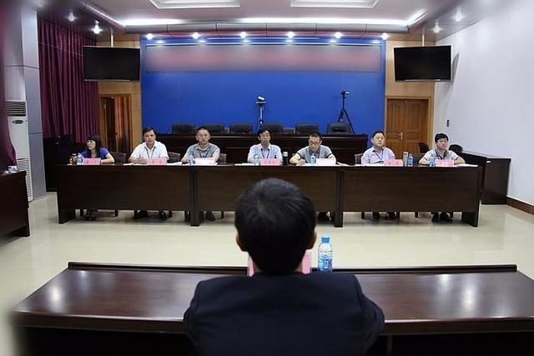
语法填空
主题语境：人与社会
这篇短文主要讲述了在面试中如何推销自己，以获得工作机会。

Slide 66
Unless you're actually in sales, the very concept of selling yourself during a job interview can be frightening. You don＇t want to sound arrogant（傲慢的），or worse，desperate. But learning how to be a self-promoter in 56 convincing manner is what the job interview is all about. The following tips can help you close the sale on a job offer. Dress 57 (appropriate). Many hiring managers will form their first impression of you 58 (base) on what you're wearing. The right interview clothing 59_________ (depend) on the company you are applying for and the culture of the 60 (organize). Ask unique questions. The secret of distinguishing yourself 61 other job candidates is simple: Ask good questions 62 are valuable to the company. These pointed, yet uncommon questions mark you as an in-depth, curious,persistent researcher. Prepare meaningful anecdotes（轶事）．No matter 63 industry you＇re in， you can expect 64 (ask) behavioral job interview questions. Normally, these questions require you to come up with examples from your past work experiences. Unfortunately, this is where a lot of job seekers stumble（支吾）．To craft a fascinating anecdote，experts recommend 65 (use) real feedback to highlight your contribution.
a
appropriately
based
depends
organization
from
that/which
what/which
to be asked
using

Slide 67
重要词汇
1. concept
2. interview
3. desperate
4. self-promoter
5. convincing
6. appropriately
7. distinguish
8. candidate
9. in-depth
10. persistent
11. anecdotes
12. craft
n. 概念
n. /v. 面试
n. 绝望的
n. 自我推销者
adj.令人信服的
adv. 恰当地
v. 区别(from)
n.候选人，申请者
adj. 深入的
adj. 执着的，坚持不懈的
n. 轶事
v. 精心准备/n. 手艺，工艺

