Slide 1

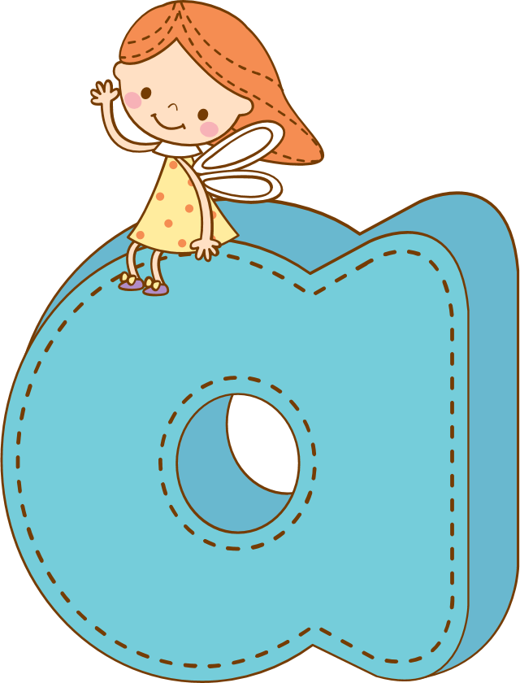
2023广州一模
回报
Zoe
Notes:
更多模板亮亮图文旗舰店：https://liangliangtuwen.tmall.com

Slide 2
目录
01
故事线及评卷细则
02
作答示范及下水作文
03
语言表述积累

Slide 3

01
故事线及评卷细则

Slide 4
Sandy and Jane came to see the jobo tree on the hilltop again. Jobos were their favorite fruit,but the tree belonged to a lady who lived in the house by the hill.They heard she was difficult,but that sometimes she would give fruit in return for an errand（差使）.
The girls finally gathered their courage to knock on her door. An elderly woman with a fierce look answered, staring down at the girls. “We heard...” said Sandy, her voice shaky, “that you give jobos in payment for running an errand.”
The lady raised one eyebrow, then went into the kitchen and took two baskets. She pushed them
into the girls’ hands. “Go fill these with jobos,and come right back."
The girls raced up the hill to the tree and filled the baskets with the ripest jobos.Back at the house, the lady filled a bag with rice and handed it to Sandy. “Take this bag and one basket of jobos to the Brown family. And ask them for the payment,” the lady added with a tight smile.“If you return without the payment,you won’t get the fruit.”
The girls struggled all the way with the bag and the basket.When they were there, Mrs.Brown answered the door. Inside on the floor were three little children, each painting something on papers. Mr.Brown was lying sick in bed. Times were hard.
The girls handed her the food. “This is from the lady with the jobo tree,”said Sandy.
“She asked for the payment,too.”Jane said awkwardly.
“The payment! The payment!” The children repeated, waving the paper in their hands happily.
Sandy and Jane looked at each other strangely. With a smile,Mrs.Brown handed Sandy a large sealed（密封的）envelope so full that it was almost starting to break open. The girls said goodbye and left quickly.“I wonder,”Sandy murmured,“whether Mrs.Brown can afford to pay for that food.”
Worried,the two girls discussed what was in the envelope as they walked back.
The lady opened the envelope,took out a pile of papers, and smiled.

Slide 5



故事线
讲述了两个女孩想通过给一个老夫人跑腿，换取她家种的美味jobo果，尽管老夫人答应了，让她们俩跑腿给一家贫穷的人送了一袋米和一篮jobo果，但是条件是必须收到付款。她们送货后，收到一个信封，里面到底有货款吗？
梗概
主题
人与社会：助人类
视角
第三人称视角

Slide 6

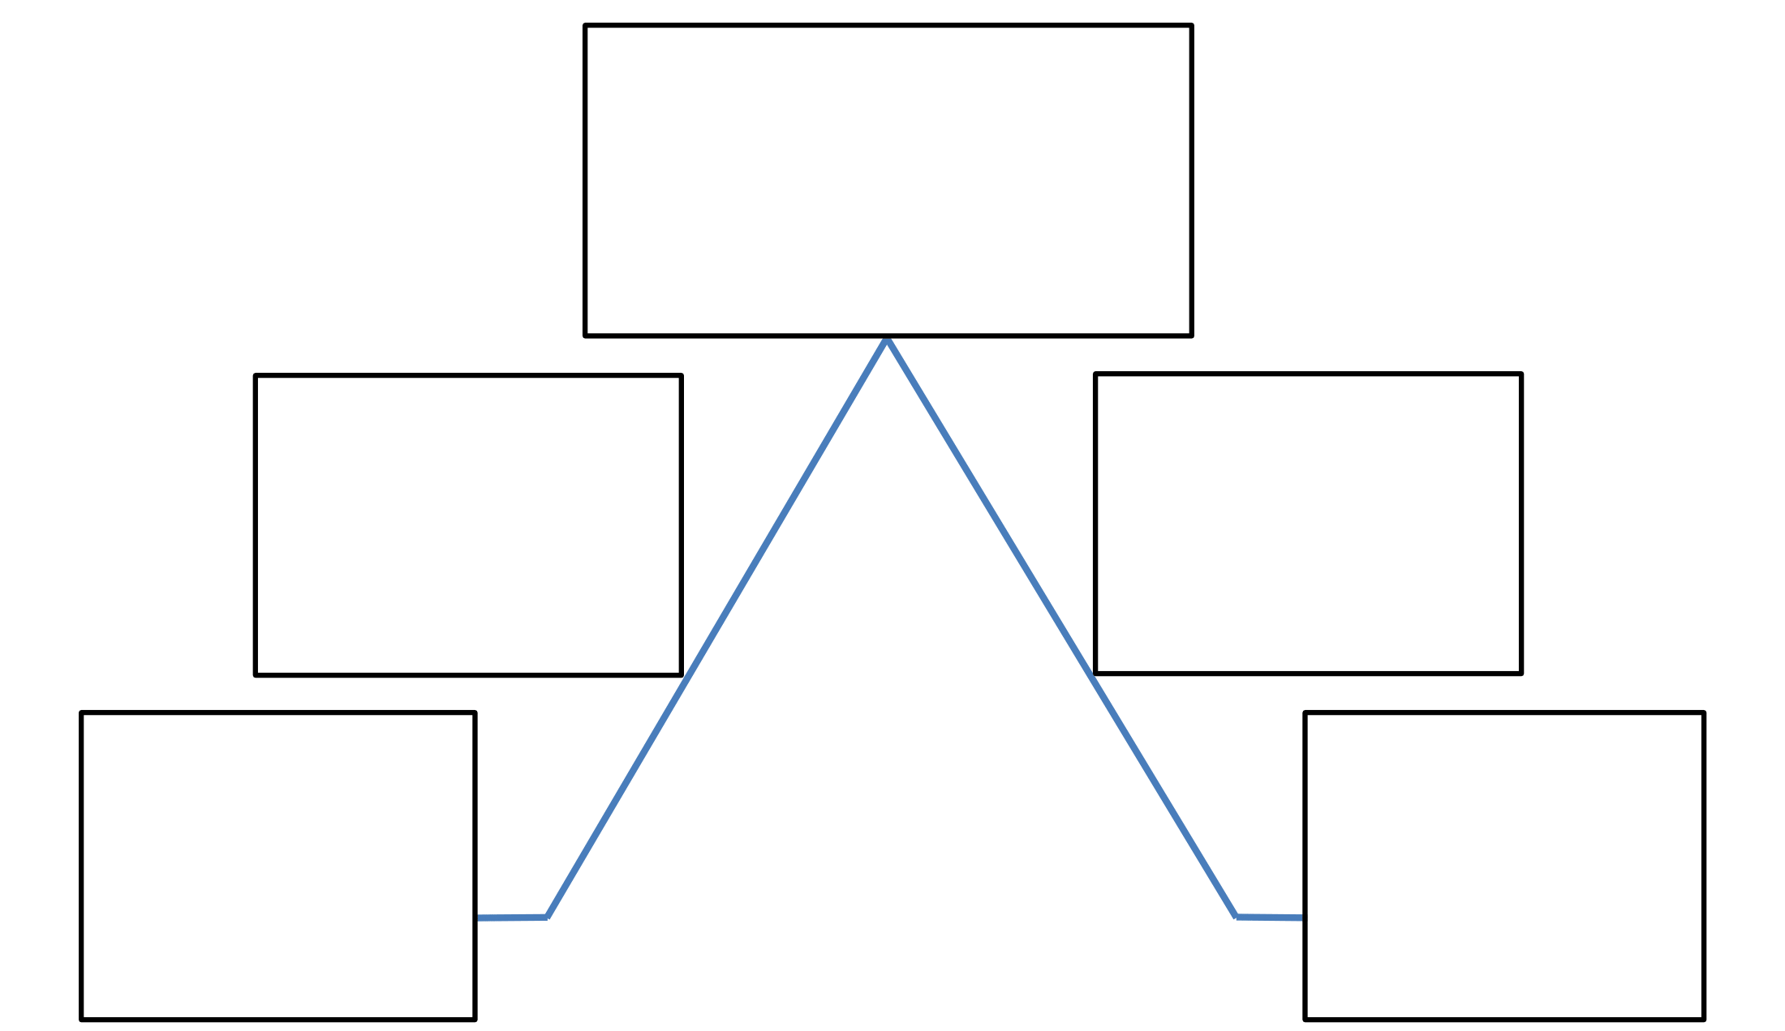
故事线
climax
The poor family who received
the groceries did give them
the payment contained
in an envelope
They ran errand
for the woman
to trade
her jobo fruit.
Did the envelope
contain the
money ?
trigger
revesal
The girls
like jobos.
get to know
the real
character of
the woman
stasis
resulotion

Slide 7
情感线
surprised
The poor family who received
the groceries did give them
the payment contained
in an envelope
They ran errand
for the woman
to trade
her jobo fruit.
Did the envelope
contain the
money ?
hopeful
worried
The sisters
like jobo fruit.
get to know
the real
character of
the woman
eager
thougtful

Slide 8
Sandy and Jane came to see the jobo tree on the hilltop again. Jobos were their favorite fruit,but the tree belonged to a lady who lived in the house by the hill.They heard she was difficult,but that sometimes she would give fruit in return for an errand（差使）.
The girls finally gathered their courage to knock on her door. An elderly woman with a fierce look answered, staring down at the girls. “We heard...” said Sandy, her voice shaky, “that you give jobos in payment for running an errand.”
The lady raised one eyebrow, then went into the kitchen and took two baskets. She pushed them
into the girls’ hands. “Go fill these with jobos,and come right back."
The girls raced up the hill to the tree and filled the baskets with the ripest jobos.Back at the house, the lady filled a bag with rice and handed it to Sandy. “Take this bag and one basket of jobos to the Brown family. And ask them for the payment,” the lady added with a tight smile.“If you return without the payment,you won’t get the fruit.”
The girls struggled all the way with the bag and the basket.When they were there, Mrs.Brown answered the door. Inside on the floor were three little children, each painting something on papers. Mr.Brown was lying sick in bed. Times were hard.
The girls handed her the food. “This is from the lady with the jobo tree,”said Sandy.
“She asked for the payment,too.”Jane said awkwardly.
“The payment! The payment!” The children repeated, waving the paper in their hands happily.
Sandy and Jane looked at each other strangely. With a smile,Mrs.Brown handed Sandy a large sealed（密封的）envelope so full that it was almost starting to break open. The girls said goodbye and left quickly.“I wonder,”Sandy murmured,“whether Mrs.Brown can afford to pay for that food.”
Worried,the two girls discussed what was in the envelope as they walked back.
The lady opened the envelope,took out a pile of papers, and smiled.
伏笔点
The lady left one basket of jobos for them.

Slide 9
Sandy and Jane came to see the jobo tree on the hilltop again. Jobos were their favorite fruit,but the tree belonged to a lady who lived in the house by the hill.They heard she was difficult,but that sometimes she would give fruit in return for an errand（差使）.
The girls finally gathered their courage to knock on her door. An elderly woman with a fierce look answered, staring down at the girls. “We heard...” said Sandy, her voice shaky, “that you give jobos in payment for running an errand.”
The lady raised one eyebrow, then went into the kitchen and took two baskets. She pushed them
into the girls’ hands. “Go fill these with jobos,and come right back."
The girls raced up the hill to the tree and filled the baskets with the ripest jobos.Back at the house, the lady filled a bag with rice and handed it to Sandy. “Take this bag and one basket of jobos to the Brown family. And ask them for the payment,” the lady added with a tight smile.“If you return without the payment,you won’t get the fruit.”
The girls struggled all the way with the bag and the basket.When they were there, Mrs.Brown answered the door. Inside on the floor were three little children, each painting something on papers. Mr.Brown was lying sick in bed. Times were hard.
The girls handed her the food. “This is from the lady with the jobo tree,”said Sandy.
“She asked for the payment,too.”Jane said awkwardly.
“The payment! The payment!” The children repeated, waving the paper in their hands happily.
Sandy and Jane looked at each other strangely. With a smile,Mrs.Brown handed Sandy a large sealed（密封的）envelope so full that it was almost starting to break open. The girls said goodbye and left quickly.“I wonder,”Sandy murmured,“whether Mrs.Brown can afford to pay for that food.”
Worried,the two girls discussed what was in the envelope as they walked back.
The lady opened the envelope,took out a pile of papers, and smiled.
Obviously, the payment seemed to be the painted paper drawn by the children
伏笔点

Slide 10
评卷细则（关于主题、情节、完整性）
1. 该续写的主题是关于助人，如果考生严重偏离主题偏 (如故事结局消极、负面，颂扬的主题与原文毫不相关等)，得分最高不超过及格分。如果主题虽然有所偏离或片面，非主流，但不太影响故事情节的整体发展，酌情扣 1-2 分。
2.因没读懂前文而导致情节严重偏差（例如没有读懂所收的付款是小孩所画），得分最高不超过及格分。因忽略前文个别重要线索而导致的个别关键情节与前文不融洽，采取降一档的方式处理:因个别关键词汇不理解等导致的情节或细节不合理，酌情扣 1-2 分。
3.关于完整性问题的处理:视完成部分的内容质量和字数情况综合判断。例如:虽然只续写了其中一段，但该部分完成质量好、字数达到要求的，可采取降一档的方式处理。两段长短不一不作为扣分的依据。两段续写内容虽不拘泥于原文，但与前文融洽、结局设计合理，符合故事走向的续文也应该接受，写作手法上也可以有较大的灵活度。

Slide 11
02
作答示范及下水作文

Slide 12
作答示例 (1)
Worried, the two girls discussed what was in the envelope as they walked back. “It’s weird," Jane said.“Why were the Browns so happy about the payment? They had no money!” Sandy didn’t reply. She was still upset about the scene of Mr.Brown sick in bed.“Why did the lady ask for it if she was to help out? It doesn’t make sense,” Jane continued, frowning. Sandy nodded with a deep sigh. “Maybe it’s not what we think it is.But I agree, something’s not right. Well, I wish we could have our payment’ They went silent for the rest of the way back. When they were in the lady’s house again, Jane handed over the envelope.
The lady opened the envelope, took out a pile of papers, and smiled. “Oh yes, lovely!” She was unfolding papers one by one.“Beautiful!”The lady went quickly into the kitchen and began taping them to the wall.The two girls peeked in. On the papers were colorful drawings, obviously from the children of the Browns! The girls looked at each other and broke out in smiles. After the lady finished, she joined the two girls again.“And here’s your payment,” she said, handing the other basket of jobos to the girls.“Thank you,” they said with admiration.“Anytime,” said the lady. “Come again,girls.” As they walked home.Sandy and Jane enjoyed their treat. The juice that ran down their arms was as sweet and warm as the feeling they had inside. (251 words)

Slide 13
作答示例(2)：
Worried, the two girls discussed what was in the envelope as they walked back. “It seems there are a lot of paper notes in it.” said Sandy. Jane, however, thought it couldn’t be the case. She let out a long sigh.Curious and anxious as they were, they didn’t have the courage to open it beforehand without the lady’s approval. Back to the house, they carefully handed the envelope to the lady. She took it with expectation glittering in her eyes.The two girls held their breath and could wait no more.
The lady opened the envelope, took out a pile of papers, and smiled.On the papers were colorful pictures from theBrown’s kids!The girls looked at each other and smiled in relief. Then the lady handed them the other basket ofjobos.“Goodjob, young ladies. Here’s your payment,” she said with a wink. The girls took the basket in great delight,“Thank you.... Could we come again next week?” asked the girls eagerly. The lady laughed,“Why not?” As they enjoyed the sweet reward on their way home. Jane and Sandy felt so grateful and lucky to have seen a warm heart through a cold face. (201 words)

Slide 14
邹飞丽下水作文
Worried, the two girls discussed what was in the envelope as they walked back. Jane couldn’t contain her curiosity and suspicion, “Sandy, it is so obvious that the Browns are incapable to pay anything like that”. Sandy agreed, nodding thoughtfully and then shaking her head in disbelief, “ Right! But what shocked me was the adults’ carefree attitude and the cheerful yelling from the kids. This abnormal behaviors may account for something extraordinary.” Gripping the envelope tightly in hand, her palm moistened. Both of them hastened their pace and strode for the lady’s home in an attempt to find out the answer.
The lady opened the envelope, took out a pile of papers, and smiled. They were all typical children’s unsophisticated drawing about dolls or airplanes. None of anything that were pulled out like authentic paper notes. Seeing this, the two girls dropped their jaws and mouth hung open with wide eyes. Then they threw hands to cover their mouth to stifle the surprised exclamation that emitted. The lady turned back to give them another basket of jobos to pay for the errand. Finally, a beautiful soul appeared in front of them, which would be revealed to people who cared enough. (178 words)

Slide 15
邹飞丽下水作文polished version
Worried, the two girls discussed what was in the envelope as they walked back. Jane's curiosity and suspicion got the better of her, "Sandy, it's so obvious that the Browns are incapable of paying anything like that." Sandy nodded in agreement, thoughtfully at first and then shaking her head in disbelief, "Absolutely! But what really shocked me was the adults' carefree attitude and the cheerful yelling from the kids. This abnormal behavior could indicate something extraordinary." Sandy's palms were moist as she tightly gripped the envelope. Both of them hastened their pace and strode towards the lady's home in an attempt to uncover the answer.
The lady opened the envelope, took out a pile of papers, and smiled. They were all typical children's unsophisticated drawings of dolls or airplanes, devoid of any authentic paper notes. Seeing this, the two girls dropped their jaws, their mouths hanging open with wide eyes. They then threw their hands to cover their mouths to stifle the surprised exclamation that escaped them. The lady turned around to give them another basket of jobos to pay for their errand. Finally, a beautiful soul appeared in front of them, which would only be revealed to those who cared enough.

Slide 16
03
语言表述积累

Slide 17
表示不理解
Jane continued, frowning. Sandy nodded with a deep sigh.
简皱着眉头继续说。桑迪深深叹了一口气，点了点头。
They went silent for the rest of the way back.
他们在回去的路上一直保持沉默。
Jane, however, thought it couldn’t be the case. She let out a long sigh.
然而，简认为事实并非如此。她长长地叹了一口气。

Slide 18
表示不理解
Curious and anxious as they were, they didn’t have the courage to open it beforehand without the lady’s approval.
尽管他们既好奇又焦虑，但没有女士的批准，他们没有勇气提前打开它。
Jane couldn’t contain her curiosity and suspicion.
简无法抑制自己的好奇心和怀疑

Slide 19
表示不理解
Sandy agreed, nodding thoughtfully and then shaking her head in disbelief, “This abnormal behaviors may account for something extraordinary.”
桑迪同意了，若有所思地点头，然后难以置信地摇了摇头，“这种不正常的行为可能是非同寻常的原因。”
Both of them hastened their pace and strode for the lady’s home in an attempt to find out the answer.
两人都加快了步伐，大步走向这位女士的家，试图找出答案。

Slide 20
表示吃惊
The girls looked at each other and broke out in smiles.
女孩们面面相觑，露出了笑容。
Seeing this, the two girls dropped their jaws and mouth hung open with wide eyes. Then they threw hands to cover their mouth to stifle the surprised exclamation that emitted.
看到这一幕，两个女孩下巴掉下，张大了眼睛。然后，他们伸出双手捂住嘴，抑制住发出的惊讶惊叹。女

Slide 21
表示重新认识助人后的升华
The juice that ran down their arms was as sweet and warm as the feeling they had inside.
顺着他们手臂流下的果汁和他们内心的感觉一样甜蜜温暖。
Jane and Sandy felt so grateful and lucky to have seen a warm heart through a cold face.
Jane和Sandy感到非常感激和幸运，能够透过冰冷的脸看到一颗温暖的心。
A beautiful soul appeared in front of them, which would only be revealed to people who cared enough.
一个美丽的灵魂出现在他们面前，这只会向足够关心的人展示。

