Slide 1
從資料科學到 機器學習與人工智慧

Slide 2
Data Visualization 資料視覺化

Slide 3
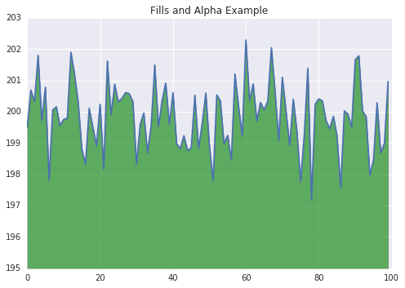
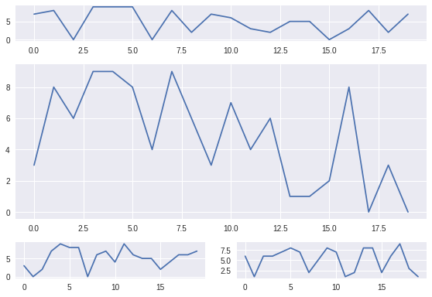
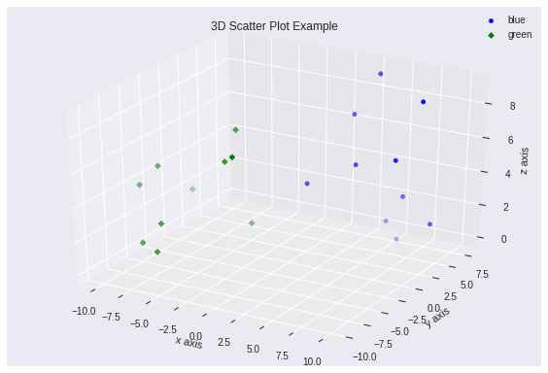
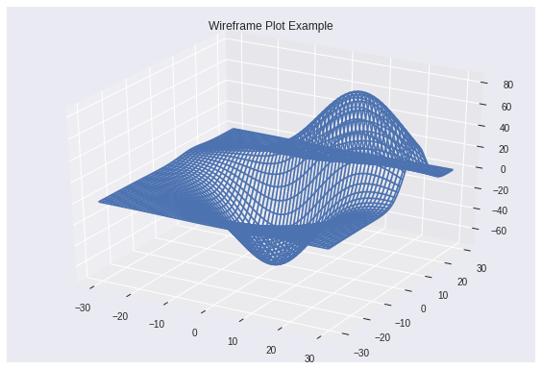
Charting in Colaboratory
https://colab.research.google.com/notebooks/charts.ipynb

Slide 4
Data Visualization 資料視覺化の各種套件
Matplotlib
Seaborn
Ggplot
Bokeh
Pyga
Plotly

Slide 5
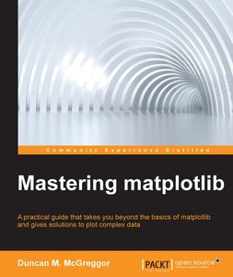
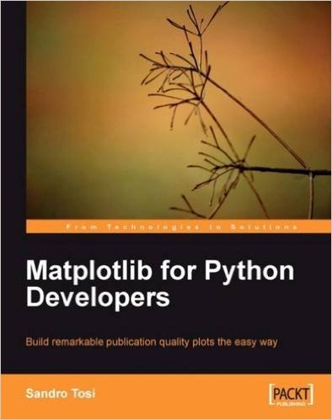
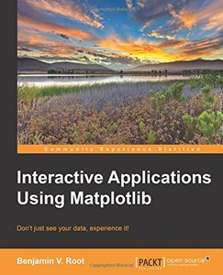
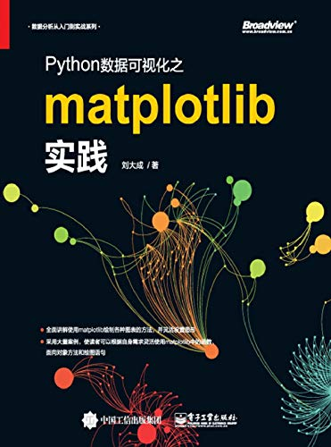

Slide 6
import matplotlib.pyplot as plt
import numpy as np
x = np.linspace(0, 10, 1000)
y = np.sin(x)
plt.plot(x, y, ls='-r', lw=2, label='sin(x)')
plt.legend()
plt.show()
# 生成資料
# 使用plt.plot()繪圖
# lw === line width，用於設置線條寬度
# '-r'是說線條使用正常的連續曲線，顏色使用紅色
# label設置線條的標籤，我們會在圖例中看到它

Slide 7
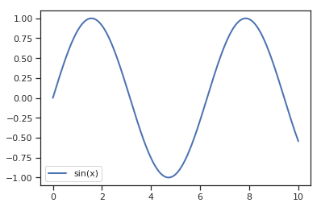
import matplotlib.pyplot as plt
import numpy as np
x = np.linspace(0, 10, 1000)
y = np.sin(x)
plt.plot(x, y, lw=2, label='sin(x)')
plt.legend()
plt.show()
https://www.data-insights.cn/?p=48

Slide 8
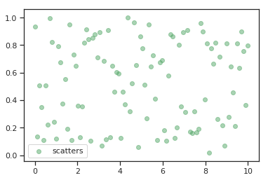
使用plt.scatter()繪圖
import matplotlib.pyplot as plt
import numpy as np
x = np.linspace(0, 10, 100)
y = np.random.rand(100)
plt.scatter(x, y, c='g', alpha=0.5, label='scatters')
plt.legend()
plt.show()
c ==color，設置顏色
Alpha::控制透明度
https://www.data-insights.cn/?p=48

Slide 9
https://www.data-insights.cn/?p=48

Slide 10
https://www.data-insights.cn/?p=48

Slide 11
Data Visualization 資料視覺化の作業

Slide 12
# coding: utf-8
import matplotlib.pyplot as plt
from matplotlib.image import imread
img = imread('../dataset/lena.png')
plt.imshow(img)
plt.show()

Slide 13
# coding: utf-8
import numpy as np
import matplotlib.pyplot as plt
x = np.arange(0, 6, 0.1)
y1 = np.sin(x)
y2 = np.cos(x)
plt.plot(x, y1, label="sin")
plt.plot(x, y2, linestyle = "--", label="cos")
plt.xlabel("x")
plt.ylabel("y")
plt.title('sin & cos')
plt.legend()
plt.show()

Slide 14
Data Visualization 資料視覺化の作業

Slide 15
# coding: utf-8
import numpy as np
import matplotlib.pylab as plt
def relu(x):
return np.maximum(0, x)
x = np.arange(-5.0, 5.0, 0.1)
y = relu(x)
plt.plot(x, y)
plt.ylim(-1.0, 5.5)
plt.show()

Slide 16
# coding: utf-8
import numpy as np
import matplotlib.pylab as plt
def sigmoid(x):
return 1 / (1 + np.exp(-x))
def step_function(x):
return np.array(x > 0, dtype=np.int)
x = np.arange(-5.0, 5.0, 0.1)
y1 = sigmoid(x)
y2 = step_function(x)
plt.plot(x, y1)
plt.plot(x, y2, 'k--')
plt.ylim(-0.1, 1.1)
plt.show()

Slide 17
Data Visualization 資料視覺化の各種套件
資優生的作業

Slide 18
Charting in Colaboratory
https://colab.research.google.com/notebooks/charts.ipynb

Slide 19
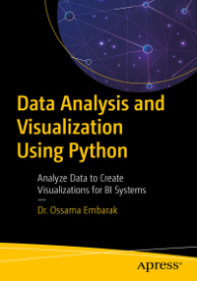
第二章
https://github.com/Apress/data-analysis-and-visualization-using-python

Slide 20
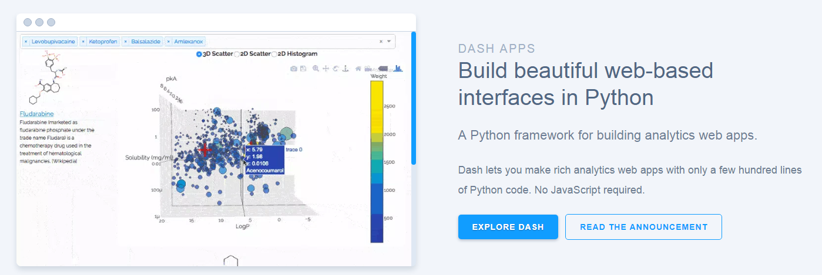
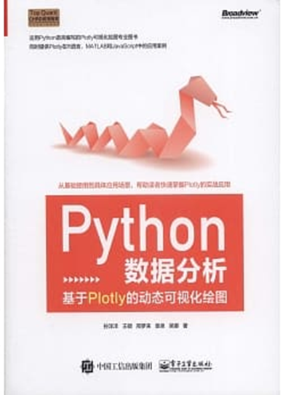
到官方網址https://plot.ly/看看互動式資料視覺化成果
延伸閱讀:推薦的教科書
Python數據分析：基於Plotly的動態可視化繪圖
作者： 孫洋洋, 王碩, 邢夢來, 袁泉, 吳娜
電子工業出版社
https://github.com/sunshe35/PythonPlotlyCodes

Slide 21
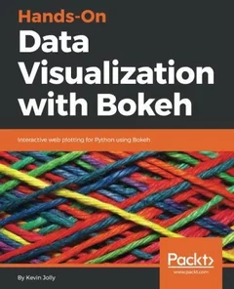
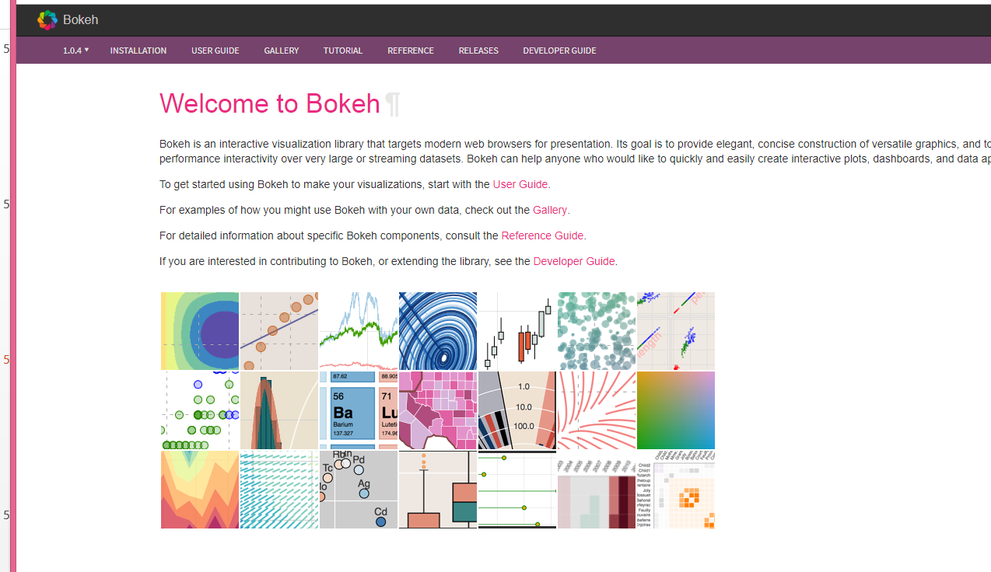
到官方網址https://bokeh.pydata.org/en/latest/
看看互動式資料視覺化成果
!pip install bokeh

Slide 22
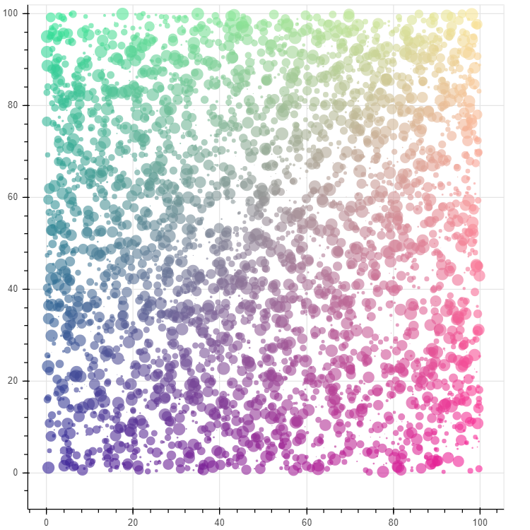
import numpy as np
from bokeh.plotting import figure, show
from bokeh.io import output_notebook
N = 4000
x = np.random.random(size=N) * 100
y = np.random.random(size=N) * 100
radii = np.random.random(size=N) * 1.5
colors = ["#%02x%02x%02x" % (r, g, 150) for r, g in zip(np.floor(50+2*x).astype(int), np.floor(30+2*y).astype(int))]
output_notebook()
p = figure()
p.circle(x, y, radius=radii, fill_color=colors, fill_alpha=0.6, line_color=None)
show(p)
https://colab.research.google.com/notebooks/charts.ipynb

Slide 23
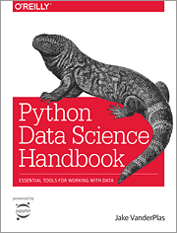
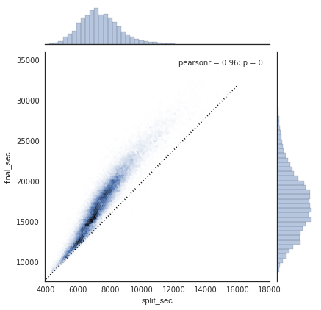
在Google Colab學習seaborn
!pip install seaborn==0.9.0
範例學習1:
https://colab.research.google.com/github/jakevdp/PythonDataScienceHandbook/blob/master/notebooks/04.14-Visualization-With-Seaborn.ipynb
範例學習2:
https://colab.research.google.com/drive/1o6MijFkNHiTPeS8Y5n59j2cH4-Mf2wX3

Slide 24
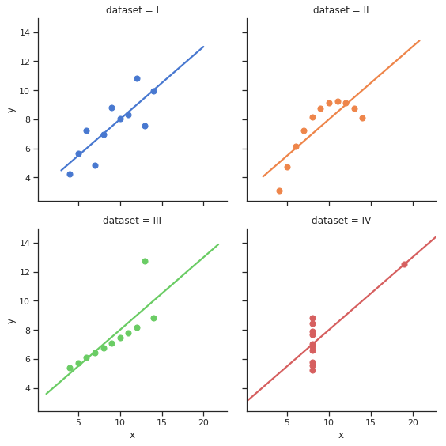
import seaborn as sns
sns.set(style="ticks")
# Load the example dataset for Anscombe's quartet
df = sns.load_dataset("anscombe")
# Show the results of a linear regression within each dataset
sns.lmplot(x="x", y="y", col="dataset", hue="dataset", data=df,
col_wrap=2, ci=None, palette="muted", height=4,
scatter_kws={"s": 50, "alpha": 1});
https://www.data-insights.cn/?p=179

Slide 25
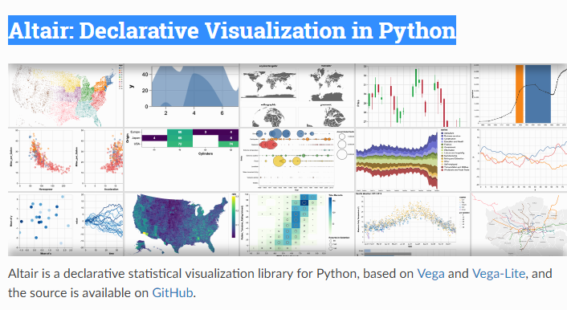
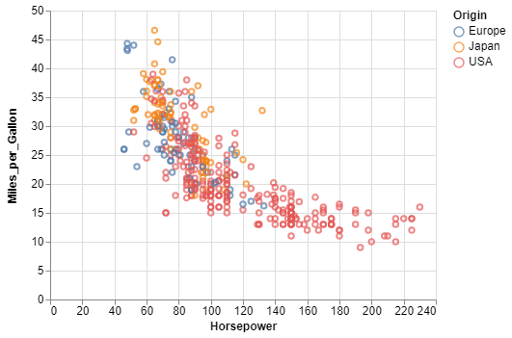
Altair: Declarative Visualization in Python
到官方網址https://altair-viz.github.io/
看看資料視覺化成果
import altair as alt
from vega_datasets import data
cars = data.cars()
alt.Chart(cars).mark_point().encode(
x='Horsepower',
y='Miles_per_Gallon',
color='Origin',
).interactive()

Slide 26
實作練習
類神經網路入門

Slide 27
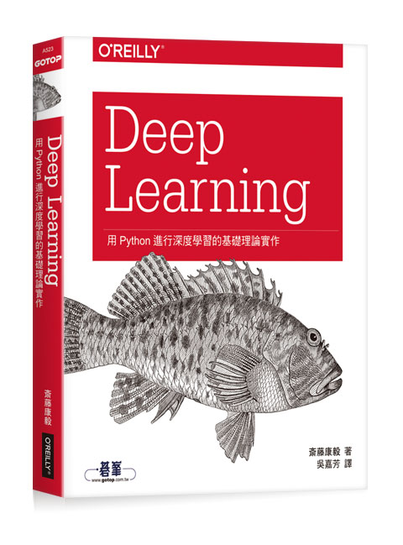
Deep Learning：用Python進行深度學習的基礎理論實作
作者： 斎藤康毅 譯者： 吳嘉芳
出版社：歐萊禮 出版日期：2017/08/17
第一章 Python入門
第二章 感知器
第三章 神經網路
第四章 神經網路的學習
第五章 誤差反向傳播法
第六章 與學習有關的技巧
第七章 卷積神經網路
第八章 深度學習
附錄A Softmax-with-Loss層的計算圖
參考文獻
https://github.com/oreilly-japan/deep-learning-from-scratch

Slide 28
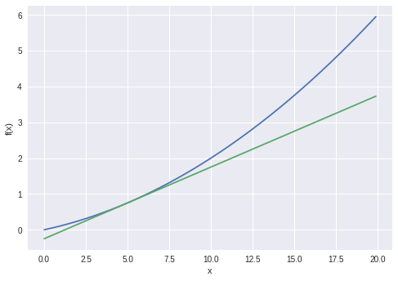
x = np.arange(0.0, 20.0, 0.1)
y = function_1(x)
plt.xlabel("x")
plt.ylabel("f(x)")
tf = tangent_line(function_1, 5)
y2 = tf(x)
plt.plot(x, y)
plt.plot(x, y2)
plt.show()
# coding: utf-8
import numpy as np
import matplotlib.pylab as plt
def numerical_diff(f, x):
h = 1e-4 # 0.0001
return (f(x+h) - f(x-h)) / (2*h)
def function_1(x):
return 0.01*x**2 + 0.1*x
def tangent_line(f, x):
d = numerical_diff(f, x)
print(d)
y = f(x) - d*x
return lambda t: d*t + y

Slide 29
# coding: utf-8
import numpy as np
import matplotlib.pylab as plt
def numerical_diff(f, x):
h = 1e-4 # 0.0001
return (f(x+h) - f(x-h)) / (2*h)
def function_1(x):
return 0.01*x**2 + 0.1*x
def tangent_line(f, x):
d = numerical_diff(f, x)
print(d)
y = f(x) - d*x
return lambda t: d*t + y
x = np.arange(0.0, 20.0, 0.1)
y = function_1(x)
plt.xlabel("x")
plt.ylabel("f(x)")
tf = tangent_line(function_1, 5)
y2 = tf(x)
plt.plot(x, y)
plt.plot(x, y2)
plt.show()

Slide 30
Implementing a Neural Network from Scratch in Python – An Introduction
http://www.wildml.com/2015/09/implementing-a-neural-network-from-scratch/

