Slide 1
Entity Framework DB+App

Slide 2
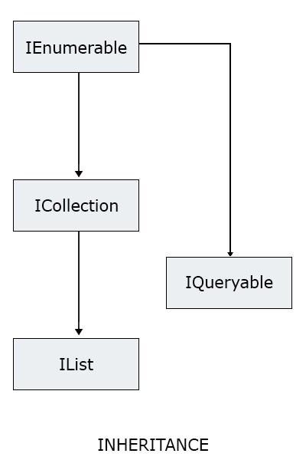
Before we start
Let’s just see this:
List is data type of some collection
It implements interface IList
IList implements ICollection
ICollection implements IEnumerable

Slide 3

Let’s just remember polymorphism
Polymorphism allows the following code to compile without any error:
It is clear a1 will be a list of integer
It may seem confusing but with help of polymorphism a2 will be list of integer as well !
Reason is – we cannot have object of type interface, it must be some data type - it must be some concrete class. So we can declare it to be interface, but as soon as it get’s some value, it will become List<int>. It will become the class that implements that interface.
This is possible to do only because:
List<T> implements ICollection<T>, and ICollection implements IEnumerable
Same thing happens to a3.

Slide 4
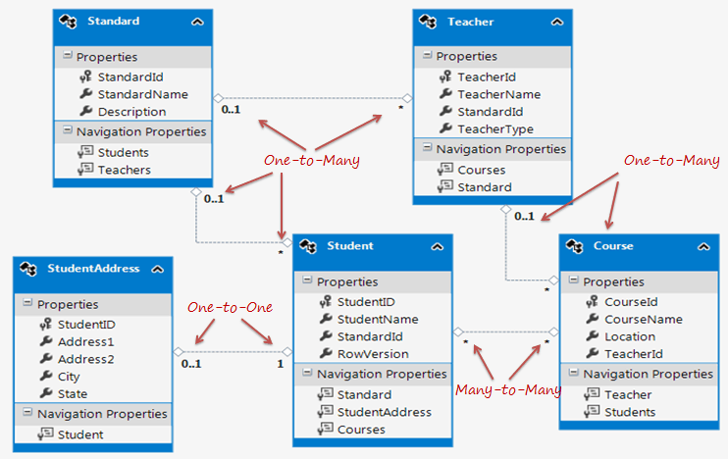
Relationships between Entities in Entity Framework
Entity framework supports three types of relationships, same as database:
One-to-One
One-to-Many
Many-to-Many

Slide 5
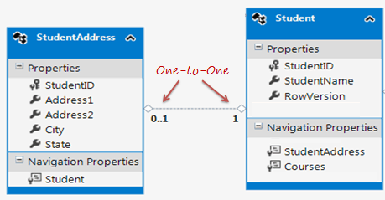
One-to-One Relationship
As you can see in the figure, Student and StudentAddress have a One-to-One relationship (zero or one).
A student can have only one or zero addresses.
Entity framework adds the Student reference navigation property into the StudentAddress entity and the StudentAddress navigation entity into the Student entity.
Also, the StudentAddress entity has both StudentId property as PrimaryKey and ForeignKey, which makes it a one-to-one relationship

Slide 6
Navigation property
Navigation Property:
The navigation property represents a relationship to another entity.
There are two types of navigation properties:
Reference Navigation
Collection Navigation
If an entity includes a property of another entity type, it is called a Reference Navigation Property. It points to a single entity and represents multiplicity of one (1) in the entity relationships.
In Simple words it is something like a Foreign key of the table

Slide 7
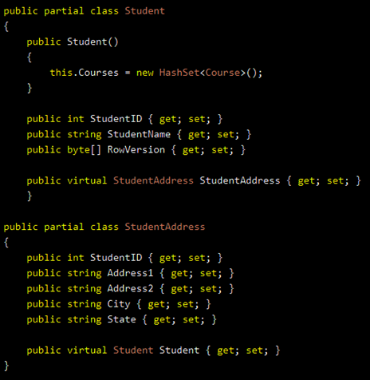
Student and Student address
See now models of Student and Student Address:
See that Student class has StudentAddress
See that StudentAddress class has Student
These are reference navigation properties
If you see image of the tables, you will see
they are the foreign keys.

Slide 8
One-to-Many Relationship
The Standard and Teacher entities have a One-to-Many relationship marked by multiplicity where 1 is for One and * is for Many.
This means that Standard can have many Teachers whereas Teacher can associate with only one Standard.

Slide 9
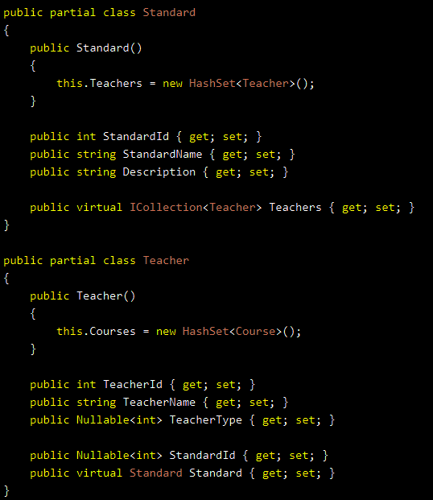
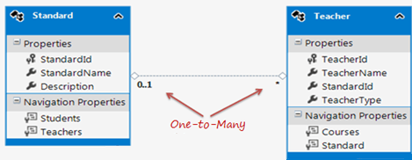
One-to-Many Relationship
To represent this, the Standard entity has the collection navigation property Teachers (please notice that it's plural), which indicates that one Standard can have a collection of Teachers (many teachers)
And the Teacher entity has a Standard navigation property (reference property), which indicates that Teacher is associated with one Standard.
Also, it contains the StandardId foreign key (PK in Standard entity). This makes it a One-to-Many relationship

Slide 10
Many-to-Many Relationship
The Student and Course have a Many-to-Many relationship marked by * multiplicity. It means one Student can enroll for many Courses and also, one Course can be taught to many Students.
The database includes the StudentCourse joining table which includes the primary key of both the tables (Student and Course tables).
Entity Framework represents many-to-many relationships by not having the entity set (DbSet property) for the joining table in the CSDL and visual designer. Instead it manages this through mapping.

Slide 11
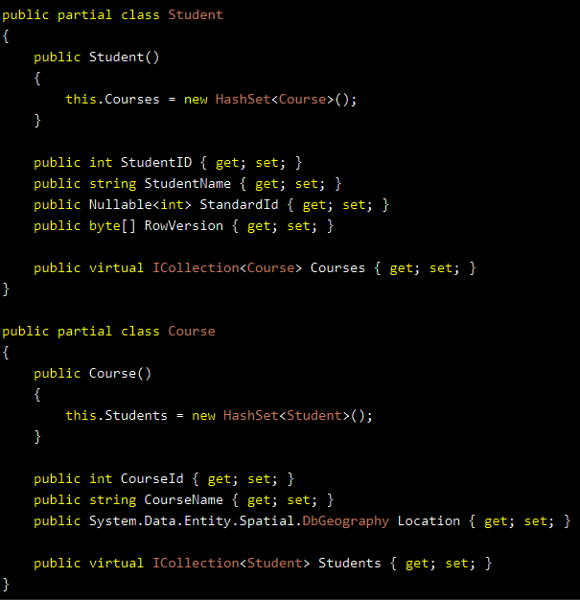
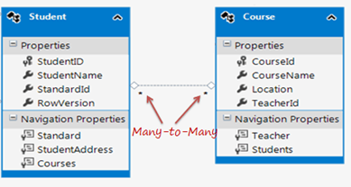
Many-to-Many Relationship
As you can see in the figure below, the Student entity includes the collection navigation property Courses and Course entity includes the collection navigation property Students to represent a many-to-many relationship between them.

Slide 12
Let’s make the app
First we will:
Attach the database
Check the tables that we are using
Add new project School as Windows Forms project
Then add Entity Framework
Use Entity Framework to make entity model for all entities from the database (tables, views, procedures)
When this is ready, we will focus on Student, Course and StudentAddress

Slide 13
Attaching the database from a file
Let’s first attach the database:
Find the SchoolDB.mdf file added as part of the teaching material
Now in SSMS go to Databases folder, right-click → Attach
Clicking the Add button will lead you to form where you can choose which database to attach.
Now make sure to copy the database file from your downloaded material to the place where other databases are stored (see in the exporer part of the screen to the left)
After copying it, you will have to close the dialog and then repeat the step: go to Databases folder, right-click → Attach
Then Add → select School.mdf file and remove log file from Associated file section
Now click OK and wait SSMS to add the database

Slide 14
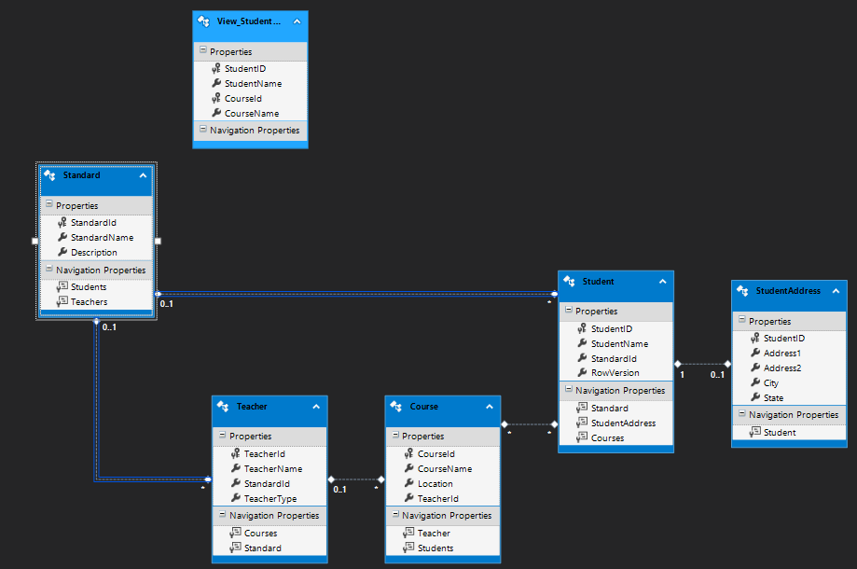
Adding EF
We will end up getting something like this:

Slide 15
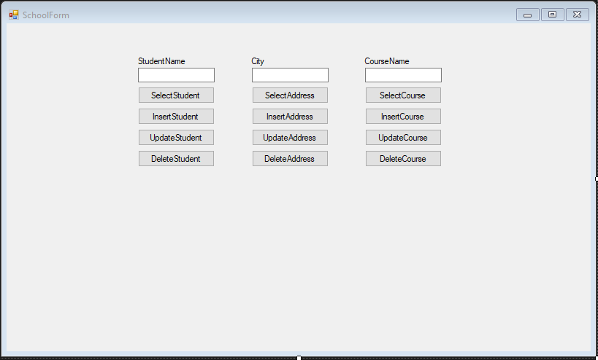
Now the application
To make it simple – just open the project that has been added as part of the teaching material
We will have CRUD buttons for:
Student
Address
Course
Where input parameters to query will be:
StudentName
City
CourseName
Results for now will be displayed in MessageBoxes

Slide 16
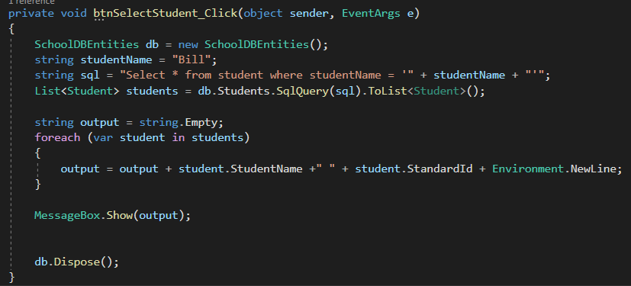
Let’s create the logic for buttons - SELECT
Select student:
Now let’s add logic that will read from the textbox StudentName and use it as query parameter.
Additionally we can allow the query to show students all if textbox is empty

Slide 17
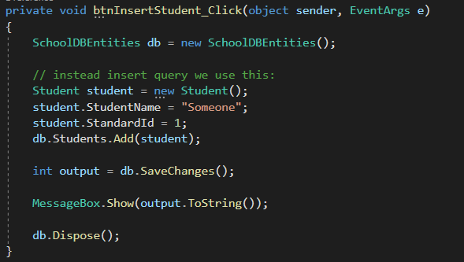
INSERT
We are using different way to insert

Slide 18
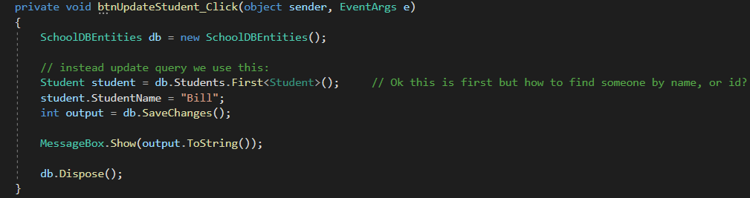
UPDATE
We are using different way to update

Slide 19
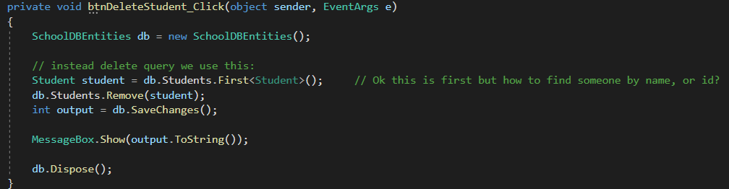
DELETE
We are using different way to delete

Slide 20
Finish up the rest of the buttons
Now let’s finish the logic for the rest of the button
Test them

Slide 21
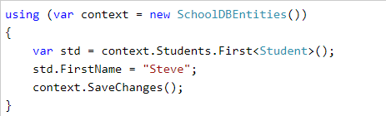
Few questions
Is there an easy way to select without using query? (select * from …)
Is there an easy way to get the specific Student or address or Course to be updated and deleted?
Is there a way to show for student, not only his name, but standard and address?
Can we simplify skip that dispose? – Answer is yes, BUT we need to make sure connection is closed – we need to use USING keyword
What is declared inside of using, exists only inside the {}, after that it is deleted

Slide 22
LINQ
Here comes Linq to help us out.
Linq is set of commands that we use in C# and it looks somewhat similar to that from SQL.
Linq Tutorial is here: https://www.tutorialsteacher.com/linq/linq-tutorials
Linq is using some advanced techniques, so we will try to keep it as simple as possible
Remember it is just a tool that help us work faster

Slide 23
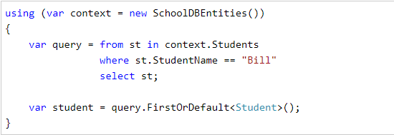
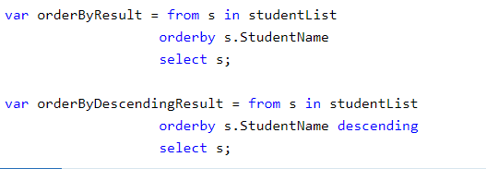
LINQ Query syntax
Here is the way to use it – notice it reminds of SQL query

Slide 24
Use LINQ
Let’s try to use Linq Query syntax to rewrite code for all the button logic.
Next week awaits us something called Lambda expression (which will be used with Linq)

