Slide 1
Week 17 & 18

Slide 2
Goal
Our goal is for student to build application from the scratch with support of the teacher
We will build the application using:
C# Windows Forms (or Web Application if student insists)
Database
Preconditions – discussion about:
Database preparation
C# Code connecting to DB
Design of the application
Functionalities of the application

Slide 3
Prepare DB
Database for this example could be prepared in two ways:
Downloading scripts from teaching material of Week 11 and executing them in SSMS
Teacher could prepare database file (.mdf) which could be attached using SSMS

Slide 4
Connecting C# with DB
This one is up to decision of the student
My personal advice is to keep it easy and use Entity Framework

Slide 5
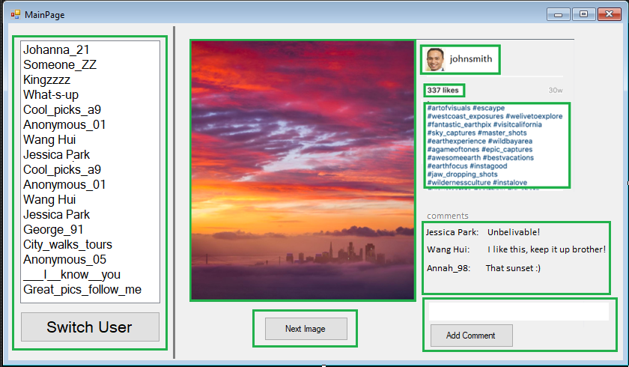
Design of the app
Here is one suggestion. However feel free to do something else if you want

Slide 6
Functionalities of the app
To have a good functionality we need to pay attention to our design, and answer the following questions:
What each section is doing
How to execute each of the commands
How to provide data to meet our design
Are there any flows in the design, and can we improve it
Are we repeating our code, can we reuse ti instead?

