Slide 1
Selections and Aggregate functions

Slide 2
Let’s first add some more books
INSERT INTO books (title, author_fname, author_lname, released_year, stock_quantity, pages)
VALUES
('10% Happier', 'Dan', 'Harris', 2014, 29, 256),
('fake_book', 'Freida', 'Harris', 2001, 287, 428),
('Lincoln In The Bardo', 'George', 'Saunders', 2017, 1000, 367);

Slide 3
Distinct
See what happens when executing query with Distinct
SELECT DISTINCT author_lname FROM books;
Let’s see how many rows we can see for:
Distinct author_fname
Distinct released_year
pages

Slide 4
ORDER BY
It is possible to order the data in a way that is useful to us. Let’s see how:
SELECT author_lname FROM books ORDER BY author_lname;
Do this using: SELECT *
Now change column which you ORDER BY:
Title
released_year
pages

Slide 5
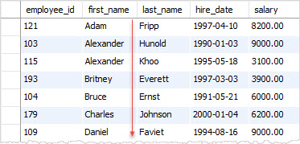
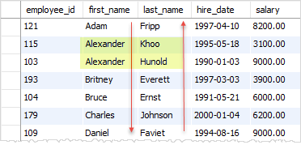
ORDER BY
Note that this way we are getting
from smaller to bigger.
This order is called: Ascending (increasing)
However there is: Descending (decreasing)
Ascending is default value, so we dont need to specify it.
On the other hand, we always need to write desc when we are using descending values

Slide 6
ORDER BY
How to use ORDER BY + DESC?
SELECT author_lname FROM books ORDER BY author_lname DESC
See how it works for SELECT *
See how DESC works for different columns
Now another thing – it is possible to ORDER BY more than one column:
SELECT author_fname, author_lname FROM books
ORDER BY author_lname, author_fname;

Slide 7
TOP
If you asked yourself how to show only 1 row from all that you selected,
or only 10, or 100 – here it is how to do it:
SELECT TOP 1 * FROM books
SELECT TOP 10 * FROM books
SELECT TOP 100 title, pages FROM books ORDER BY title
SELECT TOP 5 title, pages, author_fname FROM books ORDER BY author_fname DESC
SELECT TOP 5 title, pages, author_fname FROM books WHERE author_lname = 'Gaiman' ORDER BY author_fname, author_lname DESC

Slide 8

LIKE (no, it is not this )
LIKE is very helpful for better search
IF we cannot remember exactly what was the name of the Author or the book, but we remember some part of the name.
How to use it:
SELECT * FROM books
WHERE author_fname LIKE '%da%’
We use like only for strings. See % - it is called wildcard. Let’s see more abouth them

Slide 9
LIKE
Wildcards are used like this:
If I want text that starts with da LIKE 'da%’
(see wilcards go after da)
If I want text that ends with da LIKE '%da’
(see wilcards go before da)
If I want text that contains da LIKE '%da%’
(see wilcards go before da and after)
So wildcards say that anything can go instead of them

Slide 10


Exercises
Let’s find only those Titles that contain ’stories’
Find the longest book (most pages)

Slide 11
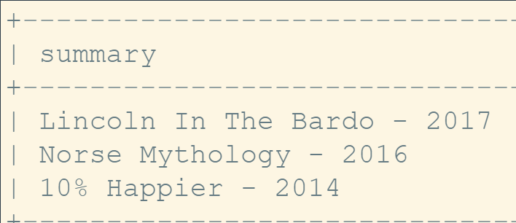
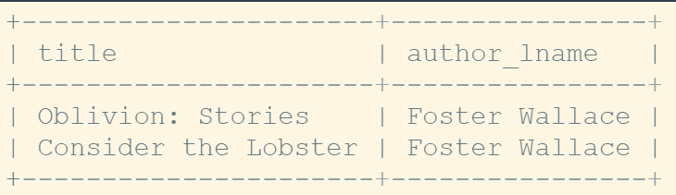
Exercises
Print a summary containing the title and year, for the 3 most recent books
Find all books with an author_lname that contains a space(" ")

Slide 12
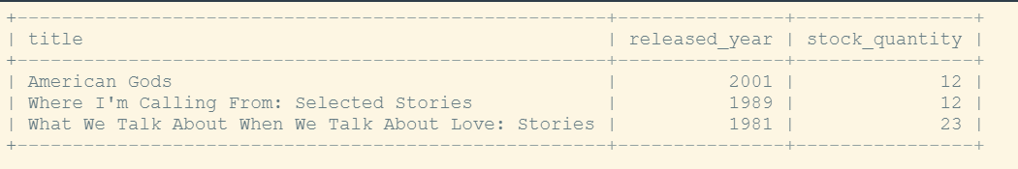
Exercises
Find The 3 Books With The Lowest Stock
Select title, year, and stock

Slide 13
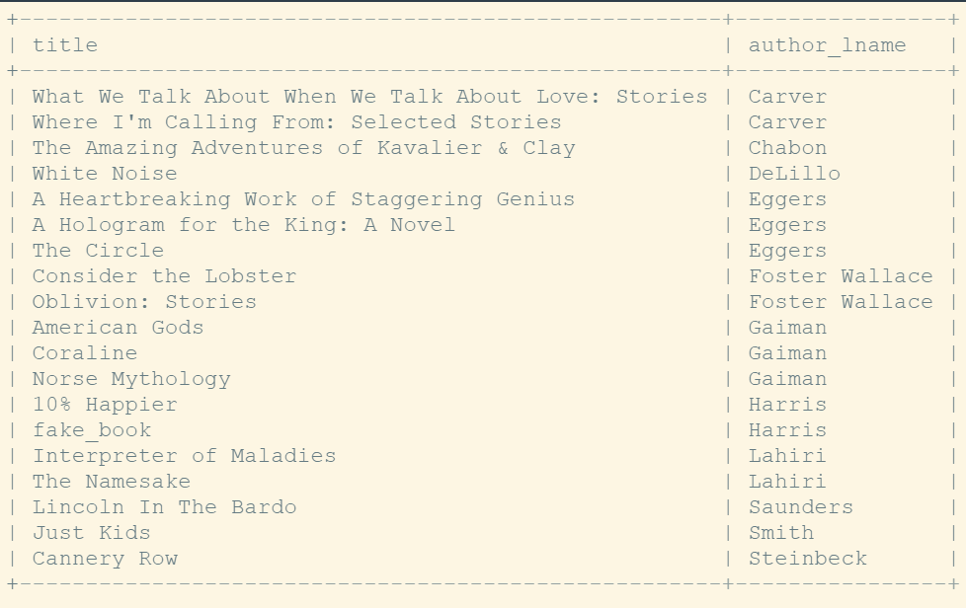
Exercises
Print title and author_lname, sorted first by author_lname and then by title

Slide 14
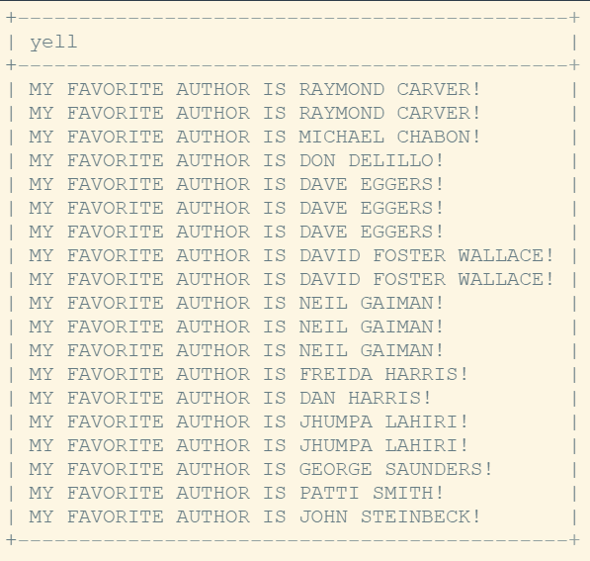
Exercises
Alright last exercise for now:
Make results be shown:
Sorted Alphabetically By Last Name

Slide 15
Aggregate Functions
Time to learn some more stuff again
Mostly used are:
Count
GROUP BY
Max
Min
Sum
Avg

Slide 16
COUNT
We use it to see how many rows are there in the table
Let’s see how many books are there:
SELECT COUNT(*) FROM books;
We can count not just books, but specific data that are related to books.
How many author_fnames?
SELECT COUNT(author_fname) FROM books;

Slide 17
COUNT
Now see if previous result is correct, how many actual first names there are?
And why we get wrong number?
How about we use DISTINCT author_fnames? (remember from last class)
SELECT COUNT(DISTINCT author_fname) FROM books;

Slide 18
COUNT
Let’s see how many author_lname:
SELECT COUNT(DISTINCT author_lname) FROM books;
Count how many titles contain “the”
SELECT COUNT(*) FROM books WHERE title LIKE '%the%';

Slide 19

GROUP BY
Now take a Deep Breathe
This is very complicated to explain by words
So let’s try again and again until we make it
GROUP BY summarizes or aggregates identical data into single rows

Slide 20
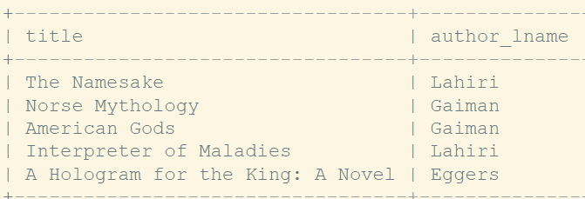

GROUP BY
SELECT title, author_lname FROM books SELECT title, author_lname FROM books GROUP BY author_lname
If you pay attention, you will see that we are grouping data so that author_lname’s are shown only once. But what is wrong with titles? We know Lahiri and Gaiman have more than one book!

Slide 21
GROUP BY
SELECT title, author_lname FROM books
GROUP BY author_lname
Group by doesn’t care about other columns. Once you Group by, it will adjust the column data that goes after GROUP BY command
In this case, only valid and useful is author_lname, title is showing only one data… So why do we need this GROUP BY?

Slide 22
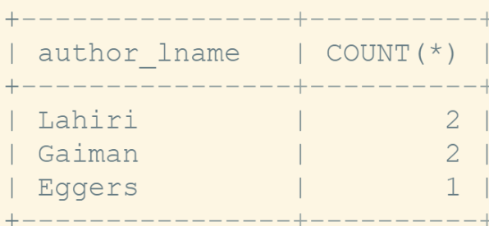
GROUP BY and count
Let’s try now to count how many books each author has written:
SELECT author_lname, COUNT(*) FROM books GROUP BY author_lname;
Group by will group data
Then COUNT(*) will count all,
but only for each author
Remember, regular COUNT(*) without GROUP BY would count all data from table.

Slide 23
MIN, MAX
Now let’s try to see usage of MIN and MAX
First without GROUP BY
MIN = Minimum (in latin language – the smallest)
MAX = Maximum (in latin language – the biggest)
Now let’s find the minimum of released_year for a book

Slide 24
MIN and MAX
SELECT MIN(released_year) FROM books;
See results. The smallest number will be shown, right?
Now let’s find the longest book (one with most pages)
SELECT MAX(pages) FROM books;
What if we wanted to show only Title of the longest book?
Will this one work?
SELECT MAX(pages), title FROM books;

Slide 25
How to solve previous problem
One way:
Let’s first find and show what is the minimum pages:
SELECT Min(pages) FROM books
Then let’s find and show title of the book where pages are of some length
SELECT title FROM books WHERE pages = (****)
Now replace **** with first query
SELECT title FROM books WHERE pages = (SELECT Min(pages) FROM books)
Another way to solve problem
SELECT TOP 1 * FROM books ORDER BY pages - it will start from lowest number

Slide 26
MIN and MAX with GROUP BY
Find the year each author published their first book:
SELECT author_fname,
author_lname,
Min(released_year)
FROM books
GROUP BY author_lname,
author_fname;
First a question – why we group by two columns?
Now try to find the year author published their last book

Slide 27
Find the longest page count for each author:
SELECT author_fname,
author_lname,
Max(pages)
FROM books
GROUP BY author_lname,
author_fname;

Slide 28
Let’s just show name in one column (first + last name)
SELECT
CONCAT(author_fname, ' ', author_lname) AS author, MAX(pages) AS 'longest book’
FROM books
GROUP BY author_lname,
author_fname;

Slide 29
SUM
SUM – adds things together
Sum all pages in the books table
SELECT SUM(pages) FROM books;

Slide 30
SUM + Group By
Sum all pages each author has written
SELECT author_fname,
author_lname,
Sum(pages)
FROM books
GROUP BY author_lname,
author_fname;

Slide 31
AVG
AVG = Average
Calculate the average released_year across all books
SELECT AVG(released_year) FROM books;

Slide 32
AVG + Group by
Calculate the average stock quantity for books released in the same year
SELECT AVG(stock_quantity)
FROM books
GROUP BY released_year;

Slide 33
Exercises
Print the number of books in the table
Print out how many books were released in each year
Print out the total number of books in stock
Find the average released_year for each author
Find the full name of the author who wrote the longest book

Slide 34
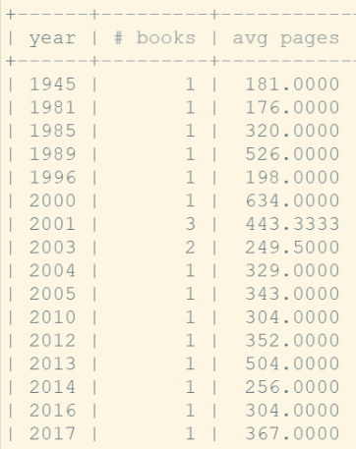
Exercises
Let’s write the query that should return result that looks like this:

Slide 35
Homework
Show top 5 books with biggest number of pages
Show top 3 oldest books
Print all author first names (do not repeat them)
Print all years when books were released (do not repeat them)
Search for book whose name starts with ‘Just’
Search for book whose name ends with ‘Stories’ and order them by title
Search for book whose name contains ‘the’ and order them by title, in order from Z -> A (descending)
Show only top 2 books, which contain ‘Niel’ in the author first name, order them by stock, year, and pages
Same as previous, just show columns (book name, author, stock, year, pages)
(Use aliases and string functions)

Slide 36
Homework
Print the number of book titles in the table
Print the number of author first names in the table (do not repeat same names) – remember command distinct
Print the number of author last names in the table
Print out how many pages were written in each year
Print out how many books were written by each author (use only last name to group)
Print out the average number of book pages
Print out the average number of book pages by each author
Find the full name of the author who wrote the shortest book
Find how many books have been written in exact year (so group by year)

Slide 37
In-Class exercises solutions
SELECT COUNT(*) FROM books;
SELECT COUNT(*) FROM books GROUP BY released_year;
SELECT released_year, COUNT(*) FROM books GROUP BY released_year;
SELECT Sum(stock_quantity) FROM BOOKS;
SELECT AVG(released_year) FROM books GROUP BY author_lname, author_fname;
SELECT author_fname, author_lname, AVG(released_year) FROM books GROUP BY author_lname, author_fname;

Slide 38
In-Class exercises solutions
SELECT CONCAT(author_fname, ' ', author_lname) FROM books
WHERE pages = (SELECT Max(pages) FROM books);
SELECT CONCAT(author_fname, ' ', author_lname) FROM books
ORDER BY pages DESC LIMIT 1;
SELECT pages, CONCAT(author_fname, ' ', author_lname) FROM books
ORDER BY pages DESC;
SELECT released_year AS year,
COUNT(*) AS '# of books',
AVG(pages) AS 'avg pages'
FROM books
GROUP BY released_year;

