Slide 1
Many to many Relations

Slide 2
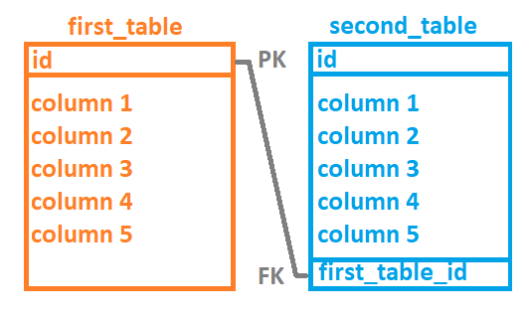
Let’s review first One to many relation
How do we connect two tables?
What kind of JOINS do we have?
What keys do we use?
Can foreign key differ from
primary key of related table?
Can we add new data with any
in value of Id in the first_table?
Can we add new data with any value of foreign key in the second_table?

Slide 3

Many to many
Many to many not as much used as one to many, but still is very important
We use them in situations similar to these:
Books can have more than one authors. Authors can have more than one book.
Same goes for other two exaples. Both left and right side can have multiple of each others

Slide 4
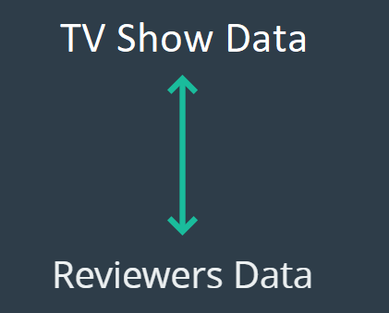
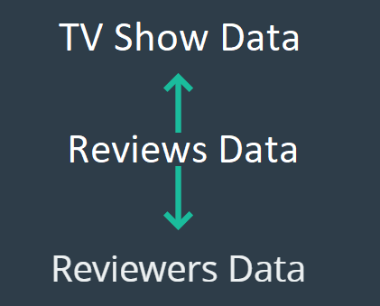
TV Show reviewing example
We have:
TV Shows
Reviewers
Since they are independent, and exist pretty much on their own, we need something to keep them connected
That is another table, that is essential
for many to many relationship

Slide 5
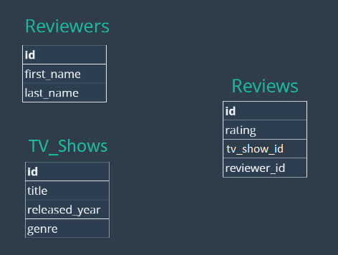
Tables
Here we will show exact tables that we use:
Reviewers – People who do the review
TV Shows – Shows that will be reviewed
Review – Connecting point for two tables
(Reviewers and TV Shows)

Slide 6
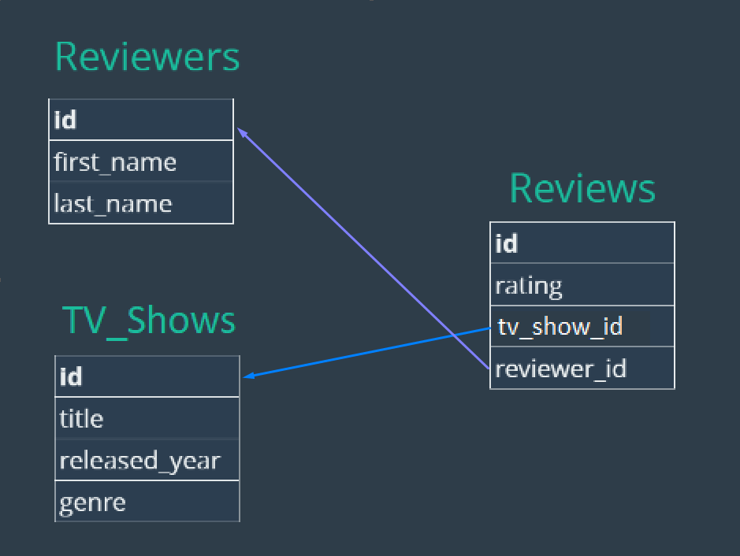
Relations between tables
See the table Reviews
It’s foreign keys are related to
primary keys of two tables
Reviews.TV_Show_id TV_Shows.Id
Reviews.Reviewer_id Reviewers.Id

Slide 7
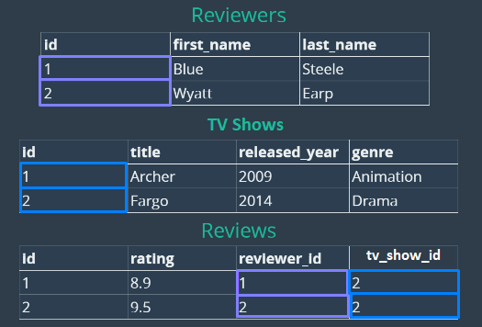
Data in the tables
Reviews.TV_Show_id TV_Shows.Id
Reviews.Reviewer_id Reviewers.Id

Slide 8
Creating tables
CREATE TABLE reviewers (
id INT IDENTITY PRIMARY KEY,
first_name VARCHAR(100),
last_name VARCHAR(100)
);
CREATE TABLE tv_shows(
id INT IDENTITY PRIMARY KEY,
title VARCHAR(100),
released_year VARCHAR(4),
genre VARCHAR(100)
);
CREATE TABLE reviews (
id INT IDENTITY PRIMARY KEY,
rating DECIMAL(2,1),
tv_show_id INT,
reviewer_id INT,
FOREIGN KEY(tv_show_id) REFERENCES tv_shows(id),
FOREIGN KEY(reviewer_id) REFERENCES reviewers(id)
);

Slide 9
Inserting data
INSERT INTO tv_shows(title, released_year, genre)
VALUES
('Archer', 2009, 'Animation'),
('Arrested Development', 2003, 'Comedy'),
('Bobs Burgers', 2011, 'Animation'),
('Bojack Horseman', 2014, 'Animation'),
('Breaking Bad', 2008, 'Drama'),
('Curb Your Enthusiasm', 2000, 'Comedy'),
('Fargo', 2014, 'Drama'),
('Freaks and Geeks', 1999, 'Comedy'),
('General Hospital', 1963, 'Drama'),
('Halt and Catch Fire', 2014, 'Drama'),
('Malcolm In The Middle', 2000, 'Comedy'),
('Pushing Daisies', 2007, 'Comedy'),
('Seinfeld', 1989, 'Comedy'),
('Stranger Things', 2016, 'Drama');
INSERT INTO reviewers (first_name, last_name) VALUES
('Thomas', 'Stoneman'),
('Wyatt', 'Skaggs'),
('Kimbra', 'Masters'),
('Domingo', 'Cortes'),
('Colt', 'Steele'),
('Pinkie', 'Petit'),
('Marlon', 'Crafford');
INSERT INTO reviews(tv_show_id, reviewer_id, rating) VALUES
(1,1,8.0),(1,2,7.5),(1,3,8.5),(1,4,7.7),(1,5,8.9),
(2,1,8.1),(2,4,6.0),(2,3,8.0),(2,6,8.4),(2,5,9.9),
(3,1,7.0),(3,6,7.5),(3,4,8.0),(3,3,7.1),(3,5,8.0),
(4,1,7.5),(4,3,7.8),(4,4,8.3),(4,2,7.6),(4,5,8.5),
(5,1,9.5),(5,3,9.0),(5,4,9.1),(5,2,9.3),(5,5,9.9),
(6,2,6.5),(6,3,7.8),(6,4,8.8),(6,2,8.4),(6,5,9.1),
(7,2,9.1),(7,5,9.7),
(8,4,8.5),(8,2,7.8),(8,6,8.8),(8,5,9.3),
(9,2,5.5),(9,3,6.8),(9,4,5.8),(9,6,4.3),(9,5,4.5),
(10,5,9.9),
(13,3,8.0),(13,4,7.2),
(14,2,8.5),(14,3,8.9),(14,4,8.9);

Slide 10
First let’s check data manually
Let’s find what are the ratings of 'Bojack Horseman‘, and who reviewed it.
Try first to use simple selects without joins – showing data using table by table
Then repeat the same for 'Archer‘ tv show

Slide 11
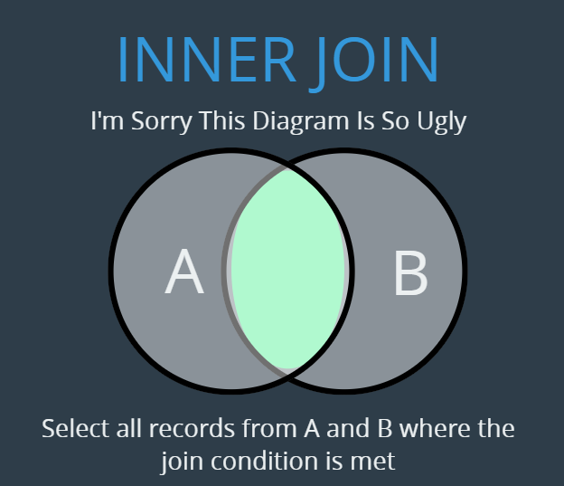
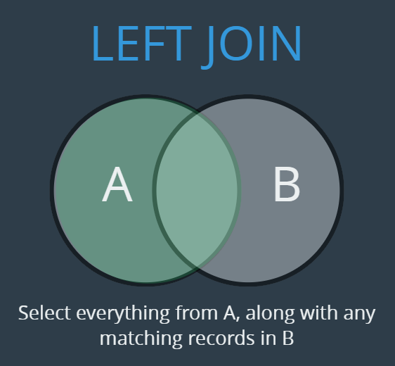
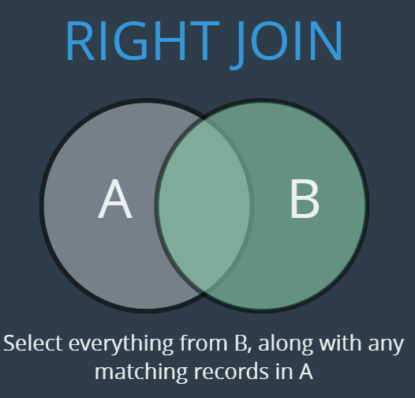
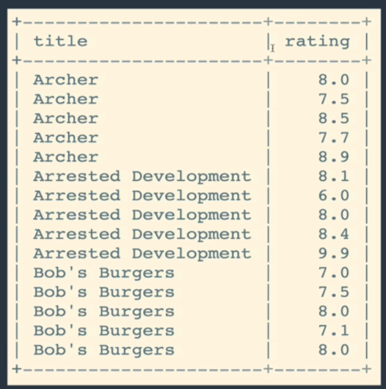
Joins and Exercise 1
Remember Joins?
Experiment with joins and
then do exercises
Let’s show ratings for tv show Archer:

Slide 12
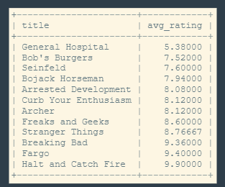
Exercise 2
Show reviews like this:

Slide 13
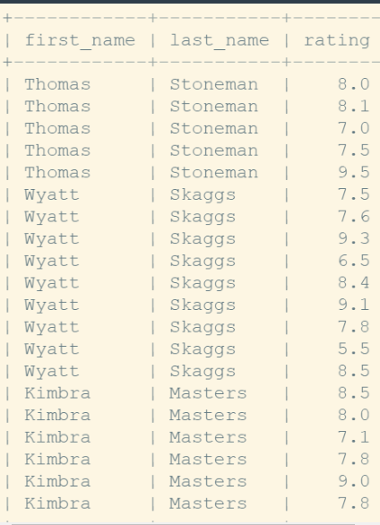
Exercise 3
Let’s do this one:

Slide 14
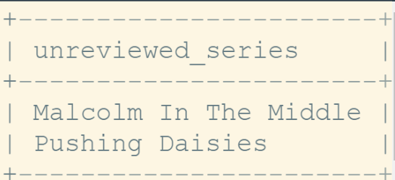
Exercise 4
Finding un-reviewed TV Show:

Slide 15
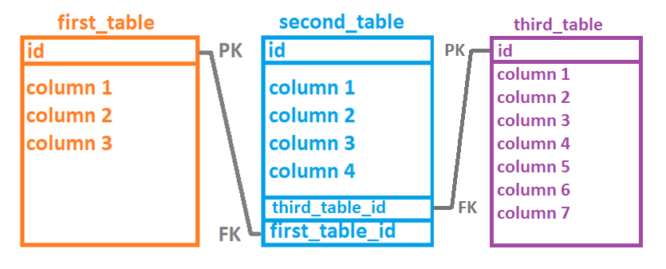
Conclusion
We make many to many relations by introducing another table in the middle:

Slide 16
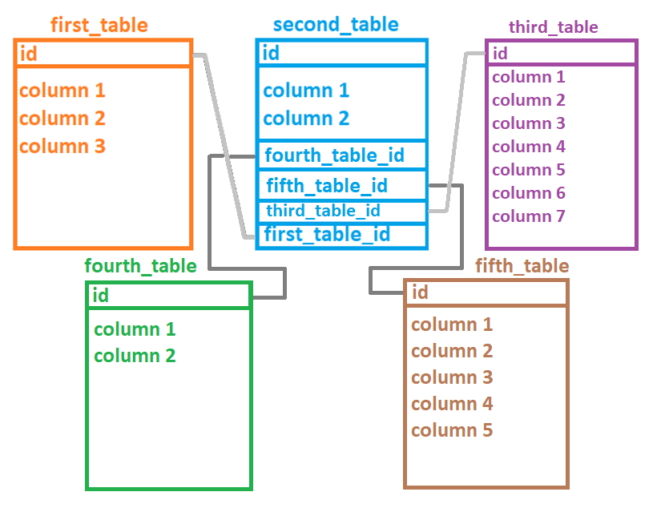
Many to many relationship - another point
It is possible to have one table that serves as contact point for many to many relations between more than 2 tables

Slide 17
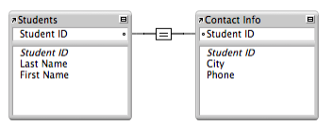
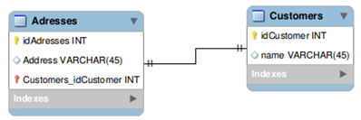
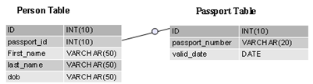
Short info about One to One
One to one in most cased is the relationship where you want to have separate table with more details about something
Examples of one to one:
person and person_details
product and product_details
company and company_details
students and contact_info
address and customers
Person and passport

Slide 18
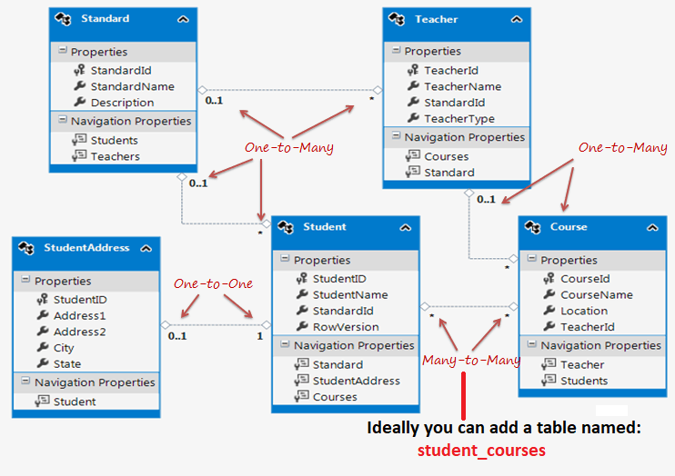
Guess which relations
See and try to identify
where relations are:
One to one
one to many
Many to many

Slide 19
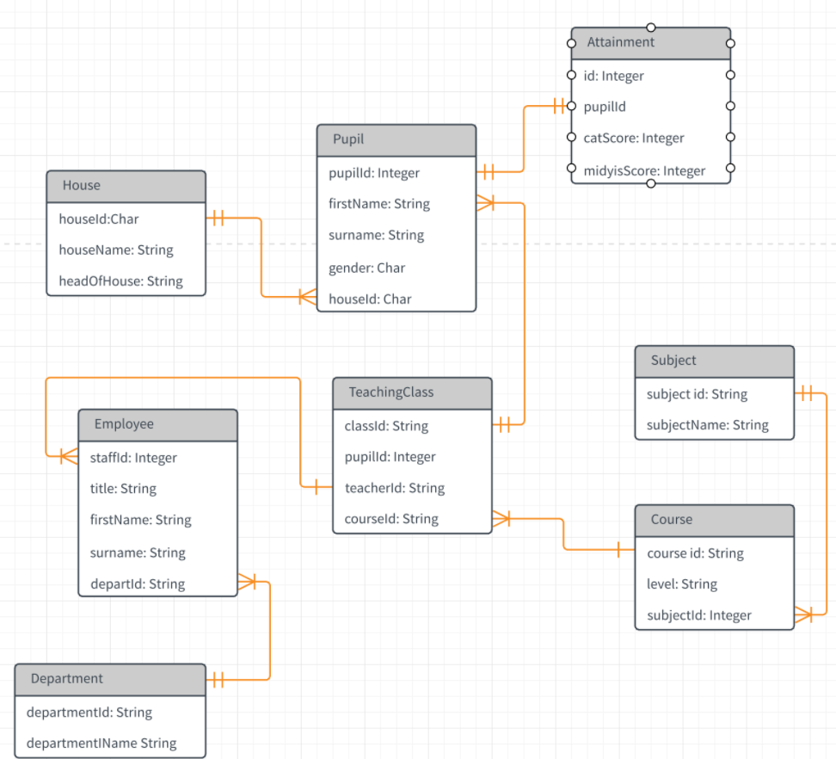
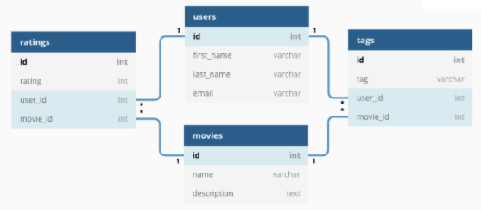
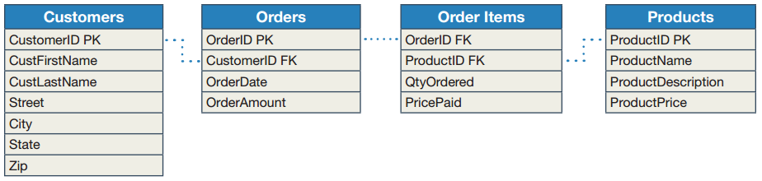
Some more examples:

Slide 20
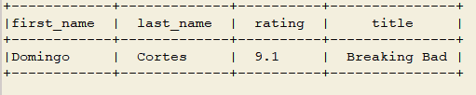
Homework
Show only tv show names that have 8.0 rating or above
Show only names of people who reviewed tv_shows as 8.0
Show details for person who reviewed tv show 'Breaking Bad' with mark 9.1

Slide 21
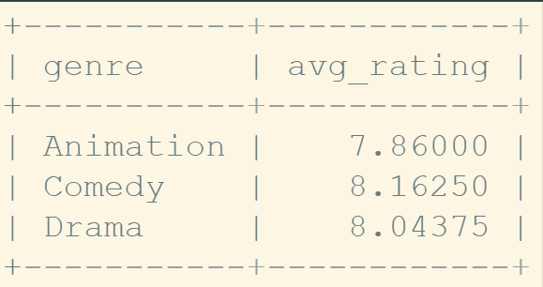
Homework
Show average rating for each genre of tv show:

Slide 22
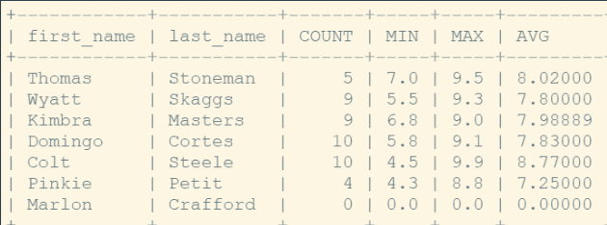
Homework
Show review details for each person:
COUNT – how many reviews person has made
MIN – what is the smallest mark person has given to tv show
MAX – what is the biggest mark person has given to tv show
AVG – what is the average mark person has given to tv show

Slide 23
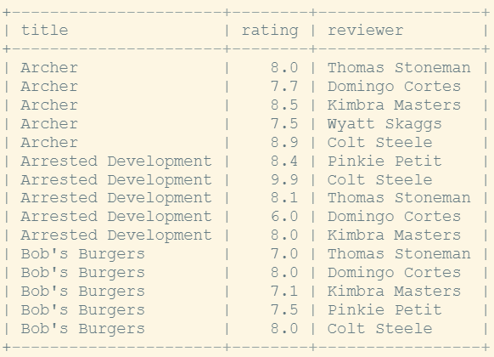
Homework

Slide 24
Exercise Solutions
-- Exercise 1
SELECT
title,
rating
FROM tv_shows
JOIN reviews
ON tv_shows.id = reviews.tv_show_id;
-- Exercise 2
SELECT
title,
AVG(rating) as avg_rating
FROM tv_shows
JOIN reviews
ON tv_shows.id = reviews.tv_show_id
GROUP BY tv_shows.title
ORDER BY avg_rating;

Slide 25
Exercise Solutions
-- Exercise 3 - Two Solutions
SELECT
first_name,
last_name,
rating
FROM reviewers
INNER JOIN reviews
ON reviewers.id = reviews.reviewer_id;
SELECT
first_name,
last_name,
rating
FROM reviews
INNER JOIN reviewers
ON reviewers.id = reviews.reviewer_id;

Slide 26
Exercise Solutions
-- Exercise 4 - UNREVIEWED SERIES
SELECT title AS unreviewed_series
FROM tv_shows
LEFT JOIN reviews
ON tv_shows.id = reviews.tv_show_id
WHERE rating IS NULL;

