Slide 1
Database Tables
Week 5

Slide 2
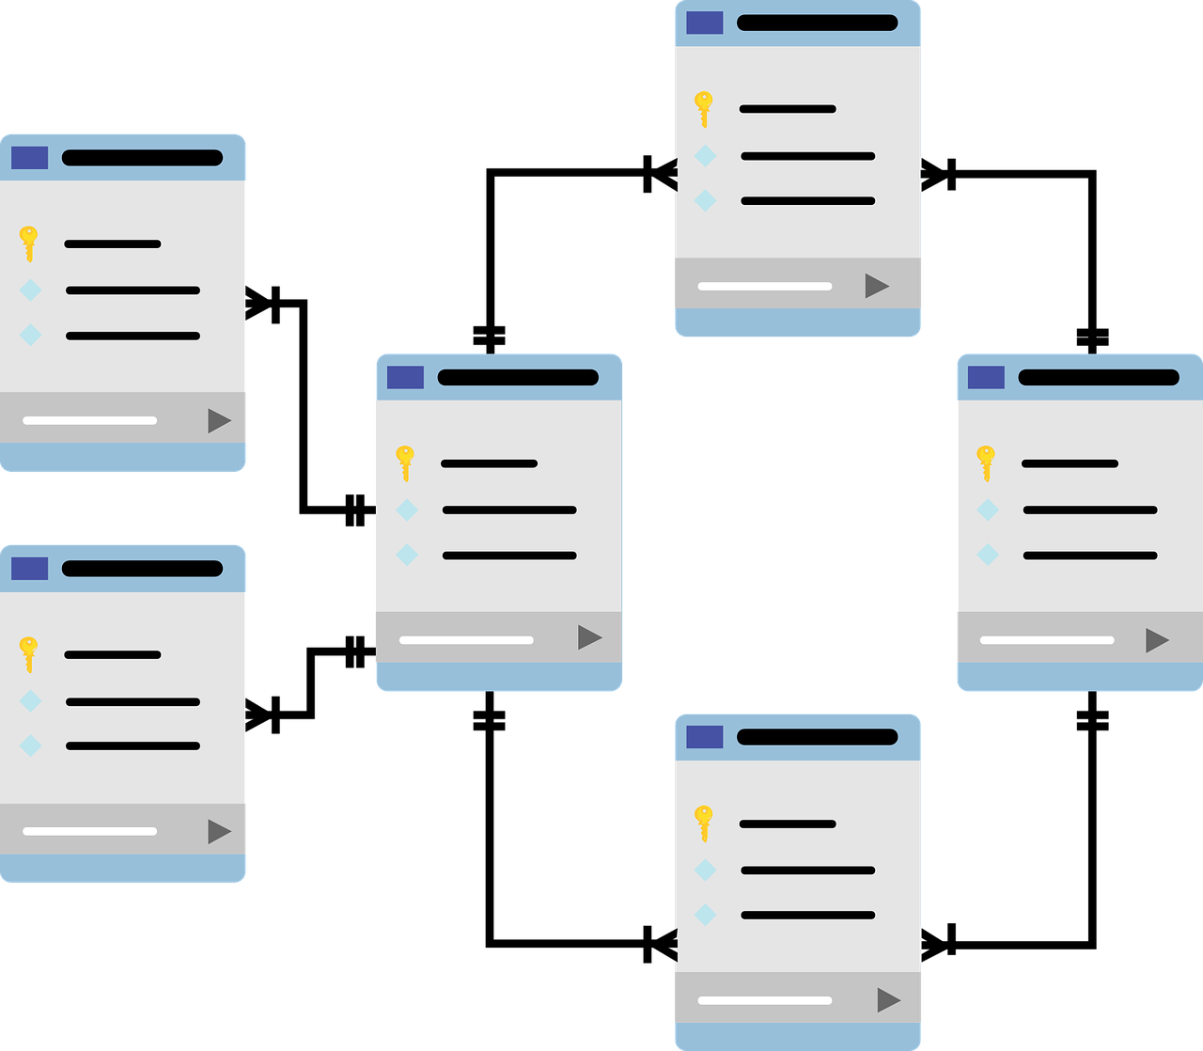
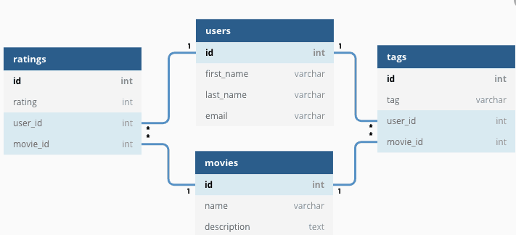
Tables
Database can be considered as bunch of tables
They are inter-connected with some relations

Slide 3
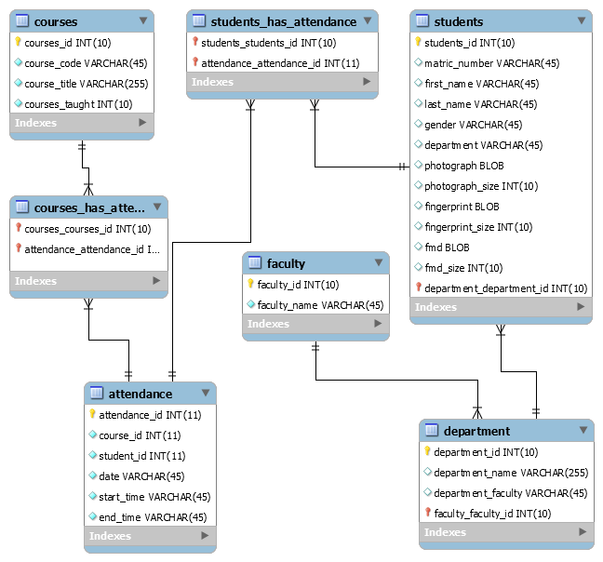
Tables and data types
To save necessary data to database you
must first:
Create table with
Setting data types and names for columns
Insert the new data into table
Data types are somewhat similar to those in C#, C++ and other programming languages

Slide 4
Numeric data types (Numbers) - 1
Data type | Description | Storage
bit | Integer that can be 0, 1, or NULL
tinyint | Allows whole numbers from 0 to 255 | 1 byte
smallint | Allows whole numbers between -32,768 and 32,767 | 2 bytes
int | Allows whole numbers between -2,147,483,648 and 2,147,483,647 | 4 bytes
bigint | Allows whole numbers between -9,223,372,036,854,775,808 and 9,223,372,036,854,775,807 | 8 bytes
decimal(p,s) | Fixed precision and scale numbers.Allows numbers from -10^38 +1 to 10^38 –1. The p parameter indicates the maximum total number of digits that can be stored (both to the left and to the right of the decimal point). p must be a value from 1 to 38. Default is 18. The s parameter indicates the maximum number of digits stored to the right of the decimal point. s must be a value from 0 to p. Default value is 0

Slide 5
Numeric data types (Numbers) - 2
numeric(p,s) | Fixed precision and scale numbers. Allows numbers from -10^38 +1 to 10^38 –1. The p parameter indicates the maximum total number of digits that can be stored (both to the left and to the right of the decimal point). p must be a value from 1 to 38. Default is 18. The s parameter indicates the maximum number of digits stored to the right of the decimal point. s must be a value from 0 to p. Default value is 0 | 5-17 bytes
smallmoney | Monetary data from -214,748.3648 to 214,748.3647 | 4 bytes
Money | Monetary data from -922,337,203,685,477.5808 to 922,337,203,685,477.5807 | 8 bytes
float(n) | Floating precision number data from -1.79E + 308 to 1.79E + 308. The n parameter indicates whether the field should hold 4 or 8 bytes. float(24) holds a 4-byte field and float(53) holds an 8-byte field. Default value of n is 53. | 4 or 8 bytes
real | Floating precision number data from -3.40E + 38 to 3.40E + 38 | 4 bytes

Slide 6
String types (text) - 1
Data type | Description | Max size | Storage
char(n) | Fixed width character string | 8,000 characters | Defined width
varchar(n) | Variable width character string | 8,000 characters | 2 bytes + number of chars
varchar(max) | Variable width character string | 1,073,741,824 characters | 2 bytes + number of chars
text | Variable width character string | 2GB of text data | 4 bytes + number of chars
nchar | Fixed width Unicode string | 4,000 characters | Defined width x 2

Slide 7
String types (text) - 2
nvarchar | Variable width Unicode string | 4,000 characters
nvarchar(max) | Variable width Unicode string | 536,870,912 characters
ntext | Variable width Unicode string | 2GB of text data
binary(n) | Fixed width binary string | 8,000 bytes
varbinary | Variable width binary string | 8,000 bytes
varbinary(max) | Variable width binary string | 2GB
image | Variable width binary string | 2GB

Slide 8
Date types
Data type | Description
DATE | A date. Format: YYYY-MM-DD. The supported range is from '1000-01-01' to '9999-12-31'
DATETIME(fsp) | A date and time combination. Format: YYYY-MM-DD hh:mm:ss. The supported range is from '1000-01-01 00:00:00' to '9999-12-31 23:59:59'. Adding DEFAULT and ON UPDATE in the column definition to get automatic initialization and updating to the current date and time
TIMESTAMP(fsp) | A timestamp. TIMESTAMP values are stored as the number of seconds since the Unix epoch ('1970-01-01 00:00:00' UTC). Format: YYYY-MM-DD hh:mm:ss. The supported range is from '1970-01-01 00:00:01' UTC to '2038-01-09 03:14:07' UTC. Automatic initialization and updating to the current date and time can be specified using DEFAULT CURRENT_TIMESTAMP and ON UPDATE CURRENT_TIMESTAMP in the column definition
TIME(fsp) | A time. Format: hh:mm:ss. The supported range is from '-838:59:59' to '838:59:59'
YEAR | A year in four-digit format. Values allowed in four-digit format: 1901 to 2155, and 0000. MySQL 8.0 does not support year in two-digit format.

Slide 9
Data types in table
Must be text
Must be text
Must be number
First Name | Last Name | Age
John | Smith | 18
Anna | Johnson | 15
Bruce | Lee | Thirty-one
Sam | Cooper | Very young, around five

Slide 10
Data types in table
Must be text
Must be text
Must be number
VARCHAR(30) VARCHAR(30) INT
First Name | Last Name | Age
John | Smith | 18
Anna | Johnson | 15
Bruce | Lee | 31
Sam | Cooper | 5

Slide 11
How to create Table
Template
Real example
CREATE TABLE tablename
(
column_name data_type,
column_name data_type
);
CREATE TABLE cats
(
name VARCHAR(100),
age INT
);

Slide 12
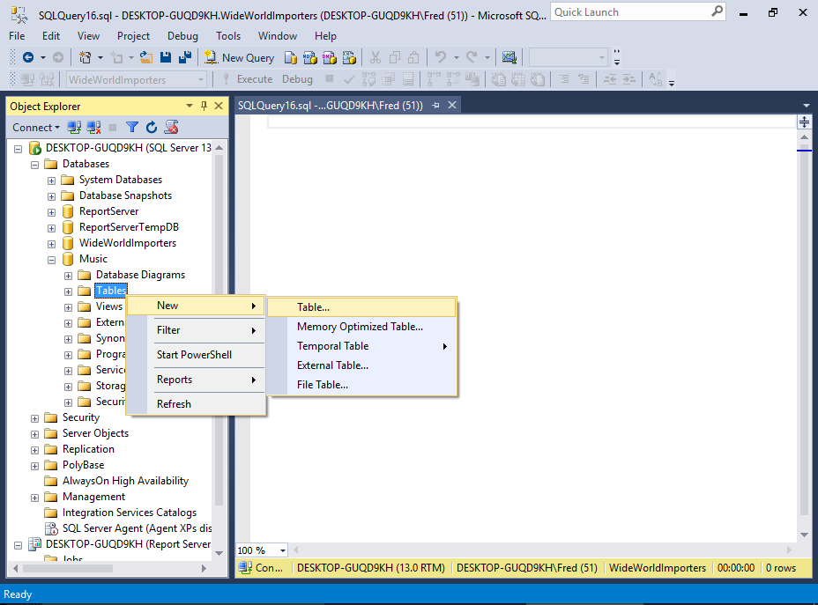
How to create Table

Slide 13
Drop Table
Dropping Tables
DROP TABLE <tablename>;
A specific example:
DROP TABLE cats;
Be careful with this command!

Slide 14
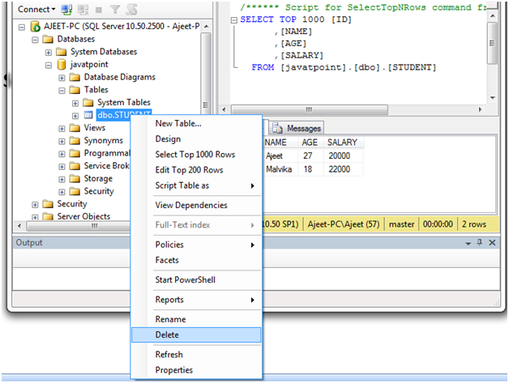
Drop Table

Slide 15
Inserting data
Adding value inside of the table goes like this:
INSERT INTO cats(name, age)
VALUES ("Jetson", 7);
Pay attention what comes first – which column name:
INSERT INTO cats(age, name)
VALUES (12, 'Victoria');

Slide 16
How to see if it worked?
To show data in table use simple command:
SELECT * FROM cats SELECT * FROM <table_name>
This is something we will learn next week in more details.

Slide 17
Adding multiple data at the same time
Here is how to insert multiple rows of data in a table
INSERT INTO cats(name, age)
VALUES ('Charlie', 10) ,
('Sadie', 3) ,
('Lazy Bear', 1);

Slide 18
Challenge
Create a people table:
Make sure to add following rows:
first_name - 20 char limit
last_name - 20 char limit
age
Then insert your first person:
first_name | last_name | age
'Tina' | 'Belcher' | 13

Slide 19
Challenge
Add second person:
Add multiple persons:
first_name | last_name | age
'Bob' | 'Belcher' | 42
first_name | last_name | age
'Linda' | 'Belcher' | 45
'Phillip' | 'Frond' | 38
'Calvin' | 'Fischoeder' | 70

Slide 20
Now let’s get back to cats
If we try this, we will see something interesting:
INSERT INTO cats(name)
VALUES ('This cat is named Charlie
which is also a human name.
In fact I know a couple of Charlies. Fun Fact’)
Note that there is no age

Slide 21
Then try this
INSERT INTO cats()
VALUES ();
What do we see?
And why NULL?
NULL means NO VALUE
It seems our table can accept new rows that do not have value!

Slide 22
How to fix this?
We need to set the rule to the table – do not accept NULL
We do it by adding table constraint.
Constraint = a limitation or restriction
NOT NULL will restrict table of adding new rows without a value
CREATE TABLE cats2
(
name VARCHAR(100) NOT NULL,
age INT NOT NULL
);

Slide 23
Another option
We can set the table to add default value if none has been provided:
CREATE TABLE cats3
(
name VARCHAR(100) DEFAULT 'unnamed’,
age INT DEFAULT 99
);

Slide 24
Now let’s insert same data many times
INSERT INTO cats(name, age)
VALUES ('Charlie', 10) , (this cat is black)
('Charlie', 10) , (this cat is white)
('Charlie', 10) , (this cat is gray)
('Charlie', 10) , (this cat is gray and white)
('Charlie', 10) (this cat is black and white)
These are not the same cat!
How do we know which Charlie is which cat?

Slide 25
We need an ID
CatId | Name | Age
1 | Charlie | 10
2 | Charlie | 10
3 | Charlie | 10

Slide 26
Setting Id as a primary key
CREATE TABLE unique_cats
(
cat_id INT NOT NULL ,
name VARCHAR(100) ,
age INT ,
PRIMARY KEY (cat_id)
);
Now add some data:
INSERT INTO unique_cats(cat_id, name, age) VALUES(1, 'Fred', 23);
INSERT INTO unique_cats(cat_id, name, age) VALUES(2, 'Louise', 3);
INSERT INTO unique_cats(cat_id, name, age) VALUES(1, 'James', 3);

Slide 27
Then yet another option
CREATE TABLE unique_cats2
(
cat_id INT NOT NULL AUTO_INCREMENT ,
name VARCHAR(100) ,
age INT ,
PRIMARY KEY (cat_id)
);
This allows us to not pay attention about Id’s when entering new values

Slide 28
Now your TURN
Define an Employees table, with the following fields:
id - number(automatically increments), mandatory, primary key
last_name - text, mandatory
first_name - text, mandatory
middle_name - text, not mandatory
age - number mandatory
current_status - text, mandatory, defaults to 'employed'

Slide 29
Solution
CREATE TABLE employees (
id INT NOT NULL AUTO_INCREMENT,
last_name VARCHAR(255) NOT NULL,
first_name VARCHAR(255) NOT NULL,
middle_name VARCHAR(255),
age INTEGER NOT NULL,
current_status VARCHAR(100) NOT NULL DEFAULT 'employed',
PRIMARY KEY (id)
);

Slide 30
Another way of adding primary key
CREATE TABLE employees (
id INT NOT NULL AUTO_INCREMENT PRIMARY KEY,
last_name VARCHAR(255) NOT NULL,
first_name VARCHAR(255) NOT NULL,
middle_name VARCHAR(255),
age INTEGER NOT NULL,
current_status VARCHAR(100) NOT NULL DEFAULT 'employed',
);

Slide 31
Homework
For homework it will be required to:
Write commands to Create tables
Write commands to insert values in the tables
All the commands should be copied in one file
Homework file should be committed and pushed to GitHub using GIT
(We can create new repository for homework)
See next two slides for task details

Slide 32
Homework – part 1
Define a Company table, with the following fields:
id - number(automatically increments), mandatory, primary key
company_name - text, mandatory
address - text, not mandatory
opened_year - number mandatory
owner_name - text, mandatory
services_offered - text, defaults to ’General services’
Add any data about companies. You can use information from Chinese, US or other countries’ companies.
Huawei, Tencent, Oppo, Apple, Samsung... Anything you like ☺
Add at least 5 rows of data

Slide 33
Homework – part 2
Define a Product table, with the following fields:
id - number(automatically increments), mandatory, primary key
product_type - text, mandatory
product_name - text, mandatory
designed_year - number mandatory
production_country - text, mandatory
product_description - text
Add any data about products. Product types could be anything:
Phones, Games, TV, Computers...
Add at least 5 rows of data

