Slide 1
Week 3
Git and Versioning control

Slide 2
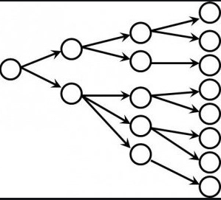
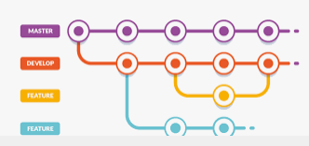
Branching
Branching is the way to work on different versions of a repository at one time.
Usually done to separate work of one person (or one team) from others
By default your repository has one branch named main which is considered to be the definitive branch. We use branches to experiment and make edits before committing them to

Slide 3
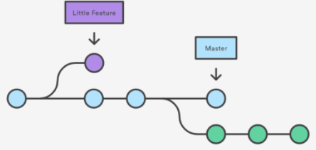
Branching
When you create a branch off the main branch, you’re making a copy or snapshot, of main as it was at that point in time
If someone else made changes to the main branch while you were working on your branch, you could pull in those updates
Branching helps us keep Main (master) branch cleaner

Slide 4
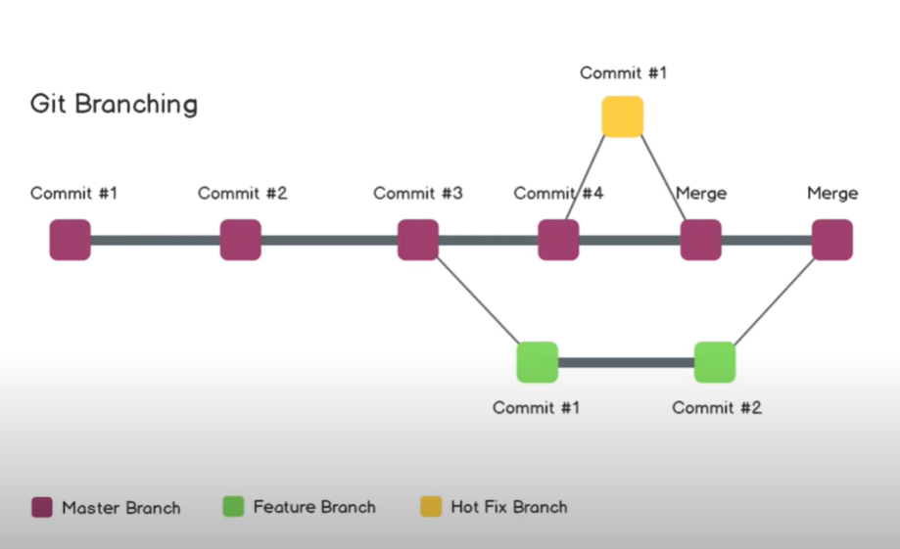
Merging
As branching is used to develop some functionality, we need some way to join that functionality to the rest of the code.
We do that using MERGE command

Slide 5
Practical usage
Make feature branches
Make change in the feature branch
After making sure it works properly merge it with Main (master) branch

Slide 6
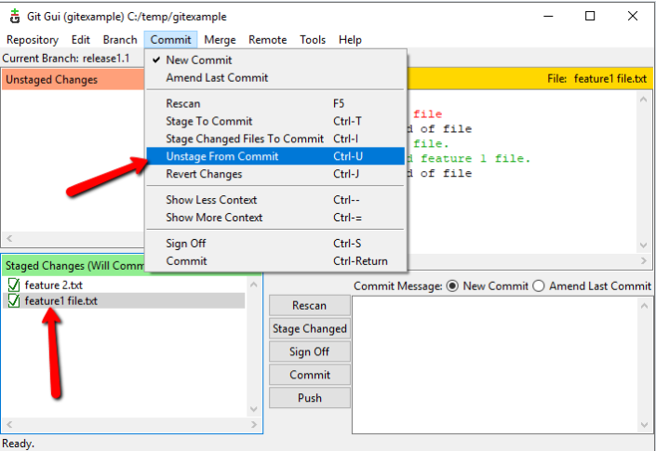
Undo staging
When we are not satisfied with change that we tracked or committed, we want to return our repository to previous state.
Unstaging –changes we previously made and added to staging, are now removed. State of code/documents are as before.

Slide 7
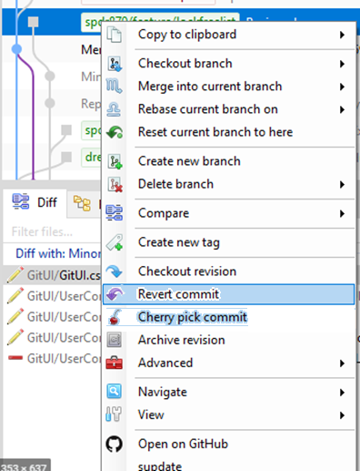
Undo commit
When we already committed change, but found out it is not ok and we want to undo it.
In different applications it is done in different way
Typically command is: Revert Commit
There are some advanced techniques that are
outside of the scope of this class that you will learn
when the time comes

Slide 8
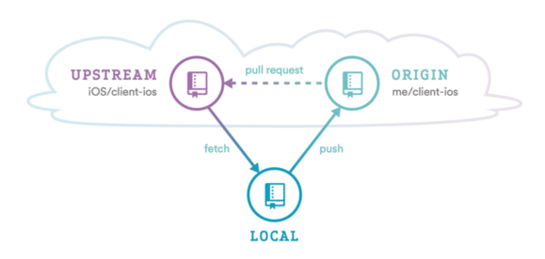
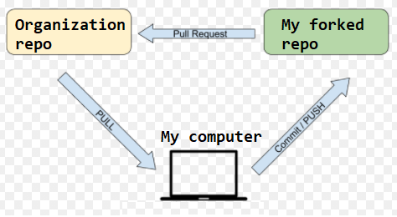
Fork (Advanced)
Making a full copy of repository
Why do we do it?
No need to do it if you are owner of the repository (since you already have full access to it)
But if I want to do something with other peoples’ repositories – when you don’t have rights to push code, then you must use it.
It is something like cloning repo on the server side

Slide 9
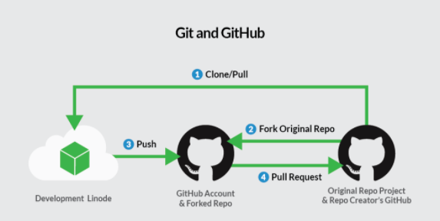
Fork (Advanced)
As result you make complete separate version of the project under your own “organization” (under your account). Now you have complete control over code/project, and can make as many changes as you wish.
This is used in real life, when there is copperation between two or more organizations.
If you separate repositories (original and forked one) you are separating the work of two (or more) organizations
And there are less potential problems about undesired changes

Slide 10
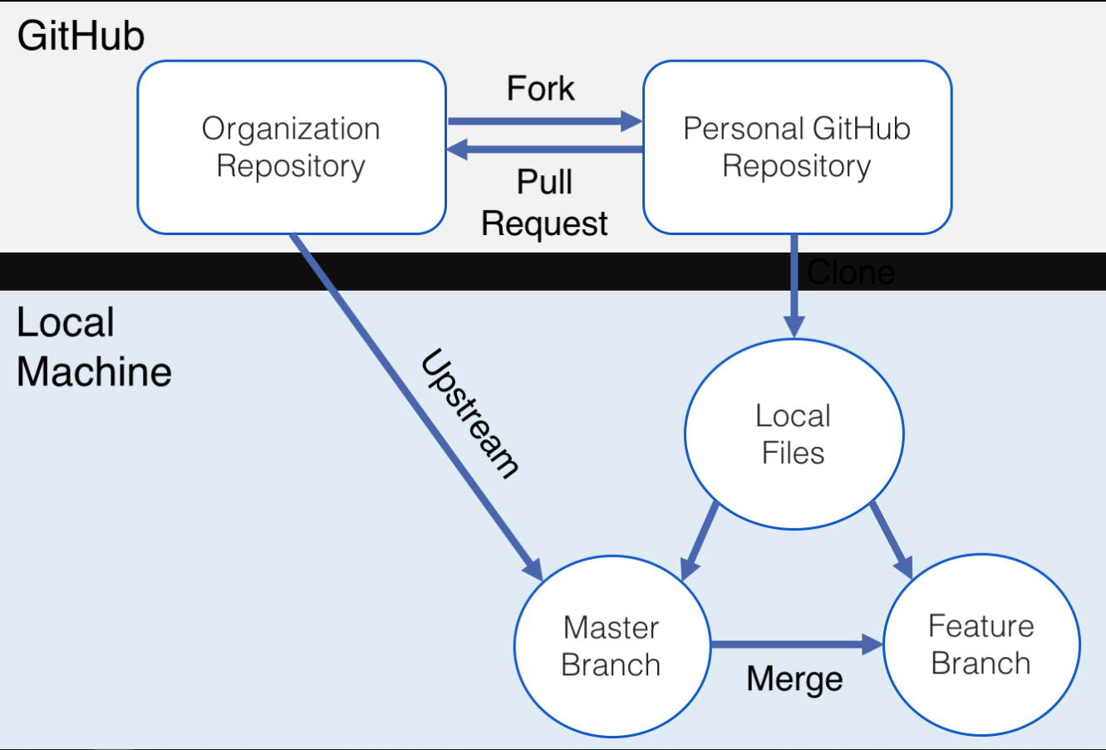
Fork (Advanced)
Identify an area in Organization’s repo that can be improved.
Fork that repo.
Make a clone of your fork on your local machine.
In that clone, make changes, run tests, create commits (possibly on a new branch), etc.
Optionally, once you're happy with your amendments to Organization’s code, make your work more presentable: tidy/squash your commits, write good commit messages that respect the style of Organization's repo. You may also want to rebase your branch to that of Organization’s branch, if Organization has pushed changes to repo since you forked it’s repo.
Push to your fork.
Issue a pull request to Organization, and wait for her to review it.
Push more commits to—and possibly rebase—your branch until Organization is satisfied with your work.
Organization merges your pull request; your work gets integrated into her GitHub repo. Champagne! Your work was not in vain.
To save space on GitHub's servers, and if you don't intend to contribute to Organization’s repo any time soon, you can safely delete your fork.

Slide 11
Further reading
See advanced commands such as:
Rebase
Stash
Cherry-picking
Read about other versioning tools such as:
SVN (TortoiseSVN)
TFS (Azure DevOps)
CVS

Slide 12
Practice
Feature 1 - Monster -> add properties: health, experience
Feature 2 - Hero –>
add properties: Damage, Experience, NewLevelExperience
add methods: Attack(Monster), Move(), LevelUp()
Merge
Feature 3 -- fixing bug from Hero LevelUp()
Merge

Slide 13
Homework
USE branch Hero_Properties
Add following properties to a hero:
string Name
string Class
List<string> skills
Array[string] killedMonsters
USE branch Hero_Methods
Add following methods:
UpdateSkill() - Add skill to the list – any string is ok ☺
UpdateKilledMonsters() - Add killed monster to the list
ShowSkill() - when called show all skills on the screen
ShowKilledMonsters() - when called show all killed monsters on the screen
ShowLevel() - show level of your hero (you may need to add property for level)
(remember sometimes you need to use arguments to provide names)

