Slide 1
C# practice and SQL clarifications

Slide 2
SQL clarifications
Why do we need it?
What have we learned so far?
Can we combine databases with applications
Any questions, further clarifications needed?

Slide 3
SQL Recapitulation
Creating/Deleting Database
Creating/Deleting Tables
CRUD operations
Where clause
Order by
Aggregation functions
Group by
JOINs

Slide 4
C# practice
What are classes
What are Interfaces
What are Abstract classes
What is private and what public
How to use functions

Slide 5

Let’s use Instagram db as an example

Slide 6
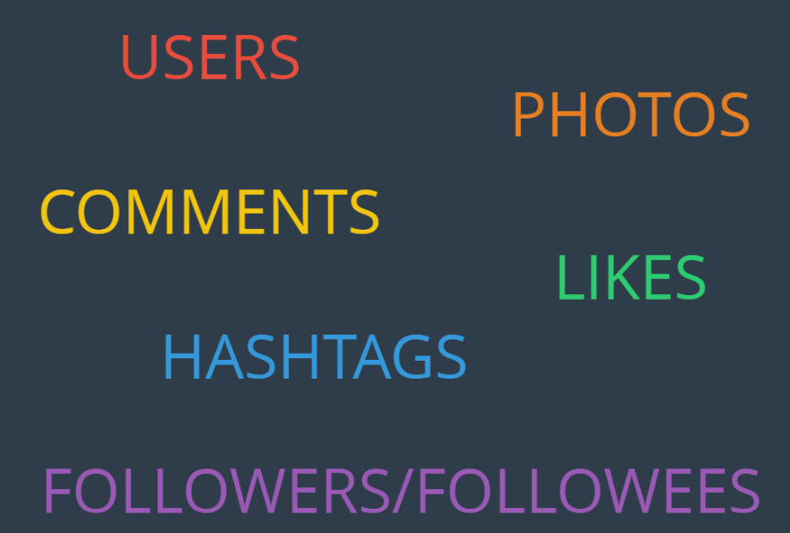
We had tables, now let’s create classes

Slide 7
Should Class be similar to table or not?
If we want to use data from database, we want to adapt our application code to be similar to that of the database
Here we create something that is called Model.
Why model?
Model is – the way it should look, the exact representation of something

Slide 8
Create classes
Let’s create classes one by one.
Let’s try to use some of the OOP principles
Remind yourself about OOP principles (encapsulation, abstraction, inheritance, polymorphism)
Each class should have some method to show on the screen details.
Have fun and experiment… this is all practice after all

Slide 9
Homework
Since there will be long period of no classes, I encourage you to experiment with C# code. Choose anything to experiment on
If no new ideas come to your mind, then try to make better that application about Hero.
Additionally, you can make the Car racing “black screen game” (each car can have speed and the fastest should win). To make things more interesting you can add effects, such as rain, snow, or road holes (where those fast cars will be slower than others) which can last very shortly.
Experimenting is good, you cannot break anything important. Just take care to commit and push only when your code works properly and you are satisfied with it.

