Slide 1
LINQ
Here comes Linq to help us out (or to make our lives more complicated)
Linq is set of commands that we use in C# and it looks somewhat similar to that from SQL.
Linq Tutorial is here: https://www.tutorialsteacher.com/linq/linq-tutorials
Linq is using some advanced techniques, so we will try to keep it as simple as possible
Remember it is just a tool that help us work faster

Slide 2
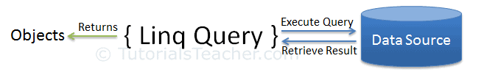
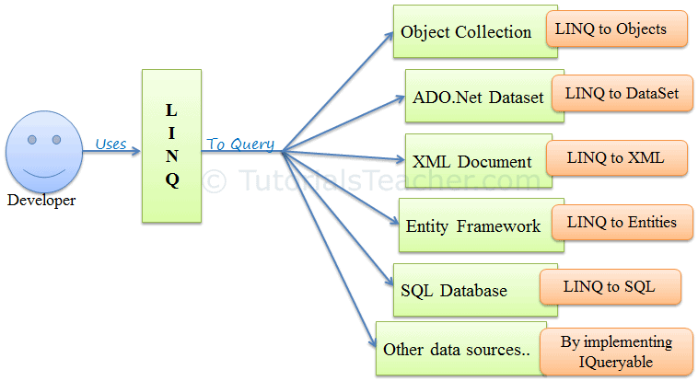
What is LINQ?
LINQ (Language Integrated Query) is uniform query syntax in C# and to retrieve data from different sources and formats.
It is integrated in C# thereby eliminating the mismatch between programming languages and databases, as well as providing a single querying interface for different types of data sources

Slide 3
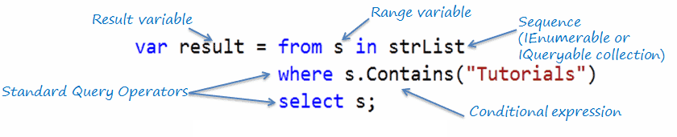

LINQ has two syntax types
Query Syntax or Query Expression Syntax
Method Syntax or Method Extension Syntax or Fluent

Slide 4
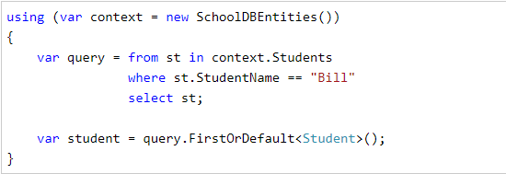
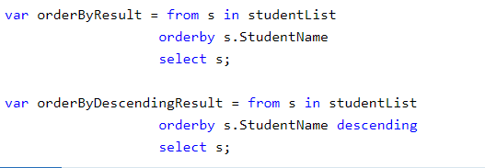
LINQ Query syntax
Here is the way to use it – notice it reminds of SQL query

Slide 5
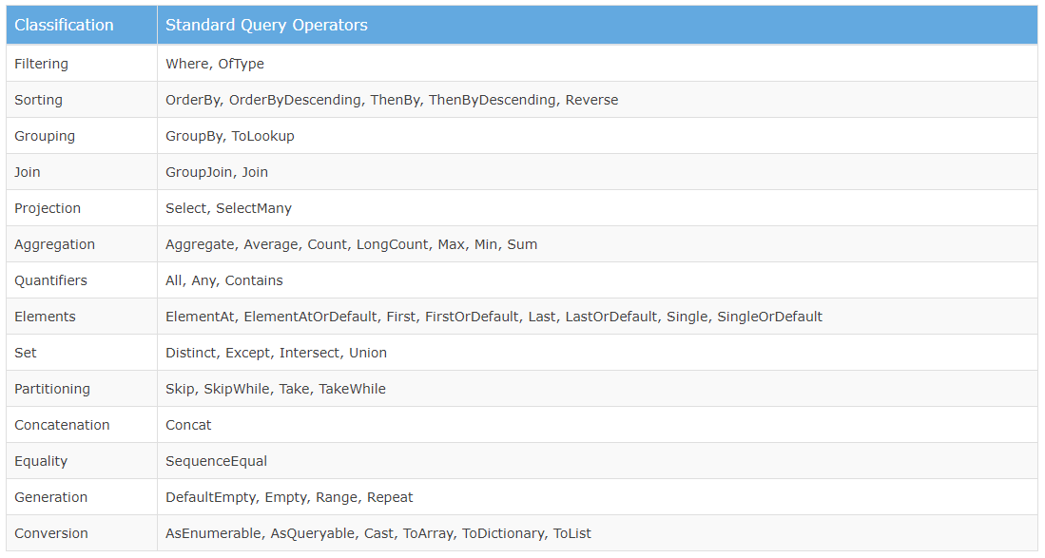
Linq Query operators

Slide 6
Use LINQ
Let’s try to use Linq Query syntax to rewrite code for all the button logic.
Remember – linq QUERY is somewhat similar to SQL query language
(here are the sample queries)

Slide 7
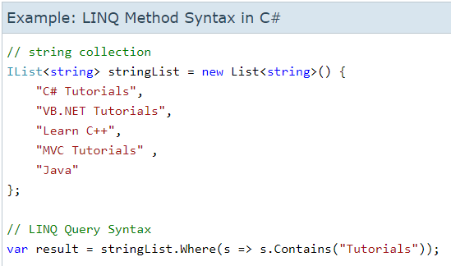
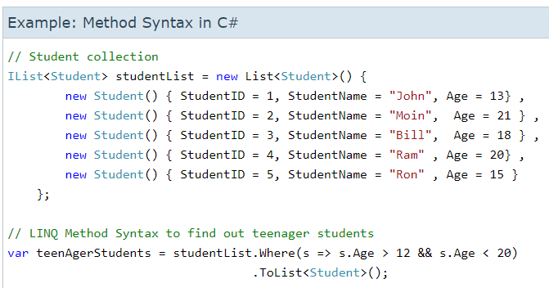
LINQ Method Syntax

Slide 8
Lambda expression (advanced topic)
To fully understand Lambda expression we need to go long way in understanding something called Delegates. Since that is outside of the scope for this course, we will just take it for granted and use lambda expression without much explaination.
Here is the further reading if you are interested, but beware it is not easy to understand (since we didn’t even mention delegates so far): https://www.tutorialsteacher.com/linq/linq-lambda-expression

Slide 9
Use LINQ
Let’s try to use Linq Method syntax to rewrite code for all the button logic.
Remember – linq METHOD uses:
Extension method (what )
Lambda expression (where we set the rules what to return back)

