Slide 1
Connecting to Database from C# application

Slide 2
Connecting to DB, why?
Accessing Data from a database is one of the important aspects of any programming language.
It is an absolute necessity for any programming language to have the ability to work with databases
C# and .Net can work with a majority of databases, the logic behind working with all of them is mostly the same

Slide 3
What do we do with the DB?
Connection
Create - Inserting data into the database
Read - Selecting data from the database
Updating data into the database
Deleting data from a database
Remember: create, read, update, delete = CRUD

Slide 4
Connection
To work with the data in a database, the first obvious step is the connection. The connection to a database normally consists of the below-mentioned parameters.
Database name or Data Source – The first important parameter is the database name to which the connection needs to be established. Each connection can only work with one database at a time.
Credentials – The next important aspect is the username and password which needs to be used to establish a connection to the database. It ensures that the username and password have the necessary privileges to connect to the database.
Optional parameters - For each database type, you can specify optional parameters to provide more information on how .net should handle the connection to the database. For example, one can specify a parameter for how long the connection should stay active. If no operation is performed for a specific period of time, then the parameter would determine if the connection has to be closed.

Slide 5
CRUD with database
Selecting data from the database – Once the connection has been established, the next important aspect is to fetch the data from the database. C# can execute 'SQL' select command against the database. The 'SQL' statement can be used to fetch data from a specific table in the database.
Inserting data into the database – C# can also be used to insert records into the database. Values can be specified in C# for each row that needs to be inserted into the database.
Updating data into the database – C# can also be used to update existing records into the database. New values can be specified in C# for each row that needs to be updated into the database.
Deleting data from a database – C# can also be used to delete records into the database. Select commands to specify which rows need to be deleted can be specified in C#.

Slide 6

So, how to connect?
In our example, we will connect to a DB which named as Demodb
First we will create that database in SQL Server Management Studio
We just need to remember that we are using Windows Authentication to establish connection to db through SSMS
Then we will open the Visual Studio and follow the steps

Slide 7
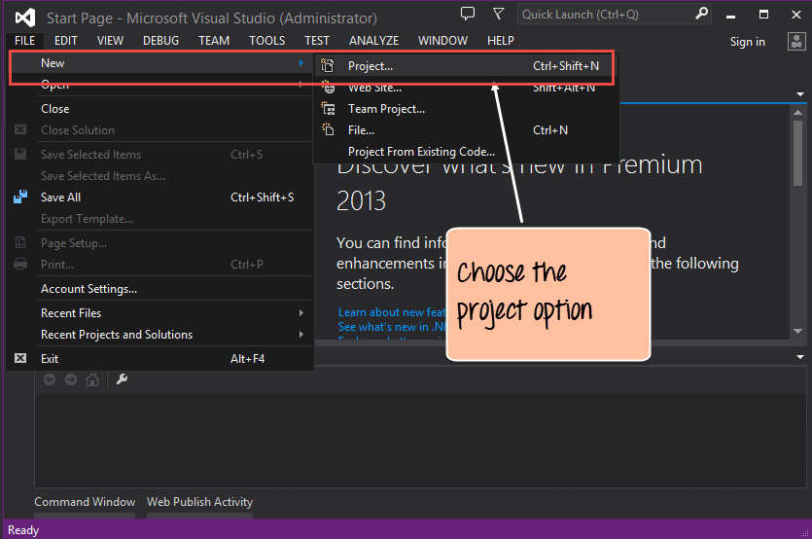
Creating new project
Step 1) The first step involves the creation of a new project in Visual Studio. After launching Visual Studio, you need to choose the menu option New->Project.

Slide 8
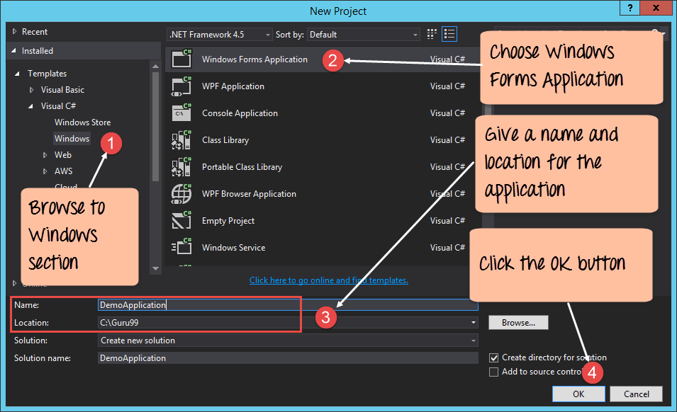
Still creating new project
Step 2) The next step is to choose the project type as a Windows Forms application. Here, we also need to mention the name and location of our project. Choose (.Net Framework), not (.Net Core)

Slide 9
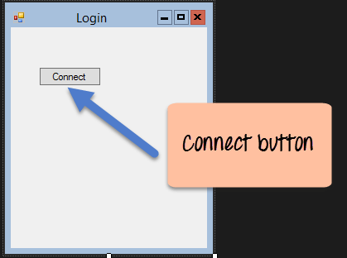
Adding Connect button
Step 3) Now add a button from the toolbox to the Windows form. Put the text property of the Button as Connect. This is how it will look like

Slide 10
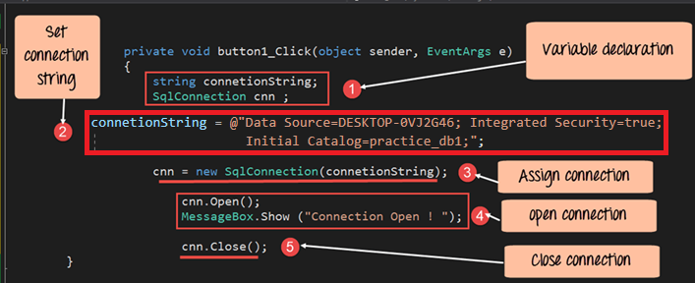
Adding logic to Connect Button
Step 4) Now double click the form so that an event handler is added to the code for the button click event. In the event handler, add the below code.

Slide 11
Code for the Button looks like this
Private void button1_Click(object sender, EventArgs e)
{
string connetionString;
SqlConnection cnn;
connetionString = @"Data Source=DESKTOP-0VJ2G46; Integrated Security=true;
Initial Catalog=practice_db1;";
cnn = new SqlConnection(connetionString);
cnn.Open();
MessageBox.Show("Connection Open !");
cnn.Close();
}

Slide 12
Connection string
Before going anywhere further: Connection string is simple words – something you will hate very much.
Actually it contains all the needed information to connect your app to a database
Connection string is different in different setups:
You can have SQL Server installed on your computer, and you connect as Windows User (as we do now)
You can have SQL Server installed on your computer, and you connect with specific Username and Password
You can have SQL Server installed on some other computer (server), and you connect using specific Username and Password
Here is the website that could be of great help for setting up connection string: https://www.connectionstrings.com/

Slide 13
Explanation of the code
The first step is to create variables, which will be used to create the connection string and the connection to the SQL Server database.
The next step is to create the connection string. The connecting string needs to be specified correctly for C# to understand the connection string. The connection string consists of the following parts
Data Source – This is the name of the server on which the database resides. In our case, it is on our computer, where we have SQL Server running with special name (compare SQL Server name with your computer name).
Integrated Security – We are using Windows username and password, so no need to provide them in the connection string
The Initial Catalog is used to specify the name of the database
Next, we assign the connecting string to the variable cnn. The variable cnn, which is of type SqlConnection is used to establish the connection to the database.
Next, we use the Open method of the cnn variable to open a connection to the database. We then just display a message to the user that the connection is established.
Once the operation is completed successfully, we then close the connection to the database. It is always a good practice to close the connection to the database if nothing else is required to be done on the database.

Slide 14
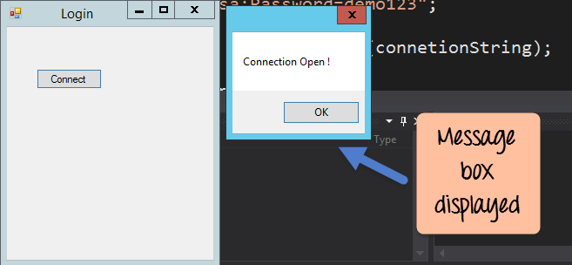
Result

Slide 15
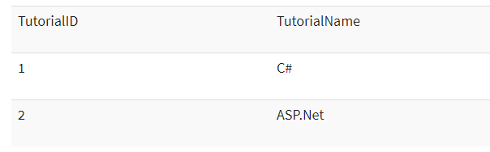
Access data with the SqlDataReader
So we are connected – now let’s read some data
First we need to insert something:
A table called demotb. This table will be used to store the ID and names of various Tutorials.
The table will have 2 columns, one called "TutorialID" and the other called "TutorialName."
For the moment, the table will have 2 rows as shown below.

Slide 16
Making code read our data
Let's change the code in our form, so that we can query for this data and display the information via a Messagebox. Note that all the code entered below is a continuation of the code written for the data connection in the previous section.
Step 1) Let's split the code into 2 parts so that it will be easy to understand for the user.
The first will be to construct our "select" statement, which will be used to read the data from the database.
We will then execute the "select" statement against the database and fetch all the table rows accordingly.

Slide 17
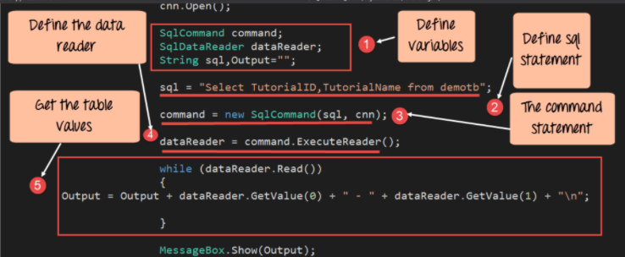
Step 1 - Code to be added

Slide 18
Step 1 - Code Explanation
The first step is to create the following variables
SQLCommand – The 'SQLCommand' is a class defined within C#. This class is used to perform operations of reading and writing into the database. Hence, the first step is to make sure that we create a variable type of this class. This variable will then be used in subsequent steps of reading data from our database.
The DataReader object is used to get all the data specified by the SQL query. We can then read all the table rows one by one using the data reader.
We then define 2 string variables, one is "SQL" to hold our SQL command string. The next is the "Output" which will contain all the table values.
The next step is to define the SQL statement, which will be used against our database. In our case, it is "Select TutorialID, TutorialName from demotb". This will fetch all the rows from the table demotb.
Next, we create the command object which is used to execute the SQL statement against the database. In the SQL command, you have to pass the connection object and the SQL string.
Next, we will execute the data reader command, which will fetch all the rows from the demotb table.
Now that we have all the rows of the table with us, we need a mechanism to access the row one by one. For this, we will use the while statement. The while statement will be used to access the rows from the data reader one at a time. We then use the GetValue method to get the value of TutorialID and TutorialName.

Slide 19
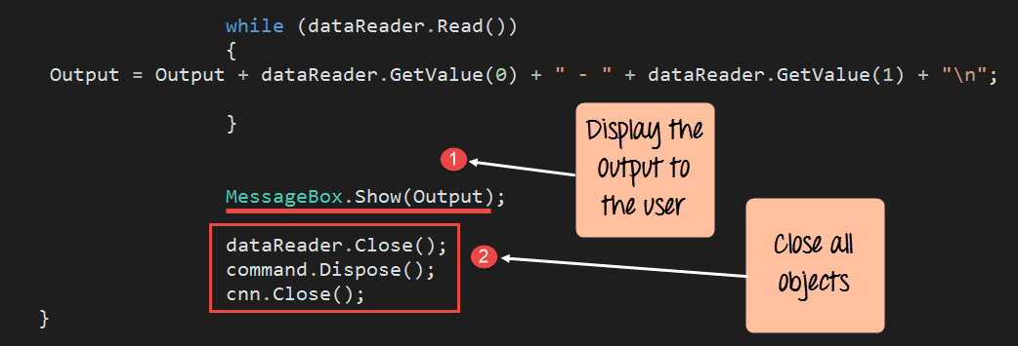
Step 2 – Code to be added
Step 2) In the final step, we will just display the output to the user and close all the objects related to the database operation.

Slide 20
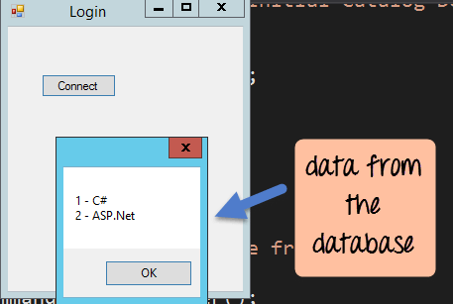
Step 2 - Code Explanation
We will continue our code by displaying the value of the Output variable using the MessageBox. The Output variable will contain all the values from the demotb table.
We finally close all the objects related to our database operation. Remember this is always a good practice.
When the above code is set, and the project is run using Visual Studio, you will get the below output. Once the form is displayed, click the Connect button.

Slide 21
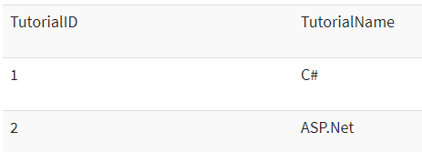
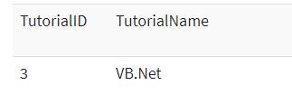
Inserting into DB
Just like Accessing data, C# has the ability to insert records into the database as well. To showcase how to insert records into our database, let's take the same table structure which was used above.
Let's change the code in our form, so that we can insert the following row into the table

Slide 22
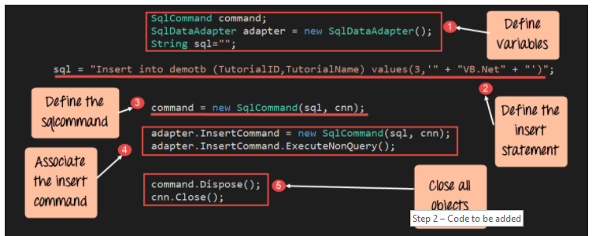
Inserting into DB - code

Slide 23
Insert - Code Explanation – part1
The first step is to create the following variables
SQLCommand – This data type is used to define objects which are used to perform SQL operations against a database. This object will hold the SQL command which will run against our SQL Server database.
The DataAdapter object is used to perform specific SQL operations such as insert, delete and update commands.
We then define a string variable, which is "SQL" to hold our SQL command string.
The next step is to actually define the SQL statement which will be used against our database. In our case, we are issuing an insert statement, which will insert the record of TutorialID=1 and TutorialName=VB.Net
Next, we create the command object which is used to execute the SQL statement against the database. In the SQL command, you have to pass the connection object and the SQL string

Slide 24
Insert- Code Explanation – part2
In our data adapter command, we now associate the insert SQL command to our adapter. We also then issue the ExecuteNonQuery method which is used to execute the Insert statement against our database. The 'ExecuteNonQuery' method is used in C# to issue any DML statements against the database. By DML statements, we mean the insert, delete, and update operation. In C# , if you want to issue any of these statements against a table, you need to use the ExecuteNonQuery method.
We finally close all the objects related to our database operation. Remember this is always a good practice.

Slide 25
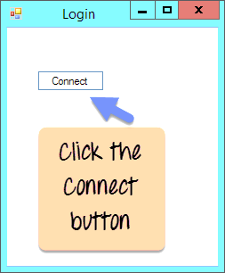
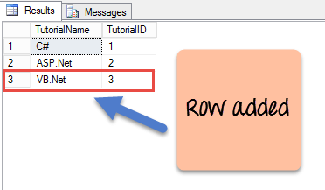
Inserting
Now as result – when Connect button is clicked we insert new data:

Slide 26
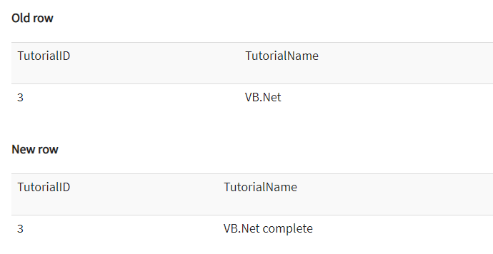
Update data:
Let’s update the data accordingly:

Slide 27
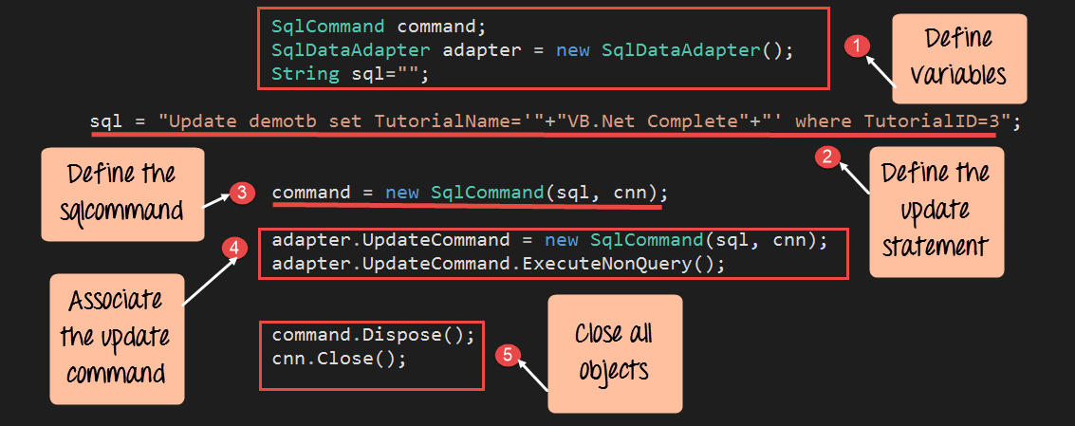
Update - Code to be added

Slide 28
Update - Code Explanation
The first step is to create the following variables
SQLCommand – This data type is used to define objects which are used to perform SQL operations against a database. This object will hold the SQL command which will run against our SQL Server database.
The dataadapter object is used to perform specific SQL operations such as insert, delete and update commands.
We then define a string variable, which is SQL to hold our SQL command string.
The next step is to define the SQL statement which will be used against our database. In our case we are issuing an update statement, this will update the Tutorial name to "VB.Net Complete" while the TutorialID is unchanged and kept as 3.
Next, we will create the command object, which is used to execute the SQL statement against the database. In the SQL command, you have passed the connection object and the SQL string.
In our data adapter command, we now associate the insert SQL command to our adapter. We also then issue the ExecuteNonQuery method which is used to execute the Update statement against our database.
We finally close all the objects related to our database operation. Remember this is always a good practice.
When the above code is set, and the project is executed using Visual Studio, you will get the below output. Once the form is displayed, click the Connect button.

Slide 29
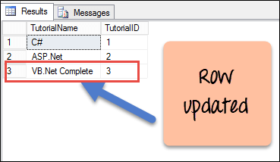
Update - result
As result we get data to change:

Slide 30
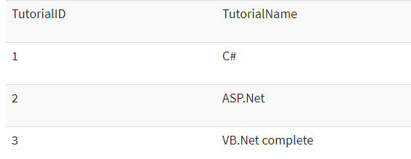
Deleting
Just like Accessing data, C# has the ability to delete existing records from the database as well. To showcase how to delete records into our database, let's take the same table structure which was used above.
Let’s delete this row

Slide 31
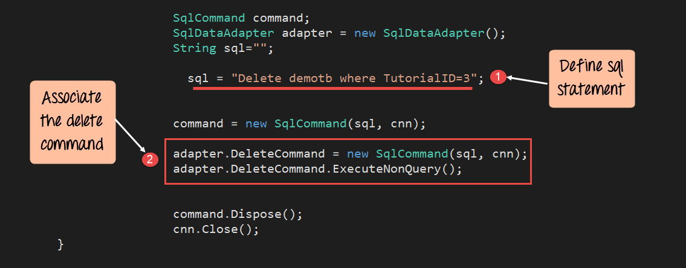
Delete – Code to be added

Slide 32
Delete - Code Explanation
The Key difference in this code is that we are now issuing the delete SQL statement. The delete statement is used to delete the row in the demotb table in which the TutorialID has a value of 3.
In our data adapter command, we now associate the insert SQL command to our adapter. We also then issue the ExecuteNonQuery method which is used to execute the Delete statement against our database.
When the above code is set, and the project is executed using Visual Studio, you will get the below output. Once the form is displayed, click the Connect button.

Slide 33
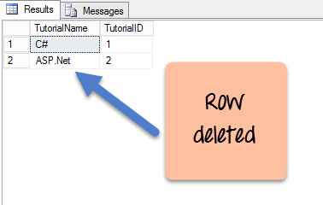
Delete - Result
We get the table with one row removed from it

Slide 34
Now let’s do some practice
Use same database, just add new table: person
Table person has columns Name and Surname
Make new Form Application with buttons:
Connect
ReadData
UpdateData
InsertData
DeleteData
Make it similar as example in previous slides.
For homework: Let’s use new database Demodb2. Make table: student
Student will have columns: name, school, grade.
Do similar logic as for the previous examples: Adding buttons and allowing CRUD operations

Slide 35
That would be all for the first App + DB class
We managed to:
Create database with one table, with some data in it
We created application that could connect to that Database
We managed to do CRUD operations for the person

