Slide 1
Javascript Fundamentals – week 20

Slide 2
Introduction
We will use Browser developer tools – ex. Google Chrome
We will use some text editor for development – ex. Visual Studio Code

Slide 3
Hello World
First command we will learn:
Alert(“hello world”)
We can use the Browser Tools and execute this command under the Console section.
Let’s see some more things:
1 + 1
if(1+1 === 2) alert(“it is 2”)
let a = 1; 1 + a

Slide 4
What is Javascript
Programming language that looks like it is object-oriented language, but it is not. It is high-level, because you do not worry about memory management

Slide 5
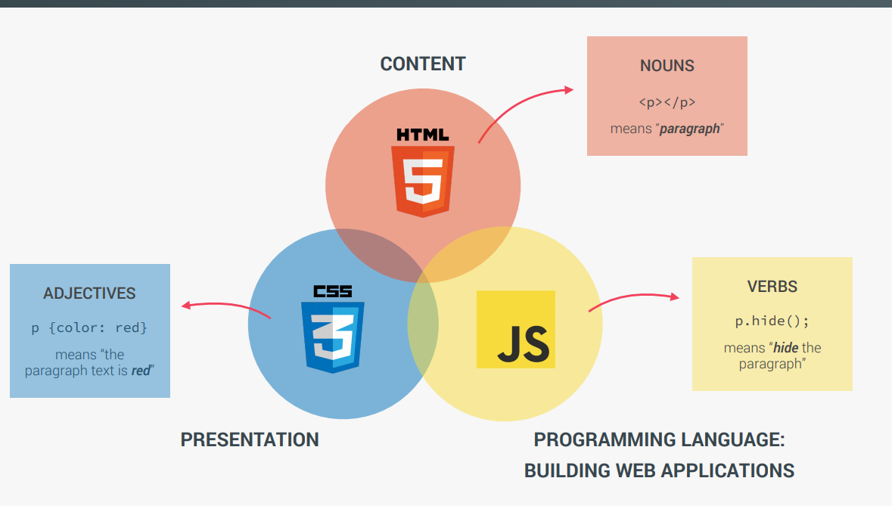
Javascript with HTML and CSS

Slide 6
JS usage (from user perspective)
Let’s see how JS could be put to some cool use:
https://bitetoothpastebits.com/
https://delassus.com/en/
https://2018.craftedbygc.com/#enter
https://longshotfeatures.com/
https://bitetoothpastebits.com/

Slide 7
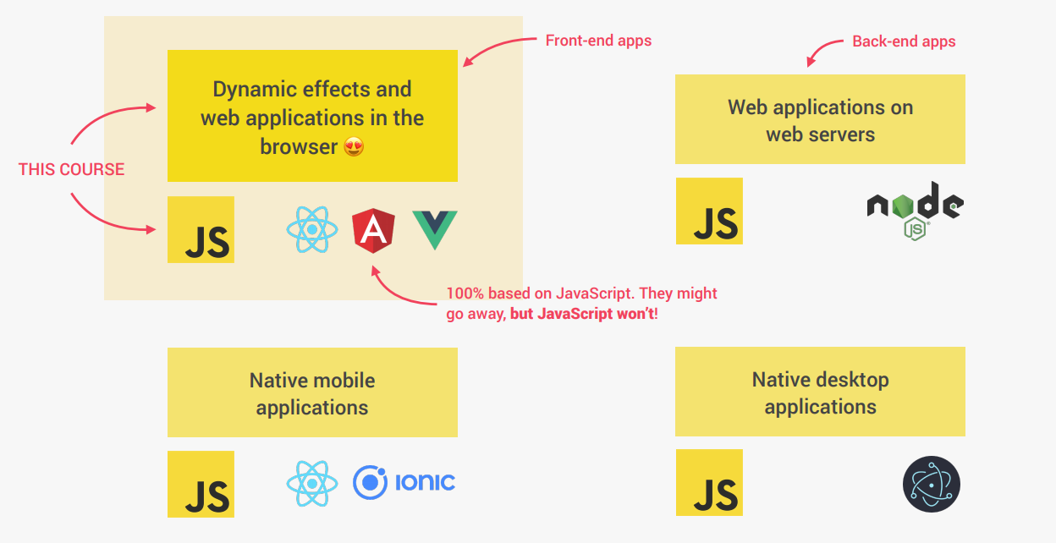
JS usage (from developer perspective)

Slide 8
Let’s download teaching material
It will be used throughout the whole course
It is organized by sections, and each has the starter version, and the finishing version
We will open started and make sure we make changes to it to be as similar as possible to the finishing one.

Slide 9
Alert and Console
Alert(“some text”) – as you have previously seen is showing the pop-up screen. This is somehow similar to that messageBox in C#
Console.log(“some text”) – writes the information in the browser. You can see it through the Browser tools

Slide 10
Let’s add some math javascript code to html
You can add this to your code:
<script>
40+10-15
</script>
If we see – nothing happens to the browser, at least we cannot see it
If you check the Console – nothing is there
So to be able to see it, you need to add Console.log()
<script>
Console.log(40+10-15)
</script>
When we are in the Console, we don’t need this Console.log, but when we are not (and in most cases we will not be), then we need to use Console.log().

Slide 11

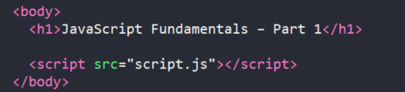
Now get JS code outside of the html
Let’s move the js code in a separate file:
and link the file to the html (usually goes at the end of body section):
If you don’t link js file to the html, you will have no script running! Nothing will happen!

Slide 12
Values and variables
Value:
23
“Jonas”
Variable
Let some_number = 27
Let firstname = “Matilda”
Value can be used only once, while variable stores the value in memory and can be reused.
If for example the value in variable firstname is replaced, the new value will be shown when using Console.log(firstname)

Slide 13
Naming of the variables
Name cannot start with numbers: 3doors = 3
We cannot use special characters: one&two = “great”
Cannot name it using reserved words: new = “great”
This one could be used, but better not to, since it can cause some unexpected troubles: name = “Mike”
We should use Camel case:
firstSecondThird = “asdadada”
Note: Here similar rules apply to the C#. However, there will be details to discuss about when we start using functions.

Slide 14
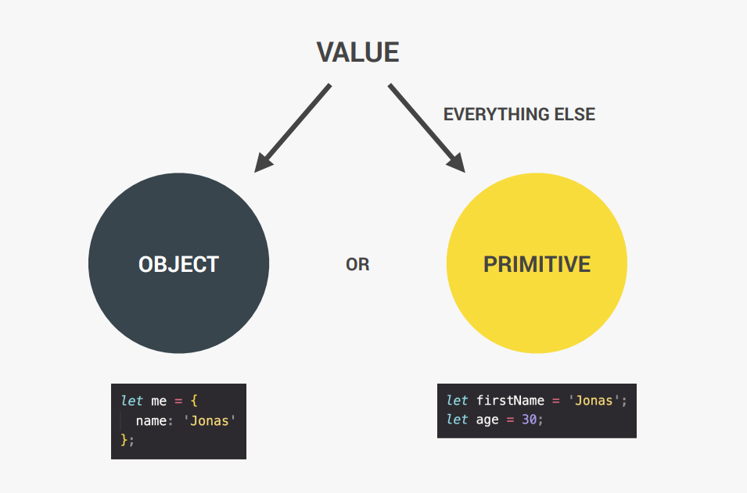
Value in JS

Slide 15
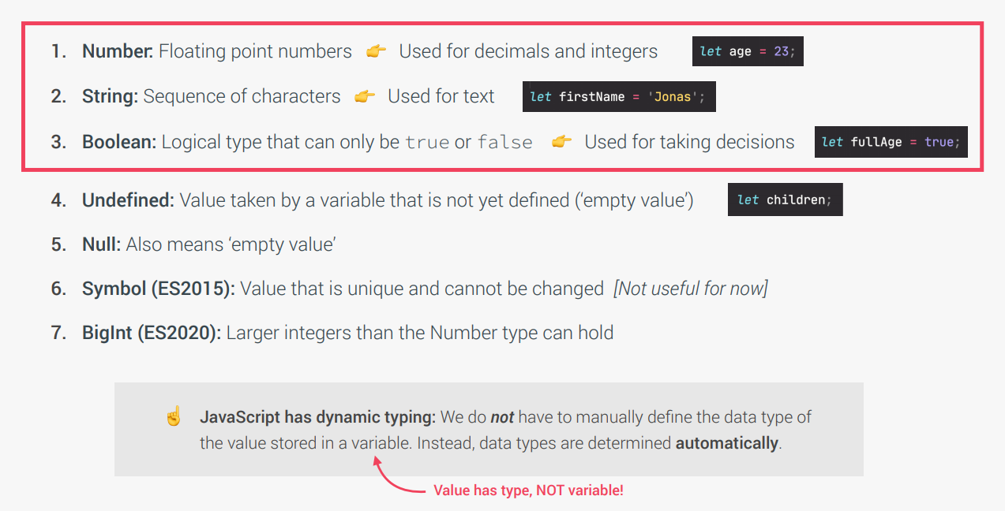
Primitive Values

Slide 16
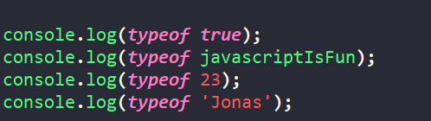
typeOf
This is very useful command that can help us get the datatype of some data:

Slide 17
Declaring variables
Three ways:
let
var
const
Variable declared with Let could be changed later in our program.
Const (constant – non changable) – cannot be changed – it will show an error
Var variable – if we compare it with let – it looks the same, but behind the scene it is different, which is a bit advanced topic

Slide 18
Operators
We can use math operators +,-,*,/
We can use similar rule like in the C++/C#:
X += 10; X -= 10; X *= 10; X /= 10;
X++; X--;
We can do the concatenation of the string using +
Console.log(‘firstname’ + ‘ ’ +‘lastname’)
There are the similar comparison operators:
>, <, >=, <=,

Slide 19
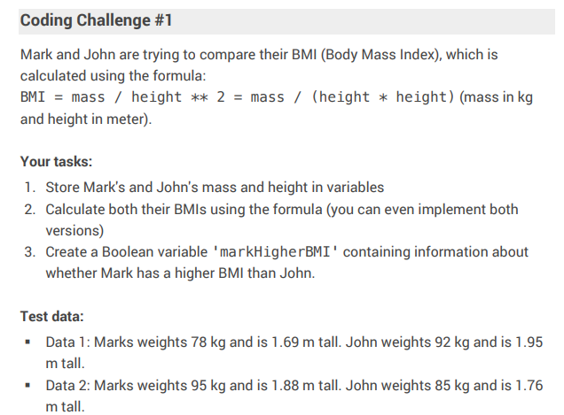

Slide 20
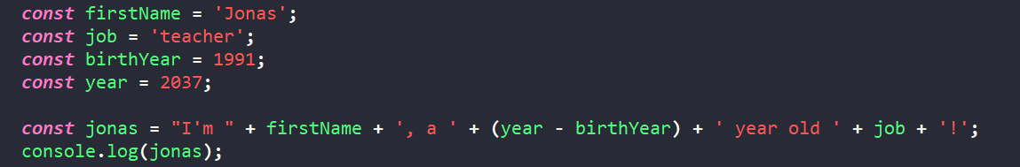
Strings
We can use strings like this:
However, there is another way to make a string – if you want it to use some special format, such as jonas
We can make the string template, by using this ` (this is not ‘ or “ ), and it can be found above TAB button:

Slide 21


String
The previously mentioned symbol ` could be used with regular string, without any input parameters:
It allows multiline string too. So instead of this
we can use this:

Slide 22
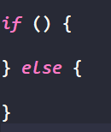
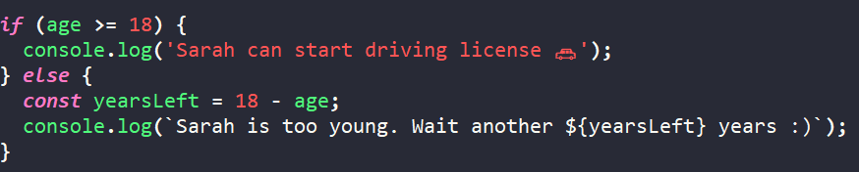
If - Else
Similar to the C++ or C#:
Pay attention on how we use the {} . It is just convention to use it like this in JS. You can freely move { to the next line, but remember – almost everyone is writing it in this way. An example:

Slide 23
