Slide 1
One to many Relations and joins

Slide 2
Short note
So far, we had very simple job:
Everything was in just one table
We could do CRUD using only single table
Select was rather easy – you don’t worry about data, since all is in single table
Since we are learning how real database should look like, things are about to change:
They will become more complex
But they will show how it actually works

Slide 3
Books again
When we make the database we want to make somewhat representation of what we have in the real world.
Before we used table books, which contained all necessary data
What we didn’t pay attention on – is that Books could have different versions:
Same book can be in versions 1,2,3 …

Slide 4
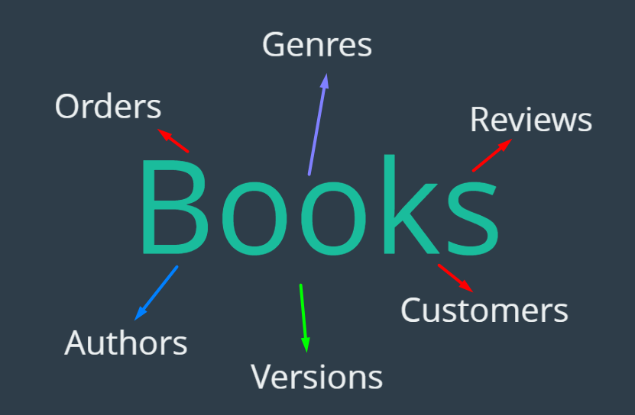
Books again
Sometimes book can have more than one Author
Then we might want to sell book to someone
When customer wants to buy a book he/she needs
to order it
Books might have more descriptions – such as genre
Then if bought we can see if customers
are satisfied – they give reviews
RED color tables – are somehow related to each other. Customer orders, and Customer does the Review

Slide 5
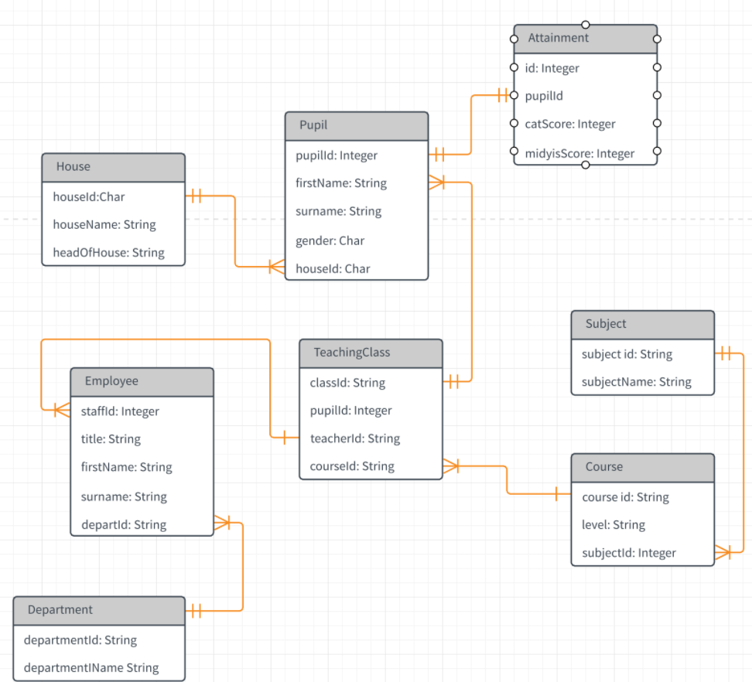
Remember relations between tables
This is typical relational database. Now we know what we can do with one table. So we need to learn how to use multiple.

Slide 6

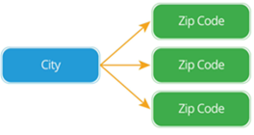
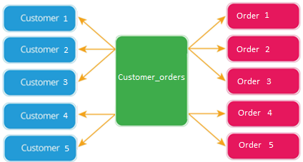
Types of Relations
One to One Relationship
One to Many Relationship
Many to Many Relationship

Slide 7

One to many
CUSTOMERS & ORDERS:
Let’s make it simple
Which columns customers should have?
A customer's first and last name
A customer's email
Which columns orders should have?
The date of the purchase
The price of the order

Slide 8
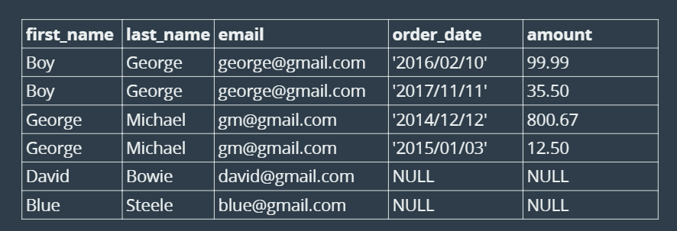
Let’s continue
We could just add all in one table. It would look like this:

Slide 9
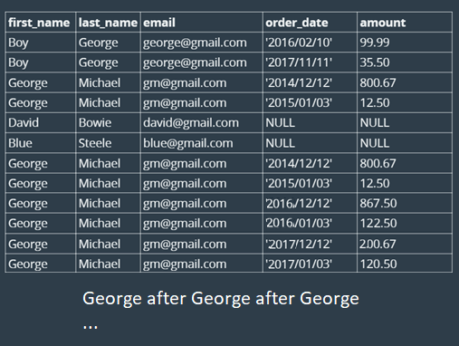
That is not good idea
Why?
What happens when George orders
many times?
Do we really need to add his email
each time?
What if we just replaced name with some id? How would we get the first name/last name in this case?
How about we put first name, last name and email in the new table

Slide 10
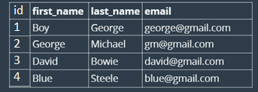
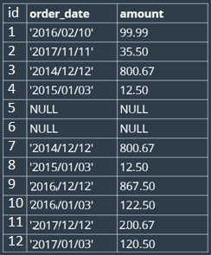
Separating table?
Now we separated these two tables, but how to connect them?
Customers Orders

Slide 11
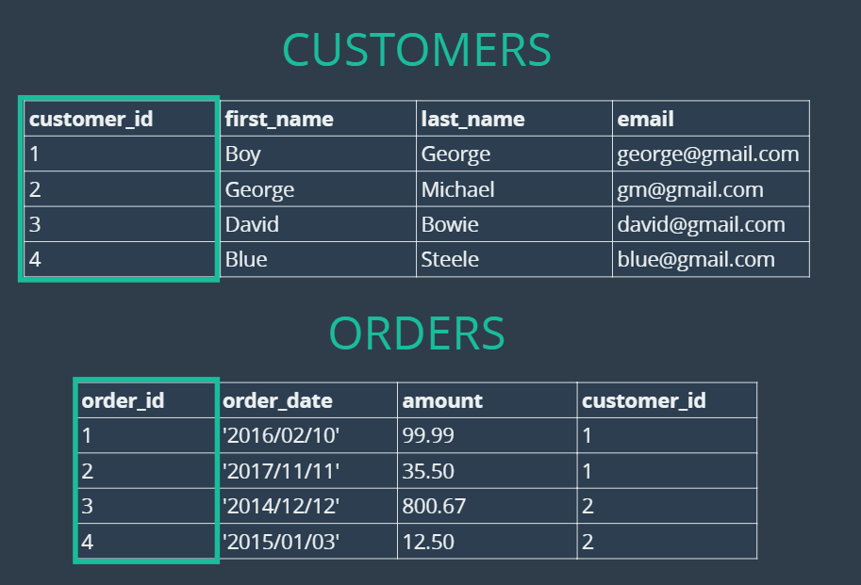
Primary keys

Slide 12
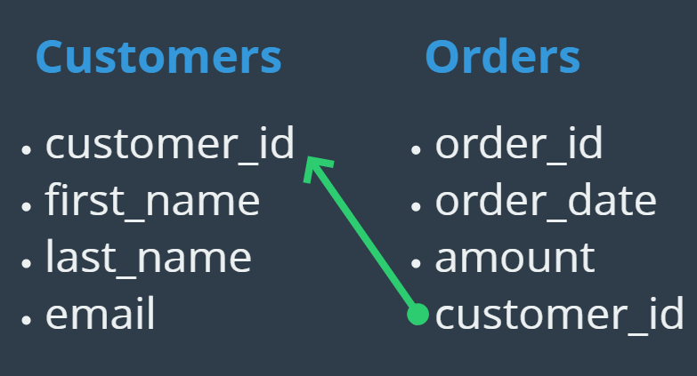
Foreign key
Each table must have a Primary key
That is something we already have seen
However, if we want to relate one table to another, we need to use same id’s, hence the Foreign key.

Slide 13
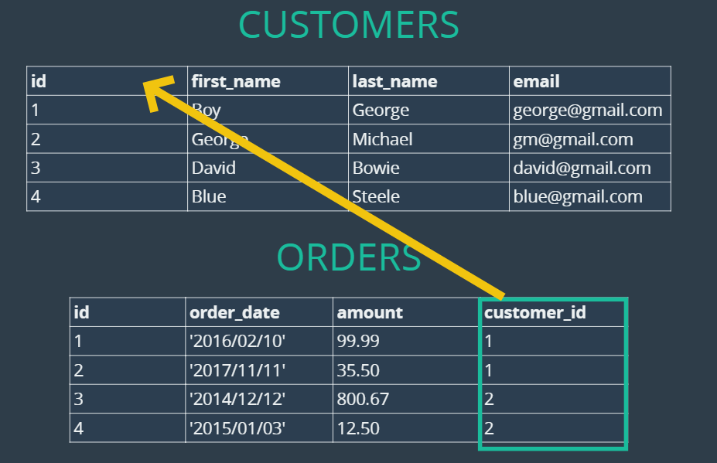
Foreign key

Slide 14
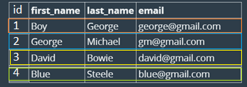
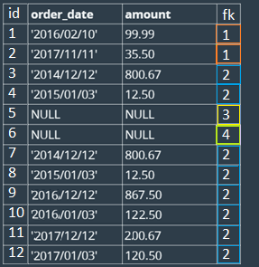
Foreign key
See the Foreign key of Orders how it connects to Customers
Customers Orders

Slide 15
Now let’s create tables
CREATE TABLE customers(
id INT IDENTITY PRIMARY KEY,
first_name VARCHAR(100),
last_name VARCHAR(100),
email VARCHAR(100)
);
CREATE TABLE orders(
id INT IDENTITY PRIMARY KEY,
order_date DATE,
amount DECIMAL(8,2),
customer_id INT,
FOREIGN KEY(customer_id) REFERENCES customers(id)
);

Slide 16
Inserting data
INSERT INTO customers (first_name, last_name, email)
VALUES ('Boy', 'George', 'george@gmail.com'),
('George', 'Michael', 'gm@gmail.com'),
('David', 'Bowie', 'david@gmail.com'),
('Blue', 'Steele', 'blue@gmail.com'),
('Bette', 'Davis', 'bette@aol.com’);
INSERT INTO orders (order_date, amount, customer_id)
VALUES ('2016/02/10', 99.99, 1),
('2017/11/11', 35.50, 1),
('2014/12/12', 800.67, 2),
('2015/01/03', 12.50, 2),
('1999/04/11', 450.25, 5);

Slide 17
Try inserting
Now try inserting customer_id that does not exist:
INSERT INTO orders (order_date, amount, customer_id)
VALUES ('2016/06/06', 33.67, 98);

Slide 18
Let’s try to see data from two tables
-- Finding Orders Placed By George: 2 Step Process
SELECT id FROM customers WHERE last_name='George';
SELECT * FROM orders WHERE customer_id = 1;
-- Finding Orders Placed By George: Using a subquery
SELECT * FROM orders WHERE customer_id =
(
SELECT id FROM customers
WHERE last_name='George'
);
-- Cross Join Craziness
SELECT * FROM customers, orders;

Slide 19
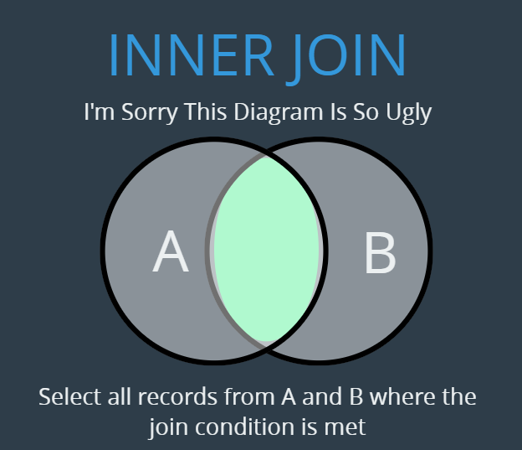
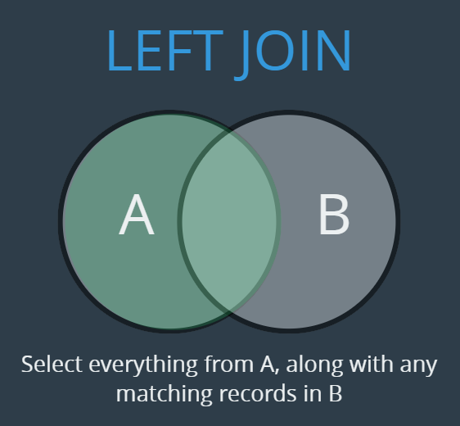
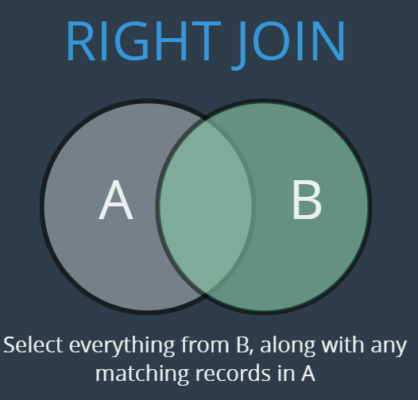
The better way - JOINS
We have 3 types:
INNER JOIN
LEFT JOIN
RIGHT JOIN

Slide 20

Inner Join
Let’s see how INNER JOIN WORK:
https://dataschool.com/how-to-teach-people-sql/inner-join-animated/
-- IMPLICIT INNER JOIN
SELECT * FROM customers, orders
WHERE customers.id = orders.customer_id;
-- IMPLICIT INNER JOIN
SELECT first_name, last_name, order_date, amount
FROM customers, orders
WHERE customers.id = orders.customer_id;

Slide 21
Inner Join
-- EXPLICIT INNER JOINS
SELECT * FROM customers
INNER JOIN orders
ON customers.id = orders.customer_id;
SELECT first_name, last_name, order_date, amount
FROM customers
INNER JOIN orders
ON customers.id = orders.customer_id;
SELECT *
FROM orders
INNER JOIN customers
ON customers.id = orders.customer_id;

Slide 22
Inner Join
-- Now let’s show how much each of the customers has spent on each order. Then show data ordered from biggest to smallest expense
SELECT
customers.id as customer_id,
SUM(amount) AS total_spent
FROM customers
INNER JOIN orders
ON customers.id = orders.customer_id
GROUP BY customers.id
ORDER BY total_spent DESC;
-- We will join two tables, and then order them by date when customer ordered product
SELECT first_name, last_name, order_date, amount
FROM customers
INNER JOIN orders
ON customers.id = orders.customer_id
ORDER BY order_date;

Slide 23

Left Join
Let see for more details here:
https://dataschool.com/how-to-teach-people-sql/left-right-join-animated/
SELECT * FROM customers
LEFT JOIN orders
ON customers.id = orders.customer_id;
SELECT first_name, last_name, order_date, amount
FROM customers
LEFT JOIN orders
ON customers.id = orders.customer_id;
-- Show All customers and sum of their orders
SELECT
customer_id,
SUM(amount) AS total_spent
FROM customers
LEFT JOIN orders
ON customers.id = orders.customer_id
GROUP BY orders.customer_id
ORDER BY total_spent DESC;

Slide 24
Left Join
-- Now let’s do similar thing – just replace those NULLs with 0 and show full name
SELECT
CONCAT(first_name, ' ',last_name),
ISNULL(SUM(amount), 0) AS total_spent
FROM customers
LEFT JOIN orders
ON customers.id = orders.customer_id
GROUP BY customers.id, customers.last_name, customers.first_name
ORDER BY total_spent;

Slide 25
Right Join
Here is more info about it:
https://dataschool.com/how-to-teach-people-sql/left-right-join-animated/
-- OUR FIRST RIGHT JOIN (seems the same as a left join?)
SELECT * FROM customers RIGHT JOIN orders ON customers.id = orders.customer_id;
Note because of our Foreign key in Order table, we cannot combine

Slide 26
Again: Inner, Left or Right join
Inner join – Return only data that matches join condition in both tables
Left join – Return all data from first table and only those that match it from the second table
Right join – Return all data from right table and only those that match it from the first table

Slide 27
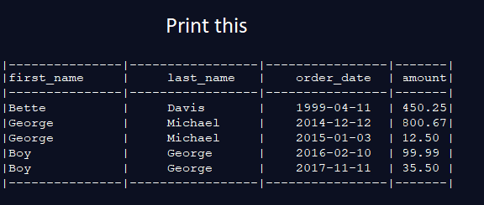
Exercises 1:

Slide 28
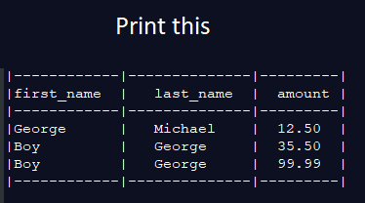
Exercises 2:

Slide 29
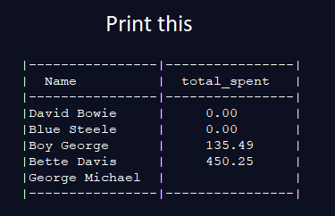
Exercises 3:

Slide 30
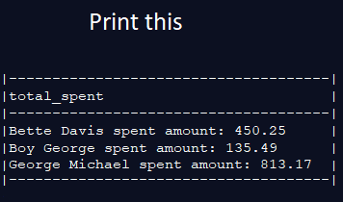
Exercises 4:

Slide 31
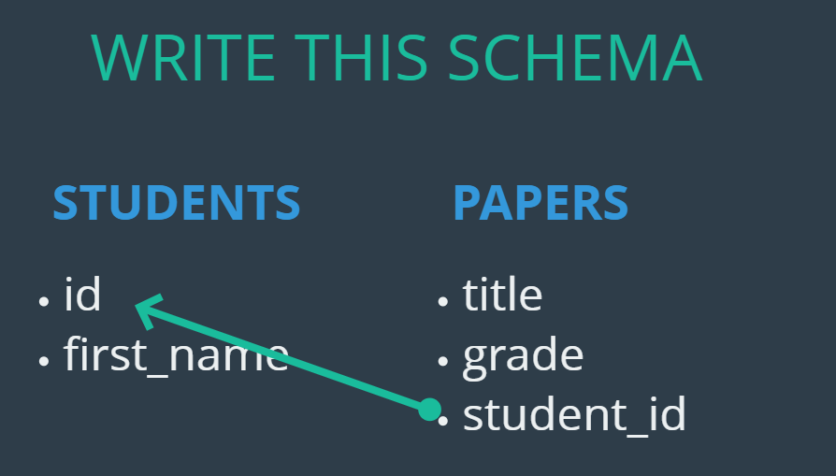
Homework 1:

Slide 32
Homework 2:
INSERT INTO students (first_name)
VALUES ('Caleb'), ('Samantha'), ('Raj'), ('Carlos'), ('Lisa’);
INSERT INTO papers (student_id, title, grade )
VALUES (1, 'My First Book Report', 60),
(1, 'My Second Book Report', 75),
(2, 'Russian Lit Through The Ages', 94),
(2, 'De Montaigne and The Art of The Essay', 98),
(4, 'Borges and Magical Realism', 89);

Slide 33
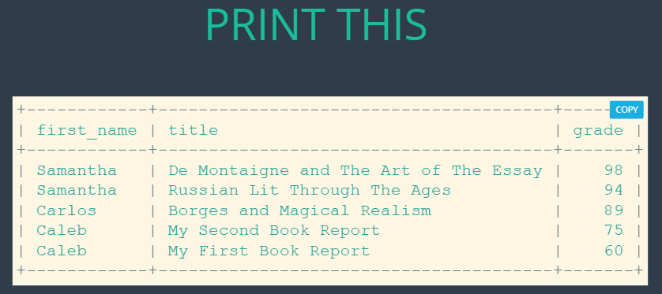
Homework 3:

Slide 34
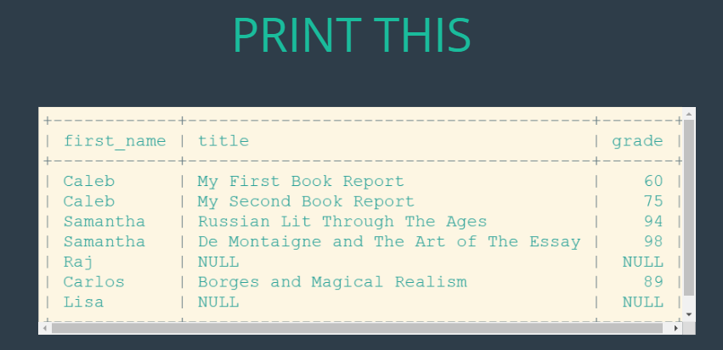
Homework 4:

Slide 35
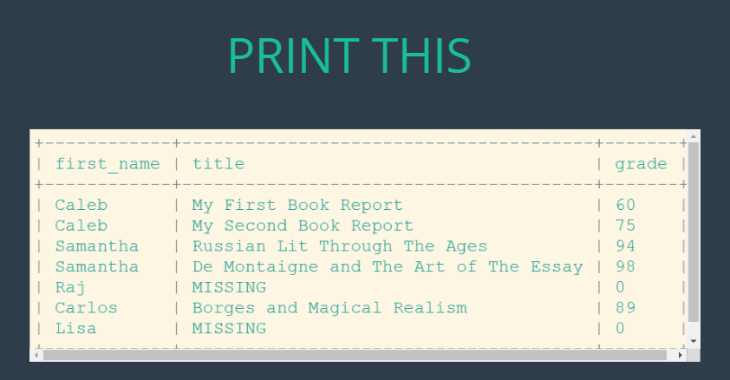
Homework 5:

Slide 36
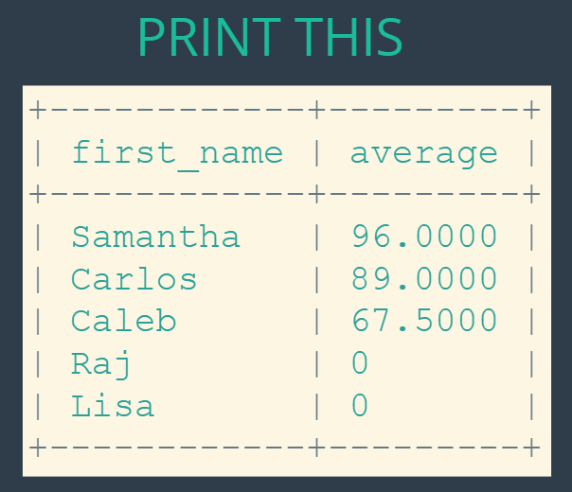
Homework 6:

Slide 37
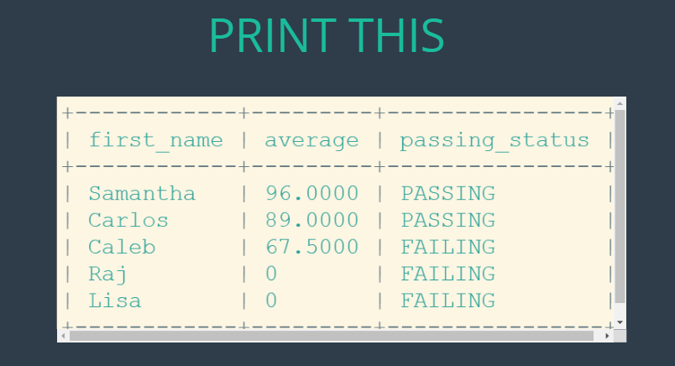
Homework 7:

