Slide 1

Computer Networks, Browsers and Script languages

Slide 2
Computer Networks
Introduction
Network types
Network topology
Network connection models
OSI model

Slide 3
Computer network
A collection of computing devices that are connected in various ways in order to communicate and share resources or files
Wired network: the connections between computers in a network are made using physical wires or cables
Wireless network: the connections between computers in a network are made using radio waves or infrared signals

Slide 4
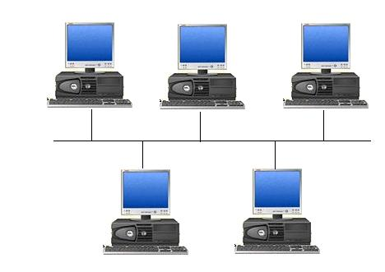
Computer network
Each computer in the network is known as: node or host
Data transfer rate: is the speed with which data is moved from one place on a network to another, which is a key feature in computer networks

Slide 5
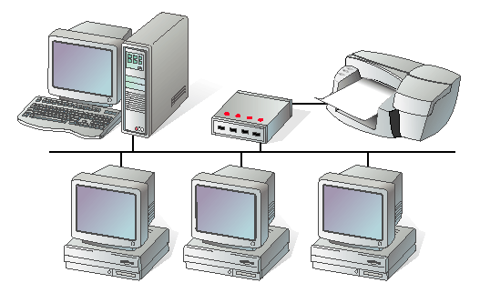
Network Types
Local Area Network (LAN): two or more computers connected together, the computers are physically near each other (for example: in the same building)
LANs are inexpensive to install
LANs provide higher speeds

Slide 6
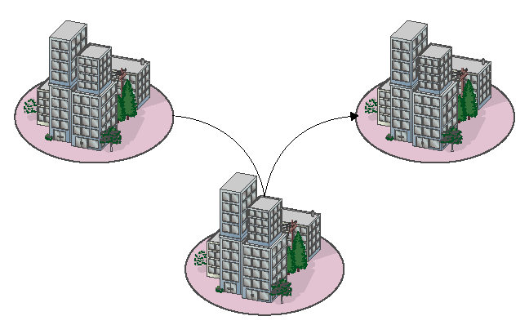
Network Types
Metropolitan Area Network (MAN): usually span tens of kilometers (for example: in the same city)
The cost of installation and operation is higher.
MANs use high-speed connections such as fiber optics to achieve higher speeds

Slide 7
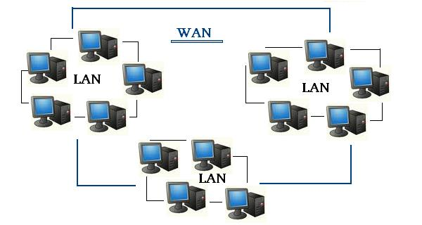
Network Types
Wide Area Network (WAN): is a connection of LANs (for example : the Internet)
WANs span a larger area than a single city.
These use long distance telecommunication networks for connection, thereby increasing the cost.

Slide 8

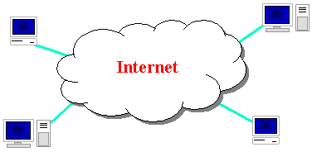
The Internet
It is a large group of computers that are connected to each other and used to send information quickly between computers around the world

Slide 9
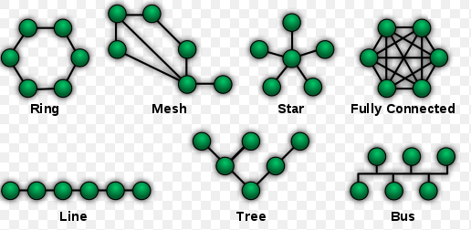
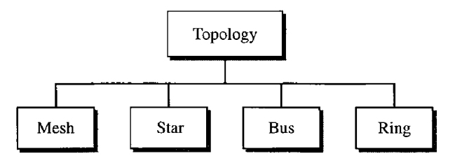
Physical topology of a network (Advanced)
The term physical topology refers to the way in which a network is laid out physically.
The topology of a network is the geometric representation of the relationship of all the links and linking devices
There are several topologies, however we will cover four basic topologies: mesh, star, bus, and ring

Slide 10
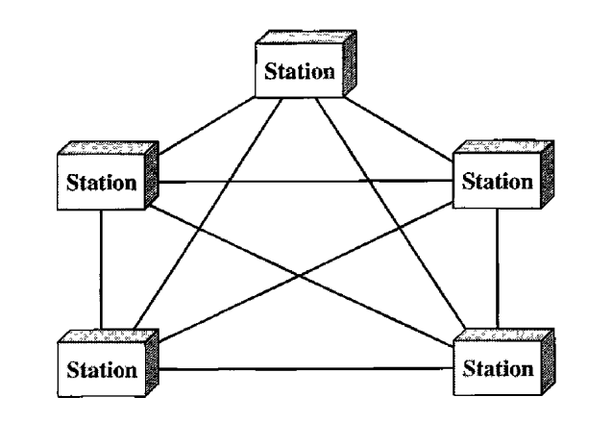
Physical topology of a network (Advanced)
Mesh Topology
In a mesh topology, every device has a dedicated point-to-point link to every other device.
The term dedicated means that the link carries traffic only between the two devices it connects.
The number of physical links in a fully connected mesh network with n nodes ➔ n(n-1)/2
The mesh topology used in the connection of telephone regional offices in which each regional office needs to be connected to every other regional office.

Slide 11
Physical topology of a network (Advanced)
Mesh Topology
Advantages:
Each link can carry its own data load, thus eliminating the traffic problems that can occur with shared links.
A mesh topology is robust. If one link becomes unusable, it does not incapacitate the entire system.
Every message travels along a dedicated line, only the intended recipient sees it. Physical boundaries prevent other users from gaining access to messages.
Point-to-point links make fault identification and fault isolation easy. Traffic can be routed to avoid links with suspected problems.
Disadvantage:
The amount of cabling and the number of I/O ports required.

Slide 12
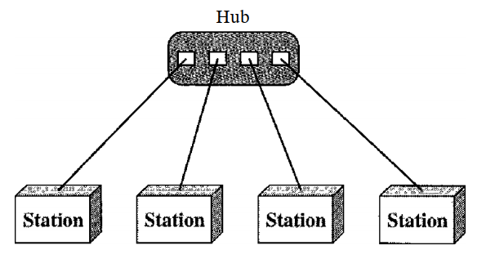
Physical topology of a network (Advanced)
Star Topology
Each device has a dedicated point-to-point link only to a central controller, usually called a hub.
A star topology does not allow direct traffic between devices.
The controller acts as an exchange: If one device wants to send data to another, it sends the data to the controller, which then relays the data to the other connected device.
The star topology is used in local-area networks (LANs)

Slide 13
Physical topology of a network (Advanced)
Star Topology
Advantages:
less expensive than a mesh topology, each device needs only one link and one I/O port to connect it to any number of others.
Easy to install and reconfigure.
Robustness, if one link fails, only that link is affected, all other links remain active.
As long as the hub is working, it can be used to monitor link problems and bypass defective links
Disadvantage:
the dependency of the whole topology on one single point, the hub. If the hub goes down, the whole system is dead

Slide 14
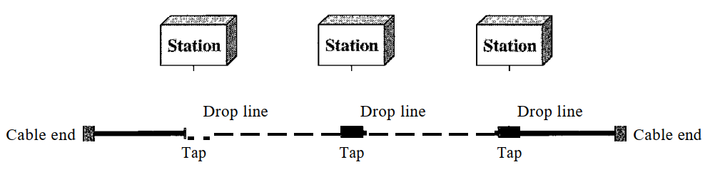
Physical topology of a network (Advanced)
Bus Topology
A bus topology is multipoint connection.
One long cable acts as a backbone to link all the devices in a network.
Nodes are connected to the bus cable by drop lines and taps.
There is a limit on the number of taps a bus can support and on the distance between those taps. As a signal travels along the backbone, some of its energy is transformed into heat. Therefore, it becomes weaker and weaker as it travels farther and farther.
Bus topology was the one of the first topologies used in the design of early local area networks.
The cable has two end terminals that dampen the signal so that it does not keep moving from one end of the network to the other.

Slide 15
Physical topology of a network (Advanced)
Bus Topology
Advantages:
Ease of installation
Bus uses less cabling than mesh or star topologies.
Disadvantages:
Difficult reconnection and fault isolation.
Difficult to add new devices.
Signal reflection at the taps can cause degradation in quality. This degradation can be controlled by limiting the number and spacing of devices connected to a given length of cable.
Adding new devices may therefore require modification or replacement of the backbone.
In addition, a fault or break in the bus cable stops all transmission, even between devices on the same side of the problem. The damaged area reflects signals back in the direction of origin, creating noise in both directions.

Slide 16
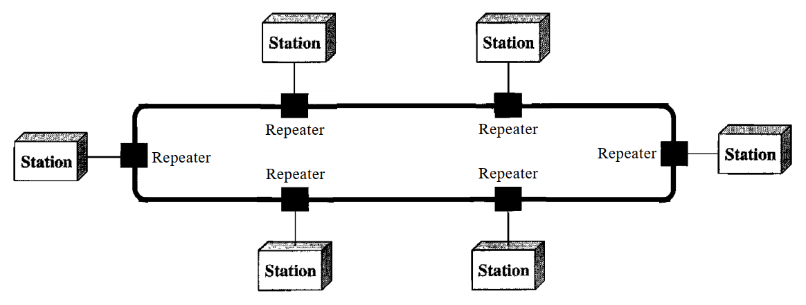
Physical topology of a network (Advanced)
Ring Topology
Each device has a dedicated point-to-point connection with only the two devices on either side of it.
A signal is passed along the ring in one direction, from device to device, until it reaches its destination.
Each device in the ring incorporates a repeater. When a device receives a signal intended for another device, its repeater regenerates the bits and passes them along

Slide 17
Physical topology of a network (Advanced)
Ring Topology
Advantages:
easy to install and reconfigure
Fault isolation is simplified.
Generally in a ring, a signal is always circulating . If one device does not receive a signal within a specified period, it can issue an alarm. The alarm alerts the network operator to the problem and its location.
To add or delete a device requires changing only two connections. The only constraints are media and traffic considerations (maximum ring length and number of devices).
Disadvantages:
Unidirectional traffic
a break in the ring can disable the entire network.
This weakness can be solved by using a dual ring or a switch capable of closing off the break.

Slide 18
Network connection models
Networks can also be classified according to the roles that the networked computers play in the network’s operation.
Peer-to-peer,
server-based,
and client-based.

Slide 19
Network connection models
Peer-to-peer model all computers are considered equal. Each computer controls its own information and is capable of functioning as either a client or a server depending upon the requirement.
Peer-to-peer networks are inexpensive and easy to install.
They are popular as home networks and for use in small companies.
Most operating systems come with built-in peer-to-peer networking capability.
The maximum number of peers that can operate on a peer-to-peer network is ten.
Each peer shares resources and allows others open access to them.
Shares can be document folders, printers, peripherals, and any other resource that they control on their computers.

Slide 20
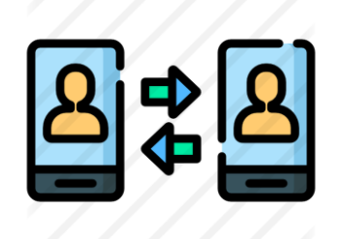
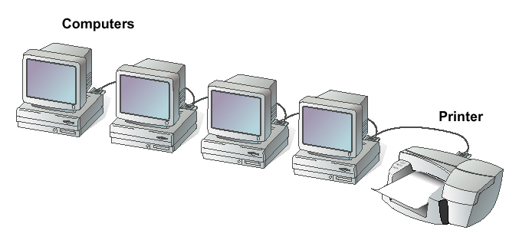
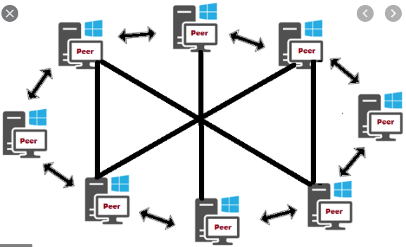
Network connection models
Peer-to-peer network

Slide 21
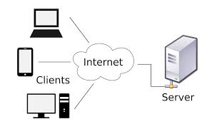
Network connection models
client-server model is a software that consists of two parts, client systems and server systems, both communicate over a computer network

Slide 22
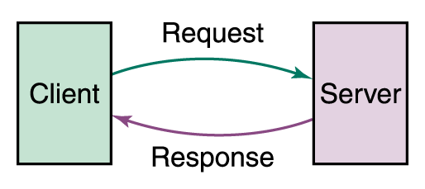
Network connection models
The client-server relationship describes the relation between the client and how it makes a service request to the server, and how the server can accept these requests, process them, and return the requested information to the client

Slide 23

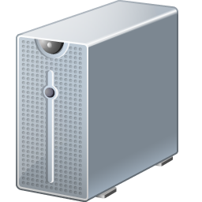

How the Web Works?
WWW use classical client / server architecture
HTTP is text-based request-response protocol
HTTP
Page request
HTTP
Server response
Server running Web Server Software (IIS, Apache, etc.)
Client running a Web Browser

Slide 24

Client/Server
There are two types of servers:
File server A computer that stores and manages files for multiple users on a network
Web server A computer that responds to requests for web pages (from the browser client)

Slide 25
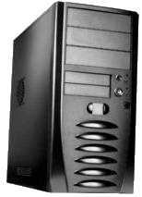

Web servers and browsers
web server: software that listens for web page requests
Apache
Microsoft Internet Information Server (IIS) (part of Windows)
web browser: fetches/displays documents from web servers – more about it later

Slide 26
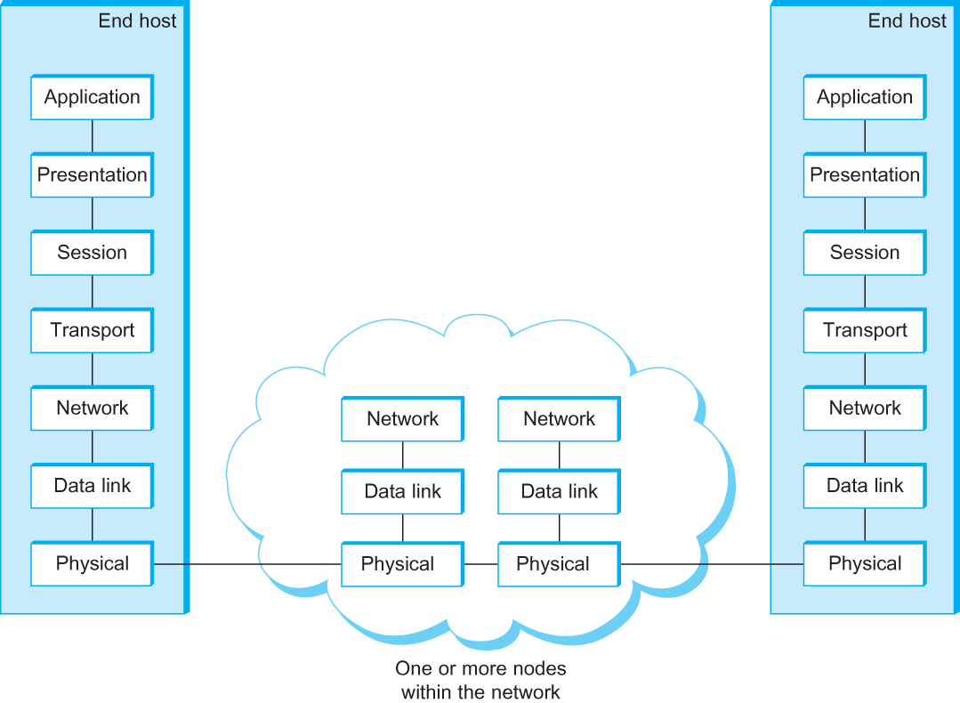
OSI Architecture (Advanced)
The OSI 7-layer Model
OSI – Open Systems Interconnection

Slide 27
Description of Layers (Advanced)
Physical Layer
Handles the transmission of raw bits over a communication link
Data Link Layer
Collects a stream of bits into a larger aggregate called a frame
Network adaptor and device drivers in OS implement the protocol in the datalink layer
Frames are actually delivered to hosts
Network Layer
Handles routing between nodes within a packet-switched network
Unit of data exchanged between nodes in this layer is called a packet
The lower three layers are implemented on all network nodes

Slide 28
Description of Layers (Advanced)
Transport Layer
Implements a process-to-process channel
Unit of data exchanges in this layer is called a message
Session Layer
Provides a name space that is used to tie together the potentially different transport streams that are part of a single application
Presentation Layer
Concerned about the format of data exchanged between peers
Application Layer
Standardize common type of exchanges
The transport layer and the higher layers typically run only on end-hosts and not on the intermediate switches and routers

Slide 29

Summary
A computer network consists of two or more computers that are connected and are able to communicate.
The basic purpose of networks is to enable effective communication, share resources, and facilitate centralized management of data.
Networks can be classified according to their geographical boundaries or their component roles.
The topology of a network is the geometric representation of the relationship of all the links and linking devices

Slide 30
Browsers
Basic Functions of Web Browsers:
Provide a way for users to access and navigate Web pages
Display Web pages properly
Provide technology to enable multimedia features
Provide access to Internet services (such as FTP, e-mail, streaming video content etc.)
Perform authentication and encryption functions

Slide 31
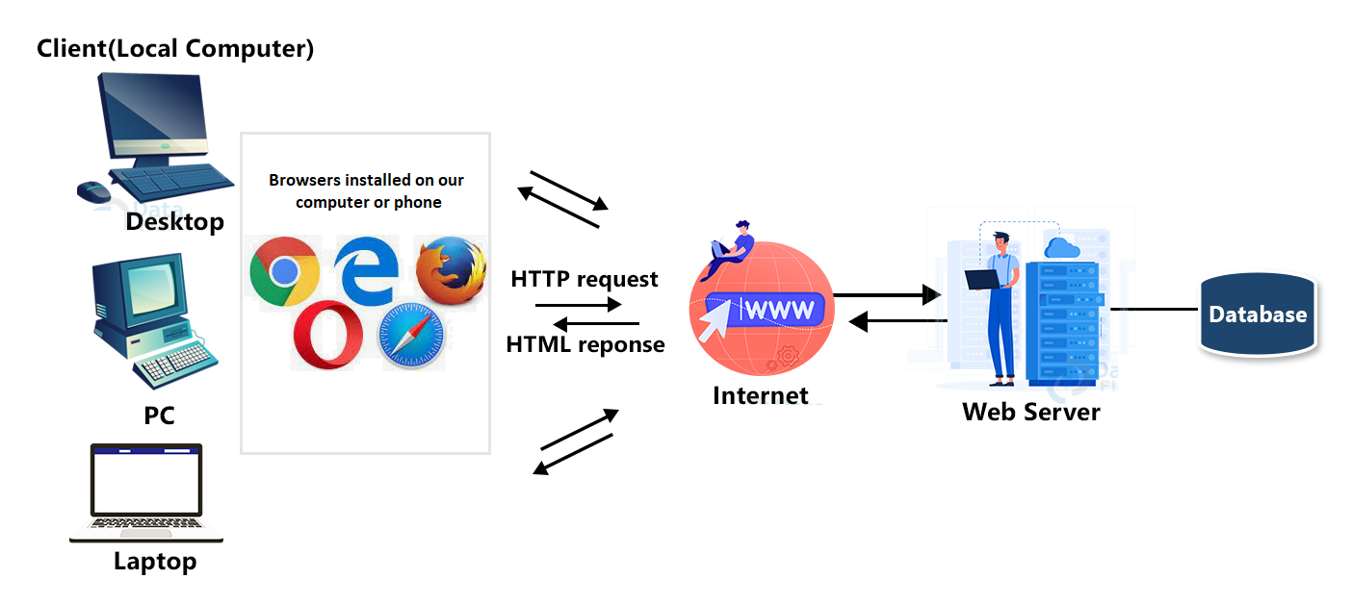
Browsers

Slide 32
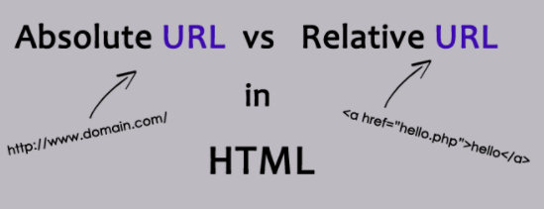
Web Addresses
Every Web page has a unique address called a Uniform Resource Locator (URL)
URLs typically include the protocol, the Internet resource (server or host name) and the domain name
You enter absolute URLs into your browser’s Address or Location box
Relative URLs can be used for coding Web sites

Slide 33
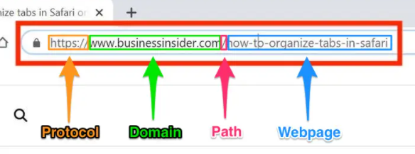
How Browsers Work
You enter a URL into the browser
Browser divides the URL into three parts: protocol, server and domain name, and file name
Browser contacts a domain name server to translate server name into an IP address
Browser uses IP address to connect to server
Browser uses HTTP to request a page from the server
Some level of authentication takes place
Server sends the requested page (coded in HTML) to the browser
Browser reads and interprets the HTML, and displays the Web page

Slide 34
URL
Protocol – how the http request is made
Domain – where to go to see the website (domain is very helpful so we don’t need to remember ip addresses)
Path – where to go on this domain
Webpage – website can have many many pages – so which one to show?

Slide 35
Browser Choices
Most popular browsers in use today are Google Chrome and Mozilla Firefox
Alternative browsers include:
Safari
Microsoft Edge
Opera
Internet Explorer (grandpa speed)

Slide 36
Google Chrome (Self-Read)
Google uses the greenfield approach to software and Web development
Greenfield – a project that lacks any constraints imposed by prior development
Chrome features:
Clean interface
Automatic crash recovery
Multi-threading
Improved sandboxing
Isolated tabs
Privacy mode

Slide 37
Browsing Techniques (Self-Read)
Techniques available to make your browsing sessions more efficient:
Using Bookmarks and Favorites
Using multiple windows and tabs
Following links

Slide 38
Browser Elements (Self-Read)
Rendering engine
Interpreter
Sandbox
Thread
Window
Tab
Cache
Supplements
Network programming
Download controls
Plug-in

Slide 39
Configuring Web Browser Preferences (Self-Read)
Browser preferences you can configure to suit your working style include:
Browser fonts
Home page
History folder
Blockers for pop-up and pop-under windows
Browser cache settings

Slide 40
Troubleshooting Internet Client Problems (Self-Read)
By adjusting browser functions and settings, you can troubleshoot the following client problems:
Poor rendering
Slow connection
No connection
Slow browser and other system functions
Authentication issues
Disk space usage

Slide 41
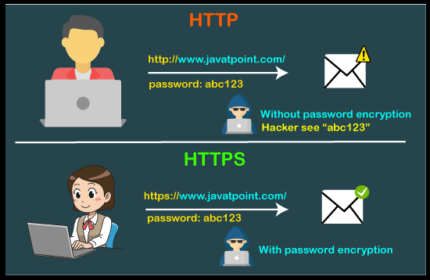
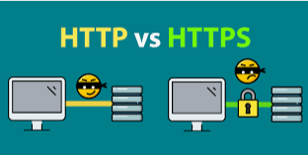
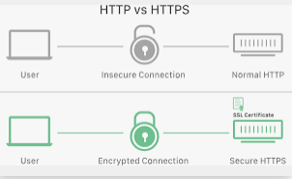
HTTP and HTTPS
What is HTTP?
HTTP (Hypertext Transfer Protocol) is the set of rules for transferring files -- such as text, images, sound, video and other multimedia files -- over the web.
As soon as a user opens their web browser, they are indirectly using HTTP. HTTP is an application protocol that runs on top of the TCP/IP suite of protocols, which forms the foundation of the internet.
How HTTP works?
Through the HTTP protocol, resources are exchanged between client devices and servers over the internet.
Client devices send requests to servers for the resources needed to load a web page; the servers send responses back to the client to fulfill the requests.
HTTPS or HTTP?
Only difference here is – S stands for SECURE. So it is the same old HTTP, just it is encrypted so no one can easily see communication between our computer and website.

Slide 42
How to send HTTP Request?
A URL. This points to the resource on the web.
An HTTP method. This indicates the specific action the request expects to receive from the server in its response.
HTTP request headers. This includes data such as what type of browser is being used and what data the request is seeking from the server. It can also include cookies, which show information previously sent from the server handling the request.
An HTTP body. This is optional information the server needs from the request, such as user forms -- username/password logins, short responses and file uploads -- that are being submitted to the website.

Slide 43
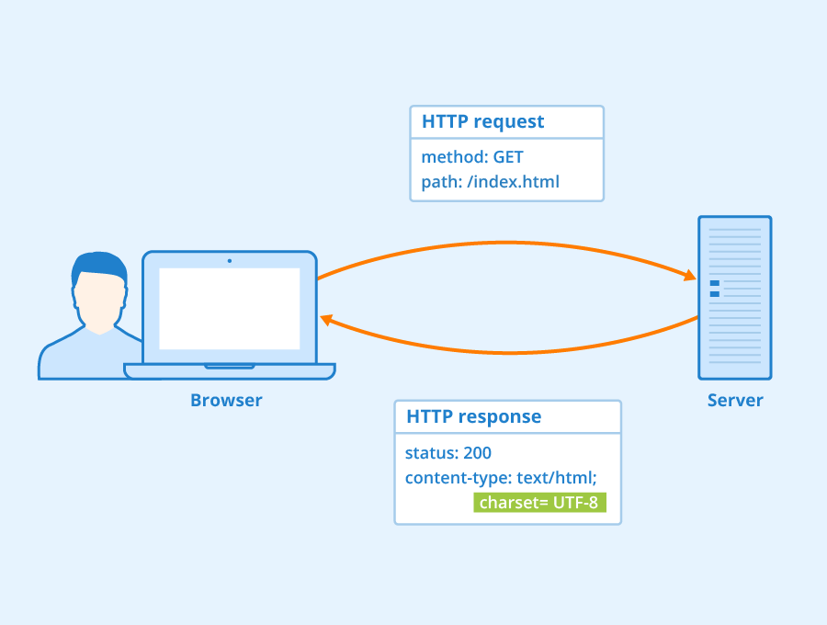
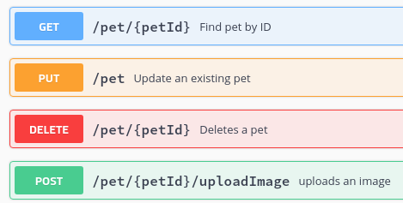
HTTP Request
Actual request over HTTP need to be sent using one of the following commands:
What you see here are just commands, not buttons on the application

Slide 44
HTTP Response
The HTTP response message is the data received by a client device from the web server. As its name suggests, the response is the server's reply to an HTTP request. The information contained in an HTTP response is tailored to the context the server received from the request. HTTP responses typically include the following data:
HTTP status code, which indicates the status of the request to the client device. Responses may indicate success, an informational response, a redirect, or errors on the server or client side.
HTTP response headers, which send information about the server and requested resources.
An HTTP body (optional). If a request is successful, this contains the requested data in the form of HTML code, which is translated into a web page by the client browser.

Slide 45
HTTP Response
200 OK. This means that the request, such as GET or POST, worked and is being acted upon.
300 Moved Permanently. This response code means that the URL of the requested resource has been changed permanently.
401 Unauthorized. The client, or user making the request of the server, has not been authenticated.
403 Forbidden. The client's identity is known but has not been given access authorization.
404 Not Found. This is the most frequent error code. It means that the URL is not recognized or the resource at the location does not exist.
500 Internal Server Error. The server has encountered a situation it doesn't know how to handle.

Slide 46
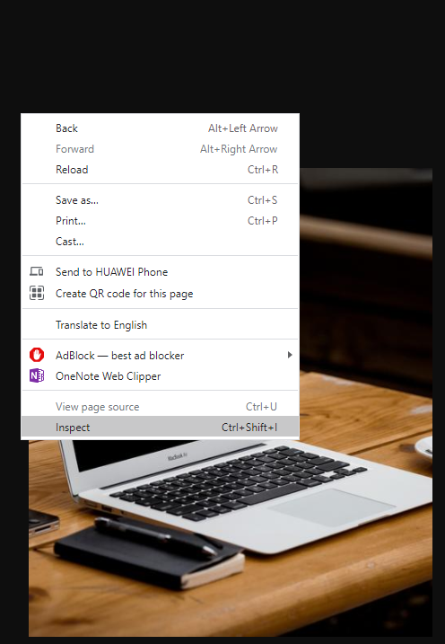
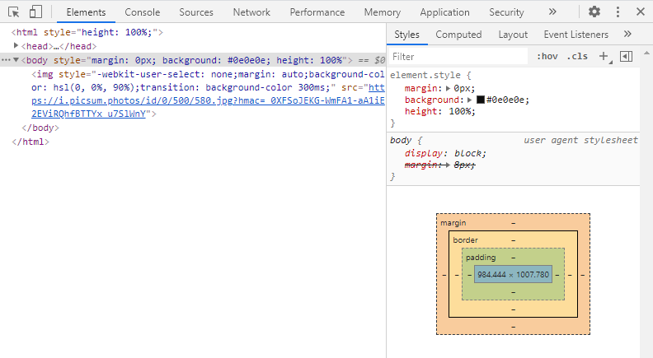
How do we see all of these?
We are using developer tools for our Browser
Most of the browsers have it
You can access them by pressing F12 or Right Click -> Inspect

Slide 47
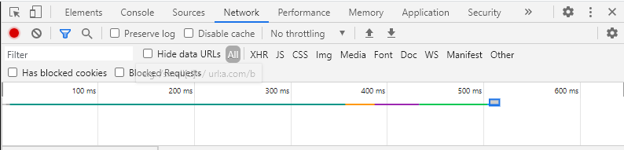
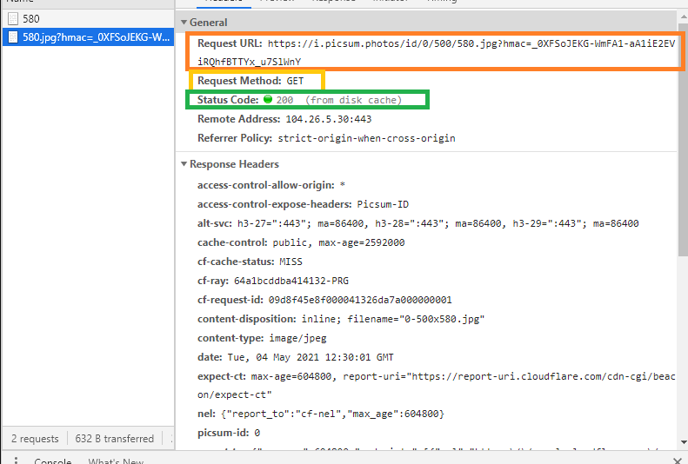
Developer tools
To see what happened with your request:
Open developer tool
Go To Network
Click on the link you want to
send your request to
See in the network section
It will contain:
Request URL
Request Method
Response Code (Status code)
Request and Response Headers

Slide 48
Scripting language
A scripting language is a programming language that executes tasks within a special run-time environment by an interpreter instead of a compiler. They are usually short, fast, and interpreted from source code or bytecode.
As they are a series of commands executed with no need for a compiler, they are cross-platform and do not require special software to be installed in order to run — except for a web browser, of course

Slide 49
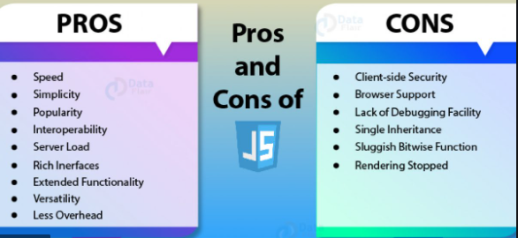
Scripting language
Here are two main types: server-side and client-side. They differ on where the code is run from, which affects not only the actual languages chosen but also the performance and their capabilities.
Server-side: PHP, Python, Node.js, Perl, and Ruby (if you use C#, Java or C++, you don’t need server-side scripting language)
Client-side: HTML, CSS, jQuery, and JavaScript

Slide 50
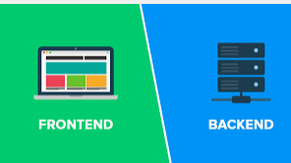
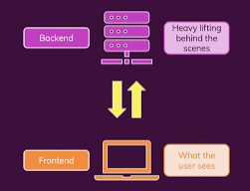
In our case
We will use C# code for our BACKEND
JS will be used for FRONTEND
JS code will be executed on client side (our Browser),
C# code will be executed on server side (the computer)
When we make C# web application it will be acting like it is on some server. This is allowed by IIS – Internet Information Service
It helping our computer to act like the server.

Slide 51

Javascript
The most famous one among the scripting languages
We will see as of next week how to use it

