Slide 1
DATABASES
introduction

Slide 2

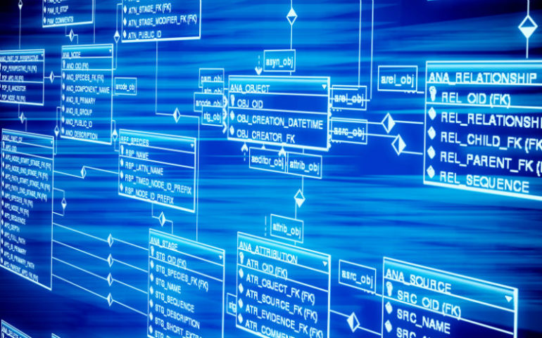
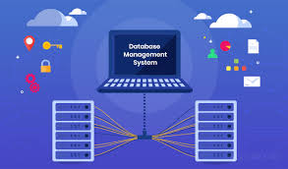
What is Database?
By Definition: Main place where we store and keep data.
In this century data is the most valuable resource that we have.
The main difference between success and failure in business is having access to the right data.

Slide 3
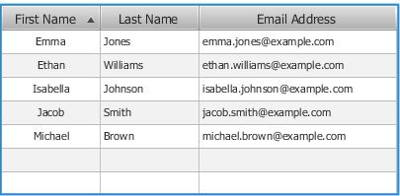
Database
Most simple databases:
List of friend’s birthdays
Phonebook
Address book, etc.
It is a collection of data
And it is also a way of accessing and using that data.
Example:
We Find all people who have first name: Emma
We Find all people who have last name: Johnson
Order data by email address (or by name/last name)

Slide 4
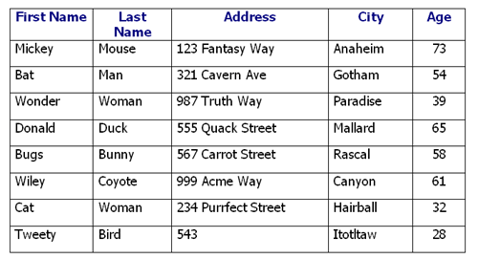
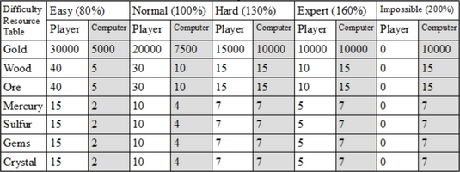
Database can have different types of data

Slide 5
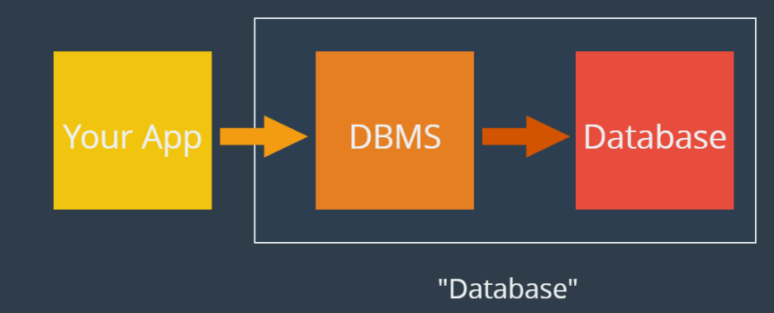

Database
We have our Application which needs to use data
Application uses Database Management system (DBMS)
DBMS is using Database - to access certain data, and to execute control for data
Then data from DB is provided by DBMS back to the app which will show it to the user.

Slide 6
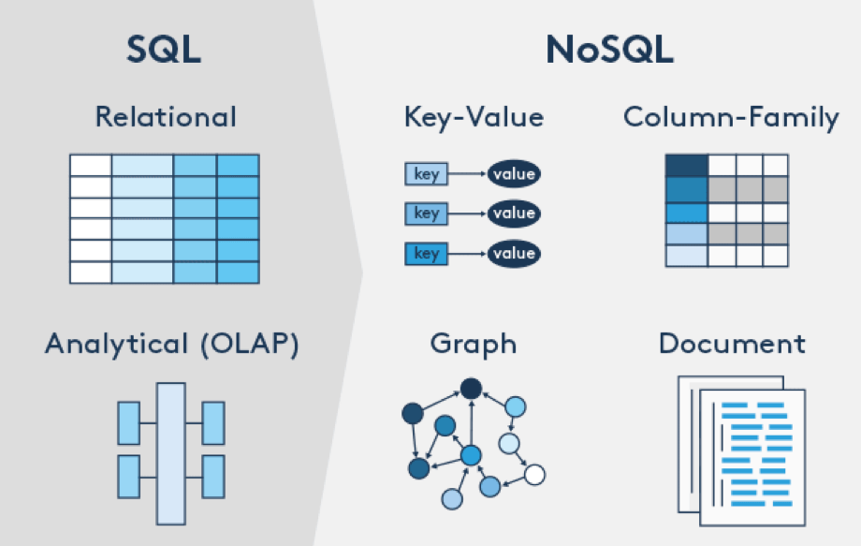
What types of databases are there?

Slide 7
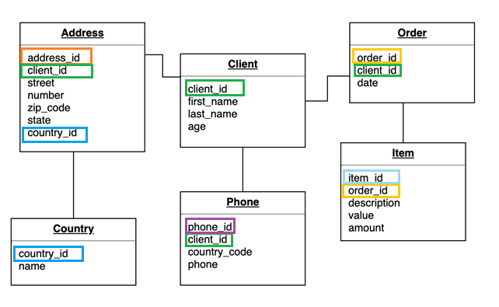
Relational Database
We will be using Relational Databases
This relation is between data groups presented in tables

Slide 8
What is SQL
In order to use data, we need some language that database can understand. In our case we are using:
SQL – Structured query language (Language that helps us use DB)
There are many relational databases, all are using SQL:
Microsoft SQL Server
MySQL
SQLite
Oracle
PostgreSQL

Slide 9
SQL - first look
Let’s visit and see how SQL could help us get certain information from DB:
CLICK ME
If link does not work, go here:
(https://www.w3schools.com/sql/trysql.asp?filename=trysql_op_or)

Slide 10
Query
Query is a command in SQL
By executing query, you can:
Create Database
Create Table
Do the operations in the Database
Create, Read, Update, Delete data

Slide 11
Install
Go to Microsoft website and download Microsoft SQL Server express 2019:
(https://www.microsoft.com/en-us/download/details.aspx?id=101064)
Then install SSMS – Microsoft SQL Management Studio:
(https://docs.microsoft.com/en-us/sql/ssms/download-sql-server-management-studio-ssms?view=sql-server-ver15)
Alternative - SQLite:
(https://www.sqlite.org/index.html)
(https://sqlitestudio.pl/)

Slide 12
Working environment
Let’s first setup our working environment - our DB management studio
Then go and take a look at our working environment
See if there are already some db pre-installed

Slide 13
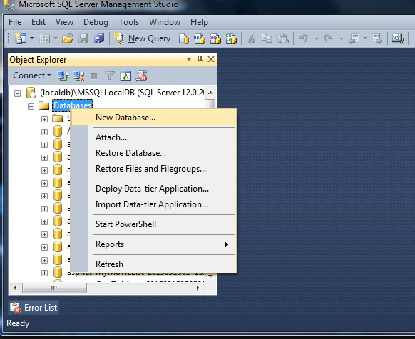
Creating database
You can create database in your
Environment by:
Right clicking Databases
Choose New Database…
Or make a query:
CREATE DATABASE db_name

Slide 14
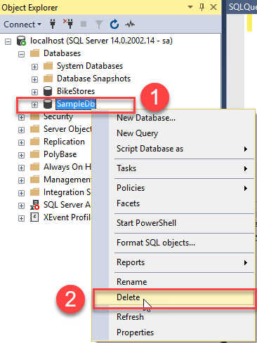
Deleting database
You can create database in your
Environment by:
Find Database you don’t need anymore
Right click on it and Choose DELETE
Or make a query:
DROP DATABASE db_name
DO NOT DELETE unless YOU ARE ABSOLUTELY SURE you DON’T NOT NEED that database!!!

Slide 15
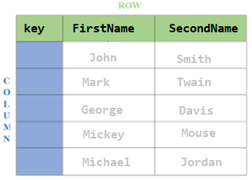
Creating Table
Next week we will talk a bit more about tables
However, for now let’s just make one or two so we can show where our data is stored
Let’s make table Names:
Table should have following columns:
Key, FirstName, SecondName
About columns and rows see next slide

Slide 16


Short clarification
Column: Up-Down
Row: Left-Right

Slide 17
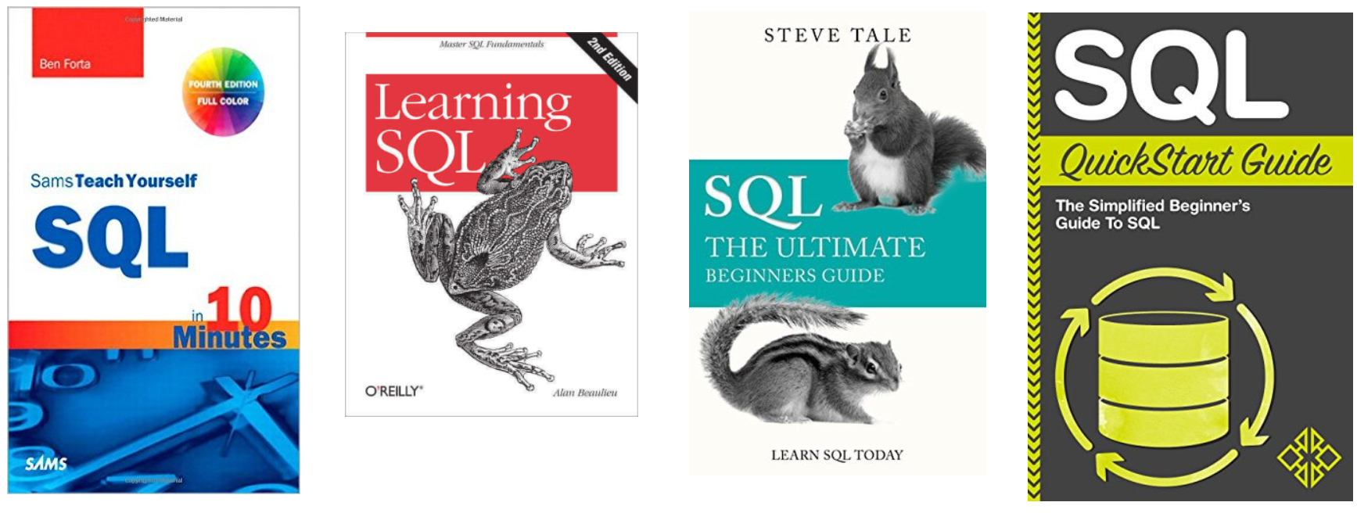
Some books that could help learning process

Slide 18
Other DB diagrams
Remember this picture?
Following slides will show other DB types
Note – In this course we are only covering relational database. Other are shown just to give you the overview

Slide 19
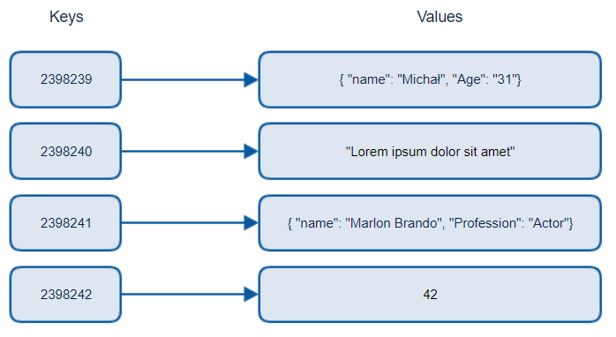
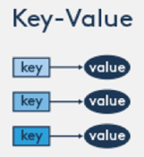
Key Value pair Database
Key is something we search by
Value can be different data types, from integer, strings, to objects

Slide 20
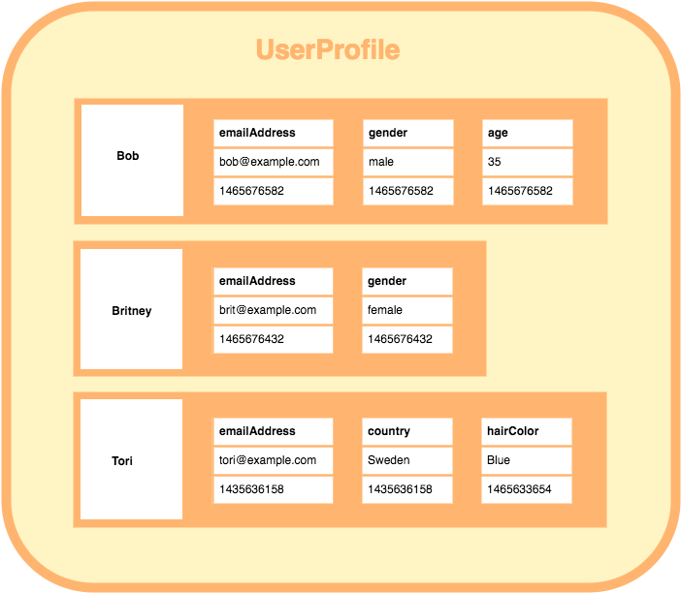

Column store Database
Bob, Britney, Tori are keys
They have multiple columns with
Timestamp (autogenerated big number))

Slide 21
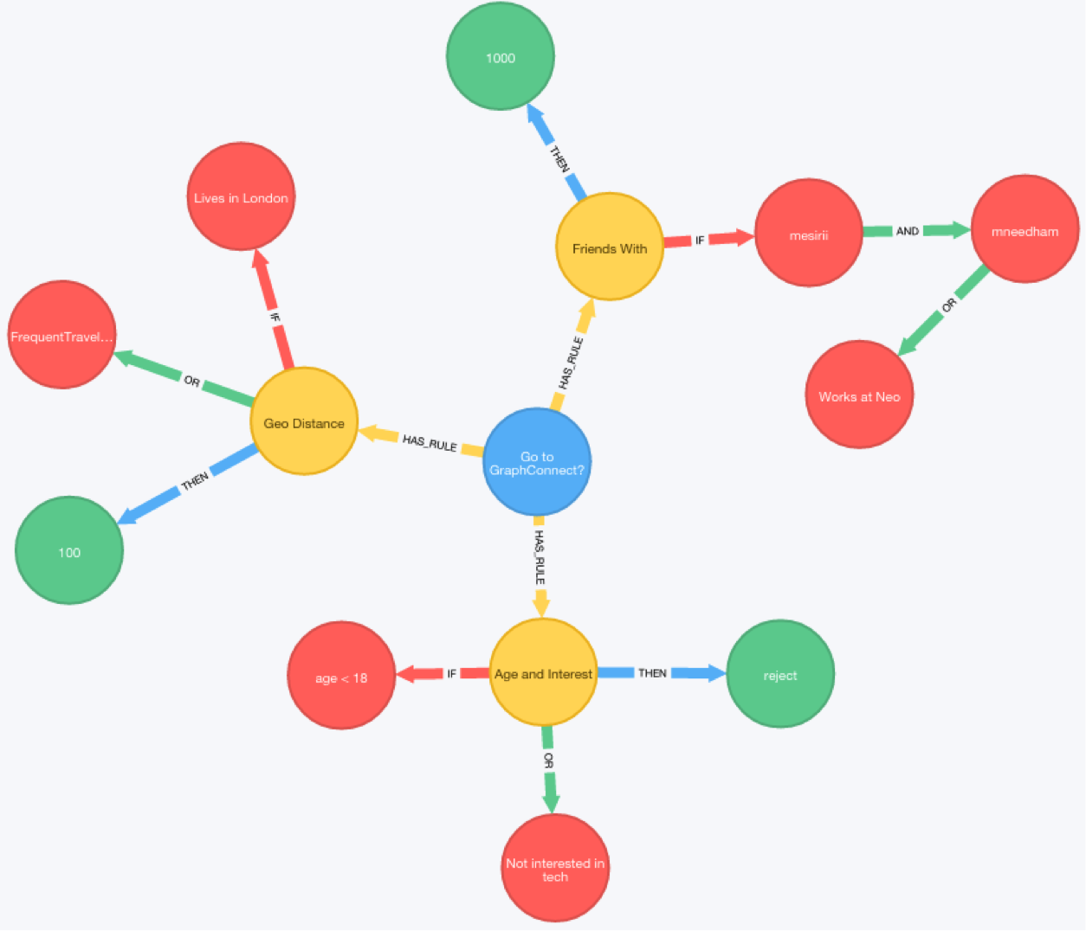
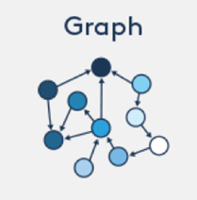
Graph Database
How are nodes (data) connected

Slide 22
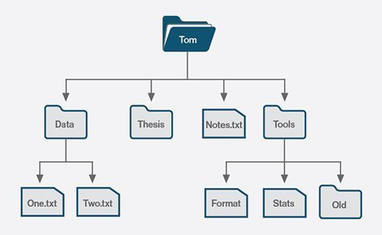
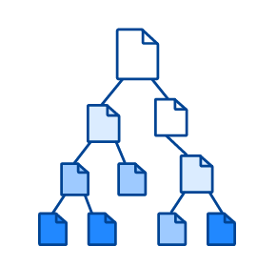

Document Database
This database is similar to what we see in Windows Explorer
It is representing hierarchy of files and folders, like saved on our computer

Slide 23
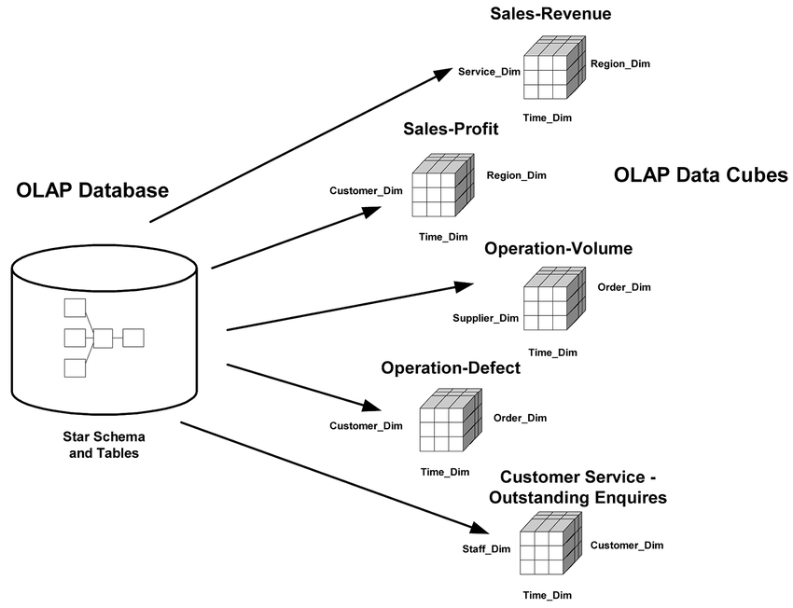

OLAP database
This model is very complicated, which makes it suitable only for advanced users. It requires a lot of background to make it clear.
Mainly it consists out of business parts and operations

