Slide 1
Introducing Entity Framework

Slide 2
What is Entity Framework
Before introducing Entity Framework, connecting and reading from database was more complicated, and possibility of making an error in the code, much higher
Instead of problematic repetitive code, we can now use simpler and more elegant "Entity Framework"
It is used to automate all database related activities for your application.

Slide 3
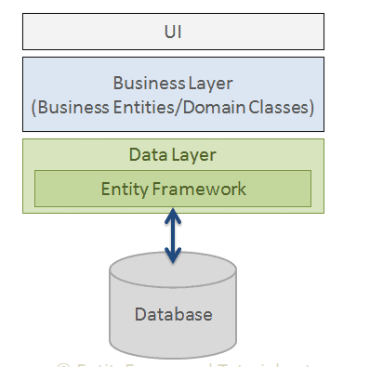
How it works?
Entity Framework is ORM framework
ORM = Object Relational Mapping
It means it will make object to be similar to
that of the table in database
For example:
Table: person → Class: Person
Person is like any other class
We can easily create object of Person and:
Fill it with values we read from table Person
Insert new value to the table Person from object Person
Update and delete data in table

Slide 4
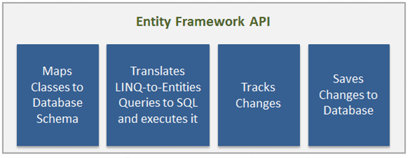
Slightly complicated explanation – part 1
Entity Framework API (EF6 & EF Core) includes the ability to map domain (entity) classes to the database schema, translate & execute LINQ queries to SQL, track changes occurred on entities during their lifetime, and save changes to the database.

Slide 5
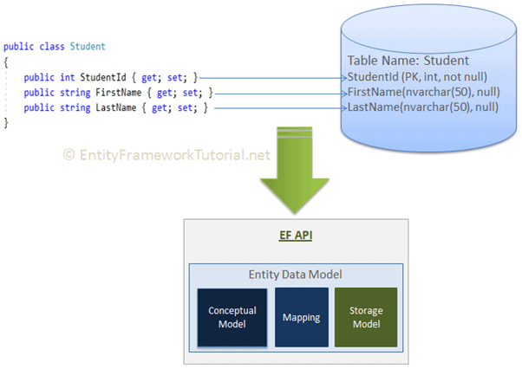
Slightly complicated explanation – part 2
Entity Data Model
The very first task of EF API is to build an Entity Data Model (EDM). EDM is an in-memory representation of the entire metadata: conceptual model, storage model, and mapping between them.
Conceptual Model: EF builds the conceptual model from your domain classes, context class, default conventions followed in your domain classes, and configurations.
Storage Model: EF builds the storage model for the underlying database schema. In the code-first approach, this will be inferred from the conceptual model. In the database-first approach, this will be inferred from the targeted database.
Mappings: EF includes mapping information on how the conceptual model maps to the database schema (storage model).
EF performs CRUD operations using this EDM. It uses EDM in building SQL queries from LINQ queries, building INSERT, UPDATE, and DELETE commands, and transform database result into entity objects.

Slide 6
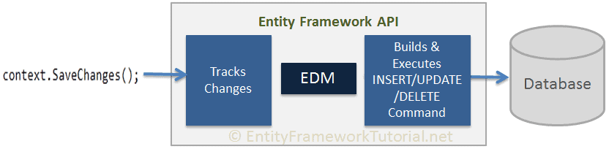
Slightly complicated explanation – part 3
EF API infers INSERT, UPDATE, and DELETE commands based on the state of entities when the SaveChanges() method is called. The ChangeTrack keeps track of the states of each entity as and when an action is performed.

Slide 7
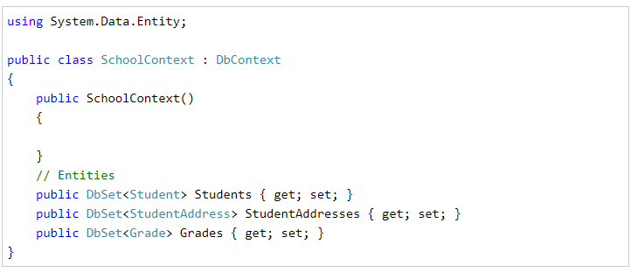
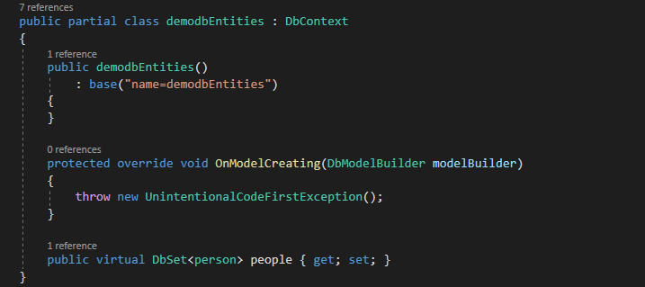
Slightly complicated explanation – part 4
The context class is a most important class while working with EF 6 or EF Core. It represent a session with the underlying database using which you can perform CRUD (Create, Read, Update, Delete) operations.
The context class is used to query or save data to the database. It is also used to configure domain classes, database related mappings, change tracking settings, caching, transaction etc.
The following SchoolContext class is an example of a context class.
In our case name of the context class is demodbEntities
We only have one table person → so we will have one dbset people for class person

Slide 8
Development approaches with EF
Database-First
Code-First
Model-First

Slide 9
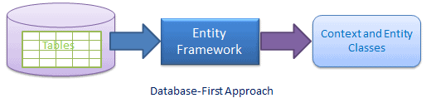
Database-First Approach
In the database-first development approach, you generate the context and entities for the existing database using EDM wizard integrated in Visual Studio or executing EF commands

Slide 10
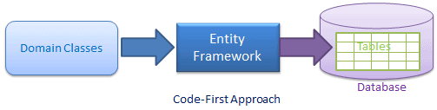
Code-First Approach
Use this approach when you do not have an existing database for your application. In the code-first approach, you start writing your entities (domain classes) and context class first and then create the database from these classes using migration commands.
Developers who follow the Domain-Driven Design (DDD) principles, prefer to begin with coding their domain classes first and then generate the database required to persist their data

Slide 11
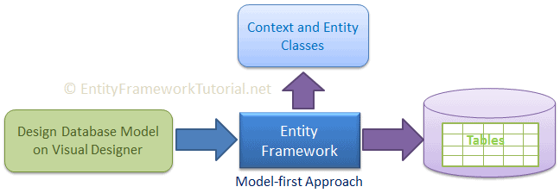
Model-First Approach
In the model-first approach, you create entities, relationships, and inheritance hierarchies directly on the visual designer integrated in Visual Studio and then generate entities, the context class, and the database script from your visual model.

Slide 12
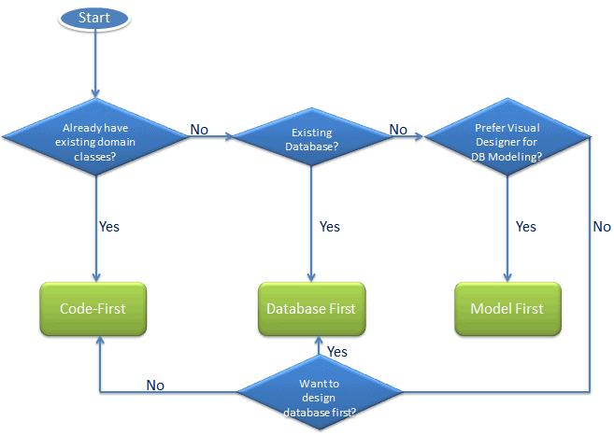
So which one to use?

Slide 13

We will use Database first approach
First we need to make sure we have prepared our database
In this case we are going to create new table in the db
In order to use the most benefits from Entity framework, we need to add primary keys to tables, and make them use IDENTITY (auto-increase)
Our table should look like this:
We can add at least one value to it:
insert into dbo.person (name,surname) values ('John','Doe')

Slide 14
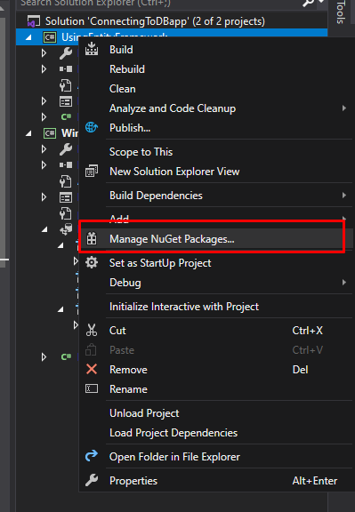
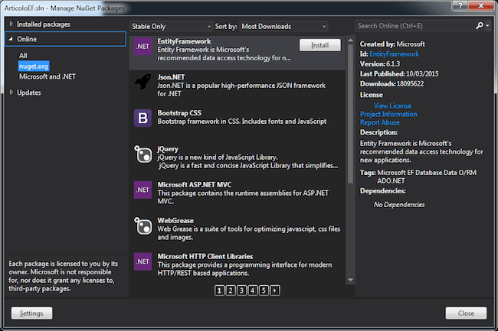
Next step is to write application in VS
When we open the project, we need to add Entity framework functionality to it.
To add some functionalities we need to use NuGet packages

Slide 15
Why NuGet package?
NuGet allows us to include in our project only those external functionalities that we really need
External functionalities are something that doesn’t come with project when you just create it
There are thousands of NuGet packages with many many libraries inside. When you download and install the package, you will add those libraries to your project
When you are making very simple application, you do not need all the libraries in the world, right? So just pick those that you need
So far we didn’t need any, but now times are changing.

Slide 16
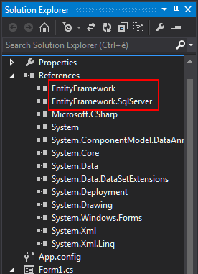
After installing NuGet package
You will see new references have been added
Now if you look at those references you will see dll files that have been added in the folder of a project
Some NuGet packages contain more than 10 libraries
You can add as many NuGet packages to your project as you wish
You can create NuGet package and let others install and use it in their project

Slide 17
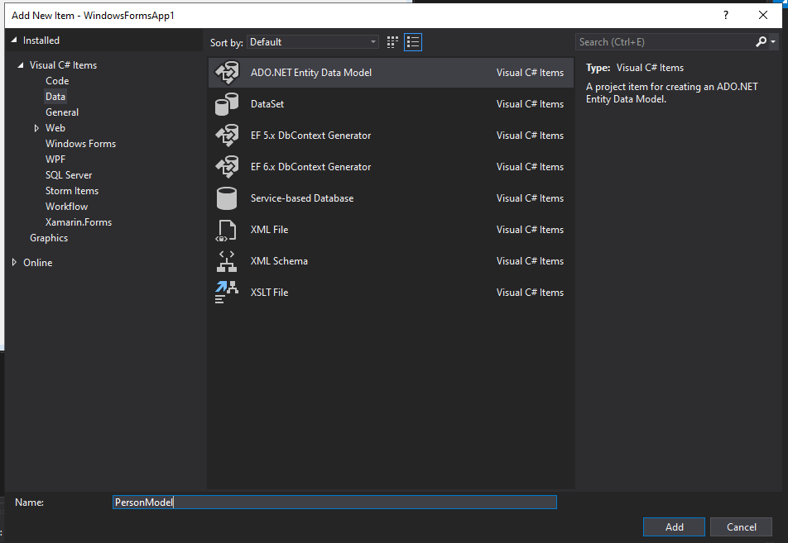
Now let’s use EF
Now we want to add new item to our project.
We do it similar to the way we add class, but now we choose data section, and in it choose ADO.Net Entity Data Model.

Slide 18
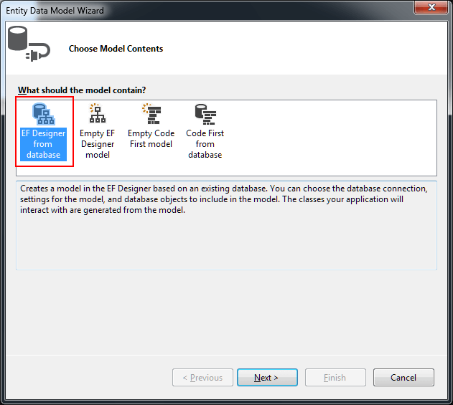
What are these things?
We want to let Entity Framework, see which database to connect to
Then EF will create needed C# code for us to help us out.
One of those things we need is a Model
Model will have classes that will correspond to those of the database

Slide 19
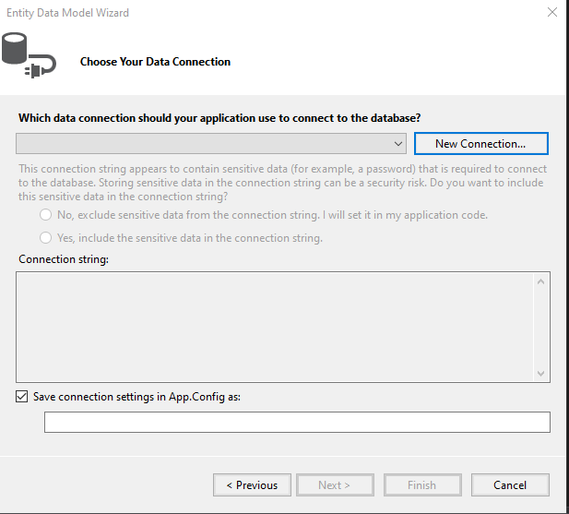
Connecting to database
This is the first moment you will realize why entity framework is better than simple .Net way of connecting to db
Just choose Go to New Connection…

Slide 20
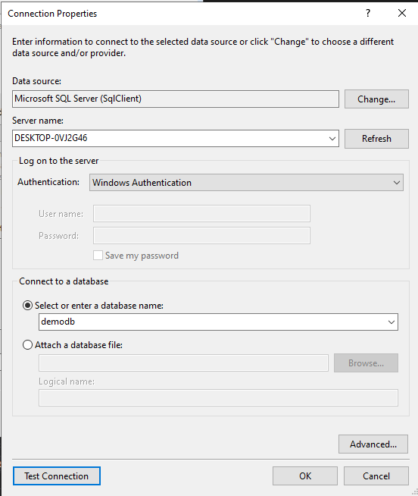
Connecting to database
Choose the server name – set the same one like in SSMS
Chose windows authentication
Then chose the database on that server
Test the connection
Note: Settings will be different for database which uses username and password, and is not on your computer.

Slide 21
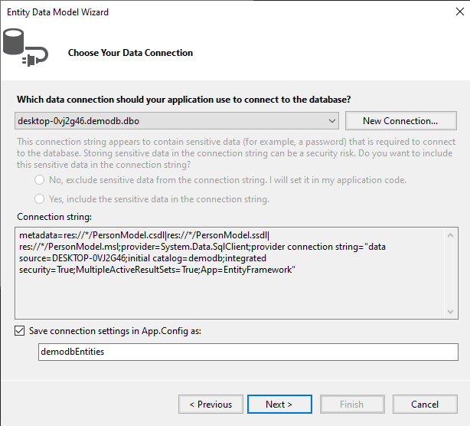
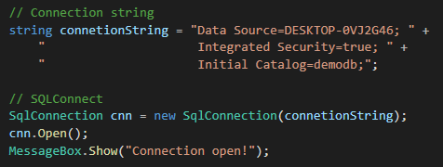
Connecting to database
Now you will see that Entity Framework has created Connection string for you.
Save connection settings in App.Config
should be the name of your Db context class
DB Context class will be used to establish
Connection, and close connection to db,
Instead of previous:

Slide 22
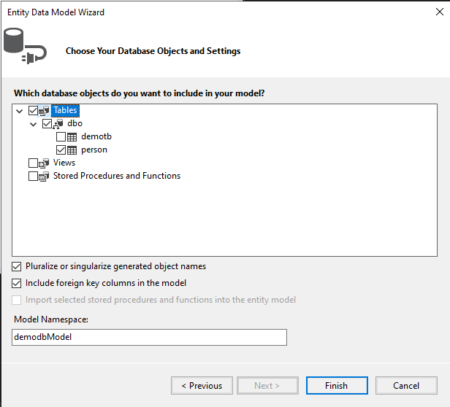
Choosing the models
Here we are deciding which model to make
Model is the class representative of the table (class person = table person)
We can choose as many as we want
However, we must know that if table doesn’t
have a primary key, then the corresponding class
will not be generated.

Slide 23
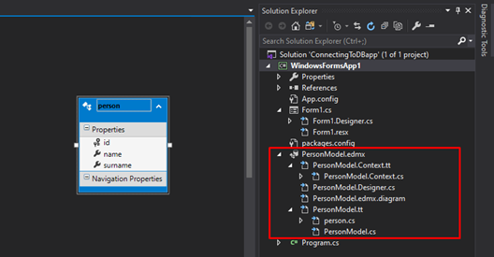
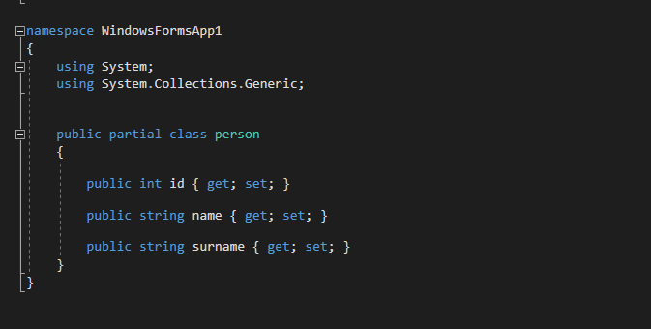
Entity framework generated data
This is what EF has made for us:
See that the class corresponds to the table

Slide 24
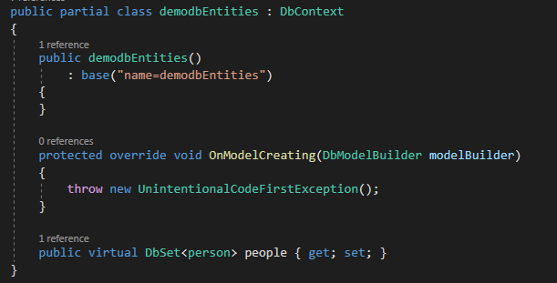
Let’s check what we now have
We added EF to our project
We generated this with EF:
demodbEntities is our DB Context class. We will use it to establish connection to database before doing some action. And then we will close the connection.
We have chosen the name for it previously
This class contains the property:
DbSet<person> people {get; set;}
Set of data like in the data table (many rows are similar to array or list)
Name of the property we use to do CRUD operations with DB
Model class person has same data types like in the table person

Slide 25
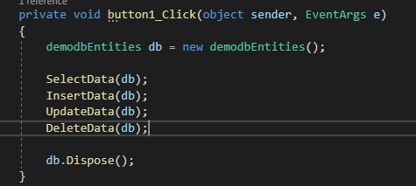
Now let’s make some CRUD with EF
We will use the Windows forms and there let’s create one button which when clicked will perform:
connection to databasede
Do CRUD actions
Close connection

Slide 26
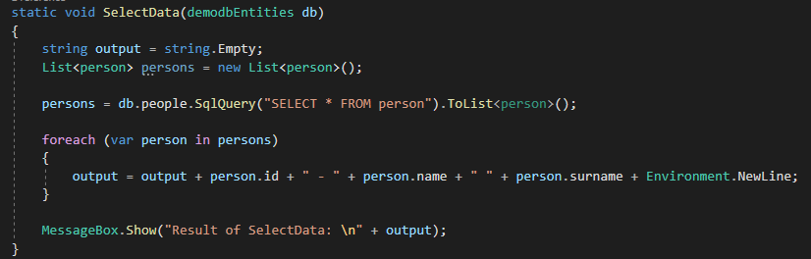
CRUD operations - READ
This is the very simple way to read data from db table.
We get List of persons, then we make output string from that list:
Note: we can make this method much better by getting parameter out to be the class property. Then Query should be changeable

Slide 27
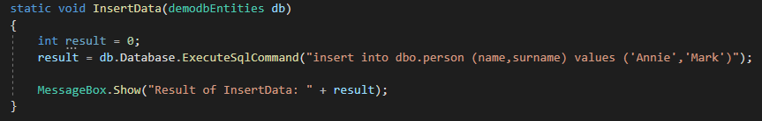
CRUD operations - CREATE
Result will be number:
0 – not inserted
1 – inserted

Slide 28
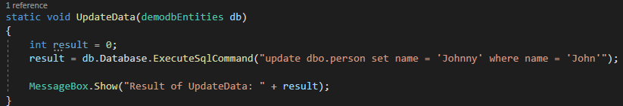
CRUD operations - UPDATE
Result will be number:
0 – not updated
1 – updated

Slide 29
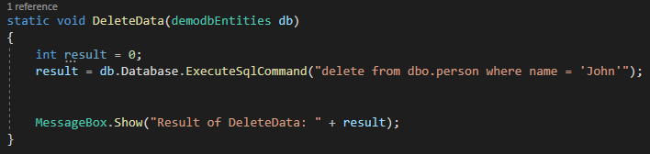
CRUD operations - DELETE
Result will be number:
0 – not deleted
1 – deleted

Slide 30
Homework
Let’s make another table to database called student:
Id
Name
School
Create new Windows forms project
Install Entity Framework NuGet package
Add the Entity Framework Data model to project
Make CRUD operations similar to these from the class

