Slide 1
Javascript Fundamentals – Week 21

Slide 2
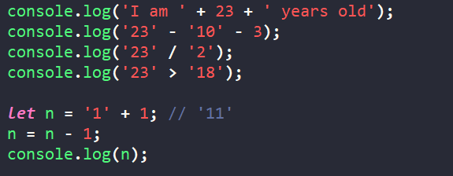
Coercion
When two values are of the two different types
See the following examples:
Then try: 2 + 3 + 4 + ‘5’ or ’10’ – ‘3’ – ‘4’ – 2 + ’5’
This is why a lot of people do not like JS, since it cannot be trusted ☺

Slide 3
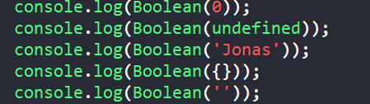
Other strange things about Javascript
Truthy and Falsy Values – Value we cannot certainly say are true or false:
Thing in {} is an object. That is something that we will learn more in future sessions.

Slide 4
Equality Operators
This will give a bit of headache, since it might confuse you:
In sql =
In C++/C# ==
In javascript ===
Javascript has as well == and difference is:
=== - strictly equal, only returns true if both types are identical ‘18’ === 18 is false
== - not too strict, so you can compare ‘18’ == 18 and get true

Slide 5
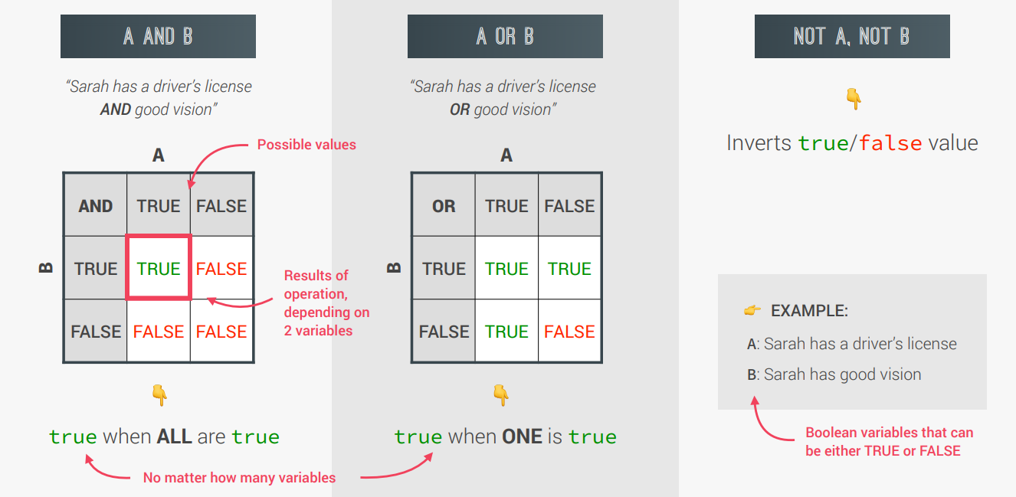
Boolean logic – AND - OR

Slide 6
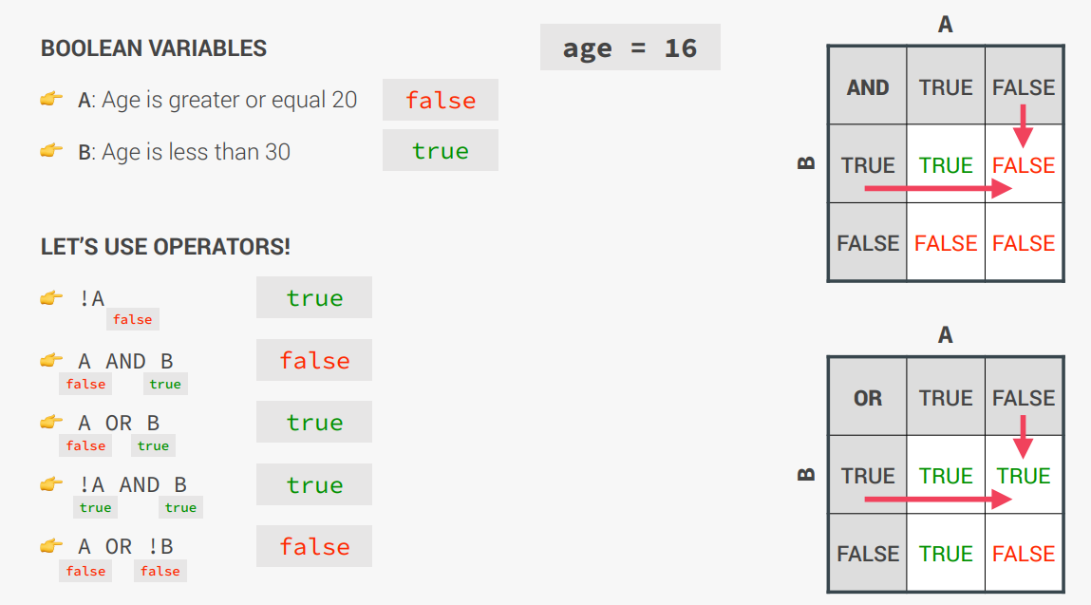
Boolean logic – AND - OR

Slide 7
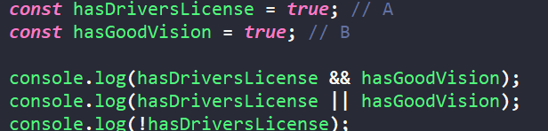
Logical operators
Using the previous two slides now this should be very clear:

Slide 8
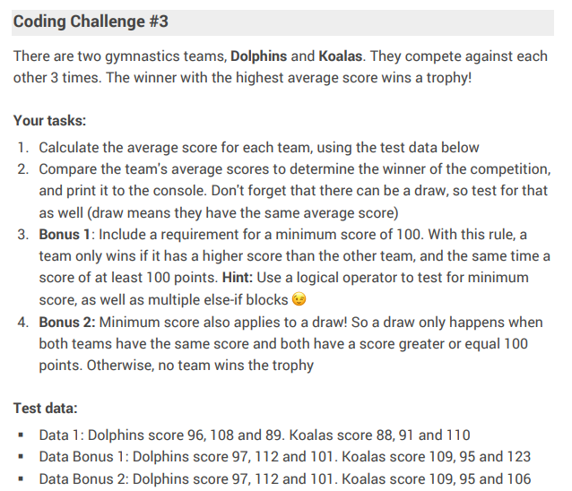

Slide 9
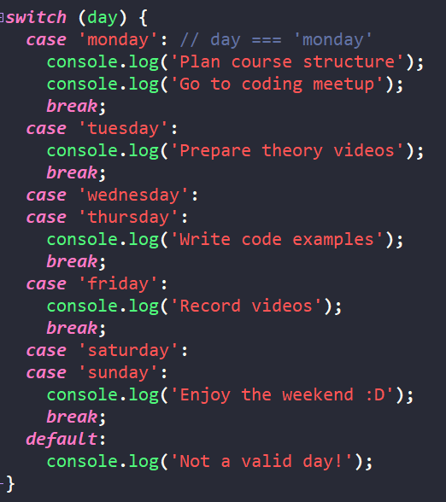
Switch statement
Similarly to C++ and C#:
Let’s make this using IF clause

Slide 10
Statement and expression
Expressions – like only values:
3 + 4
1991
true && false && !false
Statements – are like sentences, and they are built from one or more expressions:
if (23 > 10) {
const str = '23 is bigger’;
}

Slide 11
Conditional (Ternary) operator
Instead of IF:
const age = 23;
age >= 18 ? console.log('I like to drink wine 🍷') : console.log('I like to drink water 💧’);
If true – do the first one, else do the second one;

Slide 12
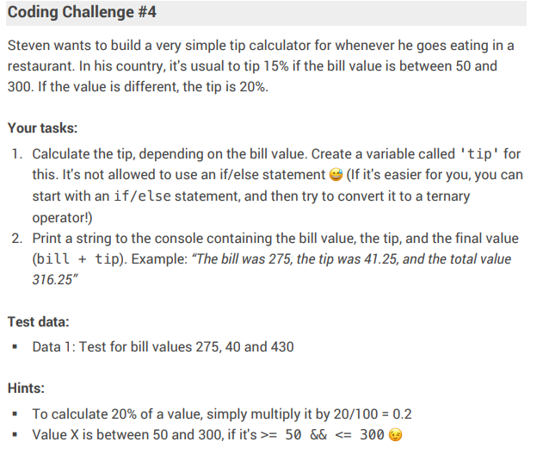

Slide 13
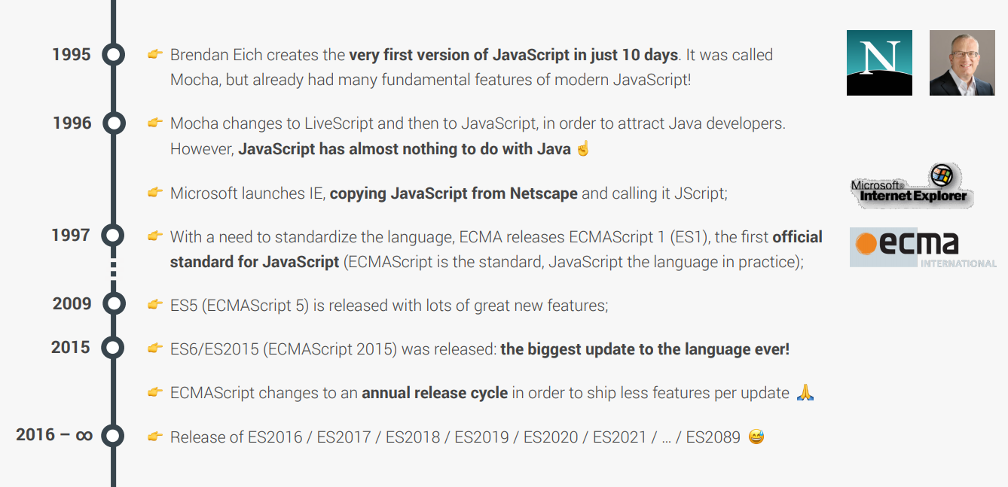
JavaScript history

Slide 14
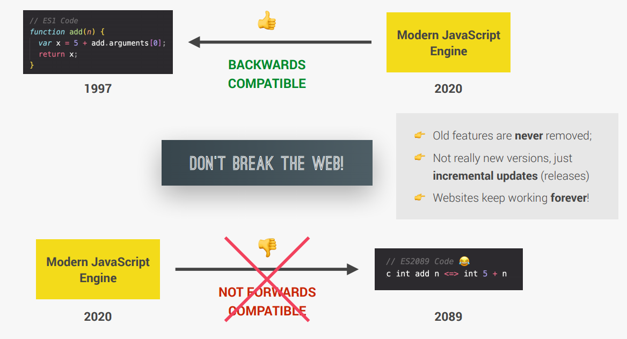
Javascript compatibility

Slide 15
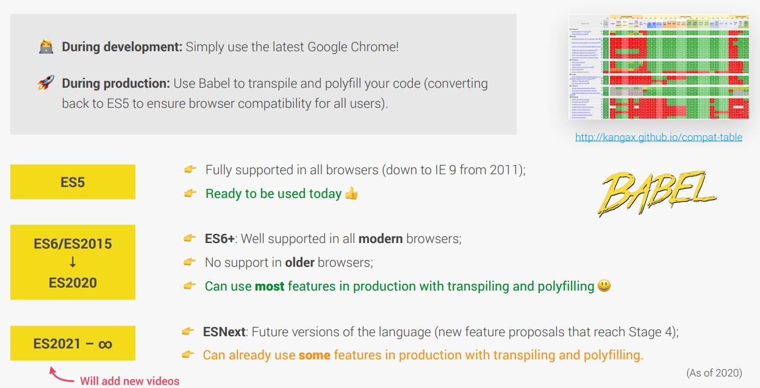
Javascript compatibility

