Slide 1
CRUD & string operations

Slide 2

What is CRUD
Create
Read
Update
Delete

Slide 3
Create (CRUD)
We already did this, last time
You will find it familiar:
INSERT INTO
INSERT INTO cats(name, age)
VALUES('Taco', 14);
Let’s just add few more, just for practice

Slide 4
Cleanup first
Before going forward, let’s first clean the database
Remember there were so many cat tables. Delete all of them and create the new one:
CREATE TABLE cats
(
cat_id INT NOT NULL AUTO_INCREMENT,
name VARCHAR(100),
breed VARCHAR(100),
age INT, PRIMARY KEY (cat_id)
);

Slide 5
Inserting new values (CRUD)
INSERT INTO cats(name, breed, age)
VALUES ('Ringo', 'Tabby', 4),
('Cindy', 'Maine Coon', 10),
('Dumbledore', 'Maine Coon', 11),
('Egg', 'Persian', 4),
('Misty', 'Tabby', 13),
('George Michael', 'Ragdoll', 9),
('Jackson', 'Sphynx', 7);

Slide 6
READ (CRUD)
For reading we are using command:
SELECT
Remember this: SELECT * FROM cats; ?
SELECT * FROM cats;
Informing computer there will be object or table to read from
Give me ALL the columns
READ data, show data on screen

Slide 7
SELECT (CRUD)
Let’s just show the column name:
SELECT name FROM cats;
Now practice:
Show only age
Show only breed

Slide 8
SELECT (CRUD)
Let’s show multiple columns, but not all of them:
SELECT name, age FROM cats;
Now practice:
Show only name and breed
Show only breed, age
Now for fun let’s show:
name, age, name, breed, name, age

Slide 9
WHERE clause
Where is VERY important word. It help us use only data that we need
We are using it if we want to read, update or delete specific data
So it will not be just used for select!
Example:
SELECT * FROM cats WHERE age=4;
What conditions are we using
After this word, expect some conditions

Slide 10
WHERE clause
Let’s do the same just for those whose name is Egg
SELECT * FROM cats WHERE name='Egg';
Now let’s show only name and age for cat whose name is Egg:
SELECT name, age FROM cats WHERE name='Egg';

Slide 11
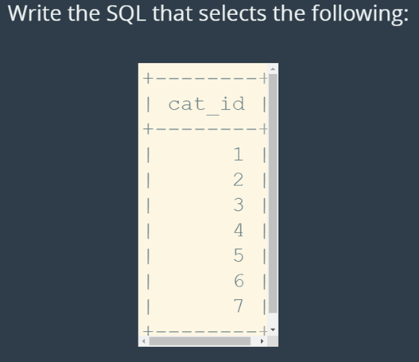
Exercies 1:

Slide 12
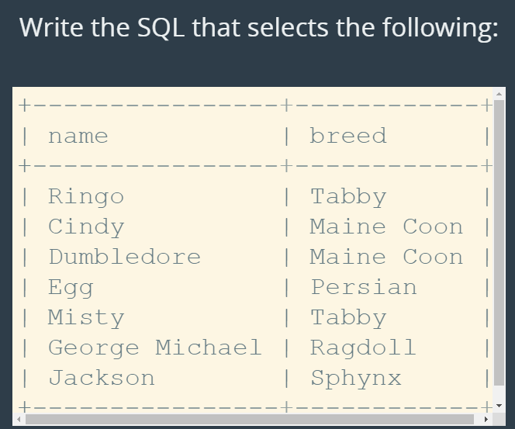
Exercises 2:

Slide 13
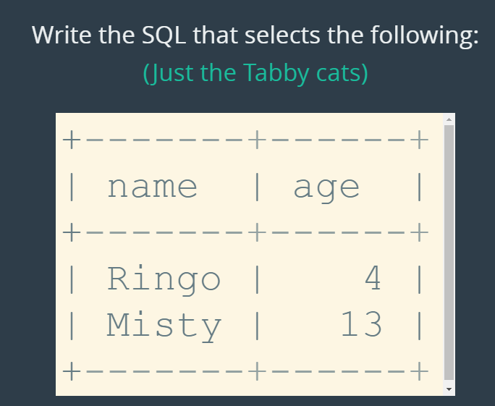
Exercise 3:

Slide 14
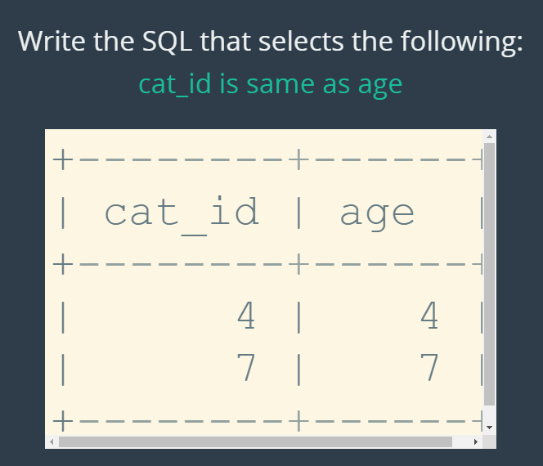
Exercise 4:

Slide 15
Aliases
Aliases are used to help readability
Using them, you change the way data columns names are displayed
SELECT cat_id AS id, name FROM cats;
See this result with alias, and without.
Let’s make some crazy aliases, just for fun:
Show: name, age, breed for cat called Cidny

Slide 16
UPDATE (CRUD)
We can updated existing data in the table by using command:
UPDATE
Example
UPDATE cats -- change data in certain table
SET breed='Shorthair’ -- in this column set the new value
WHERE breed='Tabby’; -- which rows should be changed

Slide 17
UPDATE (CRUD)
Let’s try:
UPDATE cats SET age=14 WHERE name='Misty’;
Advice: Always do select of the data, before updating.
This will save your ass ☺ from making big big mistakes

Slide 18
Exercise:
Change Jackson's name to "Jack“
Change Ringo's breed to "British Shorthair“
Update both Maine Coons' ages to be 12

Slide 19
DELETE (CRUD)
Delete command will remove the data
BE CAREFUL when deleting data!
Advice is to first do the select query, and make sure it is ok to delete that data.
DELETE FROM cats WHERE name='Egg';

Slide 20
DELETE (CRUD)
Why being careful?
Let’s say we want to delete one cat, and then we execute:
DELETE FROM cats;
What happens in this case?
ALWAYS do SELECT command first!

Slide 21
Exercise
DELETE all 4 year old cats
DELETE cats whose age is the same as their cat_id
DELETE all cats 🙀

Slide 22
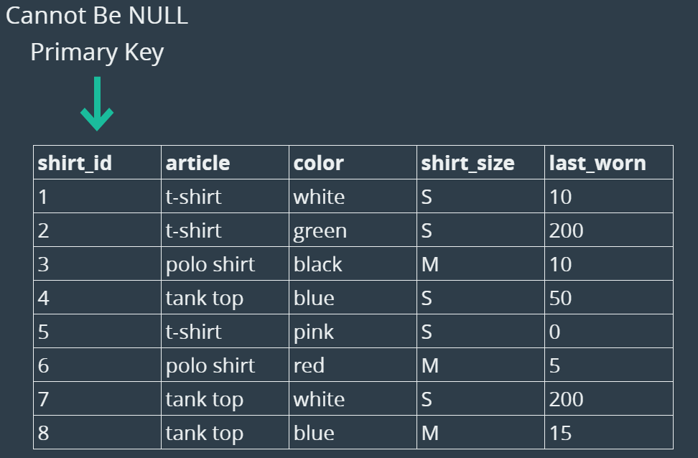
BIG Exercise
Create a new database - shirts_db
Create a new table - shirts
Table should look like this:

Slide 23
BIG Exercise
Insert all of these in one command:
('t-shirt', 'white', 'S', 10),
('t-shirt', 'green', 'S', 200),
('polo shirt', 'black', 'M', 10),
('tank top', 'blue', 'S', 50),
('t-shirt', 'pink', 'S', 0),
('polo shirt', 'red', 'M', 5),
('tank top', 'white', 'S', 200),
('tank top', 'blue', 'M', 15)
Then add New Shirt:
Purple polo shirt, size M last worn 50 days ago

Slide 24
BIG Exercise
SELECT all shirts - But Only Print Out Article and Color
SELECT all medium shirts - Print Out Everything But shirt_id
Update all polo shirts - Change their size to L
Update the shirt last worn 15 days ago - Change last_worn to 0
Update all white shirts - Change size to 'XS' and color to 'off white’
Delete all old shirts - Last worn 200 days ago
Delete all tank tops
Delete all shirts
Drop the entire shirts table

Slide 25
SQL Files
We can put all the queries into single file.
File extension for SQL is (you guess) - .sql
Filename should look like this: some_file_name.sql
I have prepared a file which will add book table. And add some data to it. Now let’s Run file book_data.sql
Check if data is added:
SELECT * FROM books;

Slide 26
One note
SELECT something_we_want_to_see FROM table_name
After SELECT we can add many different things:
SELECT 1
SELECT 'bla bla'
SELECT 'bla bla', 1, title, 'I am experimenting’, pages FROM books;
Same goes for functions – we can use them after select to get something on the screen.
Notice we are sometimes using ; and sometimes not - It is not necessary

Slide 27
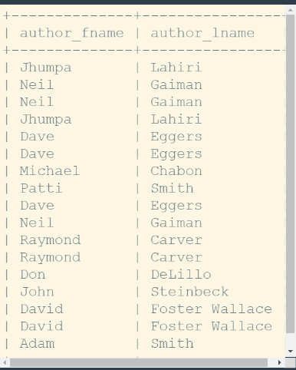
String functions
We can use functions to help us show or use data with slight change
Let’s say we want to make fullname (author_fname + author_lname)
We can use function CONCAT:
CONCAT(column, anotherColumn)
SELECT CONCAT (author_fname, ' ', author_lname)
FROM books;
We can add , between names

Slide 28
String Functions
SELECT SUBSTRING('Hello World', 1, 4);
If we want to show part of the string (starting from 1st character, use next four characters)
See what happens for:
SELECT SUBSTRING('Blabla', 2, 3);

Slide 29
String Functions
SELECT REPLACE('Hello World', 'Hell', '%$#@’);
What we get is: %$#@o World
Try the following:
SELECT REPLACE('Bla_bla', 'bla', '***’);
text find old value replace with new

Slide 30
String Functions
UPPER() and LOWER()
These seem familiar, don’t they? (remember c#)
SELECT UPPER('Hello World’); HELLO WORLD
SELECT LOWER('Hello World’); hello world

Slide 31
Exercises
Concatenate three strings: “Big”, “Big”, “World”
Replace -> with ‘ ’ in two strings: “White->Noise” and “The->Circle”
What does this query do?
SELECT REPLACE ( CONCAT('I', ' ', 'like', ' ', 'cats'), ' ', '-’ );
Show all first names and last names (as two columns) from books table as UPPERCASE
Show first names as lowercase and last names as UPPERCASE, but show them as one column.

Slide 32
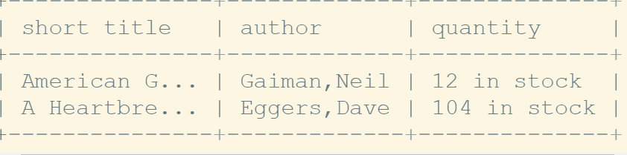
Exercises
Show from books table:
Short title will require to have 10 letters from book name and add three dots at the end
Author name – will be combination of first name and last name
Quantity will be stock_quantity + ‘in stock’
Use aliases for names of the columns

Slide 33
Homework part 1
We will be using books table:
First Create new data – insert into table:
('Book name1', 'name1', 'surname1',2010, 41, 308)
('Book name2', 'name2', 'surname2',2004, 53, 293)
('Book name3', 'name3', 'surname3',1998, 42, 271)
Then update the name of ‘Book name2’ to: 'New quest of a Hero’
For 'New quest of a Hero’ update author name and surname:
Name ‘Michael’
Surname ‘Button’

Slide 34
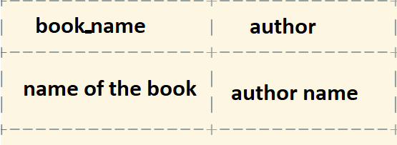
Homework part 2
Delete book whose author surname = ‘'surname3’
Show all the books which have 308 pages (you can use SELECT * )
Now show only the name of the book which has 308 pages
Now show the book name, and author name () of the book which has 308 pages:

Slide 35
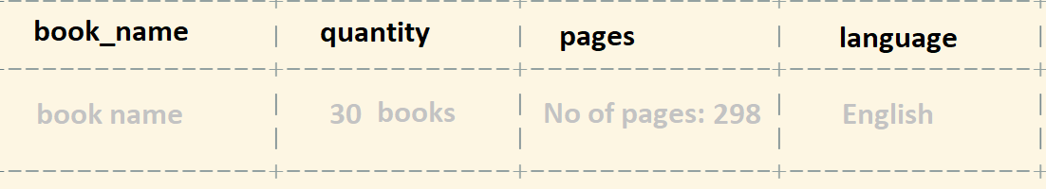
Homework part 3
Show all the books whose author first name is Neil, details to show:
Note here we need to add a new column. See how we did it in slide 26.
read from table
Now show all books for Neil, just instead of English, set language to be Chinese

